Slide 1
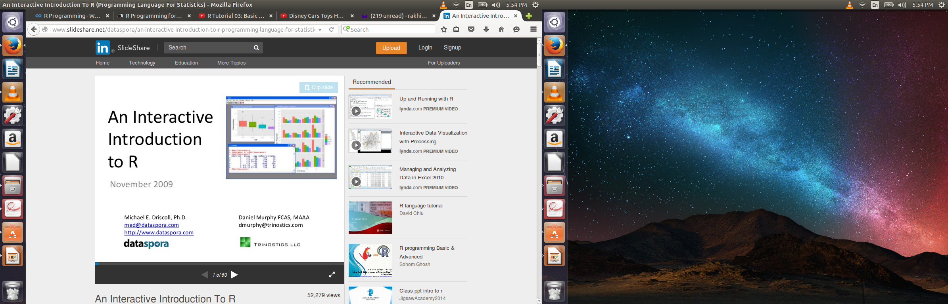
R Programming
By
Rakhi Singh

Slide 2
What is R
R is a programming language and software environment for statistical computing. It is used by statisticians and data miners for development and analysis.

Slide 3
S and S-Plus
S is statistical programming language developed by John Chambers, Rick and Allen by calling FORTRAN subroutines in 1976.
Later on the system was written in C and resemble the system we have today.
Two modern implementation of S are R and S-PLUS.
R is a part of GNU free software project.
S-PLUS is a commercial implementation of S programming language sold by TIBCO software.

Slide 4
History of R
Created in New Zealand by Statistics professor Robert Gentleman and Ross in 1991
In 1995 they used GNU General public License to make R free software.
In 2000 R version 1.0.0 is released.
R version 3.0.2 was released in Dec 2013.
R is very similar to S, making it easy for S-PLUS user to switch over.

Slide 5
Features of R
R is a tool for
Data Manipulation
Modeling and Computation
Data Visualization

Slide 6
Data Manipulation
Connecting to different data sources
Slicing and dicing data
Modifying data
Cleaning data
Filling data

Slide 7
Modeling & Computation
Statistical Analysis
Regression Analysis
Classification
Numerical Simulation
Principal component Analysis

Slide 8
Data Visualization
Graphical view of data
Composing Statistical graphs
Visualizing fit of models

Slide 9
SAS vs R
R is free, SAS costs a lot of money
R is open source, SAS is proprietary
R has newest statistics method much more quickly than SAS.
R is object oriented but SAS is table based
R is better for build your own graphics but SAS is not so good. But they are improving.

Slide 10
Design of R system
It has 2 conceptual parts
The base R system that you download from CRAN . It has packages like utils, stats, datasets, graphics, grDevices, grid, methods, tools, parallel, compiler, splines, tcltk, stats4.
Other than that there are around 4000 packages on CRAN developed by users and programmers and many more are present on people's website.

Slide 11
Obtaining R
Go to Google.
Search for Cran R
Click on Cran.r-project.org
You will find three links
Download R for Linux
Download R for Mac
Download R for Windows
Click on required link

Slide 12
Installing R on windows
Next it will ask subdirectory. Select base
Then click on Download R 3.3.1 for windows.
Once download done, double click the setup file.
It will ask for language. Select English
Select the installation directory.
In components select all of them
In startup options select No.
In display mode select SDI
In Help Style select Plain text
In Internet access select Standard.
Check all boxes in Select Additional Tasks.
After this finish installation. Open R through startup.

Slide 13
Setting your working directory
All files which R is reading or writting are stored in working directory.
> getwd()
[1] “c:/Users/rdpeng/Documents”
Goto file, select option change dir.
Now select the directory from explorer to make it working directory.
> dir()
This will give the list of all files in your working directory.
Later on you can save all your files/function in this directory

Slide 14
Objects
All the things we encounter and manipulate in R are objects.
R has 5 basic atomic classes of objects. They are character, real number, integers, complex numbers and logicals.

Slide 15
Atomic classes
R has five basic or atomic classes of objects
Character
Numeric
Integer
Complex
Logical

Slide 16
Atomic classes
x <- 5 #<- is an assignment operator, x is numeric
is.numeric(x) returns TRUE
x <-'5' # here x is of character datatype
is.character(x) returns TRUE
x = as.integer(3) # interger datatype
is.integer(y) returns TRUE
A = 5+2i # complex, Re(a) real part of a, Im(a) imaginary part of a.
z <-TRUE # logical
is.logical(z) returns TRUE
y <- c(1,2,3,4,5) # here y is a vector,
is.vector(y) returns TRUE

Slide 17
R as a calculator
Simple math
> 2+2
4
Storing results in variables
> x<- 2+2 #<- is a syntax for “=” assignment
> x^2
16

Slide 18
R as a calculator
Please try following operations on command prompt.
> 1+1
>1+10+12+1234
>sqrt(16)
>log10(100)
>10*3
>pi
>100*1.15*pi
>floor(1.9)
>ceiling(1.9)
>round(1.9)
>round(1.4)
>abs(1.9)
> 23%%5
>23%/%5

Slide 19
Operators
Airthmatic :
Addition +
Subtraction -
Multiplication *
Division /
Power ^
Modulo %%,
Integer Division %/%
Comparison :
< lesser than
> greater than
<= lesser than or equal to
>= greater than or equal to
== equal
!= different

Slide 20
Operators
Logical :
!x logical NOT.
X & Y logical AND.
X && Y identical.
X | Y logical OR.
X || Y identical.
Xor(x, y) exclusive OR.

Slide 21
Attributes
All objects in R have two intrinsic attributes: mode and length.
There are four modes – numeric, character, complex and logical
Length is the number of elements in the object.
To display the mode and length of an object, one can use the functions mode and length, respectively.
>X <- 1
> mode(x)
[1] “numeric”
> length(x)
[1] 1
A <- “test”; compar <- TRUE; z <- 1i
> mode(A); mode(compar) ; mode(z)
## test this command

Slide 22
Exponents
> X <- 5/0
> X ## print x
[1] Inf
> exp(x)
[1] Inf
> Exp(-x)
0
> x -x
[1] NAN

Slide 23
ByE and sEE you nExt wEEk

