Slide 1
Regression
Regression is the art of Data science
Rakhi Singh

Slide 2
History
French Galton invented the term Regression in 1885.
Galton was a statistician who invented the term and concepts of regression and correlation and was cousin of Charles Darwin.
In R you might need to run install.packages (“usingR”)

Slide 3
Linear Regression
Linear Regression is four step process
Correlation
Modeling
Model Diagnostics
Inference

Slide 4
Correlation
It Describes the strength of linear association between two variables.
Denoted as R
The magnitude of correlation coefficient measures the strength of association between two numerical variables.
The sign of correlation coefficient indicates the direction of association.

Slide 5
Correlation
If the increasing value of one variable is associated with rising value of other then sign of Ris positive.
In case of vice versa the sign of R is negative.
When the graph drawn is linear then relationship is linear otherwise it is non linear.
The correlation is simple when we deal with bivariate data. In case of three or more data it is multivariate or multiple correlation.

Slide 6
Coefficient of correlation
R = Covariance/(σ(x) * σ(Y))
σ(y) = √[Σ(X - ‾X)² /n]
σ(x) = √[Σ(X - ‾X)² /n]
Covariance = Σ(X - ‾X)(Y - ‾Y)

Slide 7
It is not necessary that if there is correlation between two variables then one is the cause of other. It is possible that both are sensitive to some other factor.

Slide 8
Correlation
The correlation coefficient is always between -1 and 1.
R = 0 indicates no linear relationship.
the correlation coefficient is always between -1 (perfect negative linear association) and 1 (perfect positive linear association
R = 0 indicates
no linear relationship
R = 1
R = 0
●
●
●
●
●
●
●
●
●
●
●
●
●
●
●
●
●
●
●
●
●
●
●
●
●
●
●
●
●
●
●
●
●
●
●
●
●
●
●
●
●
●
●
●
●
●
●
●
●
●
●
●
●
●
●
●
●
●
●
●
●
●
●
●
●
●
●
●
●
●
●
●
●
●
●
●
●
●
●
●
●
●
●
●
●
●
●
●
●
●
●
●
●
●
●
●
●
●
●
●
●
●
●
●
●
●
●
●
●
●
●
●
●
●
●
●
●
●
●
●
●
●
●
●
●
●
●
●
●
●
●
●
●
●
●
●
●
●
●
●
●
●
●
●
●
●
●
●
●
●
●
●
●
●
●
●
●
●
●
●
●
●
●
●
●
●
●
●
●
●
●
●
●
●
●
●
●
●
●
●
●
●
●
●
●
●
●
●
●
●
●
●
●
●
●
●
●
●
●
●
●
●
●
●
●
●
●
●
●
●
●
●
●
●
●
●
●
●
●
●
●
●
●
●
●
●
●
●
●
●
●
●
●
●
●
●
●
●
●
●
●
●
●
●
●
●
●
●
●
●
●
●
●
●
●
●
●
●
●
●
●
●
●
●
●
●
●
●
●
●
●
●
●
●
●
●
●
●
●
●
●
●
●
●
●
●
●
●
●
●
●
●
●
●
●
●
●
●
●
●
●
●
●
R = -1
properties
R=1 R= -1 R=0
the correlation coefficient is unitless, and is
not affected by changes in the center
or scale of either variable (such as unit conversion

Slide 9
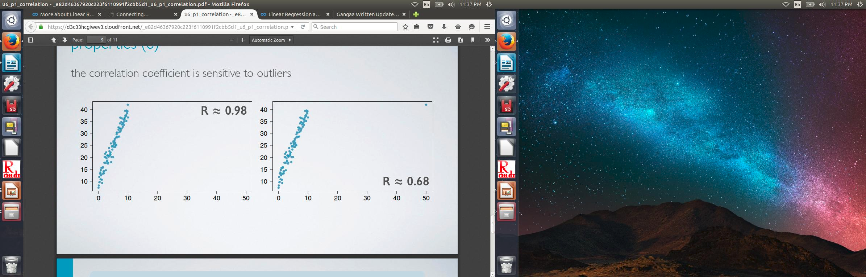
Correlation
The the correlation of X with Y is the same as of Y with X
The correlation coefficient is sensitive to outliers

Slide 10
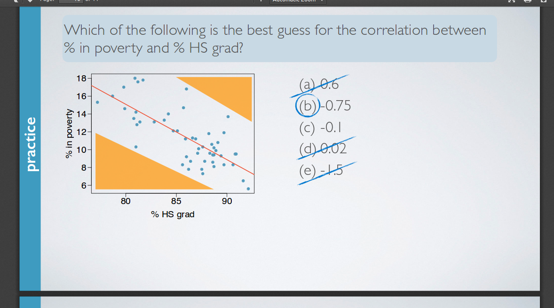
Correlation

Slide 11
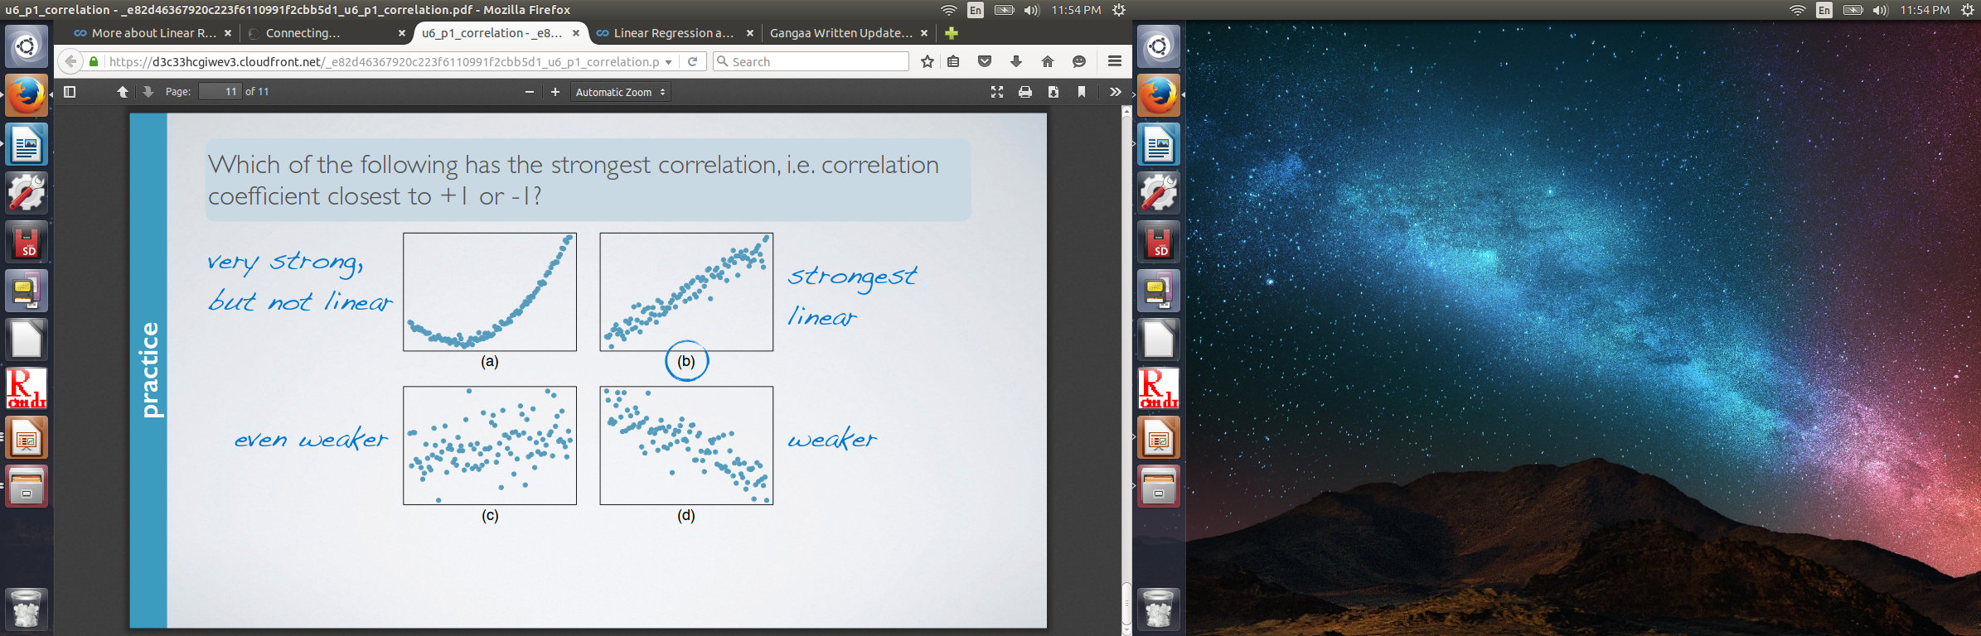
Correlation

Slide 12
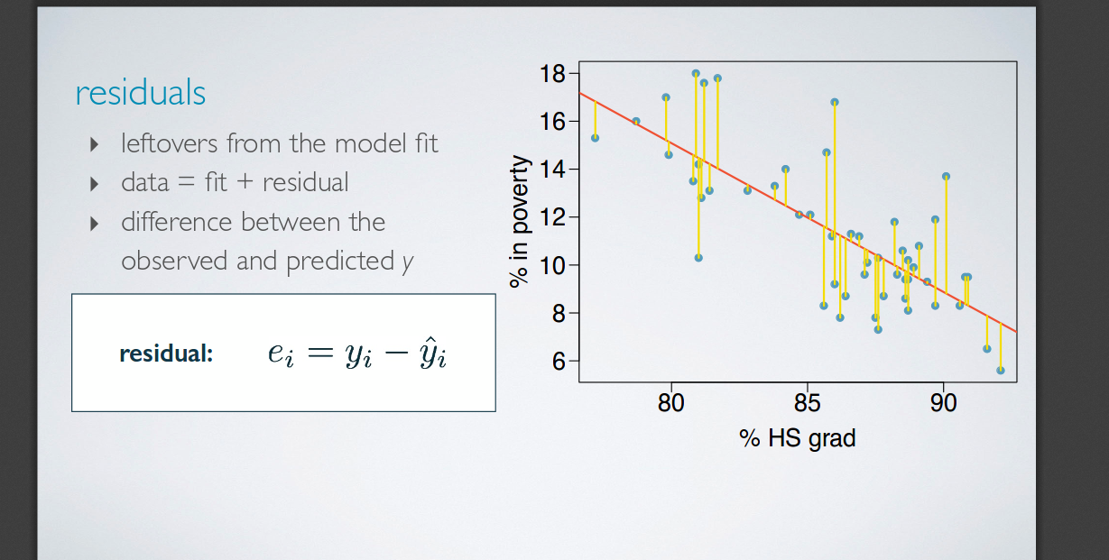
Residuals

Slide 13
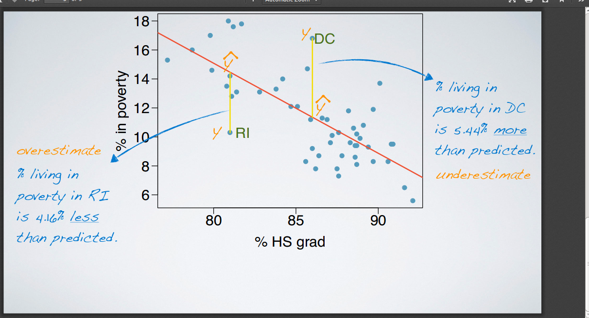
Residuals

Slide 14
Least square lines
a measure for the best line
Option 1: Minimize the sum of magnitudes (absolute values) of residuals
|e1| + |e2| + |e3| + |e4| ......|en|
Option 2: Minimize the sum of squared residuals – least squares
e1^2 + e2^2 + e3^2 .........en^2

Slide 15
why least squares?
most commonly used
easier to compute by hand and using software
In many applications, a residual twice as large as another is more than twice as bad.

Slide 16
Least square lines
Y = a + bx + e
Y is dependent variable
A is Intercept
B is Slope
X is independent variable
E is the error term

Slide 17
Estimating the regression (slope)
Slope = b = ( σ(y)/σ(x) ) R
σ(x) : Standard Deviation of x
σ(y): Standard Deviation of y
R = Cor(x,y)

Slide 18
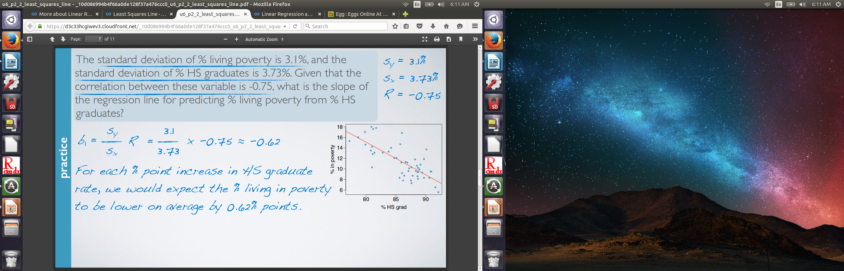
Practice

Slide 19
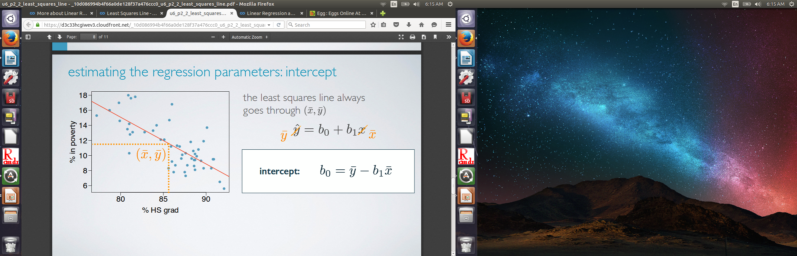
Estimating the regression parameter : intercept

Slide 20
Intercept
intercept:
When x = 0
Y is expected to equal the intercept may be meaningless in context of the data, and only serve to adjust the height of the line
slope: For each unit increase in x y is expected to be higher/lower on average by the slope

Slide 21
Least square line
Least Square line allows us to evaluate the relationship between two numerical values.
It is helpful in prediction. Prediction is to predict the value of response variable for a given value of explanatory variable.
Least square line ensures that sum of squares of deviation s of observations from the line is minimum and the sum of such deviations is equal to zero.

Slide 22
Condition for linear Regression
1. Linearty
2. Nearly normal residuals
3. Constant variability

Slide 23
Linearity
Relationship between the explanatory and the response variable should be linear.
Methods for fitting a model to non-linear relationships exists.
Check using scatterplot of the data, or a residuals plot.

Slide 24
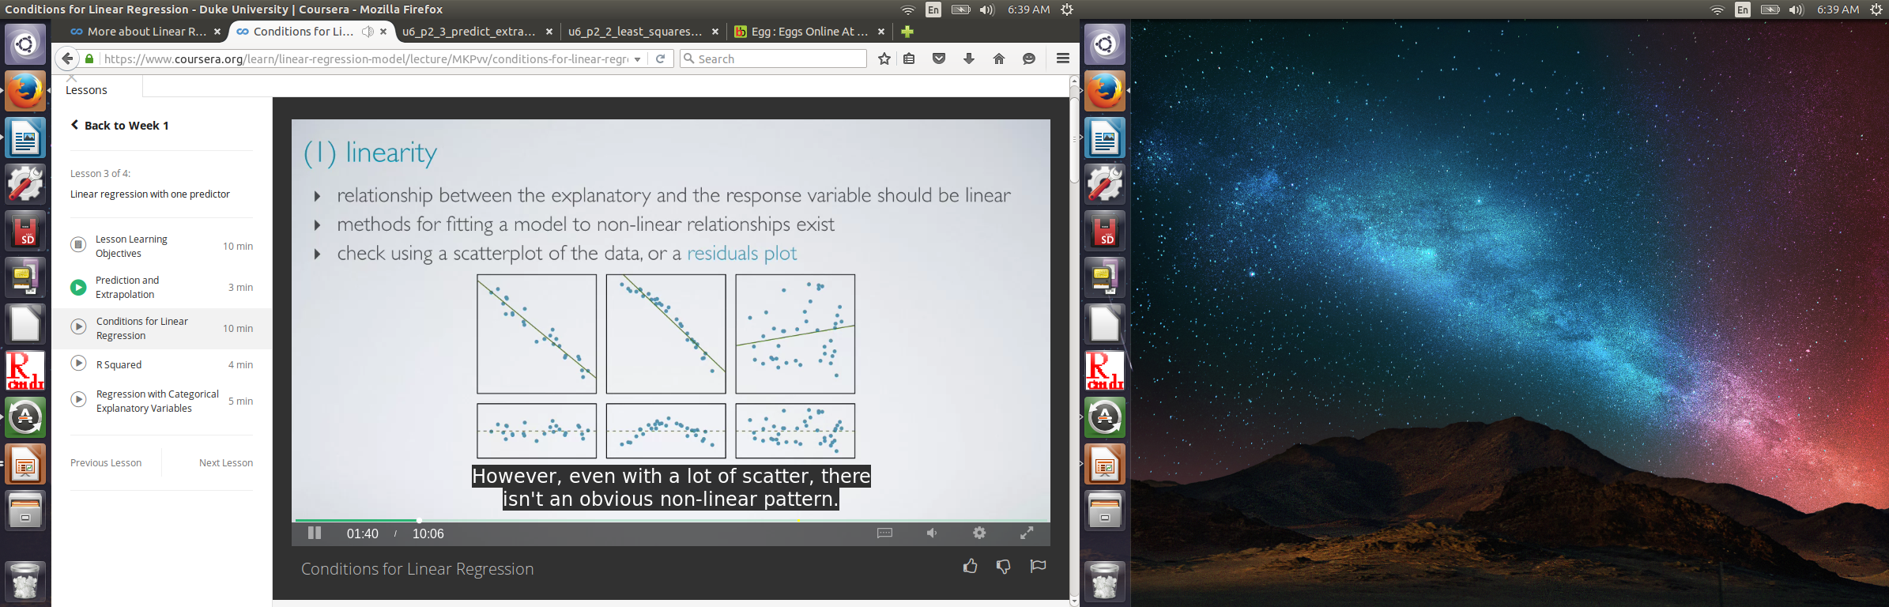
Sample Graph

Slide 25
Nearly normal residuals
1. Residuals should be nearly normally distributed, centred at 0.
2. May not be satisfied if there are unusual observations that dont follow the trend of the rest of the data.
3. Check using a histogram or normal probability plot of residuals.

Slide 26
R square
strength of the fit of a linear model is most commonly evaluated using R2
calculated as the square of the correlation coefficient
tells us what percent of variability in the response variable is explained by the model
the remainder of the variability is explained by variables not included in the model
always between 0 and 1

Slide 27
Linear Regression with R
Regression analysis is a very widely used statistical tool to establish a relationship model between two variables. One of these variable is called predictor variable whose value is gathered through experiments. The other variable is called response variable whose value is derived from the predictor variable.

Slide 28
More
In Linear Regression these two variables are related through an equation, where exponent (power) of both these variables is 1. Mathematically a linear relationship represents a straight line when plotted as a graph. A non-linear relationship where the exponent of any variable is not equal to 1 creates a curve.

Slide 29
Linear Regression
The general mathematical equation for a linear regression is −
y = ax + b
Following is the description of the parameters used −
y is the response variable.
x is the predictor variable.
a and b are constants which are called the coefficients.

Slide 30
Data
# Values of height
151, 174, 138, 186, 128, 136, 179, 163, 152, 131
# Values of weight.
63, 81, 56, 91, 47, 57, 76, 72, 62, 48

Slide 31
Lm function
x <- c(151, 174, 138, 186, 128, 136, 179, 163, 152, 131)
y <- c(63, 81, 56, 91, 47, 57, 76, 72, 62, 48)
# Apply the lm() function.
relation <- lm(y~x)
print(relation)
# It will give Intercept and slope of line

Slide 32
Lm function
print(summary(relation))
Call:
lm(formula = y ~ x)
Residuals:
Min 1Q Median 3Q Max
-6.3002 -1.6629 0.0412 1.8944 3.9775
Coefficients:
Estimate Std. Error t value Pr(>|t|)
(Intercept) -38.45509 8.04901 -4.778 0.00139 **
x 0.67461 0.05191 12.997 1.16e-06 ***
---
Signif. codes: 0 ‘***’ 0.001 ‘**’ 0.01 ‘*’ 0.05 ‘.’ 0.1 ‘ ’ 1
Residual standard error: 3.253 on 8 degrees of freedom
Multiple R-squared: 0.9548, Adjusted R-squared: 0.9491
F-statistic: 168.9 on 1 and 8 DF, p-value: 1.164e-06

Slide 33
Data() ## it will give list of dataset.
data(airquality)
names(airquality)
plot(ozone~solar.R, data=airquality)
## calculate mean ozone concentration with na removed.
mean(airquality$Ozone, na.rm=”T”)
model1=lm(Ozone~Solar.R,data=airquality)

Slide 34
Constant Variabiltiy
1. Variability of points around the least square line should be roughly constant
2.Also show that variability of residuals around the 0 line should be roughly constant as well.
3. Also called homoscedasticity.

Slide 35
Summary
For a given set of data there will be two regression lines, one showing regression of Y on X and other showing regression of X on Y.
Both lines will be positively sloped or negatively.
Both the regression line pass through mean value of X and Y.
The closer are the regression lines to each other, the higher is the degree of correlation between the variables.

Slide 36
plot(ozone~solar.R, data=airquality)
abline(model1, col=”red”)
plot(model1)
summary(model1)
Summary of medians( max,min, median,)
Coefficeints

