Slide 1

Dr. Lankapalli Bullayya degree college
Team Leader (P. Vijay)
1) P. Vijay
2) P. Anusha
3) P. Sagar
4) R. Sai Lakshmi
5) Ruchi Patel

Slide 2
Index
Part 1: Brand study, Competitor Analysis & Buyer’s/Audience’s Persona
Part 2: SEO & Keyword Research
Part 3: Content Ideas and Marketing Strategies
Part 4: Content Creation and Curation (Post creations, Designs/Video Editing, Ad
Campaigns over Social Media and Email Ideation and Creation)

Slide 3

Part 1: Brand study, Competitor Analysis & Buyer’s/Audience’s
Persona
Brand : Britannia
Brand Logo :
Brand Colors : Red, Green, Yellow

Slide 4
Brand study
MISSION & VALUES:
Mission: Britannia mission is to spread happiness through great tasting, high-quality biscuits, as embodied by their brand essence “Eat healthy, Think Better “. Their values emphasize quality and innovation, ensuring wholesome products. With a commitment to the highest standard’s, Britannia uses the finest ingredients and strict quality control measures.
Values: Britannia biscuits have always stood for quality and are known for offering innovative and wholesome biscuits.
Unique Selling Point: Britannia is committed to maintaining the highest standards of quality in all their products. They use the finest ingredients and follow stringent quality control measures to ensure that customers get the best tasting and safest products.
Brand Messaging The slogan ‘Eat healthy, think better‘ and colourful ads, has helped them capture a significant market share, reinforcing their tagline, “Eat healthy, think better “.
Brand Tagline: “EAT HEALTHY,THINK BETTER”

Slide 5
Buyer’s/Audience’s Persona
Name:- Bala Krishna
Age:- 55
Gender:- Male
Occupation:- Farmer
Income:- 2 LPA
Psychographics:-
Values:- Quality, tradition, Convenience and affordability in their food choices.
Interests:- Health consciousness, Family oriented values, Convenience, Affordability, Quality.
Personality:- Brand Loyalty, Value Conscious, Quality Conscious, Traditional and Health Conscious
Behaviour:-
Shopping Habits:- This customer tends to prioritise quality and affordability. They often look for wide range of products, including biscuits, bread, cakes and dairy items, while also considering nutritional value.
Social Media Usage:- active on social media like twitter, Facebook, Instagram etc.,
|
|
|
|
|
|
|
|
|
|
|
|
|
|
|
|
Goals:-
Understanding the goals of this customer could include things like seeking high quality snacks, Finding tasty and healthy options, Supporting sustainable practice, or simply enjoying delicious treats.
Challenges:-
Ensuring consistent quality across different products and batches can be challenging.
Competing with other brands in the market for market share and customer customer loyalty.
Managing a complex supply chain efficiently to ensure timely delivery and Availabilty.

Slide 6



Competitor Analysis
Competitor Analysis:-To provide a comprehensive competitor analysis for Britannia, I would need more specific information about the industry or market sector you’re interested in Britannia operates in various sectors including food, biscuits ,dairy, and others.
Sunfeast: Sunfeast’s unique selling proposition(USP)lies in its diverse lineup of artists, immersive experiences, and vibrant atmosphere, offering something for everyone from music enthusiasts to families looking for a memorable time under the sun.
Unibic: As its commitment to quality ingredients and innovative flavor combinations, delivering delicious cookies that satisfy cravings and exceed expectations.
Parle: Parle’s USP lies in its extensive range of affordable and flavorful snacks that have become a staple in households across India, offering delicious treats for every taste and occasion

Slide 7
Competitor 1: SUNFEAST
USP: Sunfeast’s unique selling proposition(USP)lies in its diverse lineup of artists, immersive experiences, and vibrant atmosphere, offering something for everyone from music enthusiasts to families looking for a memorable time under the sun.
Online communication :
Sunfeast, a brand of biscuits and snacks, likely communicates online through various channels like social media platforms (such as Facebook, Twitter, Instagram ), their official website, email newsletters, and possibly through collaborations with influencers or bloggers. They might share product updates, promotions ,recipes , and engage with their audience through contests or interactive content.

Slide 8
Swot:
Strengths:
Strong brand recognition: Sunfeast is a well-known brand in the biscuit and snacks industry.
Wide product range: Sunfeast offers a diverse range of products catering to various tastes and preferences.
Quality assurance : The brand is known for maintaining high standards of quality and taste in its products.
Weakness:
Competition: The biscuit and snacks market is highly competitive, with many established players vying for market share.
Price sensitivity: Consumers may be price-sensitive, especially in a market where there are many options available at various price points.

Slide 9
Swot:
Opportunities :
Innovation : Sunfeast’s can capitalize on consumer trends by introducing innovative products and flavors.
Health and wellness: With growing health consciousness among consumers, there is an opportunity for sunfeast’s to expand its offering in the health and wellness segment.
Digital marketing: Leveraging digital channels for marketing and engagement can help sunfeast reach a wider audience and enhance brand visibility.
Threats :
Changing consumer preferences: Shifts in consumer preferences towards healthier or premium products could pose a threat to Sunfeast’s traditional product offerings.
Regulatory challenges: Changes in regulations related to food safety, labelling, or advertising could impact Sunfeast’s operations and product formulations.
Economic factors: Economic downturns or fluctuations in raw material prices could affect Sunfeast’s profitability and pricing strategies.

Slide 10
Competitor 2: UNIBIC
USP: The unique selling proposition(USP) of Unibic, an Australian biscuit company, often revolves around its premium quality ingredients, unique flavors, and commitment to freshness.it might also emphasize its heritage or any specific health benefits of its products.
Online Communication: Unique likely utilizes various online communication channels such as social media platforms, email, newsletters, their official website, and possibly sponsored content or digital advertising to engage with consumers, share product information, announce promotions, and gather feedback. They might also collaborate with influencers.

Slide 11
Swot:
Strengths:
Products Innovation: Unibic offers a wide range of innovation biscuit flavors and varieties , catering to diverse consumer preferences.
Quality Ingredients: The company uses high-quality ingredients , which can be a strong selling point in a competitive market.
Distribution Network: With an established distribution network, Unibic Can reach a large number of consumers across various channels.
Weakness:
Limited geographic presence: Unibic’s market presence might be limited compared to larger multinational competitors.
Dependence On Biscuit Segment: IF Unibic relies heavily on its biscuit segment, it could face challenges diversifying its product portfolio.
Price Senstivity: In a price-sensitive market, consumers may opt for cheaper alternatives, affecting Unibic’s sales.

Slide 12
Swot:
Opportunities :
Expansion into new markets : Unibic could explore opportunities to enter new geographic markets ,both domestically and internationally.
Health-conscious trends: With increasing consumer focus on health and wellness, unibic could introduce healthier biscuits options or promote existing product’s health benefits.
E-commerce growth : The growing trend of online shopping presents an opportunity for unibic to expand its E-commerce presence and reach consumers directly.
Threats :
Competition : Intense competition from both established players and new entrants in the biscuit industry could threaten unibic’s market share.
Changing consumers preferences : Shifts in consumer preferences or dietary trends could impact the demand for unibic’s products.
Economic factors : Economic downturns or fluctuations in raw material prices could affect unibic’s profitability and operations.

Slide 13
Competitor 3 : PARLE
USP :
Parle’s lies in its extensive distribution network and affordable pricing, making its products accessible to a wide range of consumers across India. Parle is renowned for its Iconic Biscuit brands like Parle-G, Monaco, Krack Jack, and Hide & Seek which have become staples in many households. Additionally, Parle focuses on quality ingredients and consistent taste, ensuring customer satisfaction and loyalty over generations. It’s ability to Innovate and adapt to changing consumer preferences while maintaining affordability further strengthens its positions in the market.
Online Communication :
Parle maintain an active online presence through its official website and various social media platforms like Facebook, Twitter, and Instagram. They use these channels to engage with their audience, share updates about their products, Promotions, and campaigns , as well as interact with consumers through contents, polls, and user-generated content. For the latest news and updates from Parle, I recommend checking their official website and social media handles.

Slide 14
Swot:
Strengths :
Strong Brand Equality : Parle has a long-standing presence in the market and enjoys high brand recognition and trust among consumers.
Extensive Distribution Network : Parle has an extensive distribution network, allowing its products to reach both urban and rural markets across India.
Diverse Product Portfolio : Parle offers a diverse range of products, Including biscuits, cookies, snacks, and confectionery, catering to various consumer preferences.
Weaknesses:
Dependence on Traditional Products : Parle’s heavy reliance on Traditional biscuit brands like Parle-G may Hinder its ability to capture evolving consumer preferences for healthier or premium snacks.
Limited International Presence : While Parle has a strong presence in the Indian market, Its international presence is relatively limited compared to some of its competitors.
Vulnerability to Raw Material Price Fluctuations : Parle’s profitability may be impacted by fluctuations in raw material prices, such as wheat, sugar, and oil.

Slide 15
Swot:
Opportunities :
Health and Wellness Trend : Parle can capitalize on the growing demand for healthier snacks by introducing more nutritious and low-calorie options.
Expansion into New Markets : Parle can explore opportunities to expand its presence in international markets and diversity its revenue steams.
E-commerce Growth : The increasing popularity of e-commerce platforms presents an opportunity for parle to expand its online sales channels and reach a broader audience.
Threats:
Intense Competition : Parle faces intense competition from both domestic and international players in the FMCG (Fast-Moving Consumer Goods ) sector, which could affect its market share and profitability.
Regulatory Changes : Changes in government regulations related to food safety, labeling, or advertising could impact Parle’s operations and require adjustments to its business Practices.
Economic Uncertainty : Economic downturns or fluctuations in consumer spending patterns could affect Parle’s sales and revenue growth.

Slide 16
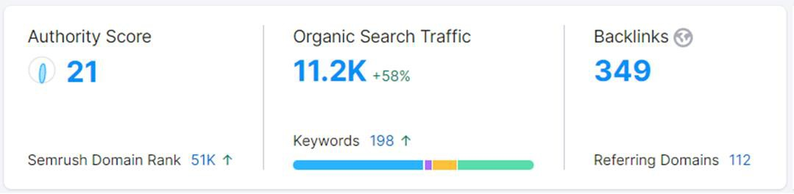
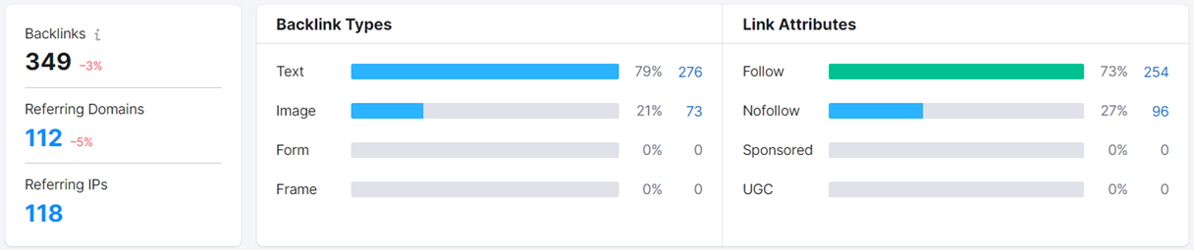
Part 2: SEO & Keyword Research
Analysis: https://www.britanniaindustries.co.in
Overview
Note: Need to create quality backlinks that will help us to boost traffic and rankings
Backlink Details – We have 254 do-follow links found, we need to create more do follow backlinks more as compared to no-follow. According to latest strategy we have to follow the 80:20 ratio for do-follow and no-follow but, we have 73:27 ratio.

Slide 17
Keyword Research
Keyword | Avg. Monthly Searches | Competition
Good day biscuit | 50000 | High
Britannia biscuits | 50000 | Medium
Nutri choice Digestive | 5000 | High
Little hearts | 5000 | Medium
Treat biscuit | 5000 | Medium
Tiger Biscuits | 5000 | Medium
Britannia Milk bikis | 5000 | High
Britannia all rounder | 5000 | Medium
Nutri choice price | 5000 | Medium
Treat biscuit price | 5000 | High

Slide 18


Keyword Research
As per present competition for every keyword at least 10 websites are trying to rank. So, to avoid that and to rank for particular keyword i suggest 2 important tools.
Google Trends: Here we can analyzes the popularity of top search queries in Google Search across various
regions and languages. By that we can figure out best organic search terms.
Keyword Planner: As per my observation keyword planner is completely made for Google Ads. From here i use to check the search volume and competition levels of organic search terms we had from Google Trendz.

Slide 19
SEO Basic On-Page Suggestions
Page: https://www.Britannia.co.in
Current Title: Britannia- Rich & Nutritious Biscuits/Cookies
Current Meta Description: Started in 1892, Britannia offers a rich and nutritious range of biscuits across all major category of biscuits.
Suggesting Title: Britannia: Delightful Snacks & Biscuits | Quality Taste & Variety
Suggesting Meta Description: Discover the joy of Britannia snacks & biscuits! Indulge in premium flavours, unmatched quality, and a delightful range. Savour the taste of happiness today!
Image Alt Tags: Need to optimize
H1 Heading Tag: H1 Tag is Missing We need to add one “Welcome to Britannia: Delightful Snacks & Biscuits Since 1892”
Mobile Friendly Test: Website is not mobile optimized.

Slide 20
SEO Strategy
SEO Strategy:
Along with On-Page, need to prepare relevant landing page.
Create specific types of content for the different search intents from search console.
Making specific content to get featured snippets.
Or maybe voice search is something that might fit your strategy.
Video Creation.
Audio Optimization & Podcasting.

Slide 21
Part 3 :Content Ideas and Marketing Strategies
Content Idea Generation & Strategy : Identify your purpose why you want to contact Britannia is it for a partnership, Collaboration, Feedback, or another reason? Clarifying your purpose will guide your strategy, Research conduct thorough research, services , recent news and any ongoing Initiatives. This will help you understand their business and how your idea can align with their goals.
Mentioned in the Calender.

Slide 22
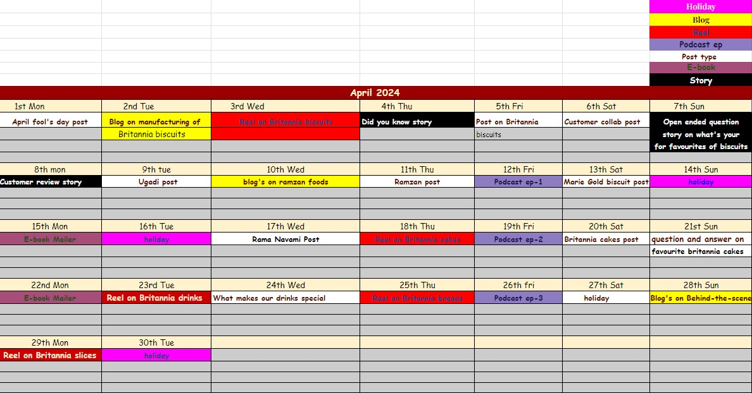
Part 3 : Content Ideas and Marketing Strategies
Content Calendar :

Slide 23
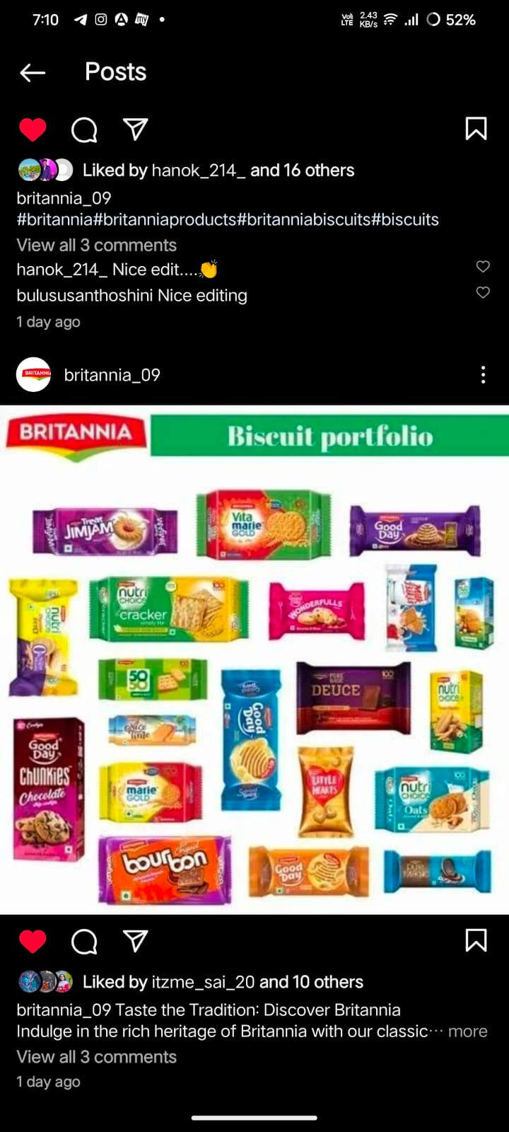
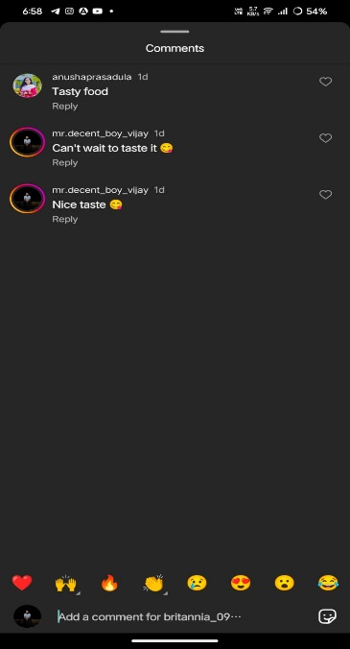
Strategy, Aim and the Idea behind this story
Could you provide more context or details about the
Britannia or strategy you’re referring To? Knowing a bit more about the Background or theme would help me provide a more accurate response. The Idea is that by having these Engaging stories such as the format it would engage follower and position the brand as trusted source of Britannia advice.

Slide 24
Content Optimization Suggestions:
Keyword Research: Before you start writing, conduct thorough keyword research to identify relevant and high-traffic keywords related to your blog topic. Use tools like Google Keyword Planner or SEMrush to find the best keywords to target.
Compelling Headlines: Create attention-grabbing headlines that clearly convey the value of your blog post. Use power words, numbers, and questions to pique the readers' interest.
Engaging Introductions: Hook your readers from the beginning with an engaging introduction. Address their pain points or questions and promise valuable insights in the rest of the post.
Well-Structured Content: Organize your blog posts with clear headings, subheadings, and bullet points. This makes it easier for readers to scan the content and find what they're looking for.
Use of Multimedia: Incorporate relevant images, videos, infographics, and other multimedia elements to enhance the visual appeal and shareability of your blog posts.
Internal & External Links: Include both internal links (linking to your own related blog posts) and external links (to authoritative sources) to provide additional context and credibility to your content.
Mobile-Friendly: Ensure your blog is mobile-friendly and responsive, as many users browse the internet on their mobile devices.
Meta Description: Write a compelling meta description that summarizes the blog post and encourages users to click through to your site from search engine results.
Call-to-Action (CTA): Include a clear CTA at the end of your blog post, encouraging readers to take the desired action, whether it's subscribing,
sharing, or leaving a comment.

Slide 25
Website Marketing Strategies:
Clear Value Proposition: Your website's homepage should have a clear and concise value proposition that tells visitors what your business does and how it can benefit them.
Fast Loading Speed: Optimize your website's loading speed by compressing images, using a content delivery network (CDN), and minimizing unnecessary scripts.
Mobile Optimization: A large portion of internet users access websites on mobile devices, so ensure your website is optimized for mobile viewing.
Simple Navigation: Make your website easy to navigate with a clear menu and well-structured pages. Users should be able to find what they're looking for quickly.
SEO-Friendly URLs: Use descriptive and SEO-friendly URLs that include relevant keywords. Avoid using complex strings of characters.
Optimize Images: Compress images to reduce file size without sacrificing quality. Use alt tags to describe images for better accessibility and SEO.
Readable Fonts and Colors: Choose fonts and colors that are easy to read and create a visually pleasing experience for users.
Contact Information: Make sure your contact information (phone number, email, address) is easily accessible, especially if you have a physical
business location.
Social Media Integration: Include social media buttons or links to encourage visitors to connect with your brand on various platforms.
Testimonials and Trust Signals: Display customer testimonials, reviews, and trust badges to build credibility and trust with your audience.
Clear Call-to-Action (CTA): Each page should have a clear and relevant CTA that guides visitors towards the desired action, whether it's making a
purchase, signing up for a newsletter, or contacting you.

Slide 26

Website Marketing Strategies:
Area's to be focus to Plan & Implement - Voice Search Optimization
VSO – Optimizing your content for voice search is crucial in today’s digital landscape. Being present on platforms like Google Voice Assistant, Apple Siri, Microsoft Cortana, and Amazon Alexa can significantly enhance your visibility and accessibility to users utilizing voice search. It’s all about tailoring your content to match the natural language queries that users might speak when conducting voice searches. you have to be in Google Voice Assistant, Apple Siri, Microsoft Cortana & Amazon Alexa.
The rise of voice search is indeed reshaping the digital landscape, and search engines like Google are adapting accordingly. With half of all online searches projected to be conducted through voice search by 2024, Optimizing for this medium becomes increasingly important for businesses and content creators. It’s a trend that’s shaping the future of search engine optimization and digital marketing strategies.

Slide 27
Part-4:- Content Creation and Curation
Post Creation:-
Select Content Categories:- In the Britannia model of development, a three tiered structure was established, with social cooperative societies operating at the village level, federated under a union at the district level, and a federation of member unions at the state level.
Format-1:- Post
Format-2:- Reel Post
Format-3:- festival Post

Slide 28
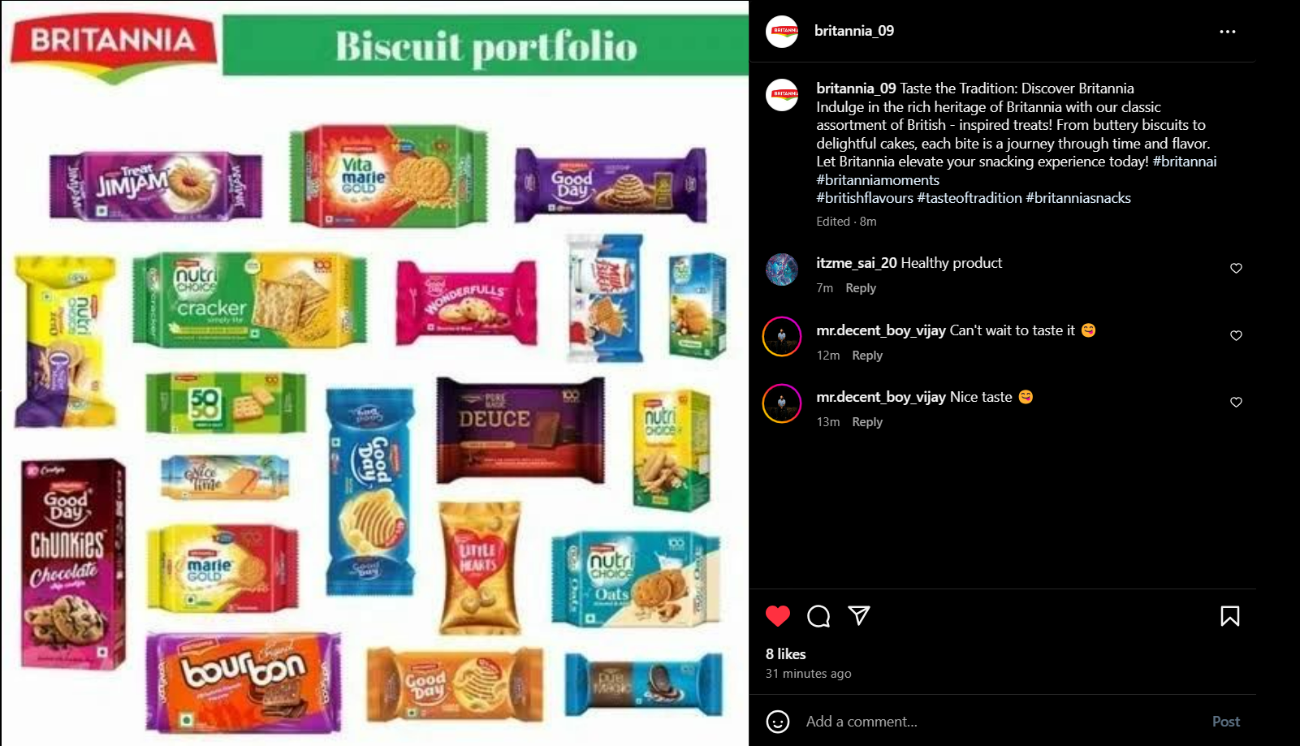
Format-1:- Static post on Britannia Biscuits
Caption:- Indulge in the rich heritage of Britannia with our classic assortment of british- inspired treats! From buttery biscuits to delightful cakes, each bite is journey through time and flavor. Let Britannia elevate your snacking experience today!
Hashtags:- #BritanniaMoments#BritanniaFlavors#Tasteoftradition#Britannia

Slide 29
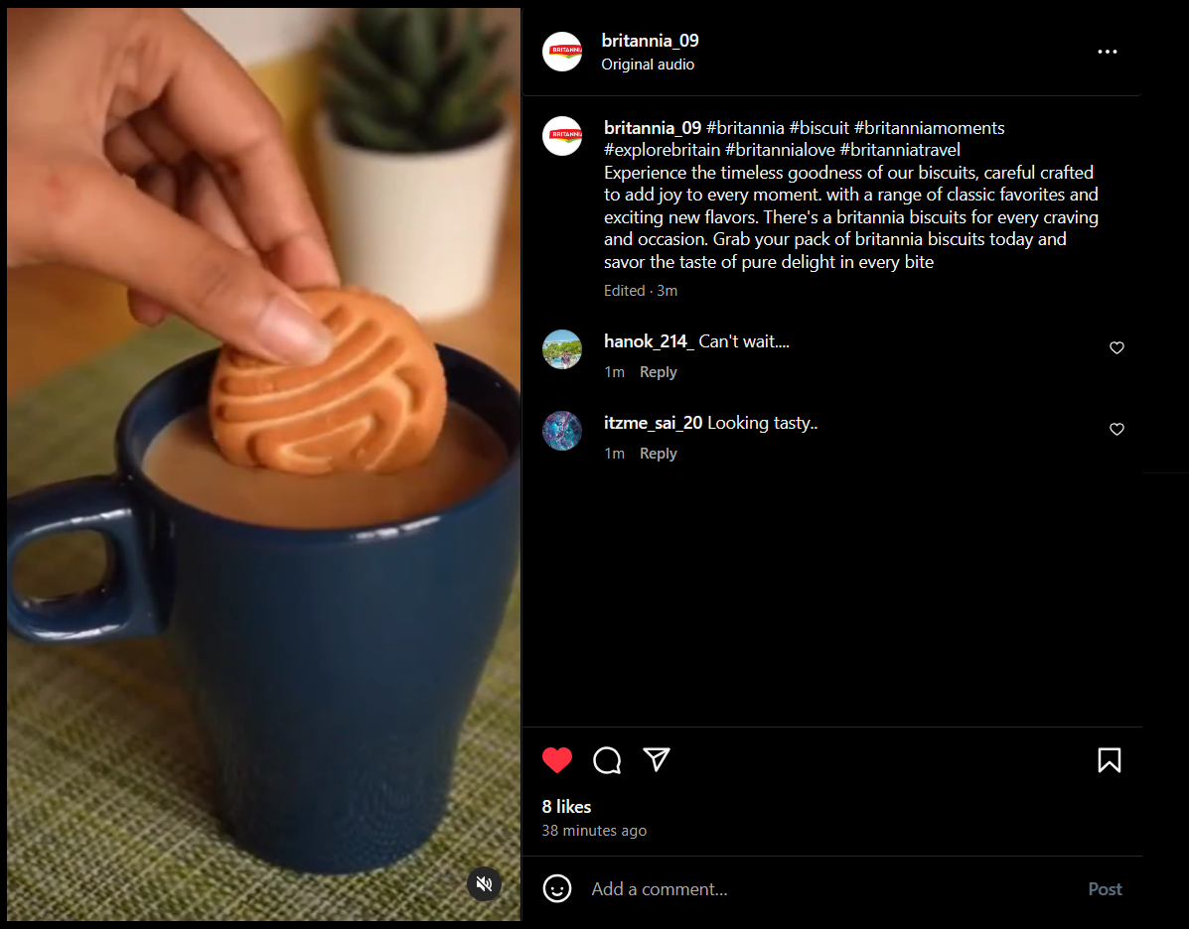
Format-2:- Reel post on biscuits
Caption:- Experience the timeless goodness of our biscuits, carefully crafted to add joy to every moment. With a range of classic favorites and exciting new flavors, There’s a britannia biscuit for every craving and occasion. Grab your pack of britannia biscuits today and savior the taste of pure delight in every bite.
Hashtags:- #britanniabiscuits#britannia#britanniamoments

Slide 30
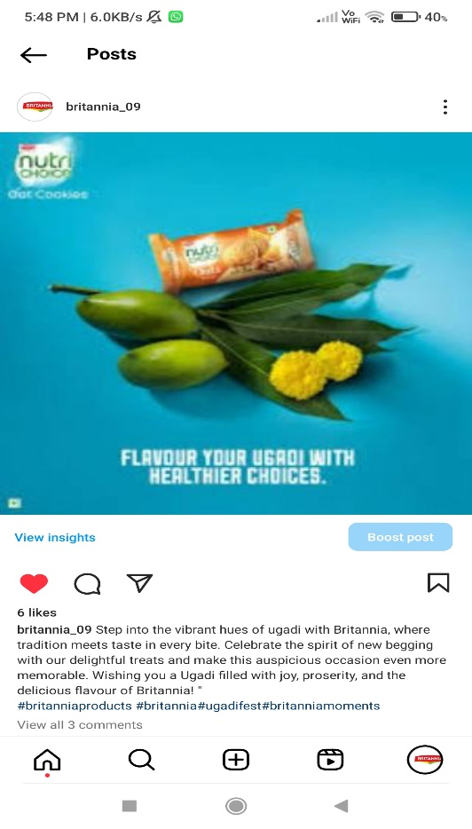
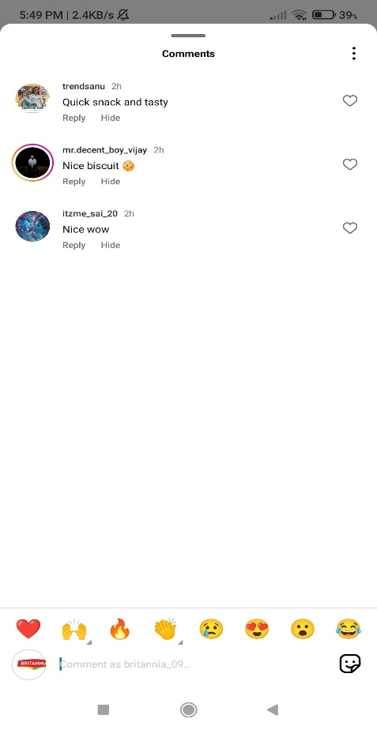
Format-3:- Festival post on UGADI
Caption:- Step into the vibrant hues of Ugadi with Britannia, where tradition meets taste in every bite. Celebrate the spirit of new begging with our delightful treats and make this auspicious occasion even more memorable.
Hashtags:- #britanniaproducts
#britannia#Ugadifest#britanniamoments

Slide 31
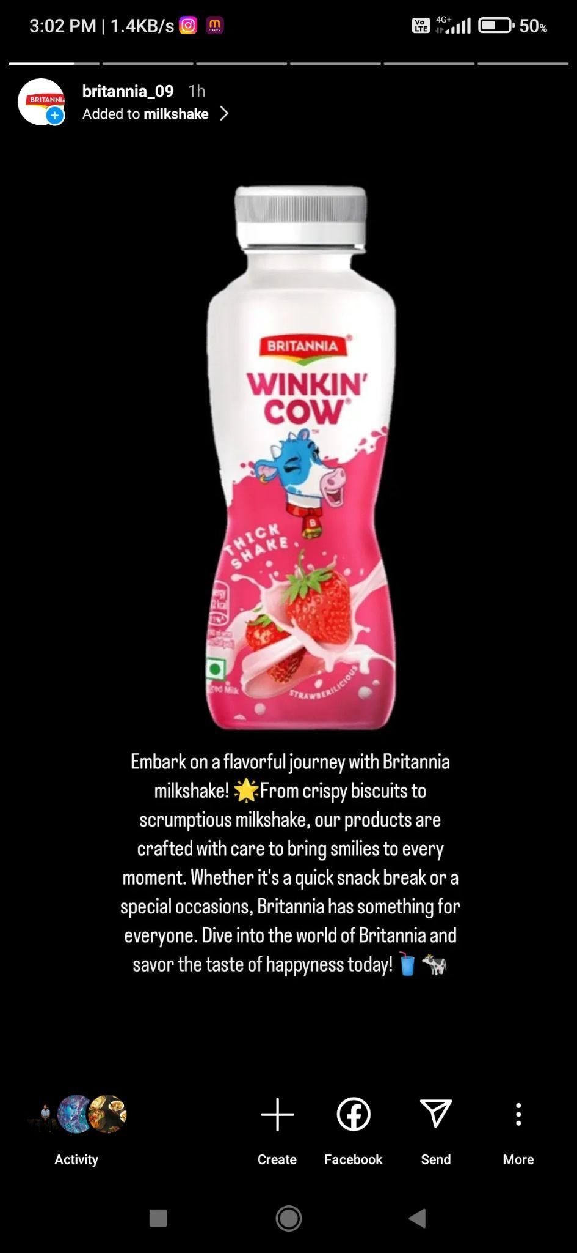
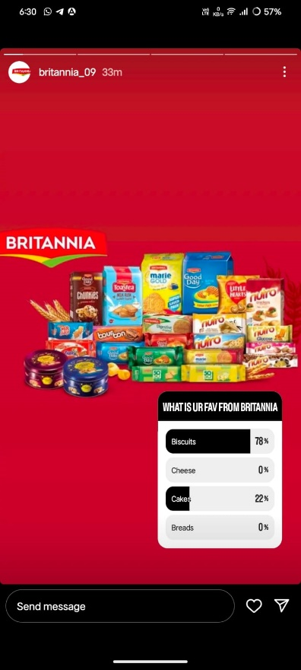
Instagram story
Screenshots of story:-
https://www.instagram.com/s/aGlnaGxpZ2h0OjE3ODYyMjI2OTY1MDg5MTk1?story_media_id=3353144915925540946_66144196691&igsh=MWVsMHNiZjFtbjJsNg==

Slide 32
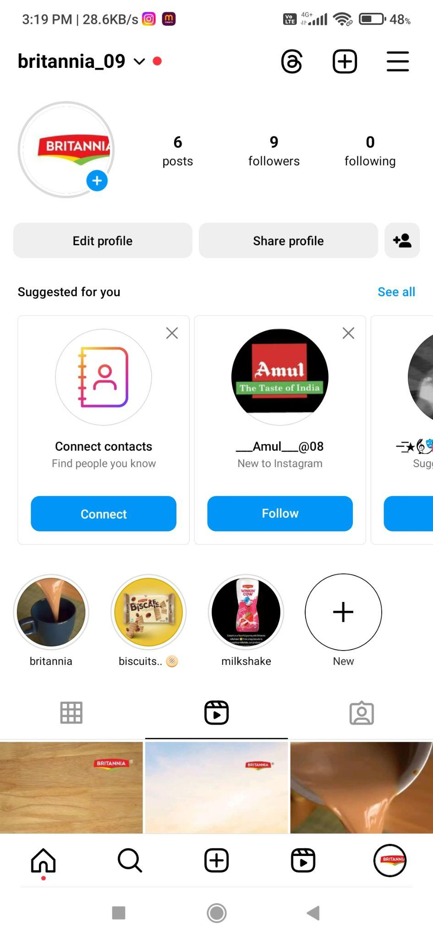
Highlights for story
Highlights links :
https://www.instagram.com/s/aGlnaGxpZ2h0OjE4MDIyMzI1MDgxNDgyNDU0?igsh=N3R3ZW91MDl2dTNj
https://www.instagram.com/s/aGlnaGxpZ2h0OjE4MDI1MzAzMjgzMDM1MzYy?igsh=eXY1NHJhYXE1bndn

Slide 33
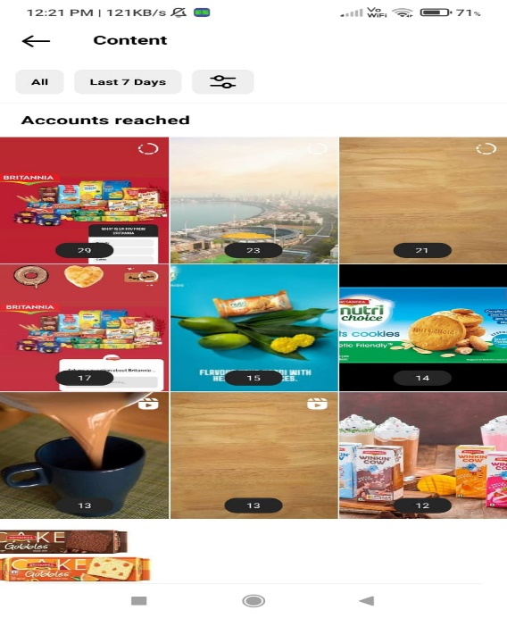
Story Insights
Reach is 100 approx
Impression is 200 approx
Like is 30 approx
Etc…..
Area for improvement :
In the subsequent years Britannia made Cheese and baby food on a large commercial scale again processing biscuit creating a history in the World.
Since the shares of Britannia journey from a small cooperative to a global brand is a remarkable tale of resilience, innovation, and social impact .

Slide 34
Designs and Video editing
Design Tools Familiarization (use Goggle Slides for crating visually appearing graphics)
Video Creation : Utilize VN or any editor of your choice to create videos related to the chosen topic.

Slide 35

Thank You

