Slide 1
SIGN SPEAK Smart Keypad For Mute People Communication
VIJAYRAM S (220901116)
MARAN ELANTHIRAIAN MK (220901125)
Under the guidance of:
Dr. D. SHYAM / Assistant Professor (SG)
Department of Electrical and Electronics Engineering
Rajalakshmi Engineering College

Slide 2
TABLE OF CONTENTS
Abstract
Introduction
Stanford Design Thinking Model in points:
Components used
Literature Review

Slide 3
ABSTRACT
Communication is essential for expressing thoughts and emotions, yet speech-impaired individuals face challenges that lead to dependency and social isolation. The lack of affordable assistive tools worsens this issue.
This project introduces a Smart Keypad with Voice Assistant to empower speech-impaired users. It features a T9 text input method, processed by an Arduino microcontroller, which generates voice output using pre-recorded audio files stored on an SD card. The device includes character deletion and message confirmation for enhanced usability. Additionally, it supports multi-language voice output, including Tamil, English, and other regional languages, ensuring inclusivity.
Designed to be portable, user-friendly, and cost-effective, this innovative solution bridges communication gaps. It enables users to express themselves independently, enhancing their social participation and improving their quality of life by promoting self-reliance.

Slide 4
INTRODUCTION
Communication is a fundamental aspect of human interaction, allowing individuals to express their thoughts, emotions, and needs. However, for people with speech impairments, this essential process can be challenging and isolating. To bridge this gap, our project introduces an innovative solution: a Smart Keypad with Voice Assistant. This device is designed to empower speech-impaired individuals by providing an intuitive, efficient, and portable communication tool. By integrating advanced technology with a user-friendly interface, this project aims to enhance accessibility, promote inclusivity, and improve the quality of life for specially-abled individuals.

Slide 5
Stanford Design Thinking Model in points:
Empathize: This project provides a T9 keypad-based communication tool for mute individuals, enabling offline, accessible interaction with natural audio playback in English and Tamil. It fosters confidence and ease in expressing thoughts through a familiar input method.
Define: Mute individuals struggle with daily communication, while existing solutions are costly or require internet. This project provides an offline, multilingual T9 keypad-based text-to-voice system with natural audio playback.

Slide 6
3) IDEATE
Design a compact, T9 keypad-based speech device to aid mute individuals in communication. Users enter predefined phrases, pick English or Tamil, and hear clear voice playback. The offline, user-friendly system enhances accessibility and autonomy.
4) PROTOTYPE
Users enter sentences word-by-word using a multi-press keypad, switching between English and Tamil for easy communication. Predefined phrases play natural audio through a speaker, enabling real-time interaction in various settings. The compact, offline device includes emergency phrases and an optional screen for sentence confirmation.
5) TEST
Verify T9 keypad input accuracy, sentence formation, language switching, and natural audio
playback. Check emergency phrase activation, offline stability, battery operation, and display
feedback reliability.

Slide 7
Components Used
ARDIUNO Microcontroller
Speaker
MP3-TF-16 DF MINI AMPLIFIER
LCD Display
Keypad
SD card

Slide 8
Literature Review
Reference | Authors | Year | Title | Key Feature
1 | Prof. Heena B. Kachhela Tulsiramji Ms. Sakshi S. Pathade Tulsiramji Prof. Sneha R. Bhange Ms. Palak O. Bhoyar | 2024 | IoT Based Speaking System for Mute People Using Hand Gesture | The paper focuses on developing a device that translates hand gestures into speech, bridging the communication gap between mute individuals and others.
2 | Pradip Mule N. Cheeran Tejaswini Palav Shailaja Sasi | 2016 | Low Cost and Easy to use Electronic Communication System for Speech Impaired People with Wired and Wireless Operability | The paper introduces an Electronic Communication System (ECS) designed for speech-impaired individuals, allowing them to communicate effectively through wired (keypad) and wireless (Bluetooth) inputs.

Slide 9
Reference | Authors | Year | Title | Key Feature
3 | Iram Haider Mohammad Ammar Mehdi Asjad Amin Kashif Nisar | 2020 | A Hand Gesture Recognition Based Communication System for Mute People | The paper presents a system aimed at enhancing communication for mute individuals by translating hand gestures into audio messages using advanced technologies like Kinect sensors.
4 | B. Rajapandian V. Harini D. Raksha V. Sangeetha | 2017 | "A Novel Approach as an Aid for Blind, Deaf and Dumb People": | To develop a communication aid for individuals suffering from blindness, deafness, or muteness, or any combination of these disabilities, enabling them to communicate seamlessly.
Title

Slide 10
Summary of the Literature review
These papers aim to assist disabled individuals, especially those with speech, hearing, and vision impairments, by offering innovative communication systems.
Technologies like Arduino boards, flex sensors, Kinect, and Bluetooth enable gesture recognition, text-to-speech, and Braille output for seamless interaction.
Each system provides real-time solutions for effective communication, ensuring accessibility in various scenarios like emergencies and everyday life.
The papers highlight future advancements, such as wireless operability, multi-language support, and enhanced portability for broader use.
Published between 2016 and 2020, these works represent a global effort by researchers to empower differently-abled individuals . inclusivity.

Slide 11
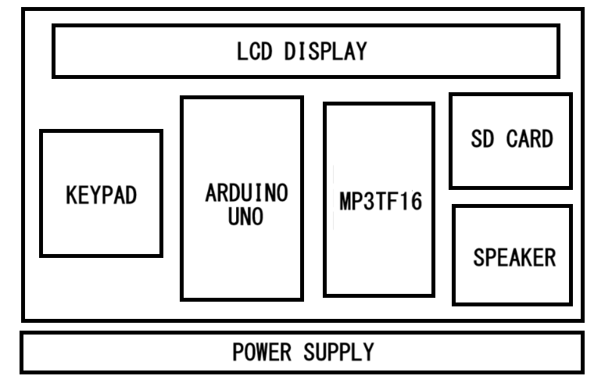
BLOCK DIAGRAM

Slide 12
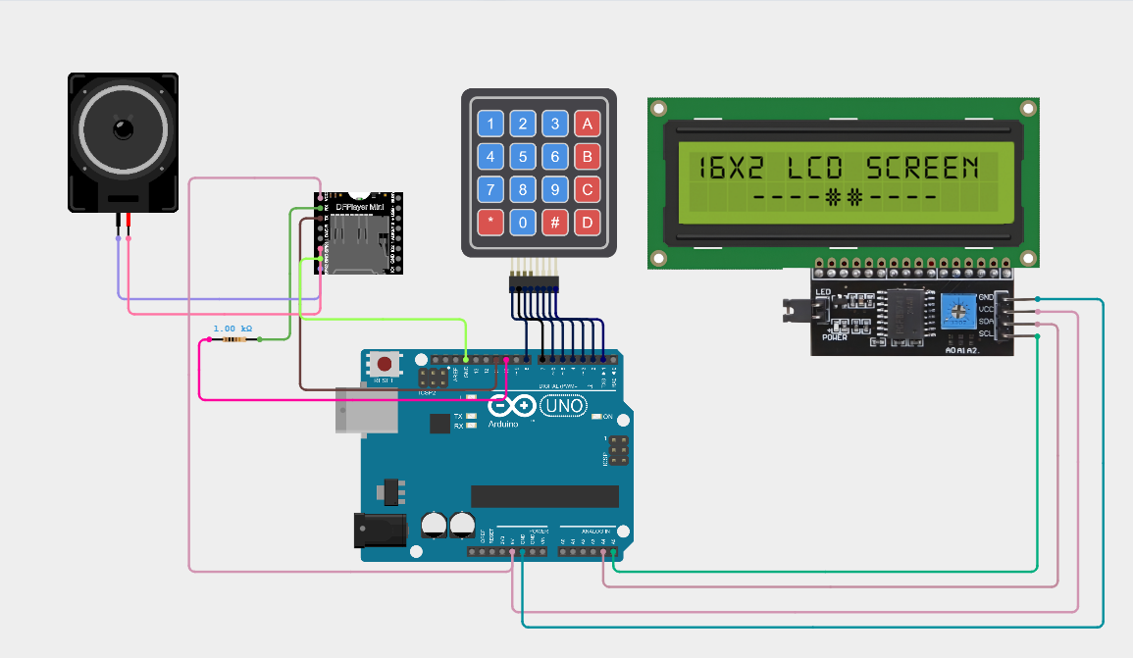
CIRCUIT DIAGRAM

Slide 13
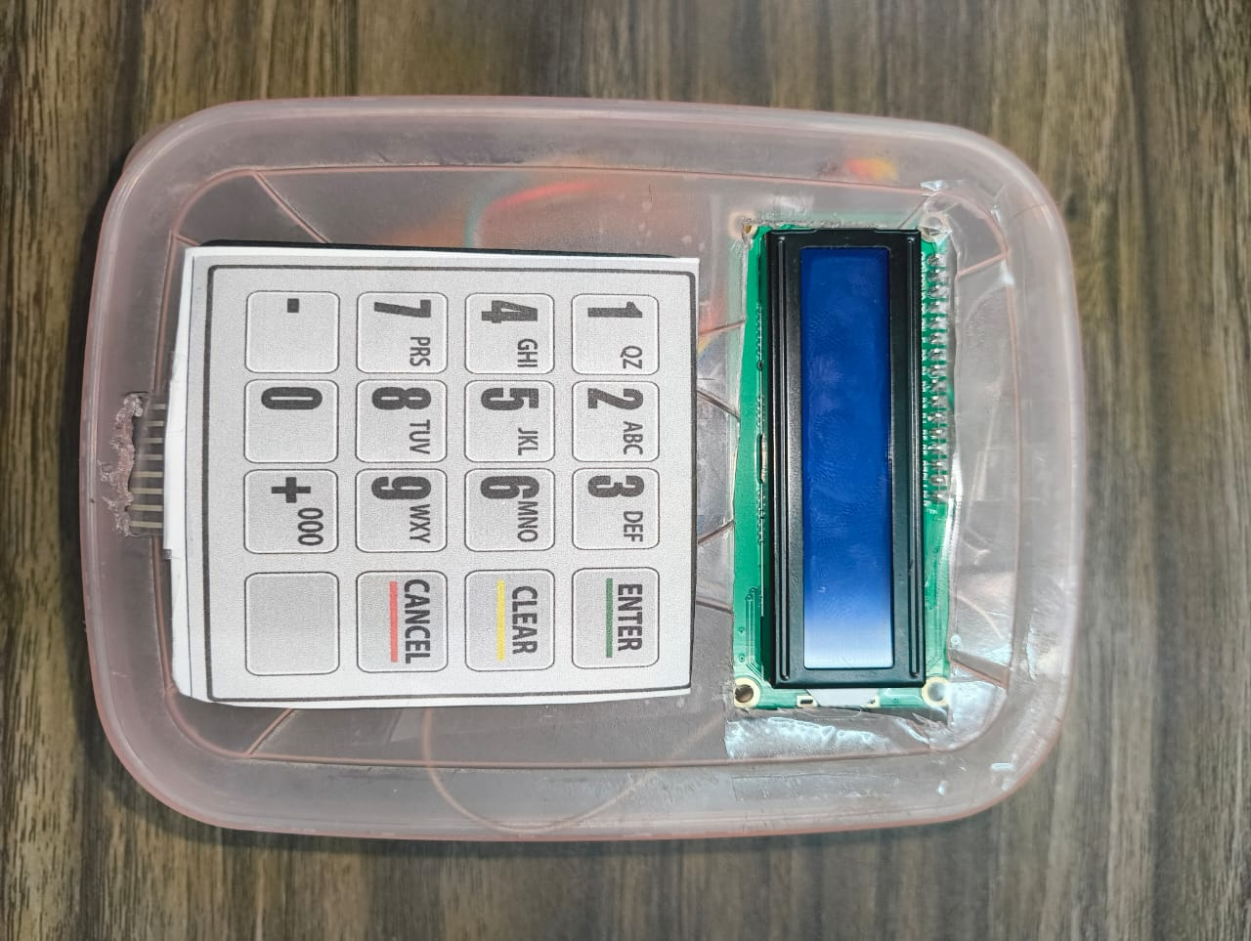
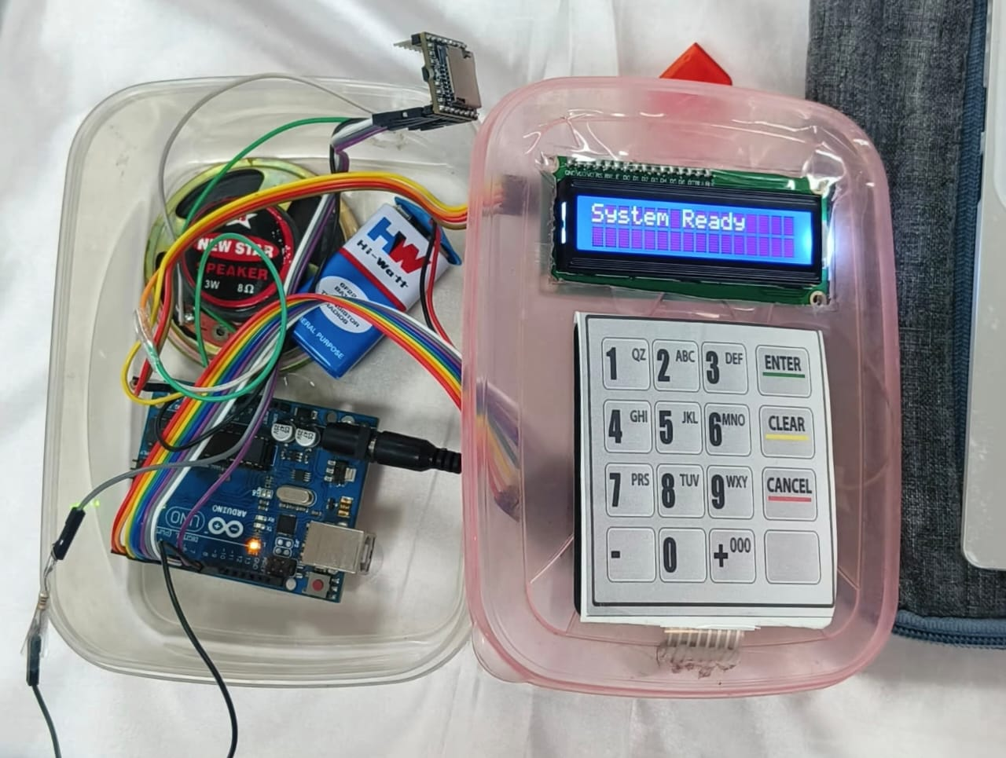
PROTOTYPE AND TESTING

