Slide 1
Exploratory Data Analysis (EDA)
E-Commerce Delivery Analytics

Slide 2
EDA (Exploratory Data Analysis) is the process of analyzing data sets to summarize their main characteristics, often using visual methods. It helps you understand the data before building any models.
Steps of EDA: Look at the data → Open the file and see what’s inside (like names of columns, number of rows).
Fix the data → Remove empty or wrong values, fix mistakes.
Learn about the data → Find out things like biggest value, smallest value, average, etc.
Draw charts → Make graphs to see patterns or trends (like bar charts, pie charts, etc.).
Find connections → See if two things are related (like height and weight).
Spot strange values → Look for values that don’t fit in (too big or too small).
ABOUT EDA

Slide 3

INTRODUCTION
In this project, we look at data from an online shopping company to understand how and when people place orders, and how fast those orders are delivered. We use simple charts and summaries to find patterns in the data. This helps us see what is working well and where there might be delays or problems in the delivery process.

Slide 4
1 Order Trends & Peak Hours Analysis
2 Delivery Time Analysis & Delay Impact
3 Customer Satisfaction & Service Ratings
4 Revenue Insights & Top-Selling Products
5 Refund & Complaint Analysis
OBJECTIVES

Slide 5

Dataset Overview
Total records and features
Brief description of data cleaning steps (e.g., handling missing dates)
Screenshot or summary of key columns: Order Date & Time, Delivery Time, Order Value, etc.

Slide 6
Objective 1 – Order Trends & Peak Hours Analysis Line chart: Number of orders by hour Highlight peak times (e.g., lunch/dinner hours) Insight: When are customers most active?

Slide 7
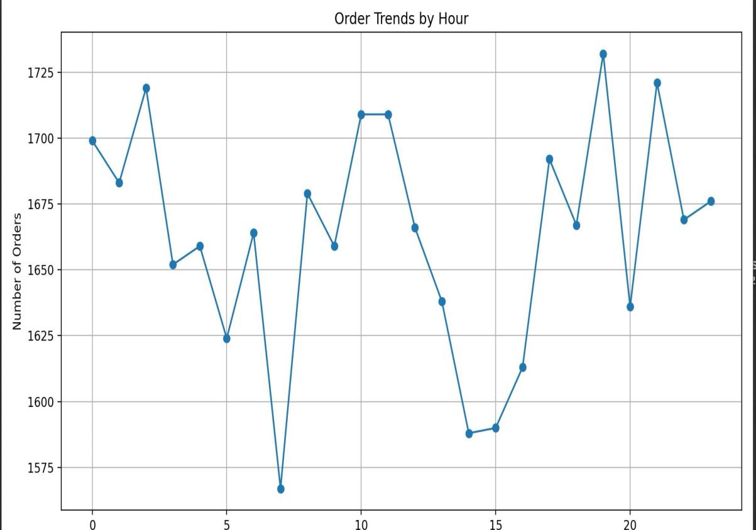
Order Trends & Peak Hours Analysis

Slide 8
Objective 2 – Delivery Time Analysis & Delay Impact Histogram: Distribution of delivery times Boxplot: Delivery Time vs Delay Insight: Average delivery time, effect of delays on duration

Slide 9
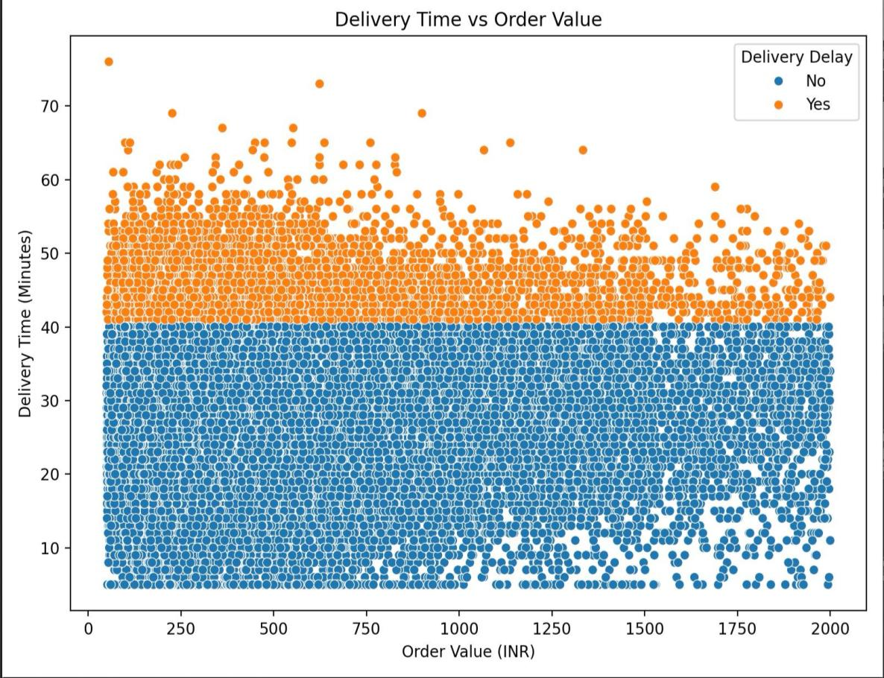
Delivery Time Analysis & Delay Impact

Slide 10
Objective 3 – Customer Satisfaction & Service Ratings
Bar chart: Frequency of each service rating
Boxplot: Order Value vs Service Rating
Insight: Is satisfaction linked to spending?

Slide 11
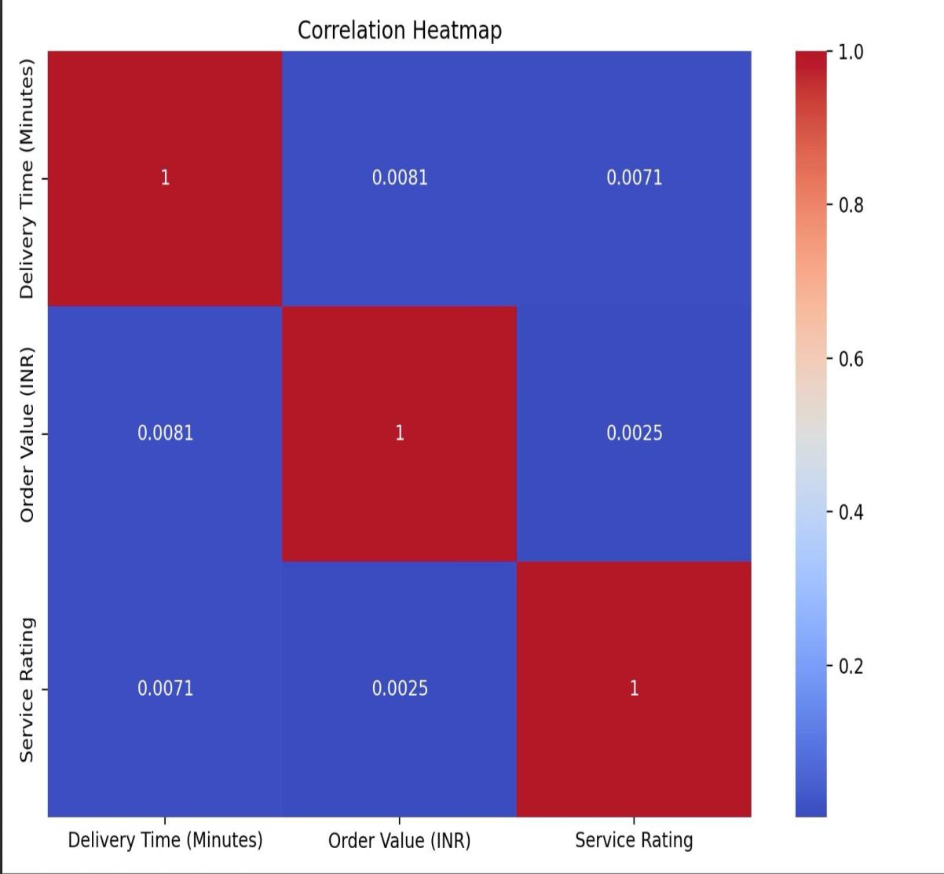
Customer Satisfaction & Service Ratings

Slide 12

: Objective 4 – Revenue Insights & Top-Selling Products
Bar chart: Total revenue by product category
Pie chart: Revenue share per category
Insight: Which categories drive most revenue?

Slide 13
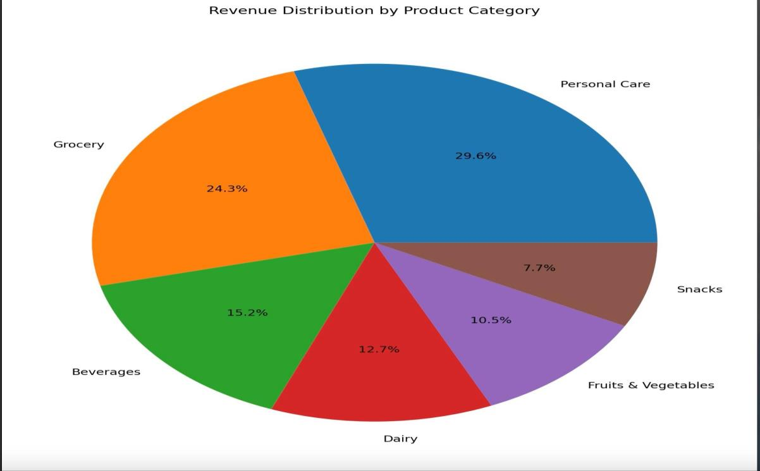
Revenue Insights & Top-Selling Products

Slide 14
Objective 5 – Refund & Complaint Analysis
Bar chart: Refund Request Distribution (Yes/No)
Insight: Are refunds frequent? Does this reflect on service?

Slide 15
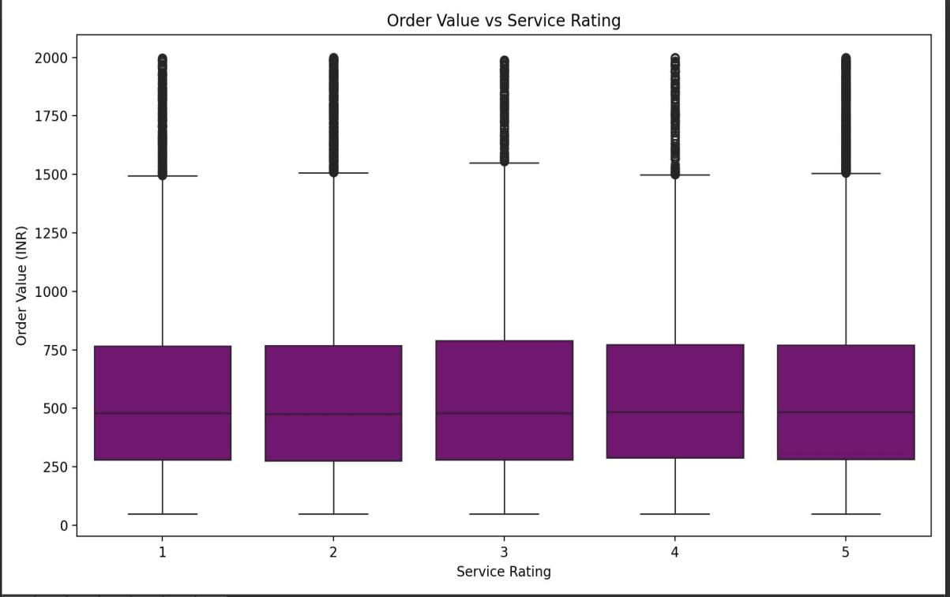
Refund & Complaint Analysis

Slide 16
Conclusion
Summary of insights from all objectives
Actionable takeaways:
Improve delivery processes during peak hours
Focus on high-value product categories
Reduce delays to enhance service rating
Monitor refund trends for quality control

