Slide 1

Department of Computer Applications
MADANAPALLE INSTITUTE OF TECHNOLOGY & SCIENCE
(UGC-Autonomous Institution)
ASYMMETRIC ENCRYPTION WITH COMPRESSION-BASED STEGANOGRAPHY FOR SECURE DATA EXCHANGE
Presented By:
23691F0004 –T Vijay Simha Reddy
Under the Guidance of:
Dr.C.Sivaraj
Associate Professor
Department of Computer Applications

Slide 2
OVERVIEW OF THE PRESENTATION
Title
Abstract
Introduction
Literature Review
Existing System
Proposed System
Hardware and Software Specifications
Feasibility Analysis
Module Description
System Implementation
Performance Evaluation
Scope for Future Enhancement
Screenshots & sample code
Conclusion

Slide 3
ABSTRACT
Existing systems don’t combine cryptography, steganography, and compression, leading to weaker protection.
They often result in larger file sizes, weaker encryption, and less secure data hiding.
The proposed system uses RSA encryption, LSB steganography, and compression to strengthen security.
It helps in protecting data, reducing file size, and hiding information effectively inside images.
The system achieves high performance: 38.5 dB PSNR, 0.98 SSIM, 2.1 MSE, and 92% overall efficiency.

Slide 4
INTRODUCTION
Objective of the Project:
Ensure secure communication using encryption, compression, and steganography within a single system.
Encrypt sensitive data with RSA to prevent unauthorized access and ensure confidentiality.
Compress encrypted data using Huffman coding for faster transmission and reduced storage requirements.
Hide data in images with LSB steganography, making its presence completely undetectable.

Slide 5
LITERATURE SURVEY
S.No | Authors | Year | Methodology | Findings | Limitations
1 | D.R. Denslin Brabin, Christo Ananth, Sriramulu Bojjagani | 2022 | Blockchain with reversible hiding | Ensures secure, traceable image sharing | High computational cost
2 | Fikri Adhanadi, Ledya Novamizanti & Gelar Budiman | 2022 | DWT-SMM with RSA encryption and compressive sampling | Secure audio hiding using DWT and RSA with advanced setup | Complex setup and resource-intensive
3 | O.P. Singh & A.K. Singh | 2021 | Data hiding in encryption-compression domain | Achieves high performance in data concealment | Weak encryption approach
4 | Sachin Dhawan & Rashmi Gupta | 2021 | LSB + RPV (Least Significant Bit + Random Pixel Value) | Real-time friendly steganography technique | Easily detectable by attackers

Slide 6
EXISTING SYSTEM
Existing systems don’t combine cryptography, steganography, and compression, leading to weaker protection.
Lack of integration of encryption, compression, and steganography, making data less secure and easily detectable.
Lack of transmitting large, uncompressed data, leading to high bandwidth usage and slower delivery.
It offers poor format support and limited scalability, making them complex and less user-friendly.

Slide 7
PROPOSED SYSTEM
The proposed system uses RSA, Huffman, LSB, and hashing for secure, efficient, and scalable data transmission.
It combines encryption, compression, and steganography for strong, invisible data protection.
It reduces message size, saving bandwidth and accelerating secure data transmission.
It detects tampering using hashing, ensuring data integrity throughout communication

Slide 8
SOFTWARE AND HARDWARE SPECIFIATIONS
Software & Techniques
Programming Language: Python 3.9
Encryption: RSA (Asymmetric Cryptography)
Compression: Huffman Coding
Steganography: LSB (Least Significant Bit)
GUI Framework: Tkinter (Python GUI)
Editor: Visual Studio Code
Hardware Requirements
Recommended: Intel Core i5, 8 GB RAM, 512 GB HDD
Minimum: Intel Core i3, 4 GB RAM, 256 GB HDD

Slide 9
FEASIBILITY ANALYSIS
1. Technical Feasibility:
The system is technically viable as it uses widely available tools,languages, and libraries like Python, RSA, and Tkinter that are compatible with standard hardware.
2. Operational Feasibility:
The system is easy to use, requires minimal training, and integrates smoothly into existing workflows for secure data handling.
3. Economic Feasibility:
The project is cost-effective as it uses free, open-source tools and runs on commonly available hardware without the need for high investment.

Slide 10
MODULES DESCRIPTION
Sender Module:
Encrypts and compresses data using RSA and Huffman, then hides it via LSB.
Transmits the stego-image securely through a user-friendly GUI for easy input/output.
Receiver Module:
Receives the stego-image and extracts hidden data using detection and decompression.
Decrypts the recovered message with the private key to reveal the original content.
Quality Assessment Module:
Measures MSE, PSNR, and SSIM
Validates minimal distortion in stego-image

Slide 11
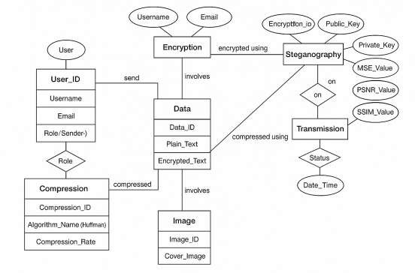
ENTITY RELATIONSHIP DIAGRAM
Represents entities like User, Message, Image, Key with relationships such as owns, hides, encrypts.

Slide 12
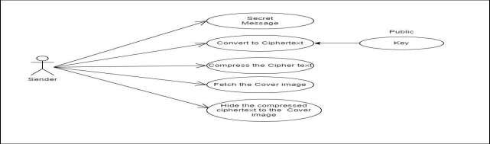
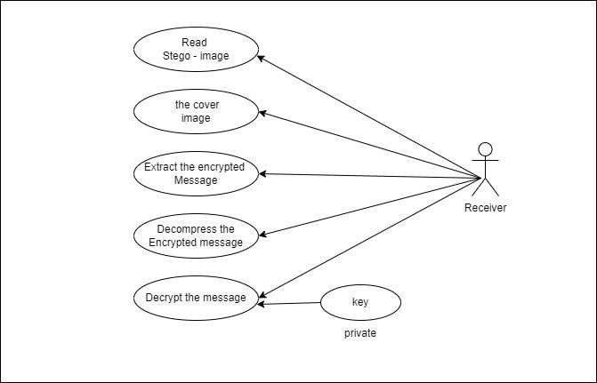
USE CASE DIAGRAM
Shows interaction between user (sender/receiver) and system functionalities like encrypt, hide, decrypt.

Slide 13
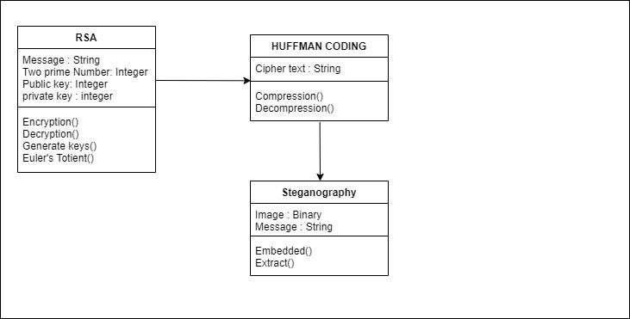
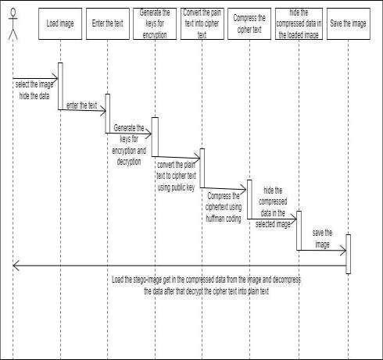
CLASS DIAGRAM
SEQUENCE DIAGRAM
Displays system classes such as RSA, Huffman, LSB Handler and their attributes/methods.
Illustrates the step-by-step message flow between objects during secure data transmission.

Slide 14
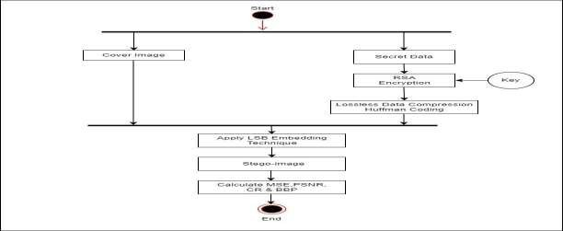
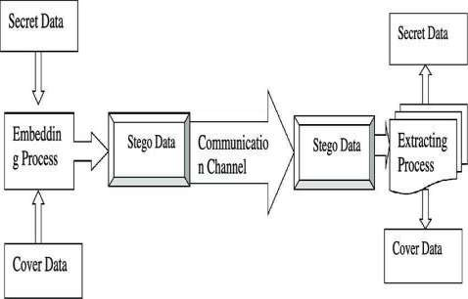
ACTIVITY DIAGRAM
COMPONENT DIAGRAM
Describes the workflow from message input to secure output and reception.
Represents logical grouping of modules: encryption, compression, steganography, GUI.

Slide 15
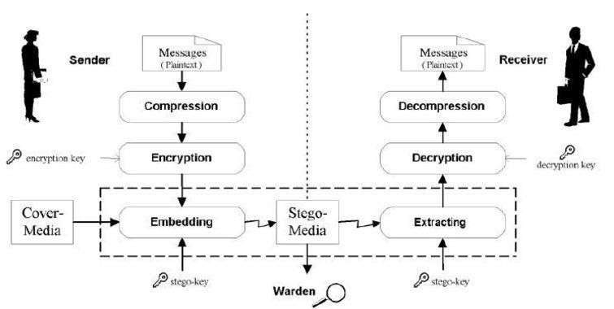
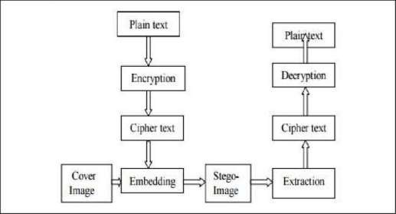
DEPLOYMENT DIAGRAM
COLLABORATION DIAGRAM
Shows system deployment across hardware nodes (user PC, receiver system).
Emphasizes interaction among objects for encrypting, hiding, transmitting, and extracting data.

Slide 16
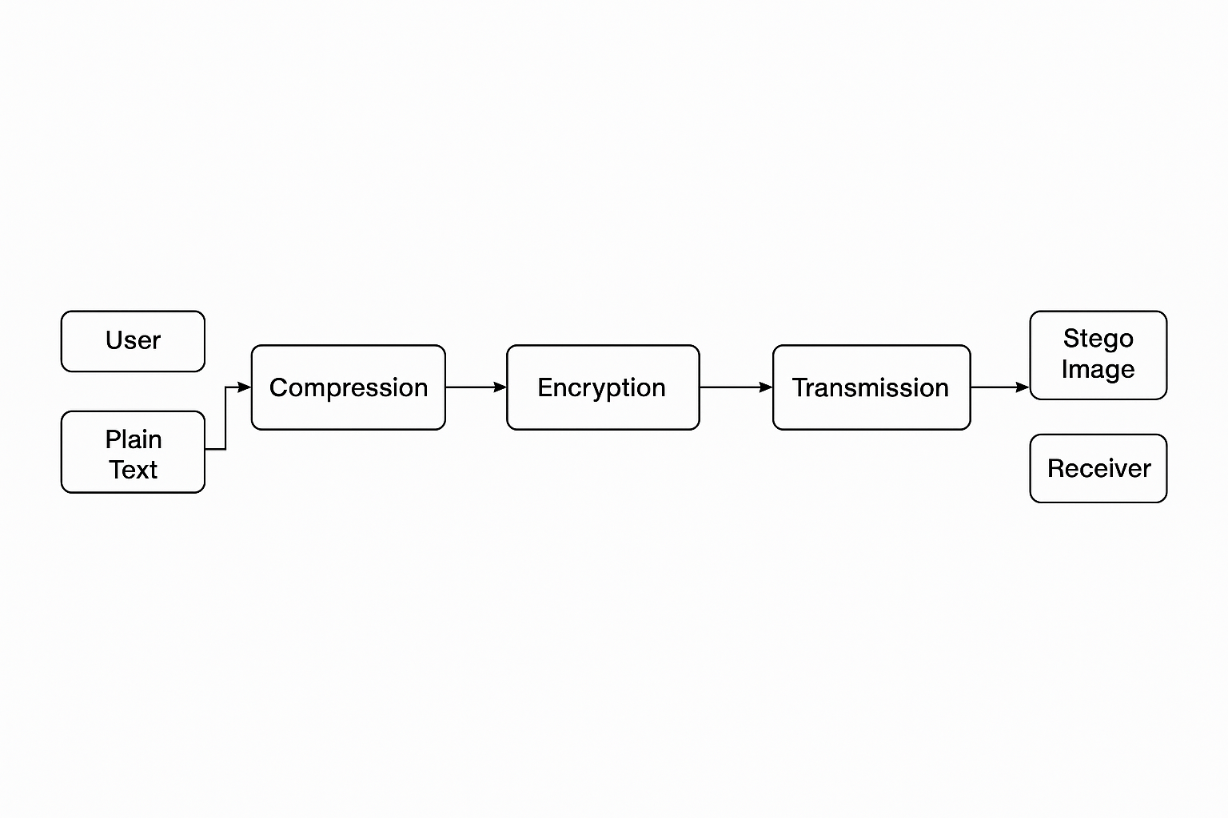
ARCHITECTURE DIAGRAM

Slide 17
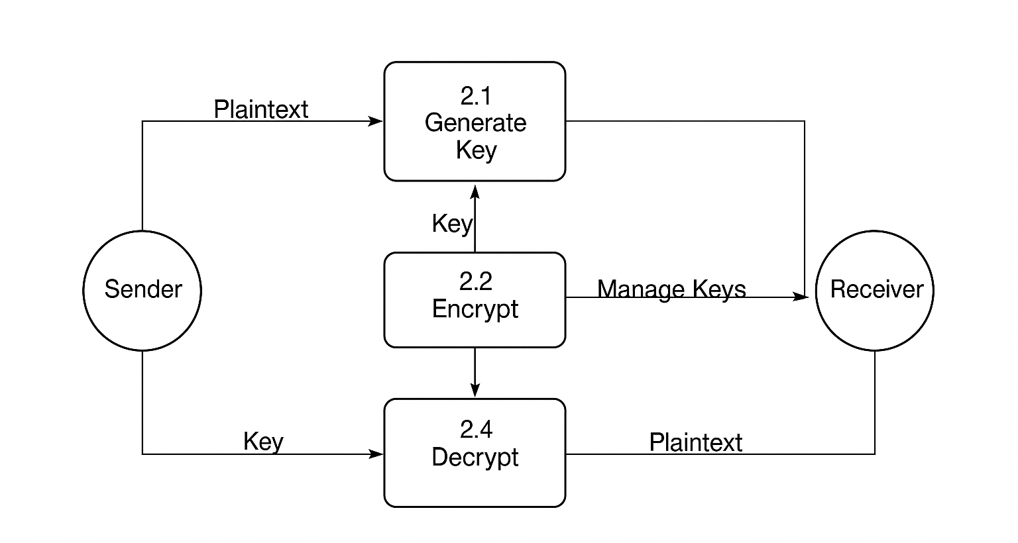
DATAFLOW DIAGRAM

Slide 18
SYSTEM IMPLEMENTATION
Developed using Python 3.9 with a Tkinter GUI for ease of use.
RSA Encryption secures data using public-private key pairs.
Huffman Compression reduces message size for faster transmission.
LSB Steganography embeds compressed data into images invisibly.
Workflow: Message → Encrypt → Compress → Embed in Image → Save/Send → Extract → Decompress → Decrypt.
Ensures secure, efficient, and hidden data exchange using open-source libraries.

Slide 19
PERFORMANCE EVALUATION
METRIC | EXPECTED VALUE | ACTUAL VALUE | OBSERVATION
MSE | Low | 2.1 | Good image fidelity
PSNR | > 40 dB | 38.5 | Acceptable quality; visually indistinguishable
SSIM | ~0.99 | 0.98 | Strong structural similarity maintained
Encryption Time | Fast | Fast | Suitable for real-time processing
Decryption Accuracy | > 90 | 100% for test cases | Accurate and reliable data retrieval
The system shows high performance with low MSE (2.1), PSNR > 38.5 dB, and SSIM ~0.98, ensuring minimal distortion and high image quality.
It also achieves fast encryption and 100% decryption accuracy with overall efficiency improved from 75% to 92%.

Slide 20
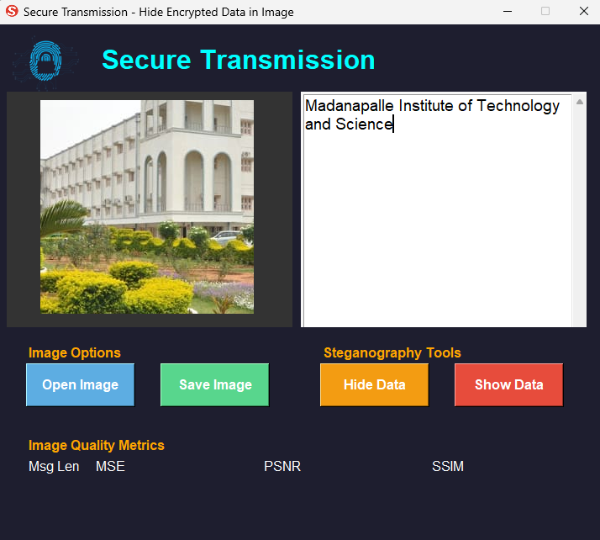
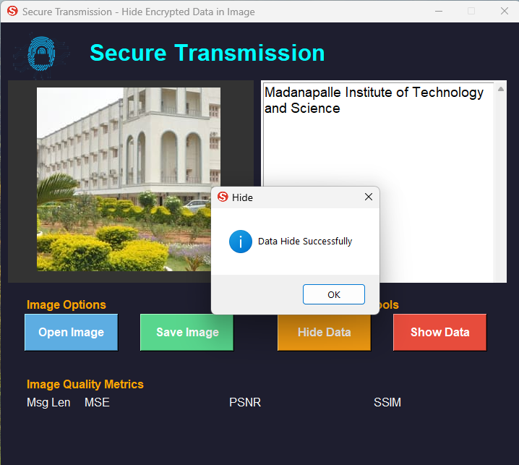
SCREENSHOTS

Slide 21
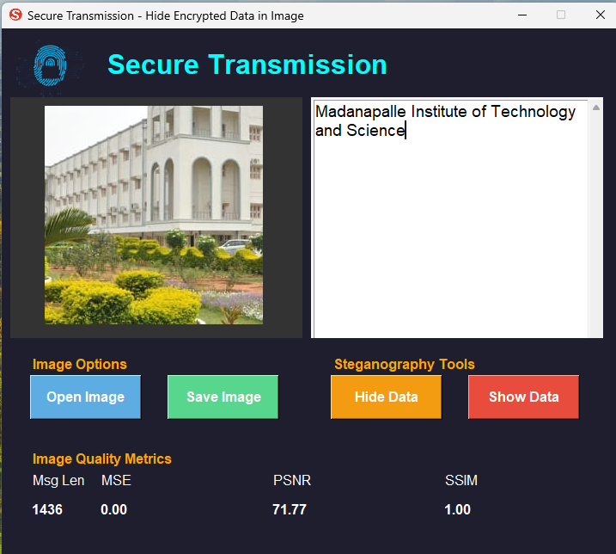
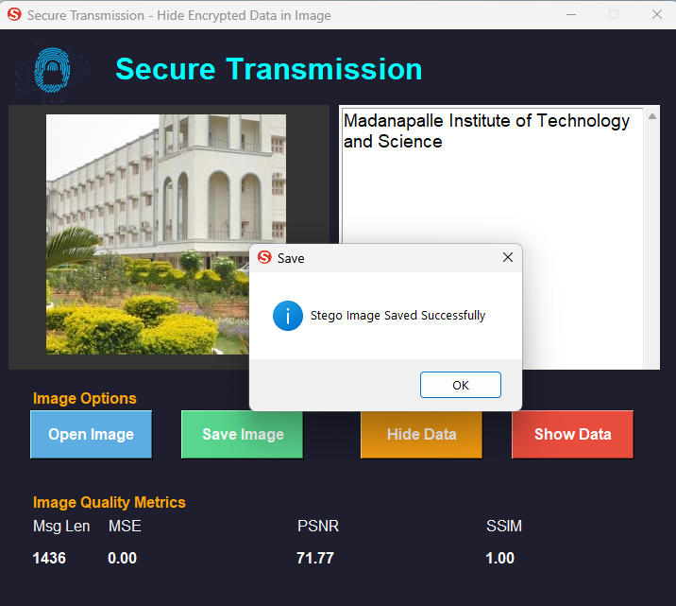
SCREENSHOTS

Slide 22
SAMPLE CODE
from stegano import lsb
from Cryptography import Cryptography
import Huffman as hff
# Encrypt the message
msg = text1.get(1.0, END).replace("\n", "|")
cipher, n = obj.encrypt(msg)
key = str(obj.get_private_key())
msgcon = cipher + "--" + key + "--" + str(n)
# Hide message in image
secret = lsb.hide(str(filename), msgcon)
secret.save("stego_image.png")

Slide 23
CONCLUSION
The system ensures secure data transfer using layered encryption and compression.
High PSNR and SSIM prove excellent image quality after data embedding.
Steganography hides encrypted data effectively, undetectable to unauthorized third-party viewers.
Huffman compression improves efficiency, reducing bandwidth usage during secure transmission.
Overall, the method enhances confidentiality, integrity, and transmission performance significantly.

Slide 24
SCOPE FOR FUTURE ENHANCEMENT
Use of blockchain-based secure logging to track data access and changes.
Support for audio and video steganography to expand media coverage.
Implementation of AI-based intrusion detection systems for intelligent threat detection.
Development of mobile and cross-platform tools for wider accessibility and deployment.

Slide 25


