Slide 1

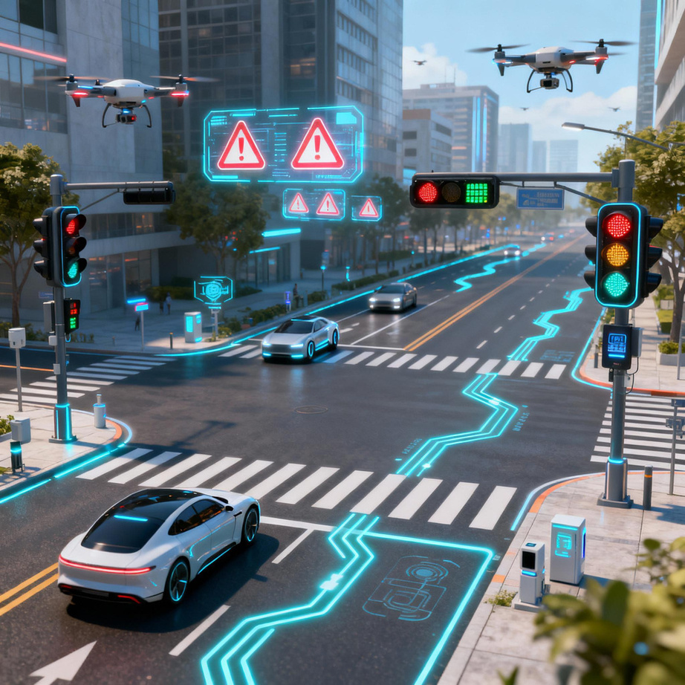
Title : RoadHazeX - A Road Hazard Reporting and Smart Navigation Application.
Team Name: Alphians
Team Member: Ajay P
Team Member: Yashwanth P
Team Member: Balaji V
Team Member: Vijayakumar D
Institution: Alpha collage of engineering, Thirumazhisai.
Objective: To enhance road safety and mobility by leveraging AI, IoT, and citizen participation for real-time road hazard detection, reporting, and resolution.
Notes:
1.7.2013
1.7.2013
1.7.2013
1
‹#›
‹#›
‹#›

Slide 2
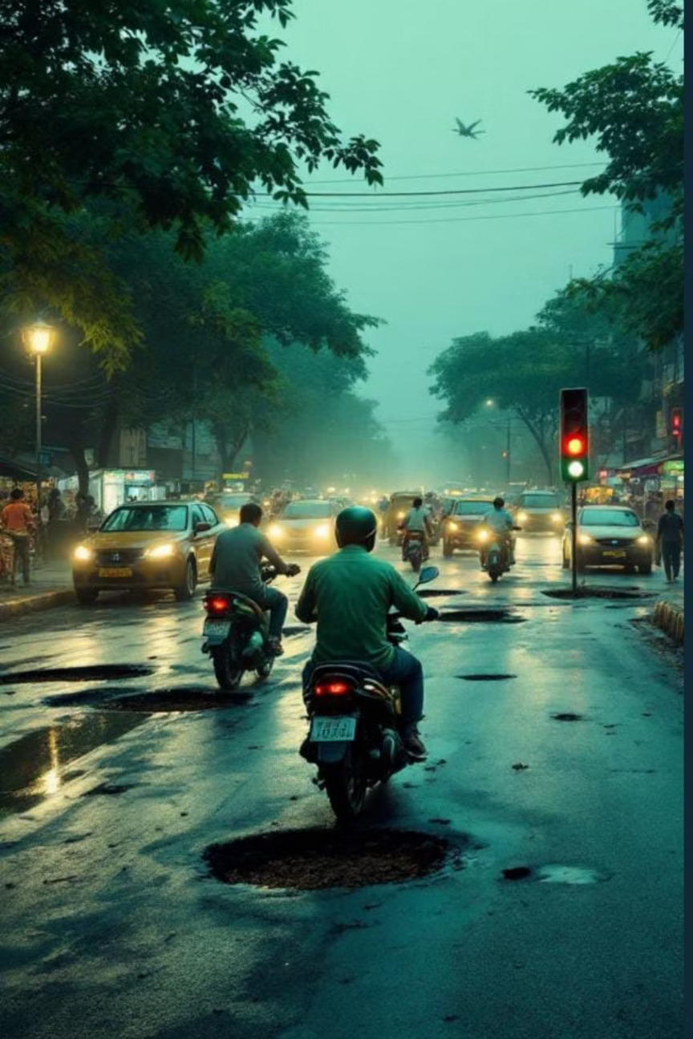

Problem Statement
Mobility Challenge:
India's roads face thousands of daily hazards — potholes, broken signals, flooding, and debris — that threaten commuter safety and damage vehicles. Lack of a unified, real-time platform delays government response and leaves small issues unattended until they escalate into major accidents or infrastructure failures.
Why It Matters:
        Unreported hazards contribute to 60% of preventable accidents.
        Delayed maintenance increases road repair costs and environmental impact.
        Safe, sustainable mobility demands collective awareness and rapid response.
Our mission: Empower citizens and authorities to make roads safer through real-time, data-driven collaboration.
Notes:
1.7.2013
1.7.2013
1.7.2013
2
‹#›
‹#›
‹#›

Slide 3
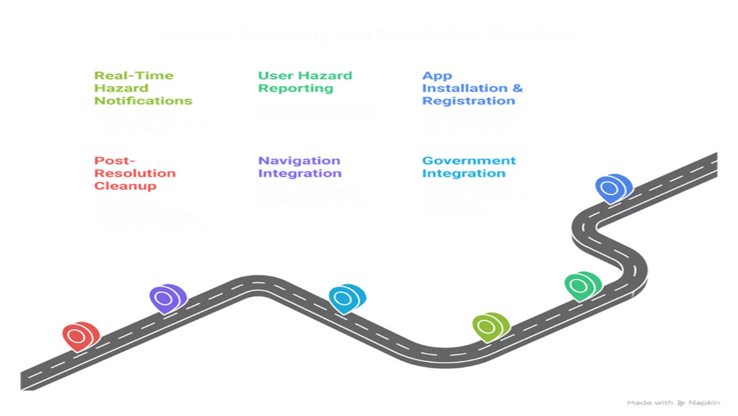
Proposed Solution – Core Workflow
Solution Overview:
A mobile-based Smart Road Hazard Reporting and Navigation App that allows citizens to report hazards through photos or short videos. Using AI (CNN for images and RNN for videos), the system verifies and classifies each report, then uploads it to a cloud server for real-time sharing with municipal authorities. Officials receive updates through a dashboard to assign and resolve issues efficiently. The app’s smart navigation system marks hazard zones, sends real-time alerts to nearby drivers, and suggests safer alternate routes, ensuring safer, faster, and more reliable travel for everyone.
01
02
App Installation & Registration
User Hazard Reporting
        Free, multilingual, lightweight app (<50 MB).
        The user captures a photo or video of the hazard, which the app processes automatically using CNN (for images) or RNN (for videos).
        Simple registration via phone or Aadhaar (optional).
        The AI model analyzes and generates a short auto-description with GPS location and user details.
        The verified report is instantly uploaded to the government database and mapped into the smart navigation system for live alerts.
03
04
Three Core Functions After Reporting
Post-Resolution Cleanup
        i) Real-Time Hazard Notifications: Alerts nearby drivers who were the users of the app via GPS geofencing.
Once officials mark a hazard as fixed, They can remove the hazard report data hence it is automatically removed from the map to prevent false alerts.
        ii) Government Integration: Sends report to municipal dashboard for status update and action.
        iii) Navigation Integration: Updates smart map and suggests alternate safe routes.
Notes:
1.7.2013
1.7.2013
1.7.2013
3
‹#›
‹#›
‹#›

Slide 4
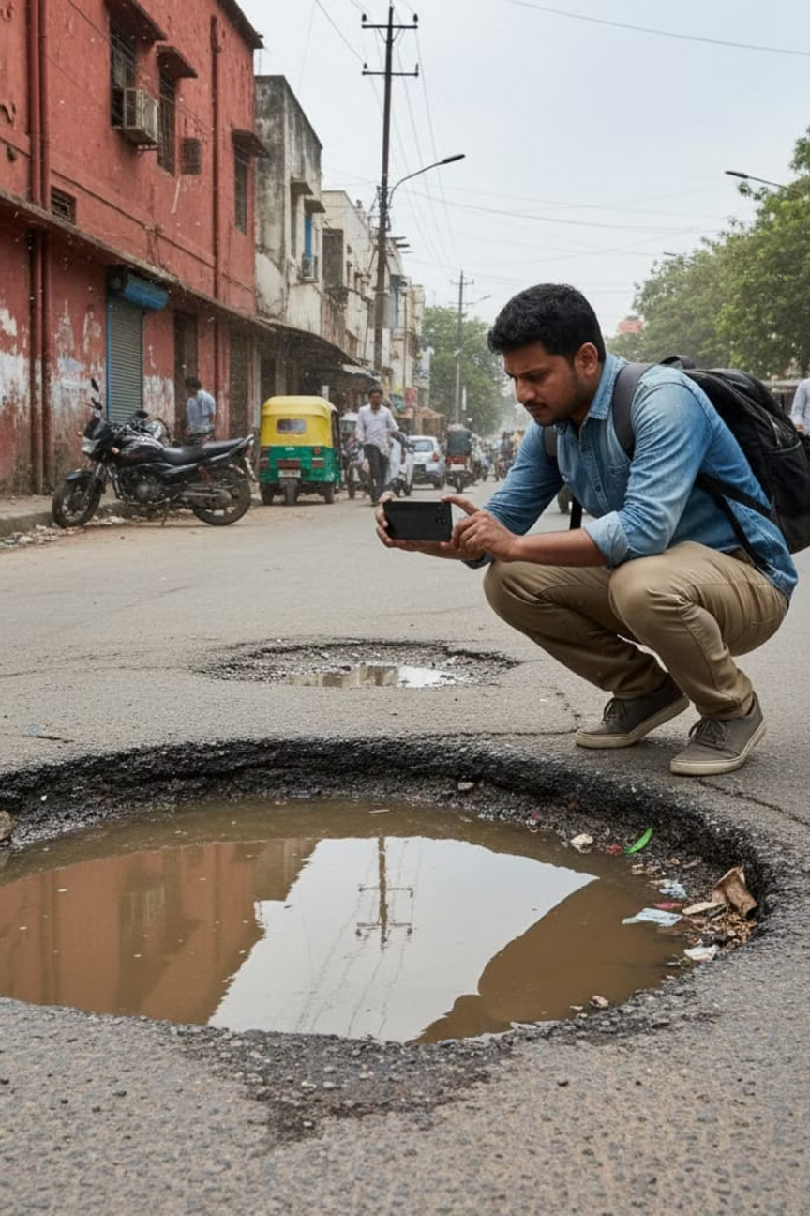
Proposed Solution – Innovation & AI Features
What Makes It Unique and AI-Driven:
Smart Categorization System
Classifies hazards into Road, Traffic, Environmental, Violation, and Emergency categories.
Real-Time Data Verification
        GPS validation ensures on-site authenticity.
        AI photo analysis confirms image-hazard relevance.
        Duplicate detection groups repeated reports.
        Credibility score built from user accuracy & community validation.
How the System Processes Reports:
        Aggregates nearby Hazard reports using geospatial clustering...
        ML-based Entropy Weighted Priority Algorithm ranks hazards by severity and frequency, inorder to prevent server down issue also from Government server end.
        For Navigation system users , App Push notifications triggered automatically when drivers approach hazard zones (applicable to app users).
Innovation: Integrates AI, crowdsourcing, and government APIs into one ecosystem — ensuring continuous, verified, and transparent road-safety monitoring.
Notes:
1.7.2013
1.7.2013
1.7.2013
4
‹#›
‹#›
‹#›

Slide 5








Impact & Relevance – Safety & Inclusivity
How Our Solution Improves Safety and Inclusivity:
The app intelligently classifies hazards into six key categories — Road, Traffic, Environmental, Violation, Emergency, and Climatic — ensuring accurate reporting, prioritization, and effective action planning.
Prevention First
Inclusive Participation
Early identification of small issues prevents major damage.
Supports all users — commuters, cyclists, and pedestrians — in multiple Indian languages.
Category
Focus areas
Accessibility
Reduced Accidents
Works on low-end smartphones with offline report caching for remote users.
Road Hazards
Potholes, uneven surfaces, damaged manholes, road debris, waterlogging.
Hazard alerts and route optimization lower road risks and congestion.
Traffic Hazards
Accidents, signal failures, illegal parking, congestion, road closures.
Easy Reporting
Environmental Hazards
Fallen trees, waste blocking roads, oil spills, pollution, animal crossings.
Instant Alerts
Smart navigation system provides real-time hazard warnings and safe route guidance.
When a user reports a hazard by capturing a photo, the AI algorithm automatically classifies the hazard type and generates a short, context-based description
Climate Hazards
Hazards due to heavy rain, landslides, storms, heat-induced road damage.
Emergency Hazards
Accidents, fire, gas leaks, infrastructure collapse, rescue operations.
Notes:
1.7.2013
1.7.2013
1.7.2013
5
‹#›
‹#›
‹#›

Slide 6
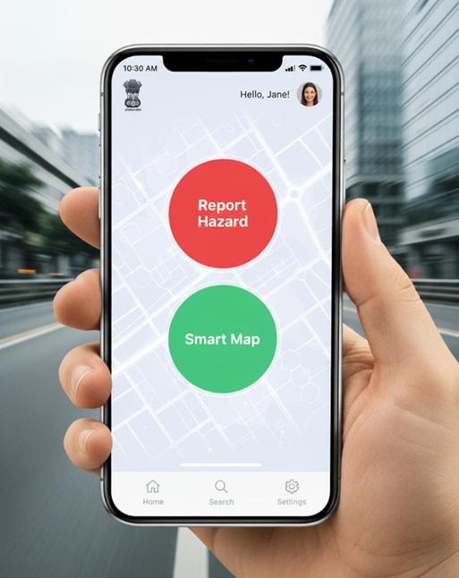
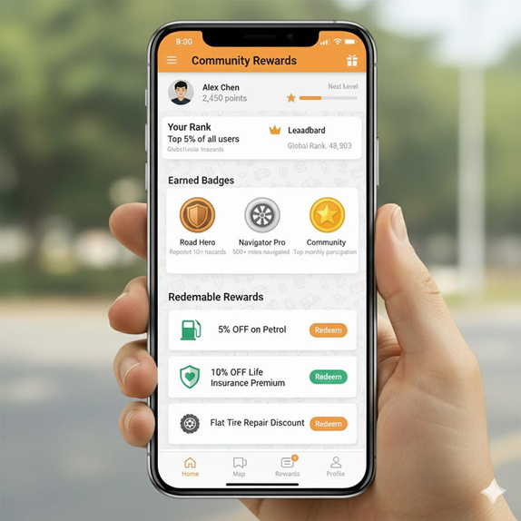
Impact & Relevance – Beneficiaries & Societal Impact
Who Benefits and How:
Citizens:
Sustainability Impact:
Safer, smoother commutes; rewards for active participation (points, coupons, vouchers on petrol,diesel,Insurance).
        Citizen engagement promotes shared responsibility.
        Reduced fuel waste and emissions via smart rerouting.
Community & Rewards Screen
Government:
        Active participation results in a cleaner, more sustainable environment.
App Home Screen
Streamlined maintenance prioritization, transparent dashboards, data-driven decisions.
        Addressing Road hazards and reporting will prevent major problem occurring in future.
Industry:
        Implementing this app paves the way for smarter, safer, and more sustainable transportation through faster hazard detection and resolution.
Insurance and logistics sectors gain from accurate hazard and route data.
Notes:
1.7.2013
1.7.2013
1.7.2013
6
‹#›
‹#›
‹#›

Slide 7
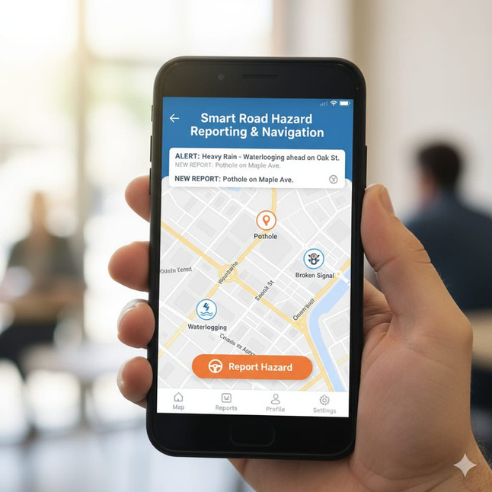




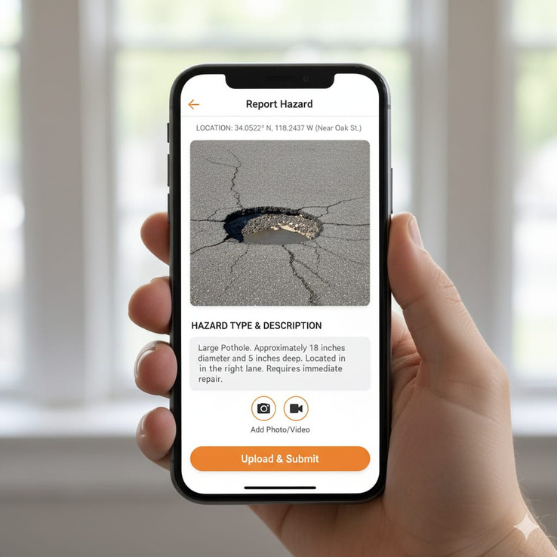

Technical Feasibility – Core Technology Stack
Frontend
Backend
Flutter / React Native (cross-platform app)
Firebase, Node.js, or Django with REST APIs
Hazard Reporting Screen
Database
Maps & Navigation
Cloud Firestore / MongoDB with GeoSpatial Indexing
Google Maps SDK / Mapbox
Real-Time Navigation with Alerts
Push Notifications
Firebase Cloud Messaging (FCM) / MQTT
AI Components:
        CNN-based image classification for photo verification
        Entropy-weighted hazard prioritization
        Predictive modeling for hotspot analysis
Notes:
1.7.2013
1.7.2013
1.7.2013
7
‹#›
‹#›
‹#›

Slide 8



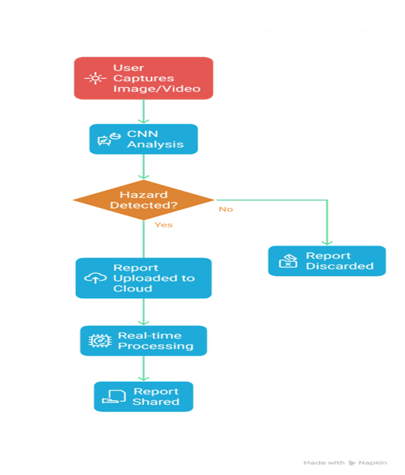
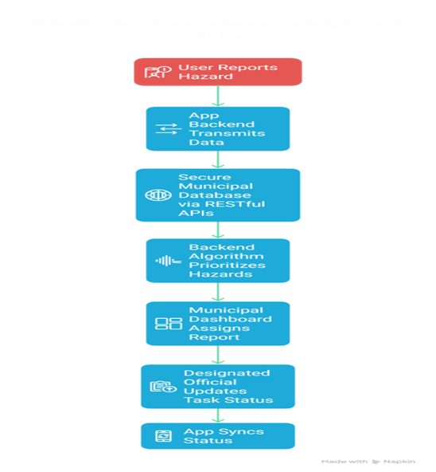
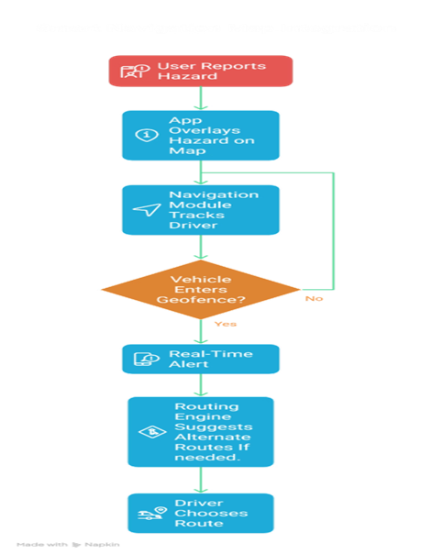
Technical Feasibility – Real-Time Implementation
System Operation:
GPS Updates
Geofencing
Real-Time Alerts
1–5 sec GPS Update Intervals for live tracking.
Geofencing Algorithms detect proximity (200–500 m radius).
Real-Time Hazard Alerts pushed through cloud notification services.
Secure API Integration:
Dashboard Tools:
Feasibility:
    Uses proven, scalable technologies already employed in apps like Waze, iRAD and Meri Sadak — making real-world deployment practical and most-effective.
        Live status: New → In Progress → Resolved.
        RESTful APIs with OAuth2/JWT for government data exchange.
        Webhooks for instant municipal updates.
        Automated reporting and analytics.
Notes:
1.7.2013
1.7.2013
1.7.2013
8
‹#›
‹#›
‹#›

Slide 9
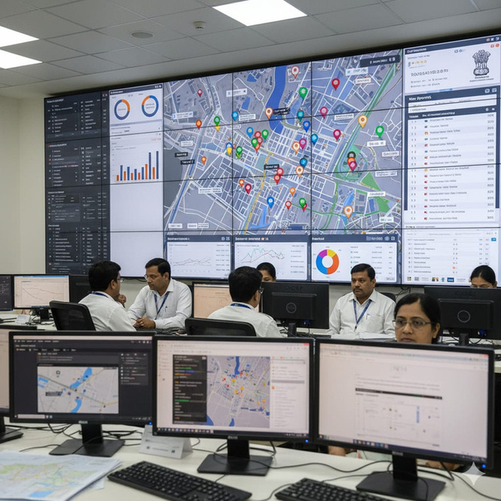
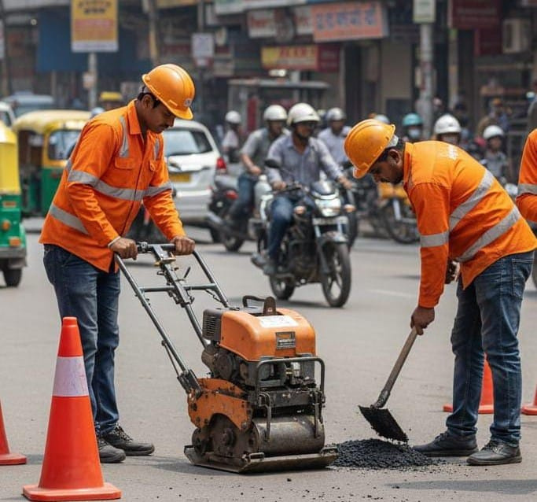
Technical Feasibility – AI Analytics & Security
AI Analytics:
Data Security & Privacy:
        Hotspot Identification: Detect recurring problem zones.
        End-to-end encryption of user data.
        Anonymized reporting options.
Live Monitoring & Verification by Govt IT team.
        Predictive Modeling: Forecast potential hazard sites using historical + weather data.
        Fraud prevention via GPS + photo validation + community scoring.
        Risk Scoring: Assign urgency for government action.
        Offline data storage & sync for low-connectivity zones.
This ensures a robust, secure, and intelligent infrastructure ready for urban and rural use alike.
Road Crew Repairing the Hazard
Notes:
1.7.2013
1.7.2013
1.7.2013
9
‹#›
‹#›
‹#›

Slide 10
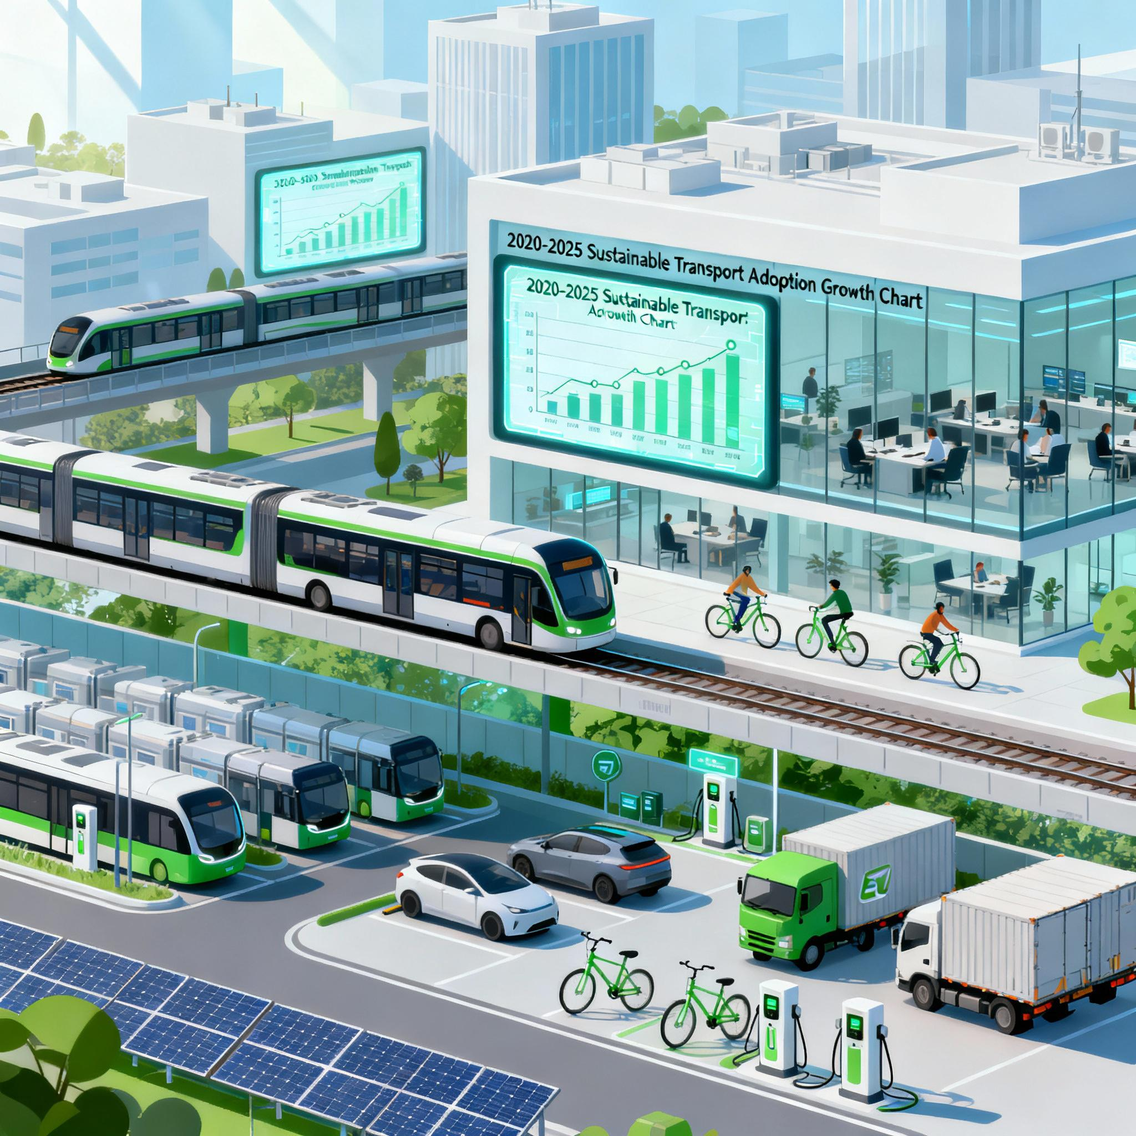


Business Scalability & Sustainability
Scalability
        Can scale city-wide to national levels using open APIs.
        Integration potential with Smart City Missions, iRAD, and NHAI systems.
        Cloud-based architecture allows effortless expansion.
Sustainability
        Public Engagement Loop: Rewards, badges, and leaderboards drive ongoing user activity.
        Government Partnership Model: Subscription-based API access for municipalities.
Long-Term Vision:
        Become India's unified Road Safety Intelligence Platform.
        Support international replication with localized data and policy integration.
        Promote zero-accident mobility through AI, analytics, and community collaboration.
Notes:
1.7.2013
1.7.2013
1.7.2013
10
‹#›
‹#›
‹#›

