Slide 1

Final Project presentation
Preventive to predictive maintenance.
Prepared by: Vijeet Gahlawat
Given to: Prof. Soumaya Yacout
Date – 23/04/2024.

Slide 2
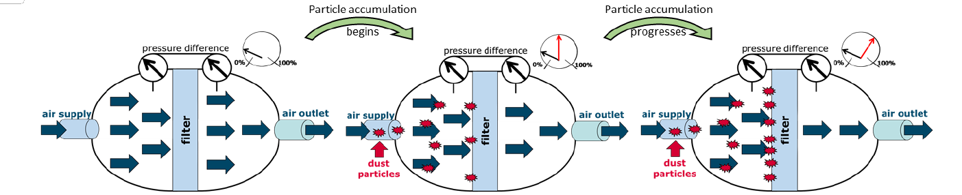
Intro
The dataset comes from a degradation process linked to a filter mat made from non-woven fiber material randomly oriented.
To assess the lifespan of the filters, standardized Arizona test dust is employed, containing particles of sizes A2, A3, and A4 for loading.

Slide 3
Objective
The objective of the 'Preventive to Predictive Maintenance' dataset is to facilitate the transition from a traditional preventive maintenance approach to a predictive maintenance strategy, specifically focusing on a replaceable component, such as a filter.
The primary goal is to develop predictive models capable of accurately forecasting the remaining useful life (RUL) of the filter based on the available data. By achieving this objective, the dataset aims to enable organizations to adopt proactive predictive maintenance practices, optimizing maintenance schedules and resource allocation while minimizing downtime and maximizing equipment lifespan.

Slide 4
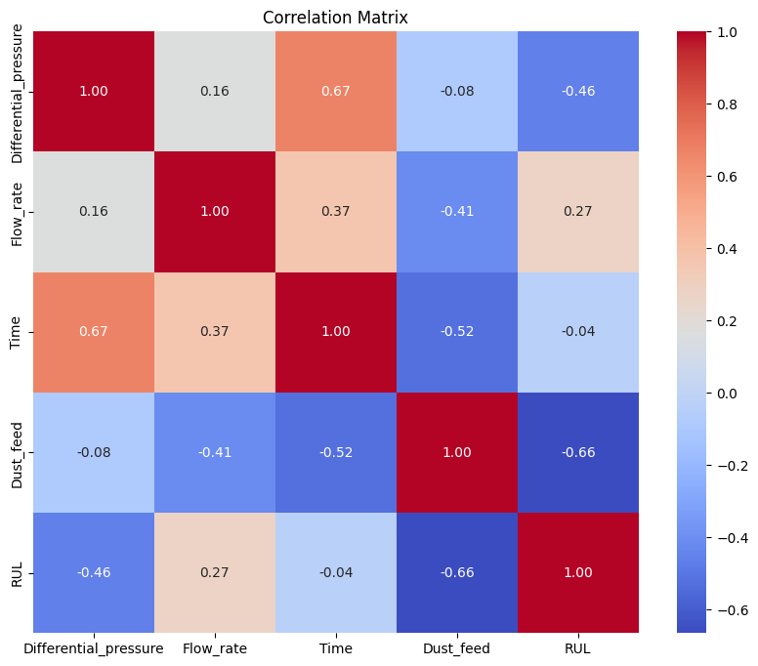
Data Overview
The data set contains a training data and a test data set.
The training data are recorded runs of the filter up to a periodic replacement.
The test data contains complete run-to-failure measurements of the filter with their corresponding Remaining Useful Life value for each instance.

Slide 5
Types of Variables
Independent Variables:
Flow_rate
Time
Dust_feed
Dependent Variables:
Differential_pressure
Controllable Variables:
Flow_rate
Dust_feed
Non-controllable Variables:
Time
Differential_pressure

Slide 6
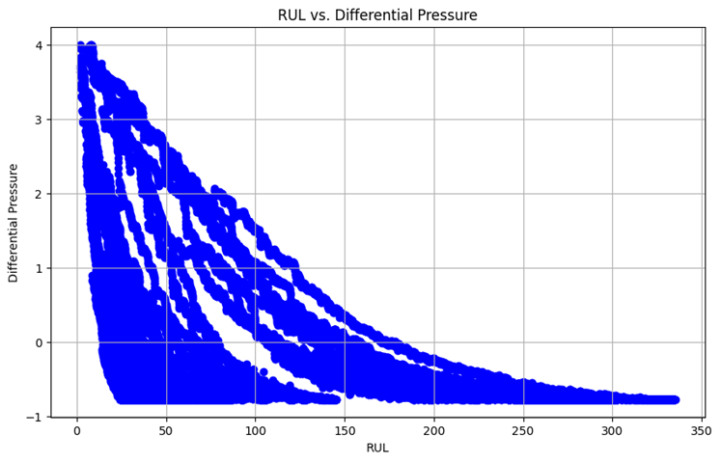
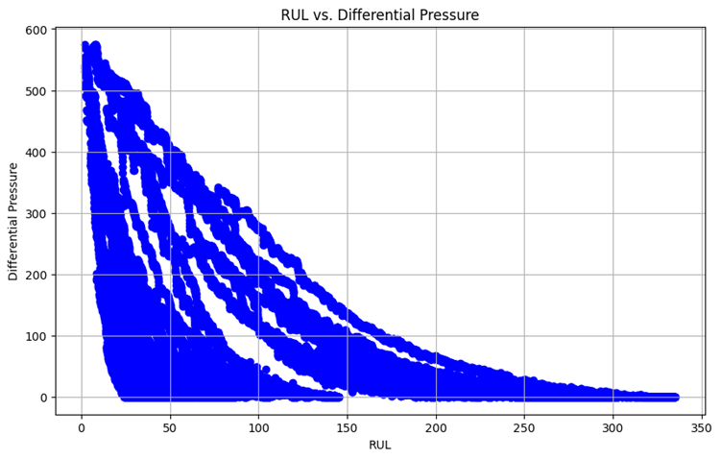
Data Preprocessing
Data features were standardized and scaled to maintain uniformity across the dataset, enhancing comparability and analysis accuracy.

Slide 7

Methodology
Data Exploration
Data preprocessing - Feature standardization
Model training – 8 models trained on Test bench Dataset (with corresponding RUL values).
Model validation – Best model selection based on the lowest Mean Square Error.
Model Testing –Model Testing on Second dataset i.e. recorded runs of the filter

Slide 8
Results on Test bench dataset
8 regression models were trained using the test bench dataset, each learning to predict RUL. Their performance was assessed using the Mean Squared Error (MSE) metric on a separate test set. Lower MSE values indicate better predictive accuracy.
Model Name | Training MSE | Test MSE
Linear regression | 1506 | 1515
Ridge regression | 500 | 491
Random Forest Regression | 0.13 | 0.80
Nueral Network | 956 | 934
XGBoost | 32 | 57
Decision Tree Regression | 0.32 | 87
Support Vector Machine Regression | 355 | 339
PLS Regression | 500 | 491

Slide 9
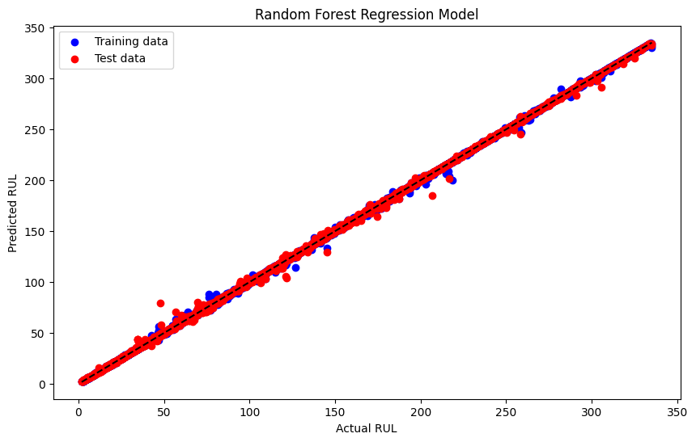
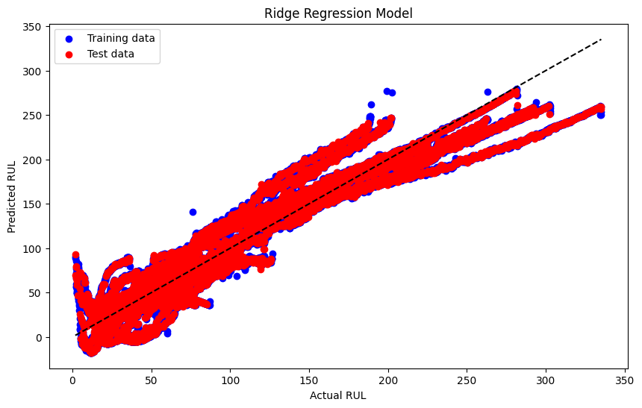
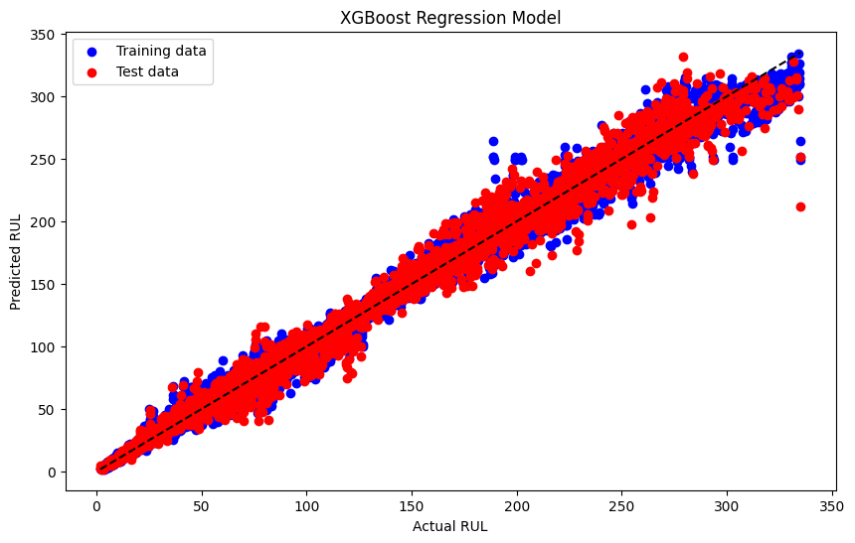
Analysis of modelling results
XGBoost was selected as the optimal model due to its ability to minimize Mean Squared Error (MSE) while avoiding overfitting, making it well-suited for addressing our specific problem.

Slide 10
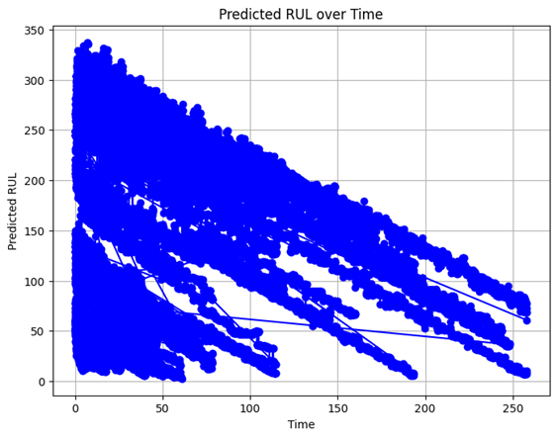
Model Testing on recorded runs of the filter
Leveraged XGBoost model's superior performance on the Filter Test bed dataset with corresponding Remaining Useful Life (RUL) values to predict RUL for a second dataset lacking RUL values.
XGBoost's learned patterns and feature relationships from the Filter Test bed dataset were applied to generate predicted RUL values for instances in the second dataset.
The predicted RUL values serve as estimations of the remaining useful life for corresponding instances in the second dataset, facilitating maintenance decisions.

Slide 11
Advantages of Predictive Maintenance for Fiber Filter Mats
Cost Efficiency: Predictive maintenance on filter mats reduces repair costs and downtime by addressing issues early, optimizing maintenance spending.
Increased Equipment Reliability and Availability:: Real-time monitoring ensures consistent filtration system performance, preventing air quality issues and prolonging filter lifespan.
Enhanced Safety and Risk Mitigation: Early detection of filter degradation minimizes safety risks, maintaining a safe work environment and compliance with regulations.

