Slide 1
Advanced Retail Analytics Final Presentation
Synthetic dataset, forecasting, dashboard, and business insights

Slide 2
Project Overview
Dataset records: 13,152
Date range: 2023-01-01 to 2025-12-31
Regions: North, South, East, West
Categories: Electronics, Furniture, Office Supplies
Goal: Analyze performance and forecast future revenue

Slide 3
Key Performance Indicators
Total Revenue: $797,059,455.76
Total Profit: $266,785,307.32
Total Units Sold: 2,787,167
Average Customer Satisfaction: 4.20/5
Profit Margin: 33.47%

Slide 4
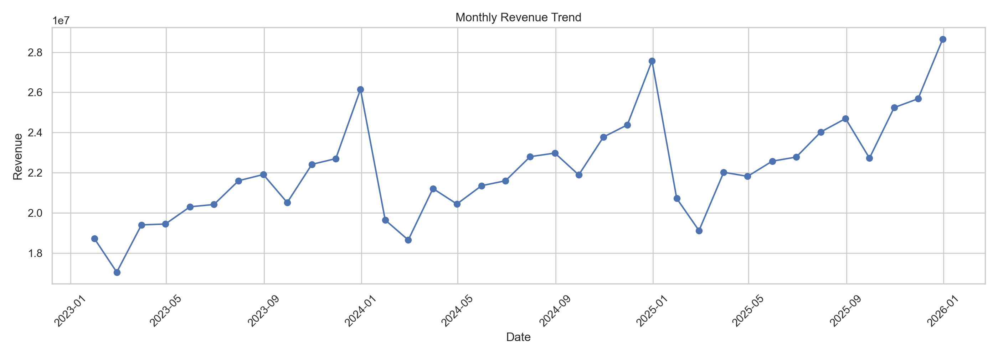
Monthly Revenue Trend

Slide 5
Business Insights
Top category by revenue: Electronics
Top region by profit: West
Peak revenue month: December 2025
Revenue growth is strongest during Q4
Marketing and demand are key drivers of performance

Slide 6
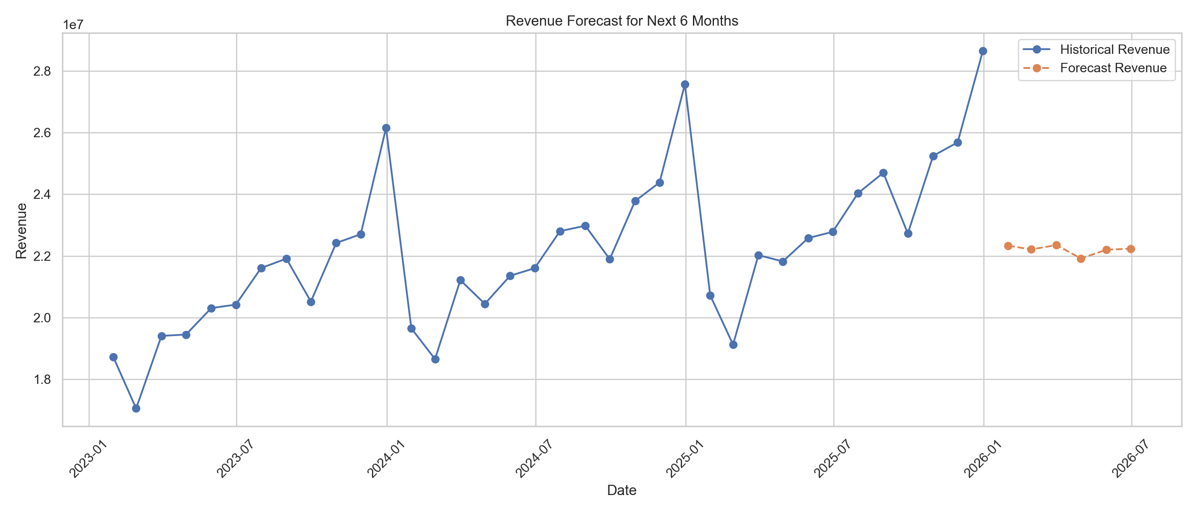
Revenue Forecast

Slide 7
Predictive Model Performance
Model: Random Forest Regressor
MAE: 1,140,163.64
RMSE: 1,241,904.97
R² Score: 0.5648
Most important features include lag revenue, rolling average, and marketing spend

Slide 8
Recommendations
1. Increase focus on high-performing categories
2. Expand profitable regional strategies
3. Use forecasting for monthly budgeting
4. Optimize discount levels to protect margin
5. Use dashboard for management review

