Slide 1


AUTOMATIC FAN CONTROLLER
PRESENTED BY:
NISHANTH SANJAY.N
VIJESH.T
GUIDED BY :
Ms.G.S.SIVAPRIYA
Dr.M.GANESH MADHAN
ANNA UNIVERSITY
MIT CAMPUS
CHENNAI

Slide 2
OBJECTIVE
The objective is to design and implement an automatic fan controller that regulates the speed of a DC fan based on the ambient temperature without using Arduino.

Slide 3
INTRODUCTION
The Automatic Fan controller adjusts fan based on temperature using a TMP 36 sensor, Op-Amp Comparator, and Inverter,eliminating the need for microcontroller like (PIC,AVR,STM32).
Compared to IoT-based and microcontroller-driven solutions,the design is affordable,easy to implement while still achieving automatic-based fan control

Slide 4
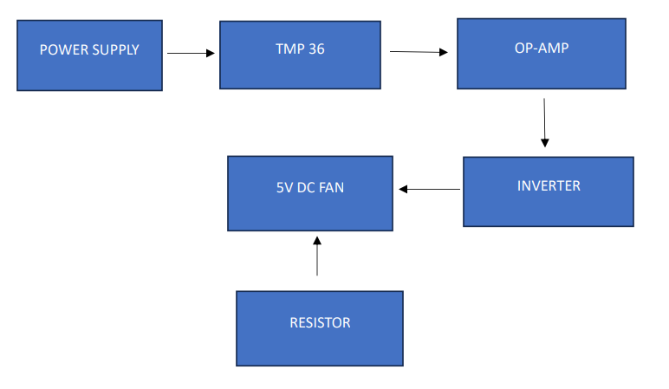
BLOCK DIAGRAM

Slide 5
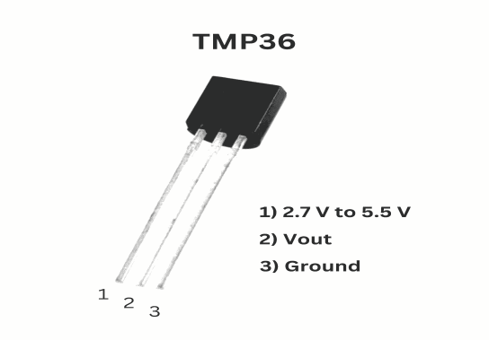
Temperature sensor(TMP36)
Description: An analog temperature sensor that outputs a voltage proportional to the temperature in Celsius.
Function: Measures ambient temperature and sends an analog signal to the op-amp for processing.

Slide 6
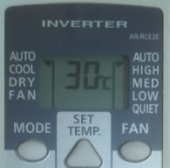
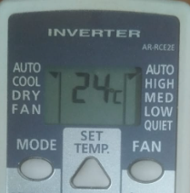


Temperature sensor(TMP36)
Operating Voltage of TMP36: 2.7V to 5.5V
Temperature Range: -40°C to +125°C

Slide 7
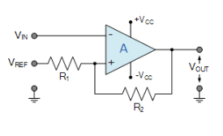
Operational amplifier(IC741) COMPARATOR
Description: A versatile op-amp used for signal amplification and processing.
Function: Compares the output voltage from the TMP36 with a reference voltage (1.5V) to determine the required fan speed.
Supply Voltage: 5V

Slide 8
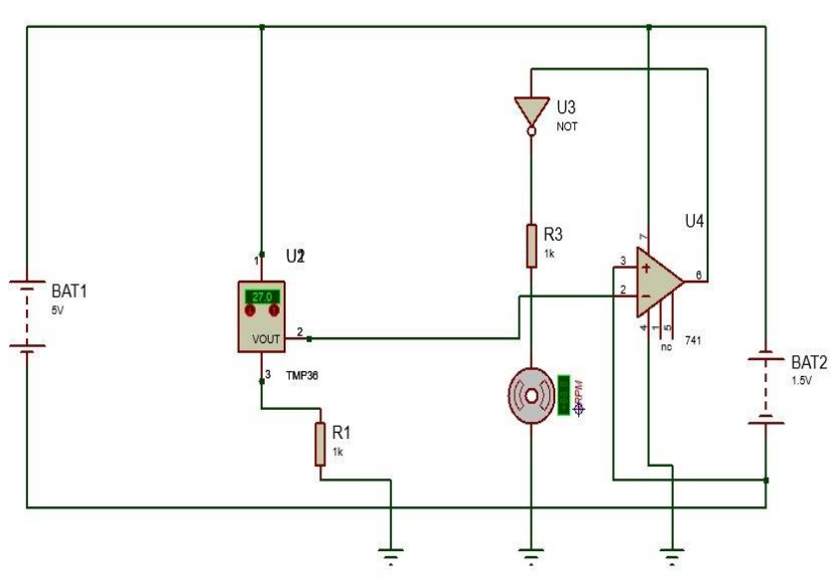
CIRCUIT DIAGRAM

Slide 9
WORKING-OVERVIEW
The automatic fan controller operates by constantly monitoring the ambient temperature through the TMP36 sensor.
The temperature data is processed using an operational amplifier (IC 741), which compares the sensor output with a predefined reference voltage.
Based on this comparison, the op-amp's output controls the DC fan speed via an inverter (IC 7404).

Slide 10
DESIRED OUTPUT
The desired output is an automatic fan control system that maintains comfortable ambient temperatures while optimizing energy usage.
The fan will respond to temperature changes, providing efficient cooling without requiring user input.

Slide 11
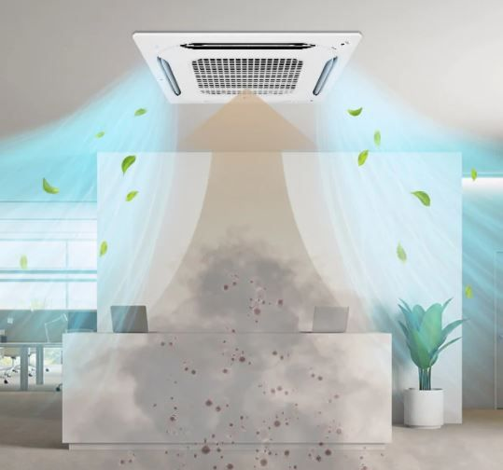
APPLICATIONS
HOME AUTOMATION
INDUSTRIAL COOLING SYSTEM
COMPUTERS AND ELECTRONICS
AUTOMOBILES
MEDICAL EQUIPMENTS

Slide 12
ADVANTAGES
COST SAVINGS
NOISE REDUCTION
CONSISTENT TEMPERATURE CONTROL
ECO-FRIENDLY
TIME-BASED OPERATIONS

Slide 13
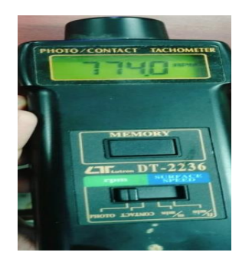
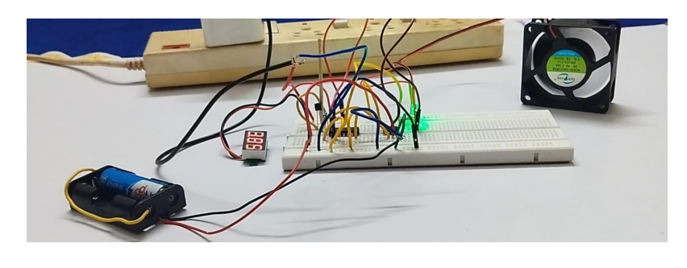
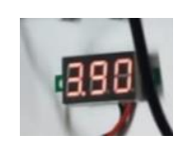
RESULT
At room temperature 24°C:

Slide 14

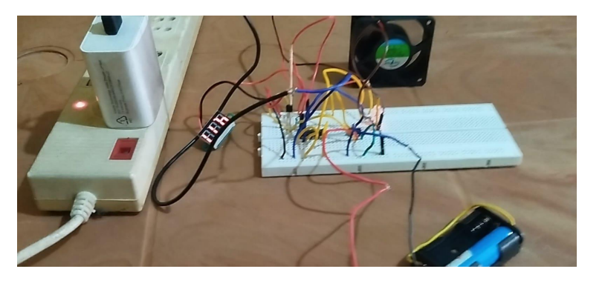
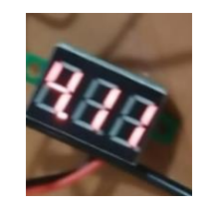
RESULT
At room temperature 30°C:

Slide 15
RESULT
To estimate fan speed(in rpm):
Rated voltage = 5 V and Rated speed = 1000 rpm
Fan speed at given supply voltage
= (Rated speed/Rated voltage)*Supply voltage
SUPPLY VOLTAGE | FAN SPEED
3.9 V | (1000/5)*3.9 = 200*3.9 = 780 rpm
4.11V | (1000/5)*4.11 = 200*4.11 = 822 rpm

Slide 16
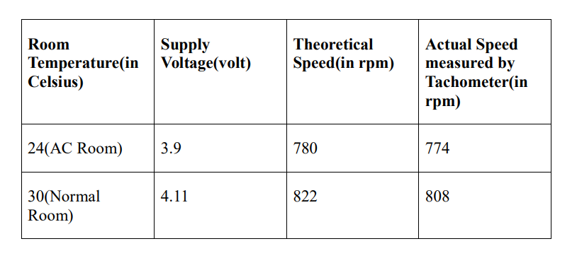
RESULT

Slide 17
CONCLUSION
The automatic fan controller combines various electronic components to create a system that intelligently regulates fan operation based on temperature readings.
Through careful design and integration of sensors, op-amps, and inverters, it showcases the principles of automation and energy efficiency, delivering both practical benefits and educational insights into electronic systems.

Slide 18
REFERENCES
[1]. JO CHRISTOPHER M. RESQUITES1, MATTHEW ALEXIE PARROCHO 2, NOEL VINEGAS3, DR. VINYL H. OQUIÑO,” IoT-Based Temperature Monitoring and Automatic Fan Control Using ESP32”, NOV 2023 | IRE Journals | Volume 7 Issue 5.
[2]. Mr. V.Nagababu, M.Naga Yaswanth Pavan Kumar, Ch.Sai Pravallika,N.Angel Sundari,” Temperature Based Fan Speed Controller Using IOT”.
[3] Shivshankar Adsule, Shivani Mohite, Rahul Patil, Prof. Namrata R. Dhawas,” Automatic Temperature Based Fan Speed Controller Using Arduino” International Journal of Advanced Research in Science & Technology (IJARST) Volume 2, Issue 4, June 2020.
[4]M. Sathishkumar, S. Rajini, Smart Surveillance System Using PIR Sensor Network and GSM, Journal of Advanced Research in Computer Engineering & Technol 2015.
[5]. J. Breckling, Ed., The Analysis of Directional Time Series: Applications to Wind Speed and Direction, ser. Lecture Notes in Statistics. Berlin, Germany: Springer, 1989, vol. 61.
[6]. K.A Akpado, C.O Ezeagwu, A. Ejiofor, A.O N wokeke.Vol. 2, Issue 7, July 2013, Modeling and Simulation of a Microcontroller Based Temperature Control in a Ventilation System.
[7]. Investigation of Single-Phase SPWM Inverter; A Thesis Sub requirements for the level of Bachelor in Electrical Engineering By Bijoyprakash Majhi Under the supervision of Prof. Somnath Maity.

Slide 19
ANY QUERIES?

Slide 20
THANK YOU

