Slide 1
Ticketing System
Jobin Mathew
Nabeel Thalakkatt

Slide 2
Ticketing System
Ticketing system is an application for tracking issues in an organisation.
Registered users can raise tickets on any issue and assigned staff can view and edit the ticket.

Slide 3
Technologies Used
Python 2.7
Django 1.10
MySql
Apache
Mod WSGI

Slide 4
Django
The web framework for perfectionists with deadlines.
Django is a free and open-source web framework, written in Python.
Django's primary goal is to ease the creation of complex, database-driven websites. Django emphasizes reusability and "pluggability" of components, rapid development, and the principle of don't repeat yourself.
Django also provides an optional administrative create, read, update and delete interface that is configured via admin models.
Some well-known sites that use Django include the Pinterest, Instagram, Mozilla, The Washington Times, Bitbucket etc.

Slide 5
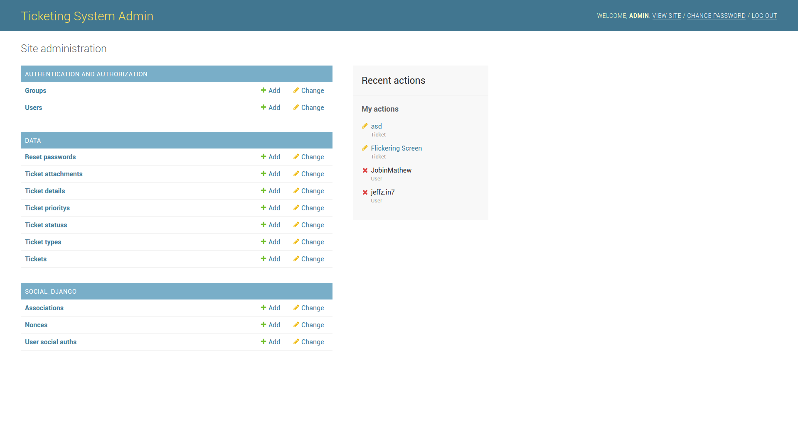
Admin Panel
Master tables are maintained using Django Admin Panel

Slide 7
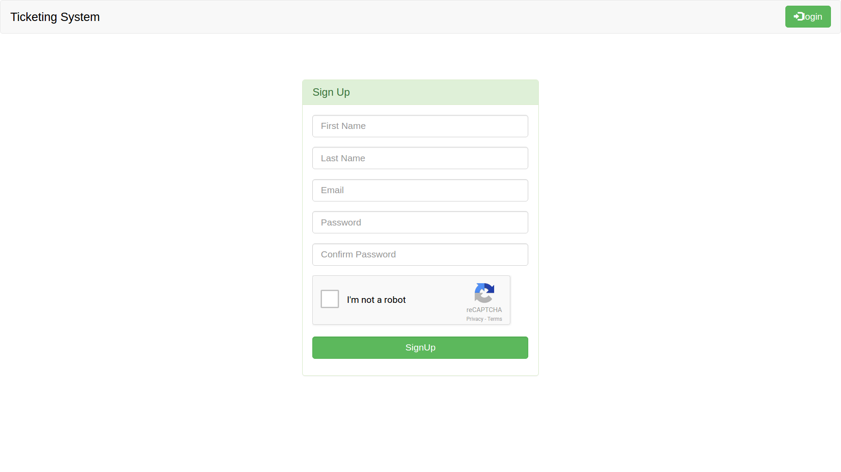
Sign Up
New users can register using their email.
Google Captcha is used for additional security.

Slide 9
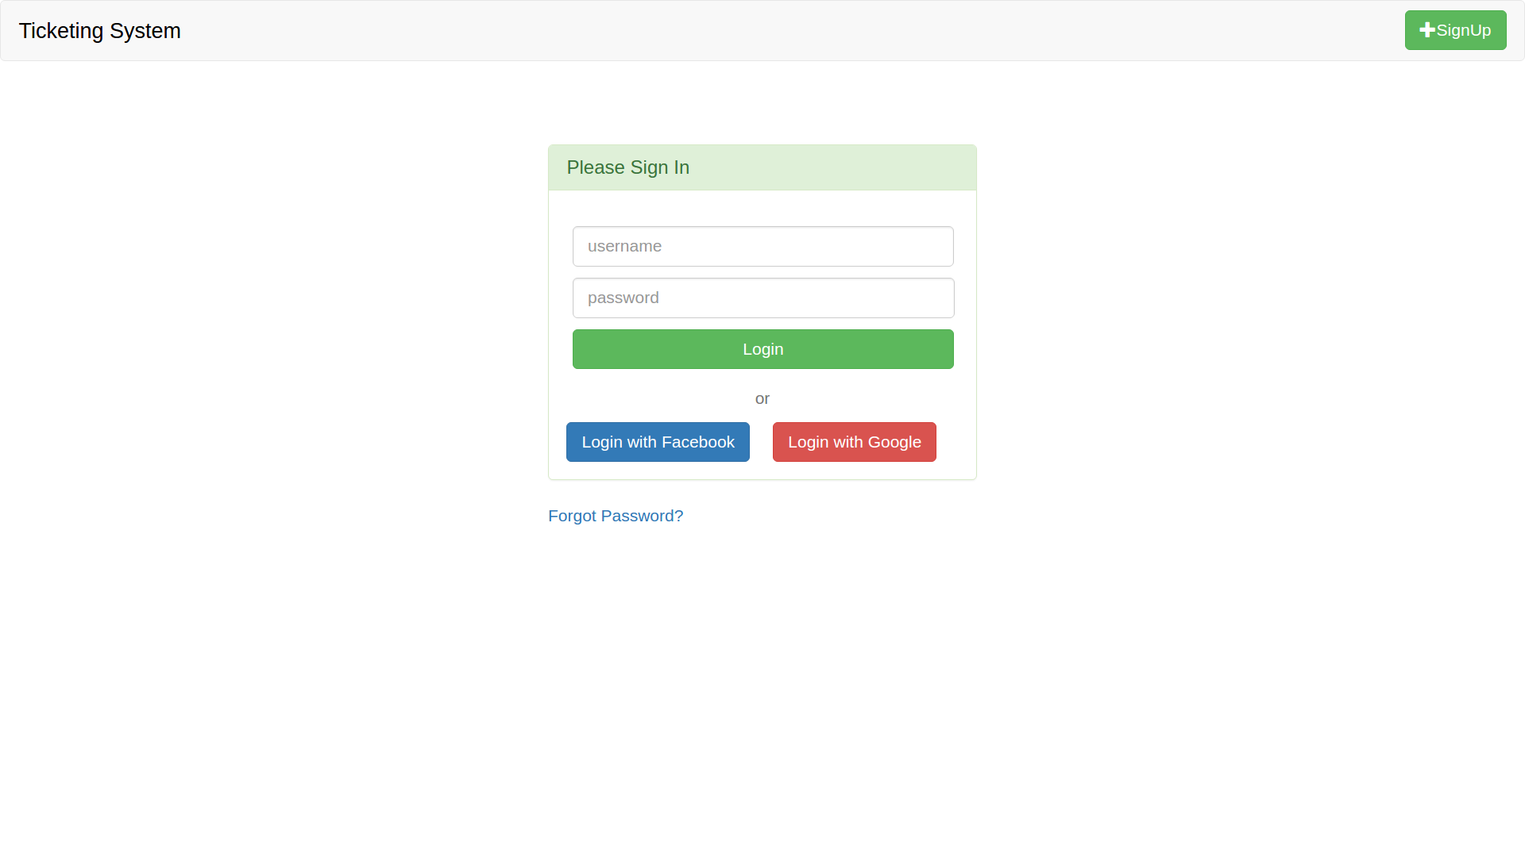
Login
Registered users can login.
Users can login using Facebook,Google accounts.

Slide 11
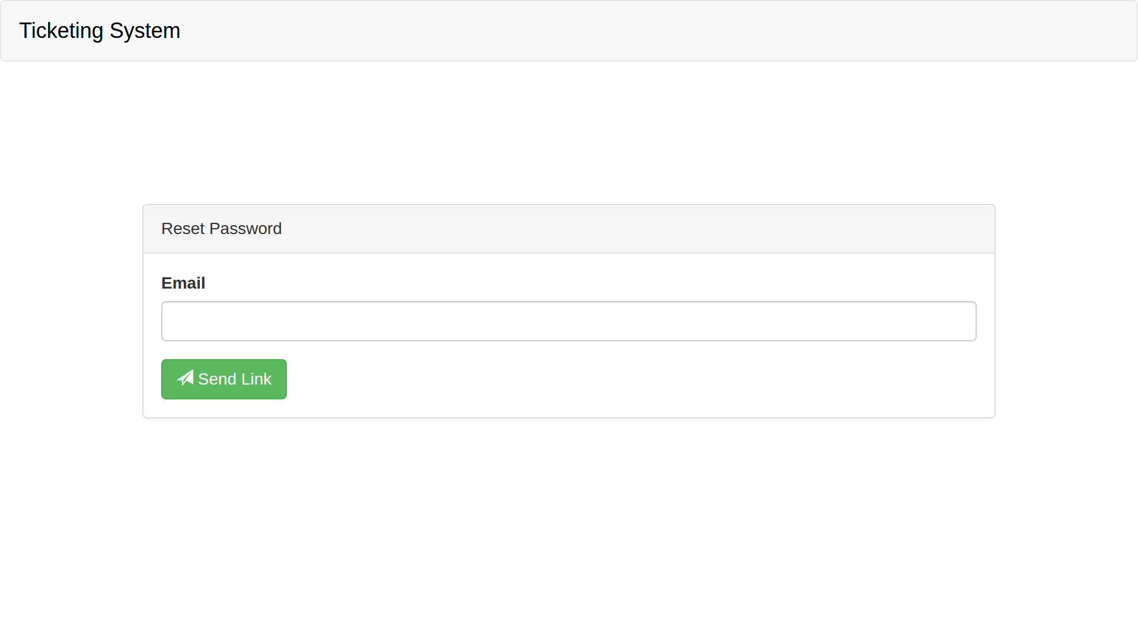
Forgot Password
Password can be reset using registered email.
A link is sent to this email which redirects to the reset password page.

Slide 13
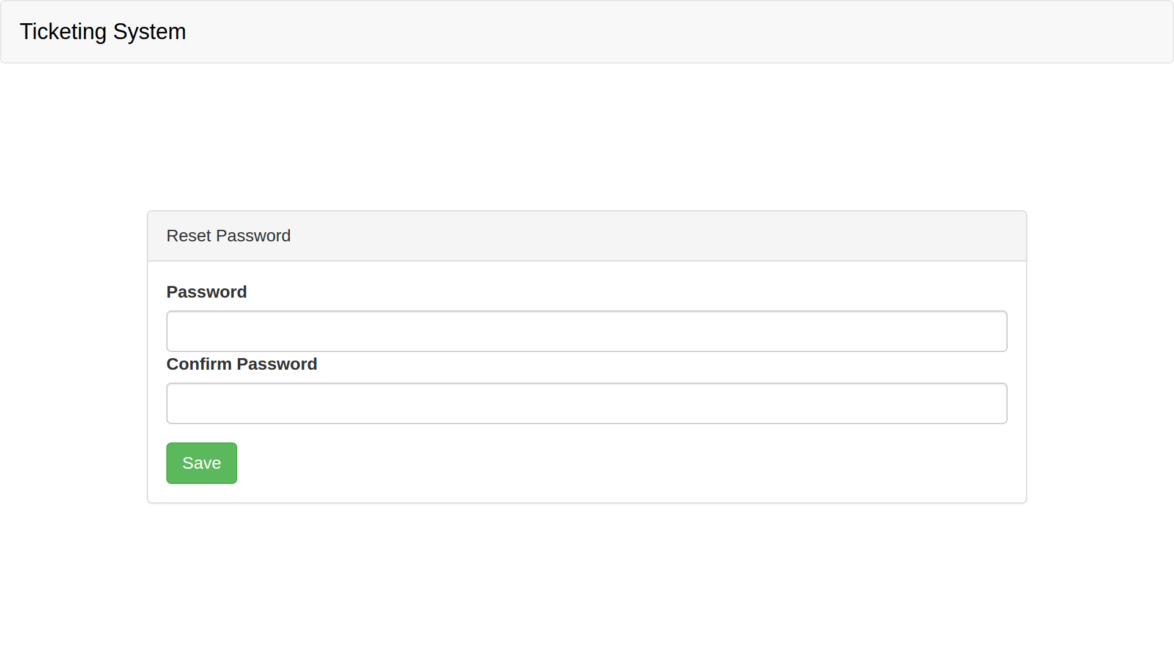

Slide 14
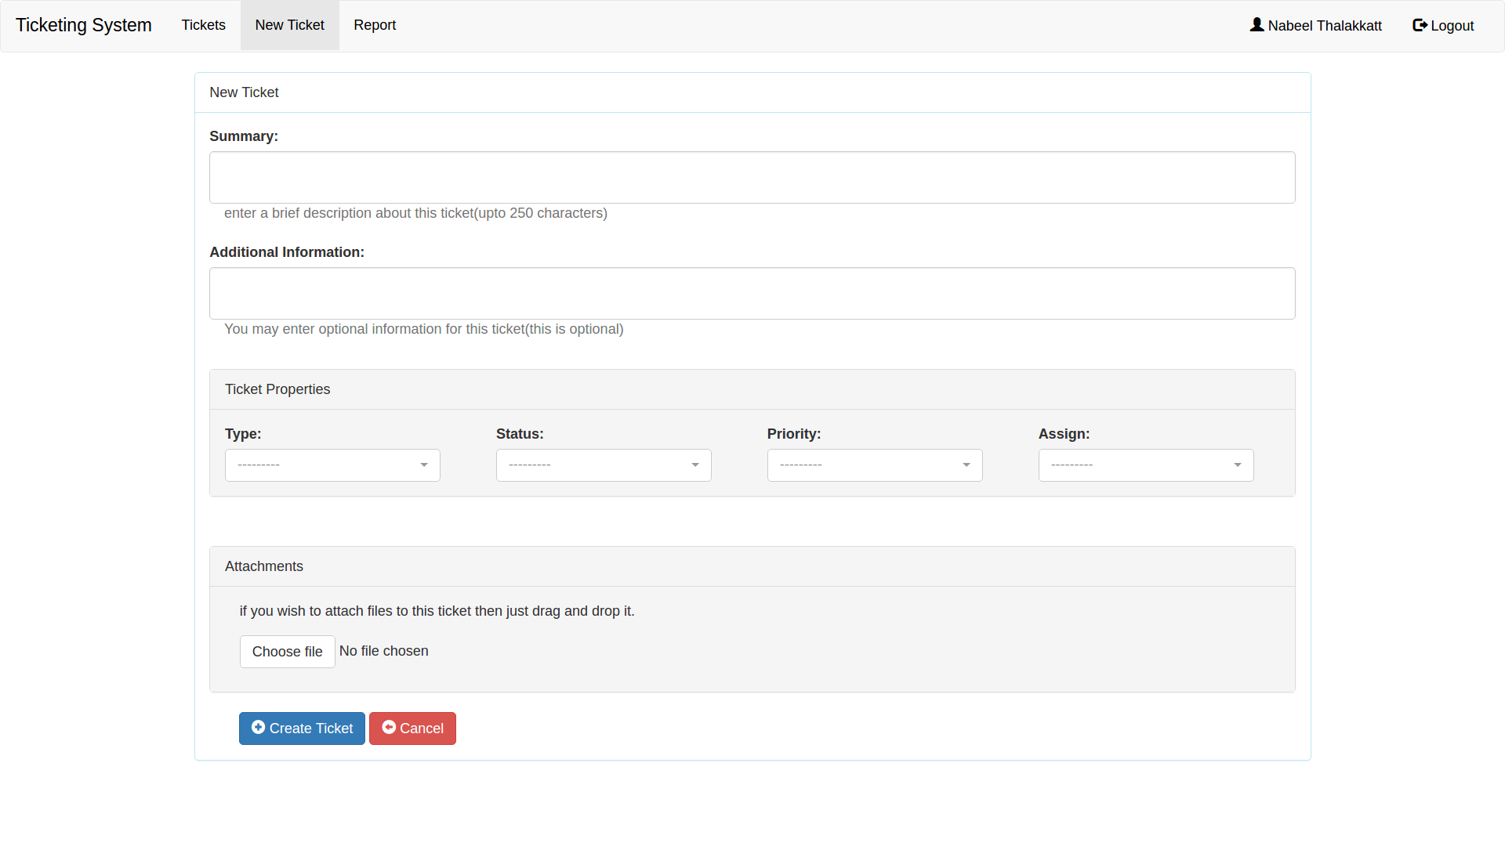
Create Ticket
Logged in users can create new ticket and attach screenshots/images regarding the same.

Slide 16
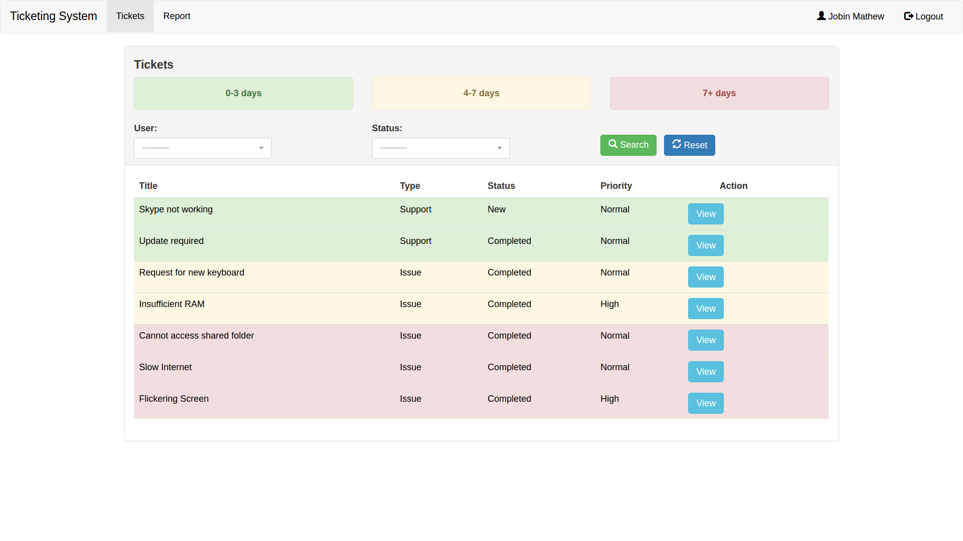
Tickets
Tickets are listed on a page and users can edit or delete their existing tickets.
Admin can view and edit tickets by any user.

Slide 18
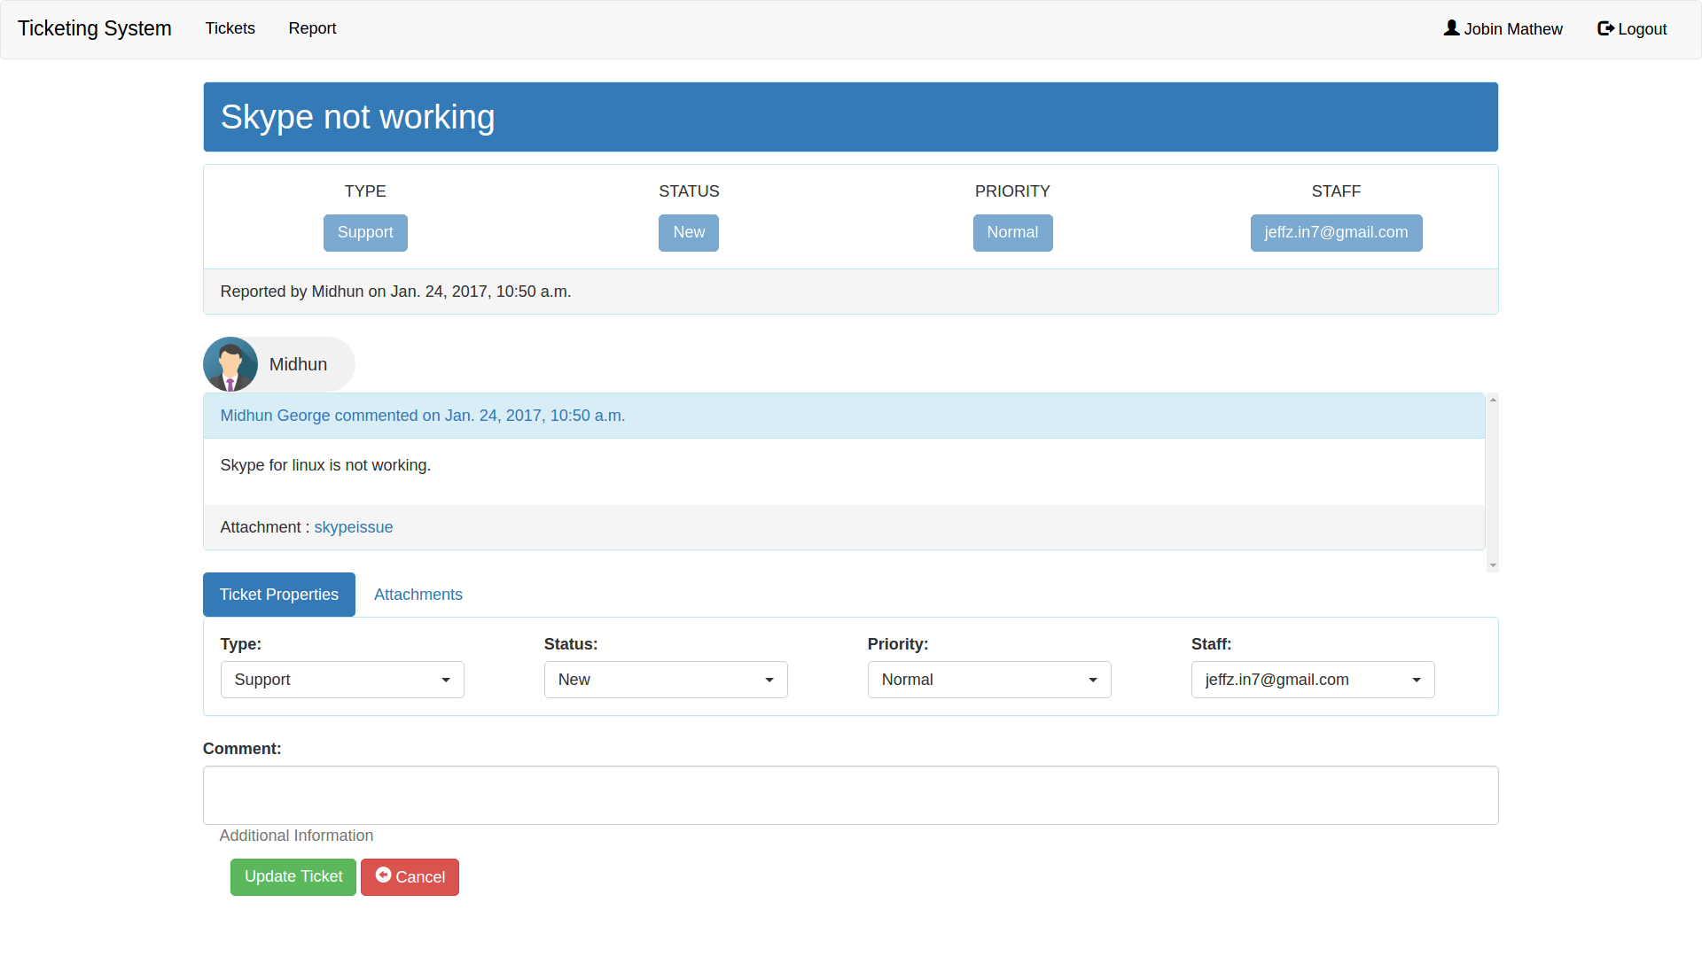
View and Update Ticket
Users can view their tickets, and update it with new screenshots and descriptions.
Staff can view and update all tickets.

Slide 20
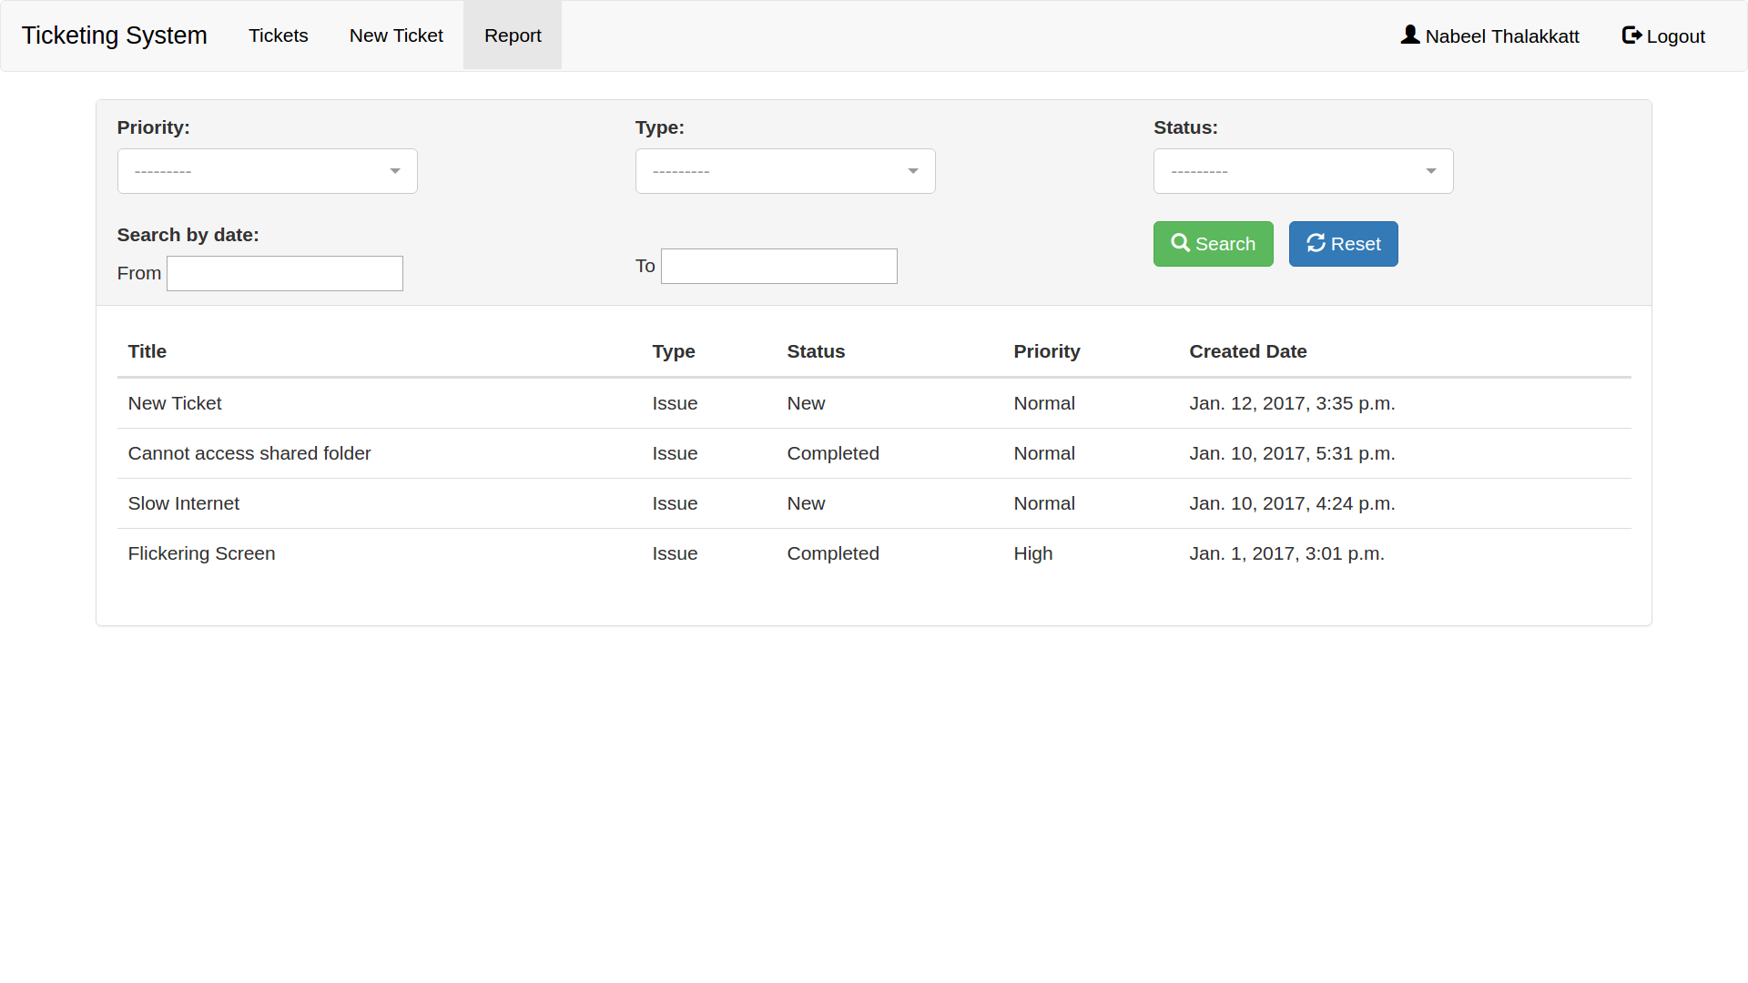
Ticket Report
Ticket report lists all the tickets.
Users can search for tickets based on their status, type, priority and date.

Slide 22
Demonstration

