Slide 1

Senior Design Project
School of Computer Science and Engineering (AI)
Title: EdgeGuard: Uncertainty-Aware Edge AI for Reliable Decision Making
Team Details
Sl.No | Roll No. | Name | USN
1. | 234 | Vijeta Hegde | 01FE23BCI082
2. | 215 | Rakshita R Talegaon | 01FE23BCI041
3. | 237 | Tejaswini M V | 01FE23BCI044
4. | 241 | Manjula Nayak | 01FE23BCI097
Guide :Maheshawari Kittur

Slide 2
Introduction :
AI models are increasingly deployed in real-world systems like self-driving cars, robots, and industrial cameras to make real-time decisions.
These models are trained on a fixed set of conditions/objects, but real-world environments are unpredictable poor lighting, fog, occlusion, unknown objects.
Most AI models still give confident predictions even when facing unfamiliar or degraded inputs — they don't know what they don't know.
This overconfidence can lead to dangerous failures in safety-critical applications where wrong predictions have real consequences.
EdgeGuard proposes an AI system that can detect its own unreliable predictions in real time, directly on edge devices without depending on the cloud.
06-09-2026
2

Slide 3
Motivation :
A wrong prediction made confidently is more dangerous than a system that says “I'm not sure” silent failures are the real risk.
Existing AI failure-detection methods (Deep Ensembles, Monte Carlo Dropout) require multiple model runs too slow for real-time, resource-limited edge devices.
Edge devices (cameras, in-vehicle systems, robots) have strict compute, memory, and power constraints solutions must be lightweight and fast (single forward pass).
Cloud-based reliability checks introduce latency and require constant connectivity not viable for safety-critical, real-time decisions.
There is a clear real-world need (autonomous driving, industrial inspection, robotics) for AI that is not just accurate, but self-aware of its own limitations motivating EdgeGuard's core objective.
06-09-2026
3

Slide 4
Problem Statement :
AI models deployed on edge devices such as cameras, robots, and industrial sensors often perform well during testing but fail silently in real-world conditions poor lighting, unseen objects, sensor degradation producing incorrect predictions with high confidence and no indication of unreliability. Existing systems monitor accuracy only during development, not after deployment, so such failures go undetected until they cause real consequences. This project develops an Edge AI system that continuously monitors the reliability of its own predictions in real time, flagging likely failures before an incorrect decision is acted upon.
06-09-2026
4

Slide 5
Objectives :
Design an AI perception model capable of making predictions while simultaneously estimating the reliability/confidence of each prediction.
Develop a lightweight uncertainty-estimation module that works in a single forward pass, suitable for edge-device deployment.
Build an evaluation framework using clean, degraded (corrupted), and out-of-distribution (OOD) test images to validate the system's reliability detection.
Optimize the combined model (base + uncertainty module) for low latency and low resource usage on edge hardware.
Benchmark the system's accuracy vs. reliability trade-off, ensuring it correctly flags unreliable predictions without hurting normal-case performance.
06-09-2026
5

Slide 6
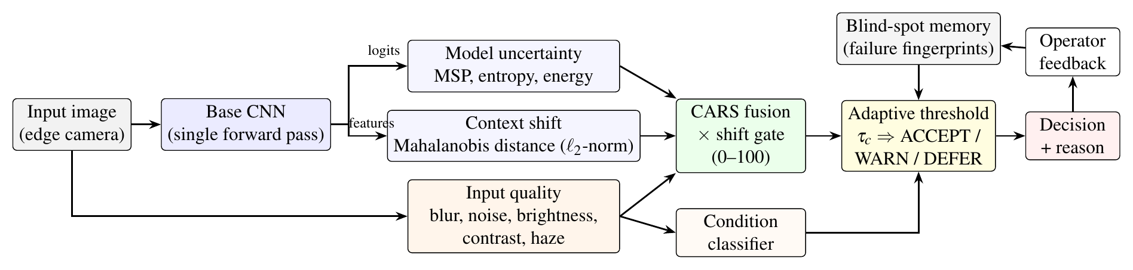
Proposed Method : System Architecture
One forward pass: the base CNN runs once; logits and penultimate features are reused, image statistics come straight from the pixels.
Three decoupled signal groups (model uncertainty, context shift, input quality) are fused into one 0-100 reliability score (CARS).
Graded decision: ACCEPT / WARN / DEFER with a stated reason; the base prediction itself is never changed.
06-09-2026
6

Slide 7
Proposed Method : Novel Contributions
Proposed Novel Contributions
1. Context-Aware Reliability Score (CARS)
Combines three factors to generate a dynamic 0–100 reliability score:
  Model Uncertainty – Is the AI unsure about its prediction?
  Input Quality – Blur, low illumination, rain, noise, etc.
  Context Shift – Is the input different from the training data?
The reliability score determines whether the system should: Accept → Warn → Defer the prediction.
2. Self-Learning Blind Spot Memory
When EdgeGuard encounters a new failure case, it stores only a compact feature representation, not the original image.
Future inputs are compared with these stored representations to detect similar failure cases faster.
Impact: Enables continual improvement while supporting privacy-preserving operation.
06-09-2026
7

Slide 8
Proposed Method : Novel Contributions (continued)
3. Adaptive Confidence Threshold
Uses a dynamic confidence threshold instead of a fixed threshold such as 90%.
The threshold adapts according to the environmental conditions.
Example:
Daylight → 85%
️ Fog → 95%
Heavy Blur → 98%
This helps reduce false acceptances and unreliable predictions under difficult conditions.
4. Explainable Failure Reason
Instead of simply reporting “High Risk”, EdgeGuard identifies the likely reason for the unreliable prediction.
Possible reasons include:
  Low Illumination
  Motion Blur
  Unknown Object / Out-of-Distribution Input
  Sensor Noise
This makes the system more interpretable and actionable for industrial operators.
06-09-2026
8

Slide 9
Proposed Method : Single-Pass Reliability Signals
Signal group | Signals | Computed from | Detects | Cost
Model uncertainty | Max softmax (MSP), entropy, energy score | Logits | Ambiguous inputs, low confidence | ~0.01 ms
Context shift | Mahalanobis distance on L2-normalised features, feature norm | Penultimate features (same pass) | Unknown objects (OOD), large shifts | ~0.01 ms
Input quality | Laplacian blur, Immerkaer noise, brightness, contrast, dark-channel haze | Raw pixels (no network) | Blur, sensor noise, low light, fog | 0.026 ms
Key fix: on raw features, dark images collapsed towards the origin and Mahalanobis OOD AUROC was only 0.49-0.67; L2-normalising the features raised it to 0.94-0.97.
Total: 10 scalar signals per image, all from the single forward pass, with no retraining of the base model.
06-09-2026
9

Slide 10
Implementation Phase : Work Completed
Phase (Review 1 plan) | Planned deliverable | Status | What was delivered
Literature review & problem formulation | Survey, problem definition | Done | 16-paper survey, problem statement (Review 1)
Baseline setup | Baseline with clean / corrupted results | Done | CNN on CIFAR-10, 8 corruption types x 5 severities
Signal implementation | Model-uncertainty + sensor-quality modules | Done | 10 single-pass signals (logits, features, image stats)
Fusion & decision layer | Risk score + decision policy | Done | CARS score, adaptive thresholds, reasons, memory
Evaluation & edge benchmarking | Accuracy-efficiency evaluation | Done (CPU) | 94k-image evaluation, latency on 1 CPU thread
Generalization & final reporting | Final system, report | In progress | IEEE paper drafted; ResNet-18 + edge board pending
Live demo app built: Gradio interface with pre-verified scenes (blur, night, fog, unknown objects, blind-spot memory).
06-09-2026
10

Slide 11
Implementation Phase : Setup
Component | Setting
Base network (EdgeNet) | 6 conv layers (32-32-64-64-128-128), BN, ReLU, GAP, dropout 0.3; 288,746 params (1.15 MB)
Training | CIFAR-10, 45k train / 5k calibration; SGD Nesterov 0.9, wd 5e-4, batch 128, one-cycle LR 0.05, 20 epochs
Clean accuracy | 84.8% on the 10k CIFAR-10 test set (ResNet-18 run supported by the same code)
Calibration set | 5k images x (clean + Gaussian noise, defocus blur, low light, fog), severity 1-5 -> 25,000 samples
Software | Python, PyTorch, OpenCV, scikit-learn, ONNX Runtime, Gradio (demo)
Deployment | Fusion folded into NumPy weights; network exported to ONNX (1.16 MB)
Hardware | 2 CPU cores, 8 GB RAM, no GPU; latency = median of 192 single-image runs on 1 thread
06-09-2026
11

Slide 12
Implementation Phase : Contributions Implemented
Proposed in Review 1 | How it was implemented | Evidence
1. Context-Aware Reliability Score (CARS) | Logistic fusion of 10 signals x context-shift gate, 0-100 | Failure AUROC 0.842; OOD AUROC 0.960; ECE 12.5% -> 4.2%
2. Self-learning blind-spot memory | 512 float16 feature fingerprints of confirmed failures (132 KB), same-class cosine match | Silent misses cut by 12-17% on unseen shifts
3. Adaptive confidence threshold | Per-condition threshold from a Clopper-Pearson bound (3% risk target) | Noise error 5.2% -> 3.1%, fog 4.9% -> 3.7%
4. Explainable failure reason | Condition classifier on image statistics + OOD rule | Correct reason in 86.1% of flagged cases
06-09-2026
12

Slide 13
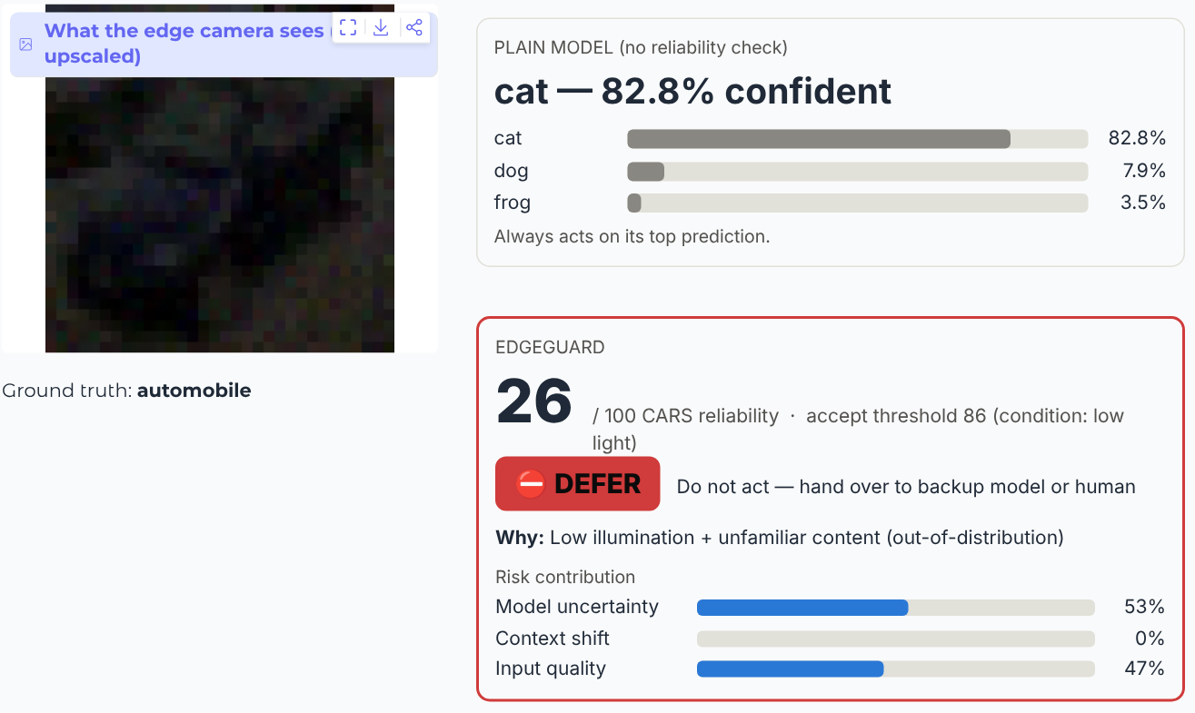
Implementation Phase : Live Demonstration
A Clean: airplane 99%, ACCEPT (CARS 93).
B Night: plain model says cat 83% for a car; DEFER, low illumination.
C Motion blur: deer 91% for an airplane; DEFER, blur.
D Fog ramp: ACCEPT -> WARN -> DEFER as fog increases.
E Unknown object: digit called bird 83%; DEFER, OOD.
F Memory: missed failure marked once, caught next time.
06-09-2026
13

Slide 14
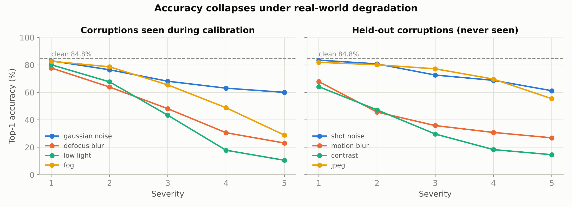
Results : Accuracy Under Distribution Shift
Accuracy fell from 84.8% (clean) to 35.1% at severity 5; contrast (34.8%), motion blur (41.4%) and low light (43.9%) hurt most.
The unguarded model was wrong on 43.5% of all 94k inputs and still acted on every prediction, which is exactly the silent-failure risk EdgeGuard targets.
06-09-2026
14

Slide 15
Results : Failure and OOD Detection (AUROC)
Method | Passes | Failure AUROC | AUPR | Unseen corr. | OOD digits | OOD textures | FPR95 digits
MSP [3] | 1 | 0.837 | 0.737 | 0.843 | 0.866 | 0.842 | 0.385
Entropy | 1 | 0.838 | 0.741 | 0.846 | 0.882 | 0.860 | 0.376
Energy [4] | 1 | 0.818 | 0.724 | 0.827 | 0.884 | 0.874 | 0.336
Mahalanobis (normalised) [2] | 1 | 0.800 | 0.723 | 0.804 | 0.971 | 0.937 | 0.148
MC dropout [1] | 20 | 0.836 | 0.738 | 0.844 | 0.881 | 0.858 | 0.366
EdgeGuard CARS | 1 | 0.842 | 0.756 | 0.848 | 0.960 | 0.910 | 0.206
Failure ranking: CARS is best (0.842) but only slightly above softmax (0.837) and 20-pass MC dropout (0.836).
Unknown objects: OOD AUROC 0.866 -> 0.960 (digits) and 0.842 -> 0.910 (textures) versus softmax; FPR95 halved.
Mahalanobis alone is the best OOD detector but the worst failure detector, so the signals are needed together.
06-09-2026
15

Slide 16
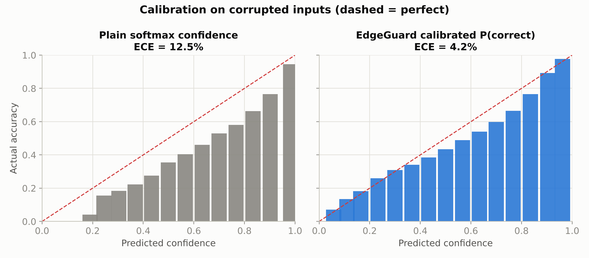
Results : Calibration and Decisions
Metric (adaptive, 3% target) | Clean | All 94k
Error of unguarded model | 15.2% | 43.5%
Coverage (ACCEPT) | 59.4% | 22.7%
Error on accepted inputs | 2.8% | 3.5%
Failures flagged (recall) | 89.0% | 98.2%
Correct inputs deferred | 5.4% | 21.5%
Correct inputs warned/deferred | 31.9% | 61.3%
Calibration on corrupted inputs: softmax ECE 12.5% vs EdgeGuard 4.2%. On clean images both are similar (1.9% vs 2.2%).
06-09-2026
16

Slide 17
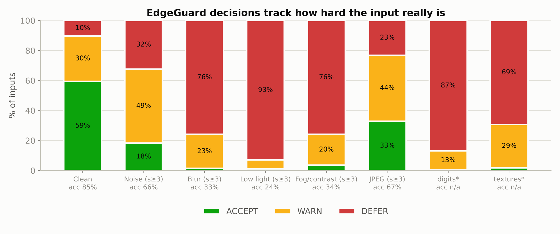
Results : Decisions Track Input Difficulty
Clean: 59% accepted, only 10% deferred.
Severe blur, low light, fog: almost nothing accepted (76-93% deferred).
Unknown digits: 87% deferred, 0% accepted.
JPEG (unseen): 33% still accepted, the weakest case.
06-09-2026
17

Slide 18
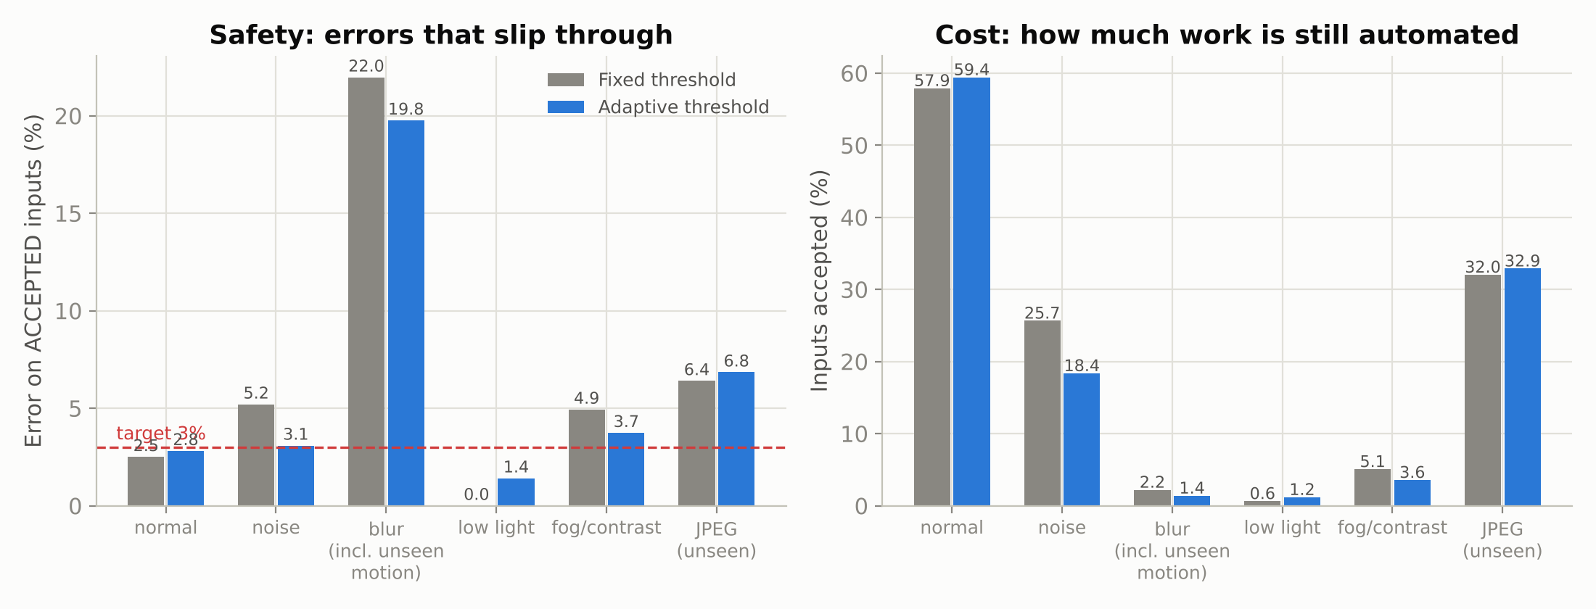
Results : Fixed vs Adaptive Thresholds
Helped on calibrated conditions: noise error 5.2% -> 3.1% and fog 4.9% -> 3.7%; overall error on accepted 4.0% -> 3.5% (coverage 24.4% -> 22.7%).
Did not solve unseen shifts: accepted blurred images (mostly motion blur) were still 19.8% wrong, JPEG 6.8%.
06-09-2026
18

Slide 19
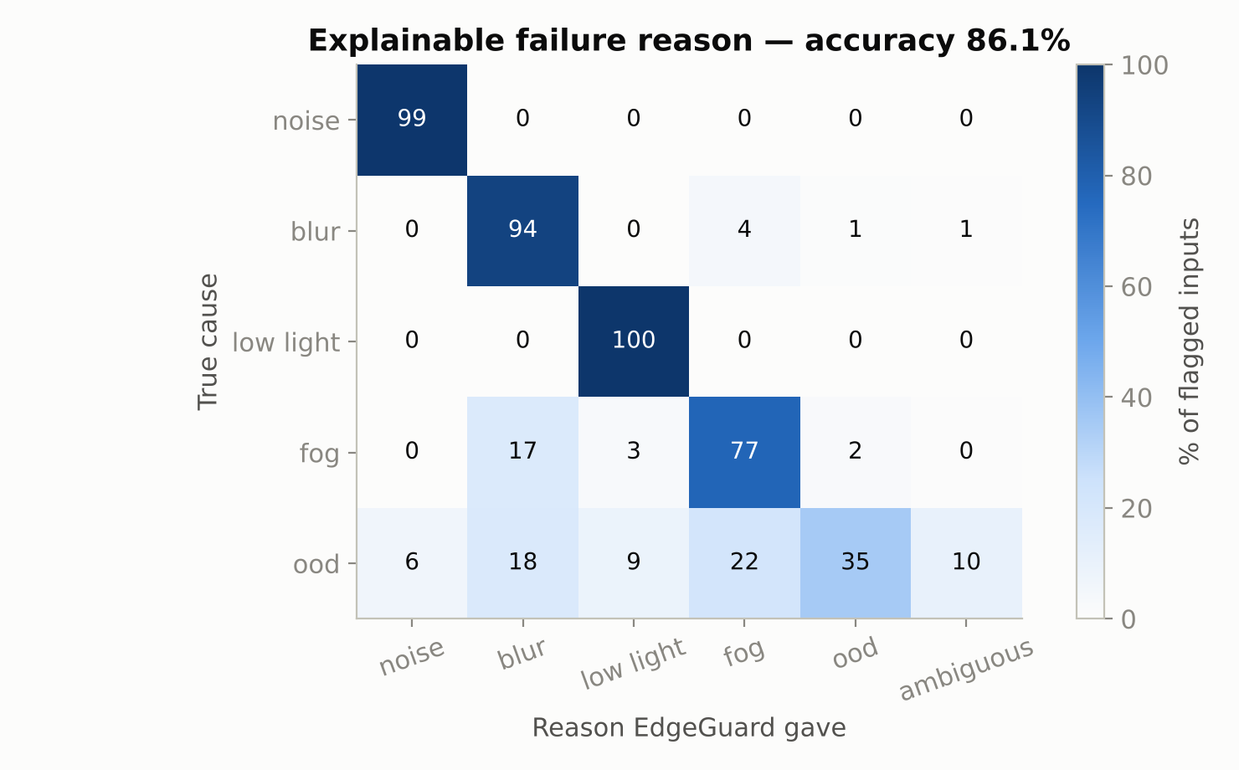
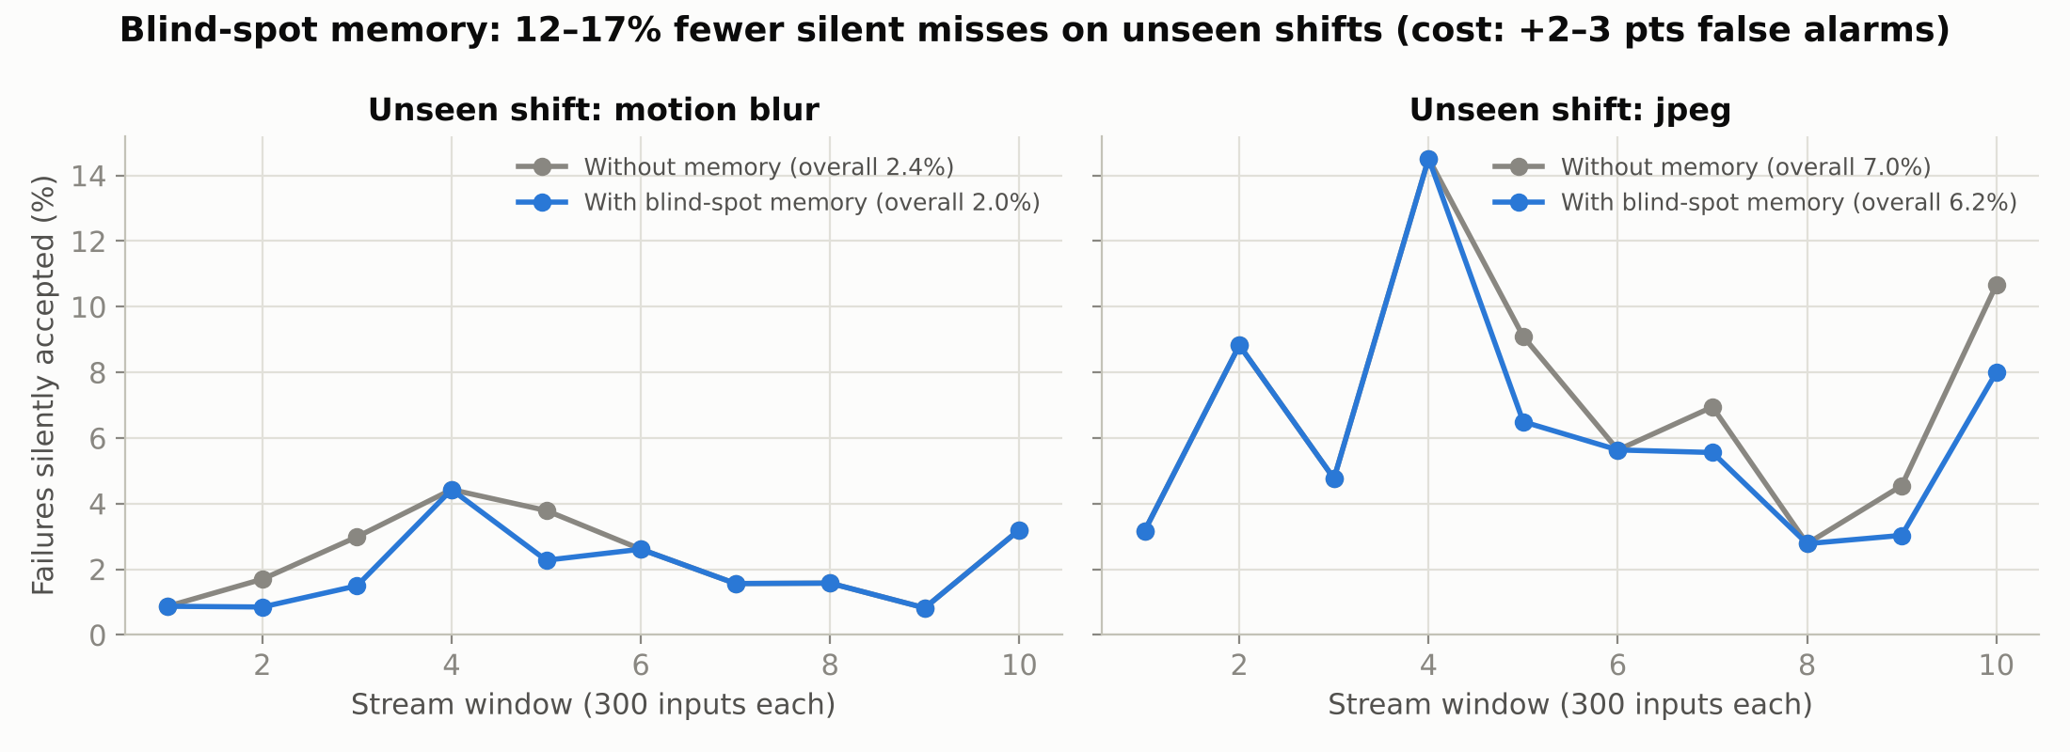
Results : Explanations and Blind-Spot Memory
Reason correct in 86.1% of 43,084 flagged cases: noise 99.5%, blur 93.7%, low light 100%, fog 77.2%.
Unknown objects named first in 35.0% (often also dark or low-contrast); OOD flag raised in 55.0%.
Silent misses: 2.36% -> 1.95% (motion blur) and 7.04% -> 6.20% (JPEG), i.e. 17% and 12% fewer.
Cost: +3.1 / +2.1 points false alarms; gain depends on how much operators confirm.
06-09-2026
19

Slide 20
Results : Ablation and Edge Efficiency
Ablation of signal groups (AUROC)
Latency per image (1 CPU thread)
Signals used | Unreliable | Unseen | OOD
Model uncertainty | 0.835 | 0.846 | 0.872
+ Context shift | 0.844 | 0.846 | 0.935
+ Input quality (full) | 0.845 | 0.848 | 0.935
Input quality only | 0.704 | 0.726 | 0.730
Method | Latency | Extra memory
Base CNN (PyTorch / ONNX) | 2.31 / 0.95 ms | -
EdgeGuard (PyTorch base) | 2.45 ms | 70 KB + 132 KB
MC dropout, 10 passes | 19.0 ms | -
Deep ensemble, 5 models | ~11.6 ms | 5x weights
Context shift adds most for OOD (0.872 -> 0.935); quality alone is not enough.
Overhead 0.14 ms = 5.9% of the PyTorch pass (14.3% of ONNX), inside the 10-15% NFR1 budget; MC dropout is ~8x slower.
06-09-2026
20

Slide 21
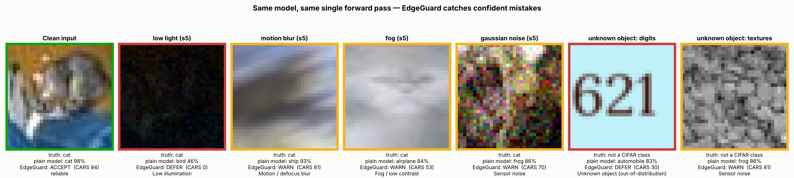
Qualitative Results :
Same model, same single pass: the plain model is confidently wrong under low light, blur, fog, noise and on unknown objects.
EdgeGuard flags each case (amber = WARN, red = DEFER) and names the cause; the clean image is accepted (green).
06-09-2026
21

Slide 22
Dataset Description :
Dataset | Role in EdgeGuard
CIFAR-10 | Normal training / in-distribution data
CIFAR-100 | Unseen objects / out-of-distribution testing
CIFAR-10-C | Real-world image corruptions such as blur, noise, fog, and brightness changes
Evaluation Metrics
We evaluate both AI prediction performance and system reliability.
Metric | Purpose
Classification Accuracy | Measures correct predictions
Precision & Recall | Measures failure detection quality
F1-Score | Provides a balanced measure of precision and recall
AUROC | Evaluates out-of-distribution (OOD) detection capability
False Alarm Rate | Measures incorrect warnings generated by the system
Inference Latency (ms) | Measures real-time prediction performance
Memory Usage (MB) | Evaluates efficiency on edge devices
Reliability Score | Measures the trustworthiness of each prediction
06-09-2026
22

Slide 23
Dataset Description : Test Sets and Metrics
Test set | Images | Role
Clean CIFAR-10 test | 10,000 | In-distribution performance
Seen corruptions: Gaussian noise, defocus blur, low light, fog | 40,000 | Degradations used in calibration
Unseen corruptions: shot noise, motion blur, contrast, JPEG | 40,000 | Generalisation to new shifts
OOD: SVHN-style digits, DTD-style textures | 4,000 | Unknown objects
Total | 94,000 | 5 severities x 2,000 images per corruption
Baselines: MSP [3], entropy, energy [4], Mahalanobis [2], MC dropout [1] (20 samples).
Metrics: AUROC, AUPR, FPR95, ECE [5], AURC [8], coverage, error on accepted, false alarms, latency, memory.
Note: OOD sets are generated proxies; real CIFAR-100 / SVHN in the final run.
06-09-2026
23

Slide 24
References :
[1] Y. Gal and Z. Ghahramani, “Dropout as a Bayesian Approximation: Representing Model Uncertainty in Deep Learning,” ICML, pp. 1050–1059, 2016.
[2] K. Lee, K. Lee, H. Lee, and J. Shin, “A Simple Unified Framework for Detecting Out-of-Distribution Samples and Adversarial Attacks,” NeurIPS, 2018.
[3] D. Hendrycks and K. Gimpel, “A Baseline for Detecting Misclassified and Out-of-Distribution Examples in Neural Networks,” ICLR, 2017.
[4] W. Liu, X. Wang, J. Owens, and Y. Li, “Energy-based Out-of-distribution Detection,” NeurIPS, 2020.
[5] C. Guo, G. Pleiss, Y. Sun, and K. Q. Weinberger, “On Calibration of Modern Neural Networks,” ICML, pp. 1321–1330, 2017.
[6] D. Hendrycks and T. Dietterich, “Benchmarking Neural Network Robustness to Common Corruptions and Perturbations,” ICLR, 2019.
[7] A. Krizhevsky, “Learning Multiple Layers of Features from Tiny Images,” Tech. Rep., University of Toronto, 2009.
[8] Y. Geifman and R. El-Yaniv, “Selective Classification for Deep Neural Networks,” NeurIPS, 2017.
06-09-2026
24

Slide 25
EdgeGuard: Uncertainty-Aware Edge AI for Reliable Decision Making
THANK YOU

