Slide 1


When words are not enough: Multimodal sarcasm detection
VIJETH RAI
QUEEN MARY UNIVERSITY OF LONDON

Slide 2
NEAR FUTURE OF AI AND ITS IMPACT IN REAL WORLD:
Customer service
Reception desks
Retail
Notes:
AI is developing very rapidly in recent years, and the future of AI will be most probably seen replacing human jobs that require communication such as…. In the real world, when things don’t go as planned, there will be people who show aggression. Some more subtle than others. These subtle passive aggressive forms of communications include….

Slide 3
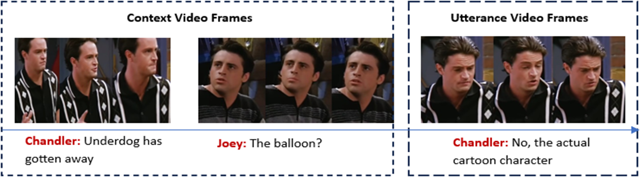
SARCASM
An art of communication that conveys the opposite of its literal meaning.
E.g., “Great weather we’re having today” during a severe thunderstorm
Figure 1: An example from dataset (extracted from Castro et al. (2019)

Slide 4
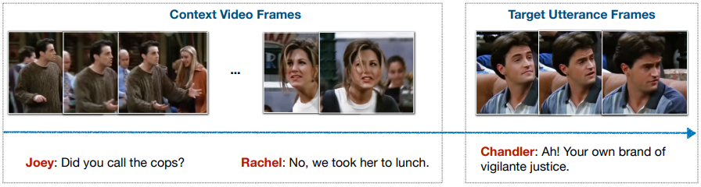
USED IN A VARIOUS FORMS...
Humour
Passive aggression
To appear less rude
Figure 2: An example from dataset (extracted from Castro et al. (2019)
Notes:
Sarcasm is used in different forms… “face saving strategy” to appear less rude while criticising the other

Slide 5
UNDEREXPLORED AREA OF RESEARCH:
Why?
Multimodal concepts are relatively new
Difficulty gathering data and errors in labels
Notes:
Multimodal sarcasm detection is an underexplored area of research and there are two major reasons for this… One is that this domain is relatively new and hasn’t gain traction, second is the difficulty of gathering data and possible errors in labels during manual annotation. Sarcasm is often so subtle that sometimes people just don’t get it until explained. Even though taking short clips from episodes of tv shows falls for research and academic purposes is legal and isn’t considered piracy even if taken without permission of the owner, Finding these episodes available to download for editing purpose is extremely hard.

Slide 6
RECENT DEVELOPMENTS
Multimodal approach to detect sarcasm was first introduced by Castro et al. (2019) with the MUStARD dataset. The results supported the hypothesis that sarcasm is multimodal.
Chauhan, Ekbal and Bhattacharyya (2020) progressed further by introducing sentiment and emotion labels to detect sarcasm. They emphasized the role of context and speaker information in detecting sarcasm using attention models.
Notes:
A quick overview of the recent developments

Slide 7
RECENT DEVELOPMENTS
Ray, Mishra, Nunna and Bhattacharyya (2022) contributed by increasing the size of dataset and correcting errors in labels. They introduced two more features: sarcasm-types and arousal-valence labels aiming to recognize emotions displayed in sarcasm.
Following the above, Pramanick, Roy and Patel (2022) paved the way in feature extraction. They extracted visual embeddings from the video frames. The results attested the importance of transfer learning.
Sun et al. (2022) made progress by using facial recognition models to generate image embeddings and explored adaptive fusion.

Slide 8
GAPS IN EXISTING RESEARCH
Manual feature creation trade-off with real-world applicability.
Training and fine-tuning attention and transformer model limitations.
Difficulty gathering multimodal data relevant to sarcasm detection.
Neglect in Audio model.
Utilization of transfer learning models trained on generalized datasets
Notes:
Annotating data manually and using it as an input feature to detect sarcasm will add bias to the model and also, these features are not available in real-world or unseen data. Training attention and transformer model requires large datasets. Training these in such a limited dataset is prone to overfitting. Already explained in previous slides. There has been no progress in feature extraction from audio input. Most studies use basic traditional acoustic features like mel spectrogram and mfccs. The transfer learning model utilized are not trained for task-specific datasets but rather on generalized datasets.

Slide 9
BRIDGING THE GAPS
We propose a Multimodal Fusion Ensemble Framework (MFEF): This leverages the power of transfer learning, specific to each modality of input along with ensemble techniques.
Audio feature extraction using traditional techniques
Case-sensitized BERT which can recognize proper nouns and captures emphasis in capitalized words.

Slide 10
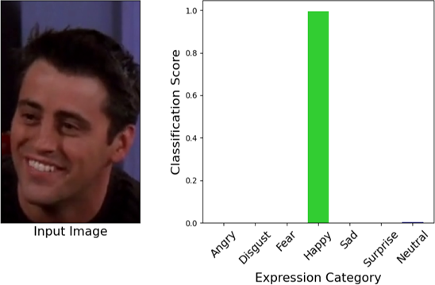
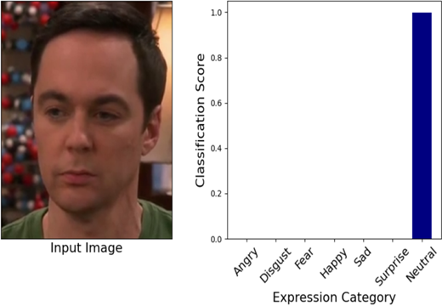
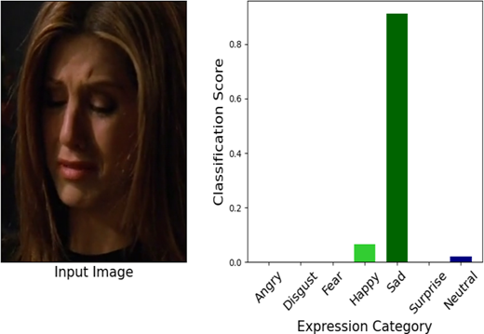
BRIDGING THE GAPS
Utilization of pretrained VGGish model to generate embeddings for audio inputs.
Utilization of Facial Expression Recognition (FER) VGG-FER model to generate embeddings for visual inputs.
VGG-FER Visualization on the Dataset

Slide 11















PROPOSED MODEL
$$Y_{predictions}$$
$$Y_{LateFusion}$$
$$Ensemble$$
$$Early Fusion$$
$$Concat Y_{preds}$$
$$Concat$$
$$Embeddings$$
$$Text Model$$
$$Audio Model$$
$$Image Model$$
$$cased BERT$$
$$VGGish$$
$$VGG FER$$
$$Text$$
$Context+Utterance$
$$Audio$$
$Utteranc$e
$$Image$$
$$Utterance$$

Slide 12
IMPLEMENTATION
Clone the git repo https://github.com/Vijeth-Rai/Multimodal-Sarcasm-Detection
Readme file shows sequence to run notebooks

Slide 13
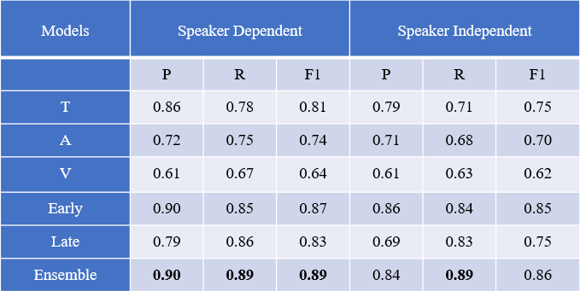
EXPERIMENTAL RESULTS
Traditional audio feature extraction versus audio embeddings through transfer learning on audio data.
Aiming to shed light on nature of sarcasm, two experimental setups are created.
Speaker-Dependent setup
Speaker-Independent setup
Observation on the experimental setups:
The better performing setup
How this can be interpreted
Notes:
Traditional audio features performed poorly and showed no sign of improvements even in the training data, even after augmentation. This sheds light on why previous work neglected progress in this modality. Transfer learning on audio data on other hand performed very well, showing the efficacy of transfer learning models. ---- One can observe that increase in performance in both setups is very small. This can lead to the conclusion that sarcasm is infact speaker independent

Slide 14
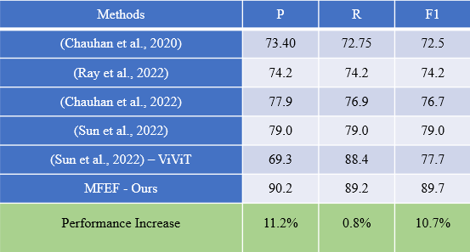
COMPARISON OF RESULTS WITH PREVIOUS RESEARCH
The proposed model excels with an increased performance of 11.2%
Why is this model so much better than previous studies?
Higher-quality image feature extraction
Previously ignored audio feature extraction
Fusion enhanced by ensemble
Increased dataset size
What the research methodology seems to suggest
Notes:
The methodology suggests that given the size of dataset, transfer learning to get embeddings of input data is the most viable course of action as evident by this study

Slide 15
CHALLENGES
Audio feature extraction
Image feature extraction
Hypertuning and overfitting
Notes:
Audio data is not readily accessible in the dataset and needs to be created from video files. Feature extraction for audio input using tradiational approach does not give good results. Gathering image data that are relevant to the facial images of the speaker is quite challenging. This took few weeks to be gathered. There are very low number of FER models available for transfer learning. Since dataset is so small, overfit is seen most of the time. Manual tuning of parameters was needed to be done in most models.

Slide 16
CONCLUSION AND FUTURE WORKS
This paper takes a step towards the future of AI: allowing the AI to act as beings capable of interacting with humans, even if sarcasm is involved.
The paper highlights the importance of extracting high-quality features from all input modalities.
Take on nature of sarcasm – what the study seems to supports.
Potential in using Neural network for sarcasm detection by increasing in size of dataset.
Benefits of increasing the size of dataset for multimodal sarcasm detection.
Use of multi-modal transfer learning models in future research.

Slide 17
REFERENCES
Castro, S., Hazarika, D., Pérez-Rosas, V., Zimmermann, R., Mihalcea, R. and Poria, S. (2019). Towards Multimodal Sarcasm Detection (An Obviously Perfect Paper). [online] pp.4619–4629. Available at: https://aclanthology.org/P19-1455.pdf.
Chauhan, D., Ekbal, A. and Bhattacharyya, P. (2020). Sentiment and Emotion help Sarcasm? A Multi-task Learning Framework for Multi-Modal Sarcasm, Sentiment and Emotion Analysis. pp.4351–4360.
Chauhan, D.S., Singh, G.V., Arora, A., Ekbal, A. and Bhattacharyya, P. (2022). An emoji-aware multitask framework for multimodal sarcasm detection. Knowledge-Based Systems, 257, p.109924. doi:https://doi.org/10.1016/j.knosys.2022.109924
Ray, A., Mishra, S., Nunna, A. and Bhattacharyya, P. (2022). A Multimodal Corpus for Emotion Recognition in Sarcasm. [online] Available at: https://arxiv.org/pdf/2206.02119v1.pdf [Accessed 25 Jun. 2023].
Sun, Y., Zhang, H., Yang, S. and Wang, J. (2022). EFAFN: An Efficient Feature Adaptive Fusion Network with Facial Feature for Multimodal Sarcasm Detection. Applied Sciences, 12(21), p.11235. doi:https://doi.org/10.3390/app122111235.
Pramanick, S., Roy, A. and Patel, V.M. (2021). Multimodal Learning using Optimal Transport for Sarcasm and Humor Detection. [online] arXiv.org. Available at: https://arxiv.org/abs/2110.10949 [Accessed 30 Jun. 2023].

Slide 18
Thank you

