Slide 1
Environmental monitoring
Project definition and
Design Thinking

Slide 2
Project Definition
The project involves setting up IoT devices to monitor environmental conditions in public parks, including temperature and humidity. The primary objective is to provide real-time environmental data to park visitors through a public platform, enabling them to plan their outdoor activities accordingly. This project includes defining objectives, designing the IoT sensor system, developing the environmental monitoring platform, and integrating them using IoT technology and Python.

Slide 3
Subtitles
Project objectivee
IOT device design
Environmental monitoring platform
Integration Approach

Slide 4

Aiding park visitors in activity planning
Project Objectives: Project Objectives: Objectives:
1.Project Objectives:
Visitor Information: Gather information about the park’s attractions, facilities, and rules. Know the park’s hours of operation, entrance fees, and any seasonal considerations.

Slide 5
Visitor interest
Safety tips
Visitor Interests: Ask visitors about their interests, such as hiking, picnicking, wildlife viewing, or photography. Tailor suggestions to their preferences.
Safety Tips: Emphasize safety, including trail conditions, weather forecasts, and wildlife precautions. Encourage them to carry essentials like water, snacks, and a first-aid kit

Slide 6
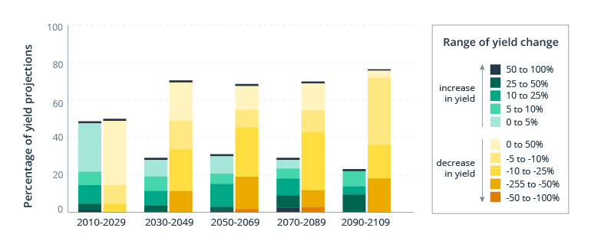
Source: Impact of climate change on agriculture
All of a sudden, floods can sweep across fields, mixing seeds in the soil and leaving farmers guessing where to harvest their crops. Spring rains are the main reason for floods that harm agribusiness profits.

Slide 7
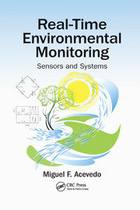
Real time environmental monitoring
This objective involves the continuous and immediate tracking of environmental conditions, such as weather, air quality, and ecological data, to gather up-to-date information for the purpose of better understanding and managing natural resources and ecosystems.

Slide 8
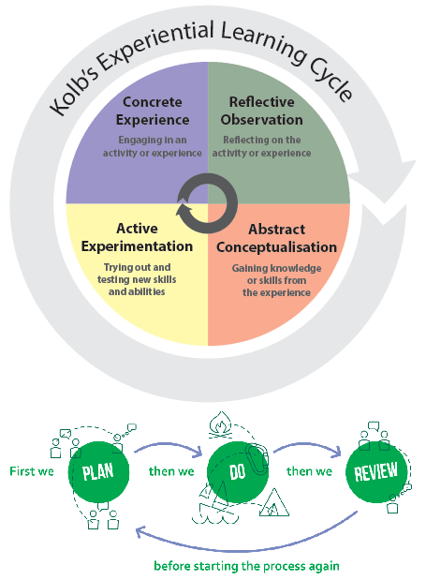
Promoting outdoor experience
This objective aims to encourage and facilitate outdoor activities and experiences within the park. It may involve organizing events, workshops, or programs that promote physical activity, exploration, and appreciation of the natural surroundings.

Slide 9
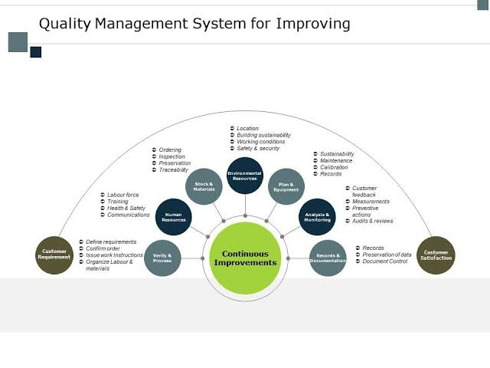
Enhancing Visitor Satisfaction:
This objective centers on improving the overall experience of park visitors. It includes measures to ensure visitors have a positive and enjoyable time in the park by addressing their needs, concerns, and feedback, ultimately leading to higher satisfaction levels

Slide 10
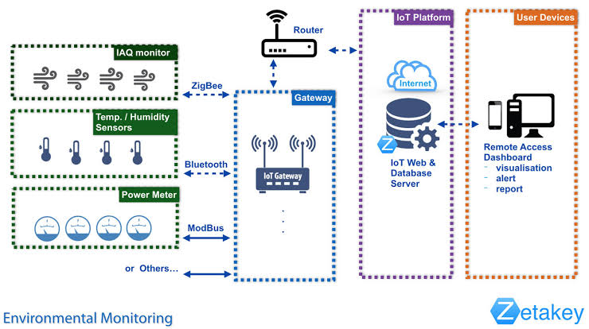
2.IOT device designs
Plan the deployment of IoT sensors (e.g., temperature and humidity sensors) in public parks.

Slide 11
Identify Sensor Locations:
Choose Sensor Types:
Determine the key areas within the park where sensor data is essential. This could include picnic areas, trails, water bodies, and playgrounds.
Consider the park's size and budget constraints when determining the number of sensors needed.
Select the appropriate IoT sensors based on your objectives. For environmental monitoring in parks, temperature and humidity sensors are essential. You might also consider sensors for air quality, noise levels, and soil moisture, depending on the park's unique features.

Slide 12
Connectivity and Data Storage:
Power Supply:
Ensure connectivity for the sensors. Depending on the park's infrastructure, you may need a combination of Wi-Fi, cellular, or LPWAN (Low-Power Wide-Area Network) connections.
Set up a cloud-based or local data storage system to collect and store sensor data securely.
Determine how sensors will be powered. Battery-operated sensors are suitable for remote areas, but they require periodic maintenance. Solar-powered sensors can be a sustainable choice.

Slide 13
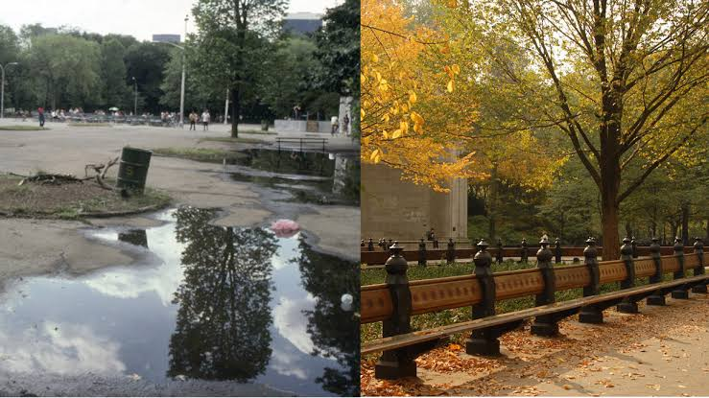
Scalability:
Design the system to be scalable, allowing for the addition of more sensors or features as needed in the future.
Remember that the specific details of the deployment will depend on the park's size, location, and available resources. It's also essential to collaborate with experts in IoT and environmental monitoring to ensure a successful deployment.

Slide 14
3.Environmental monitoring platform
An environmental monitoring platform is a comprehensive system designed to collect, analyze, and manage data related to environmental conditions in a specific area or region. These platforms are crucial for assessing the impact of various factors on the environment and can be used in a range of applications, including climate research, conservation efforts, and urban planning.
Design a web-based platform to display real time environmental data to the public.

Slide 15
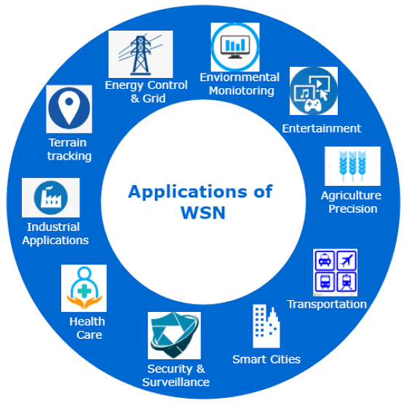
Sensor Network
The platform incorporates a network of environmental sensors that measure various parameters such as temperature, humidity, air quality, water quality, soil moisture, and more. These sensors can be distributed across the monitored area.

Slide 16
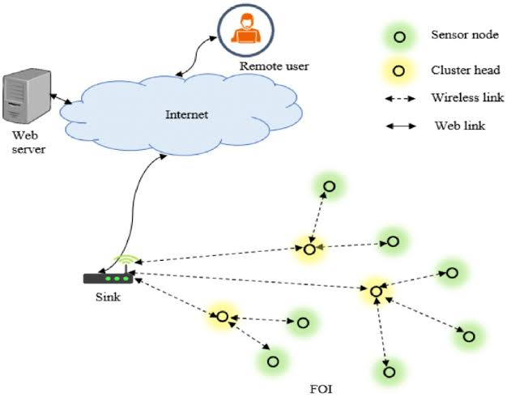
Wireless sensor networks

Slide 17
->Data Collection:
->Alerts and Notifications
->Security and Privacy:
Sensors continuously collect data and transmit it to a central repository. Data collection methods may include wired connections, wireless communication (e.g., Wi-Fi, cellular, or IoT networks), or satellite links.
The system can be configured to send alerts and notifications when predefined thresholds are exceeded, signaling potential environmental issues or hazards.
Robust security measures are put in place to protect sensitive environmental data from unauthorized access or cyber threats.

Slide 18
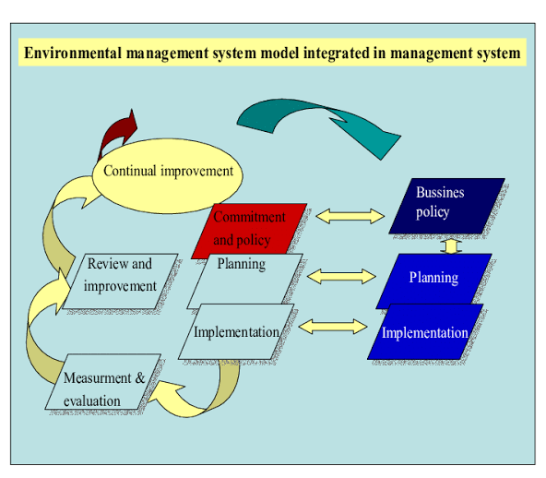
4.Integration approach
Integrating various systems, technologies, or data sources effectively requires a well-thought-out approach.

Slide 19
3.Choose Integration Methods:
1.Define Objectives and Requirements:
2.Identify Systems and Data Sources:
Start by clearly defining the objectives of the integration. What do you want to achieve by integrating these systems? What are the specific requirements and desired outcomes.
List all the systems, technologies, or data sources that need to be integrated. This includes identifying APIs (Application Programming Interfaces) or data formats that these systems support.
Determine the integration methods that are most suitable for your needs. Common methods include: API Integration: If systems provide APIs, this can be a direct and structured way to exchange data. Middleware or Integration Platforms: Consider using middleware tools or integration platforms that offer pre-built connectors and workflows for common integrations.

Slide 20
Thank you
These are the topics of( phase -1) Environmental monitoring
By :
R.vjayalakshmi

