Slide 1
CPSC 4430/5440: Machine Learning Lesson D01: Backward Propagation of Computational Graph
Derived from Fei-Fei Li (Stanford Univ)

Slide 2




Where we are...
scores function
SVM loss
data loss + regularization
want
Lecture 4 - 2

Slide 3

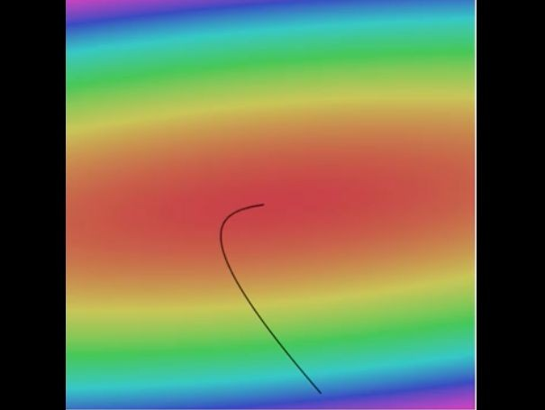

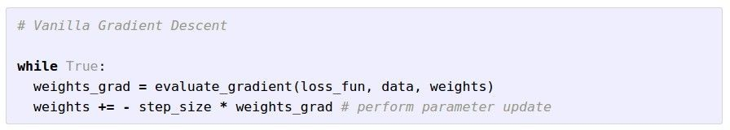
Optimization
Landscape image is CC0 1.0 public domain Walking man image is CC0 1.0 public domain
Lecture 4 - 3

Slide 4

Gradient descent
Numerical gradient: slow :(, approximate :(, easy to write :)
Analytic gradient: fast :), exact :), error-prone :(
In practice: Derive analytic gradient, check your implementation with numerical gradient
Lecture 4 - 4

Slide 5


Computational graphs
x
*
s (scores)
hinge loss
+
L
W
R
Lecture 4 - 5

Slide 6
Review: Chain Rule
Case 1
g
h
x
y
z
Case 2
x
s
z
y

Slide 7

Backpropagation: a simple example

Slide 8
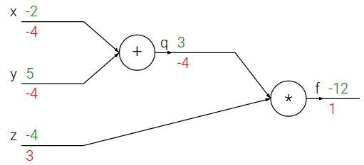
Backpropagation: a simple example

Slide 9
Backpropagation: a simple example
e.g. x = -2, y = 5, z = -4
Forward Pass
April 13, 2017

Slide 10





Backpropagation: a simple example
e.g. x = -2, y = 5, z = -4
Backward Pass
Want:
April 13, 2017

Slide 11

Backpropagation: a simple example
e.g. x = -2, y = 5, z = -4
Want:
April 13, 2017

Slide 12
Backpropagation: a simple example
e.g. x = -2, y = 5, z = -4
Want:
April 13, 2017

Slide 13

Backpropagation: a simple example
e.g. x = -2, y = 5, z = -4
Want:
April 13, 2017

Slide 14
Backpropagation: a simple example
e.g. x = -2, y = 5, z = -4
Want:
April 13, 2017

Slide 15

Backpropagation: a simple example
e.g. x = -2, y = 5, z = -4
Want:
April 13, 2017

Slide 16
Backpropagation: a simple example
e.g. x = -2, y = 5, z = -4
Want:
April 13, 2017

Slide 17



Backpropagation: a simple example
e.g. x = -2, y = 5, z = -4
Chain rule:
Want:
Upstream gradient
Local gradient
April 13, 2017

Slide 18
Backpropagation: a simple example
e.g. x = -2, y = 5, z = -4
Chain rule:
Want:
Upstream gradient
Local gradient
April 13, 2017

Slide 19

Backpropagation: a simple example
e.g. x = -2, y = 5, z = -4
Chain rule:
Want:
Upstream gradient
Local gradient
April 13, 2017

Slide 20
Backpropagation: In class practice
e.g. x = -2, y = 5, z = -4
April 13, 2017

Slide 21
In classroom Practice: e = (a+b) * (b+1)

Slide 22
Backpropagation: a simple example
e.g. x = -2, y = 5, z = -4
Chain rule:
Want:
Upstream gradient
Local gradient
April 13, 2017

Slide 23


f

Slide 24


f
“local gradient”

Slide 25

f
“local gradient”
gradients

Slide 26
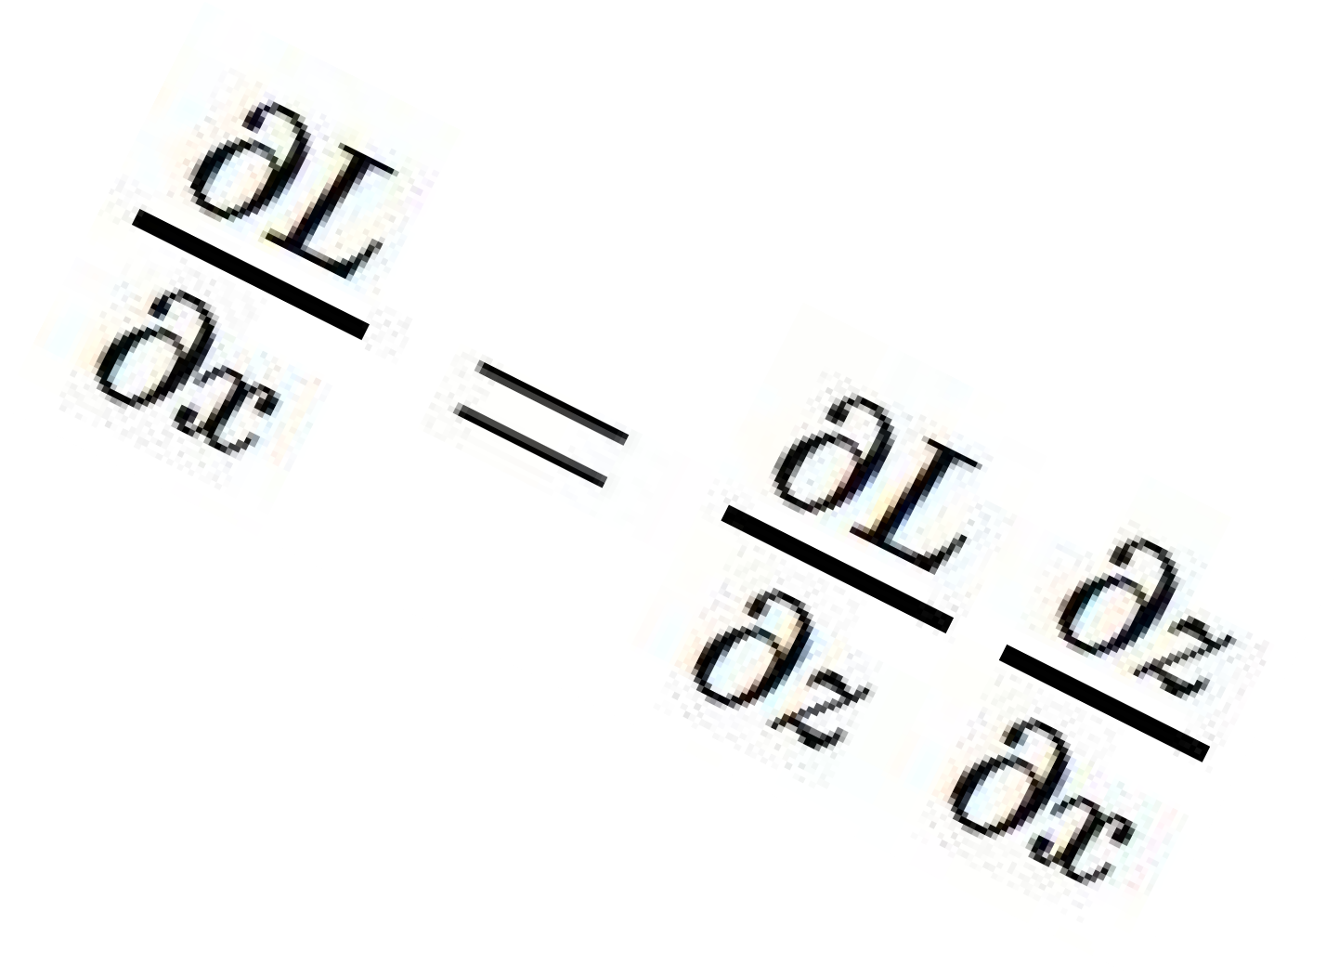
f
“local gradient”
gradients

Slide 27
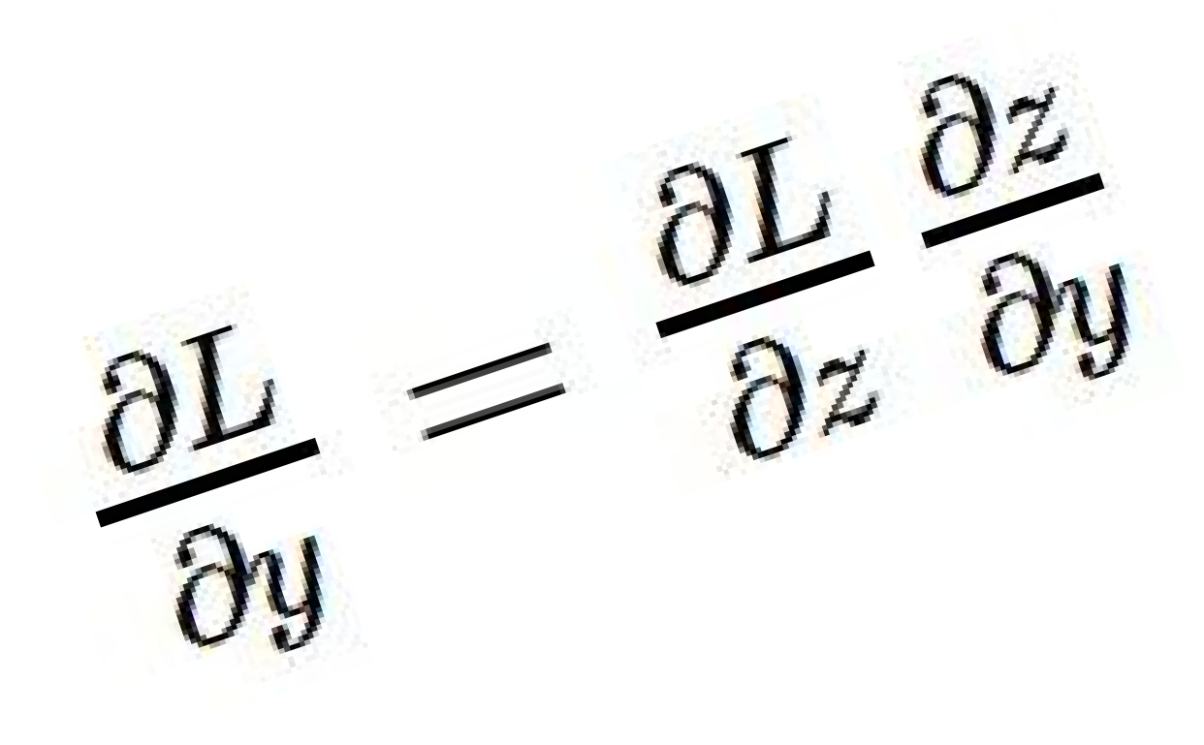
f
“local gradient”
gradients

Slide 28
f
“local gradient”
gradients

Slide 29

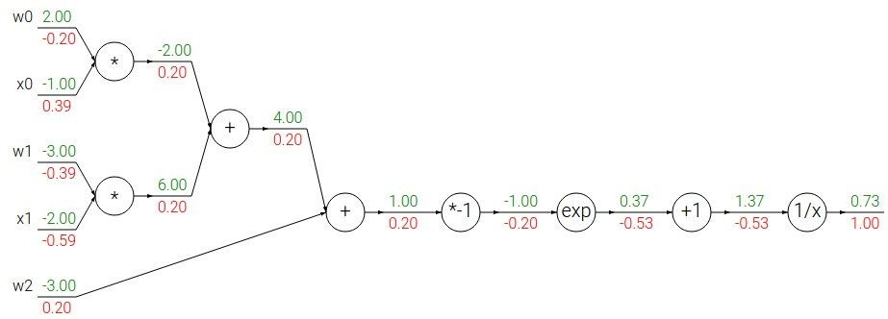
Another example:

Slide 30
Another example:

Slide 31
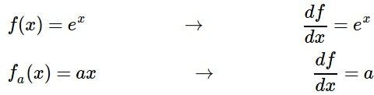
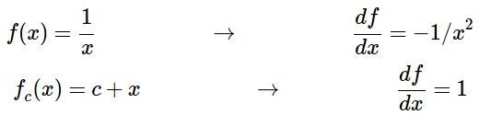
Another example:

Slide 32
Another example:

Slide 33

Another example:
Upstream gradient
Local gradient
Upstream gradient

Slide 34
Another example:

Slide 35
Another example:
Upstream gradient
Local gradient

Slide 36
Another example:

Slide 37
Another example:
Upstream gradient
Local gradient

Slide 38
Another example:

Slide 39
Another example:
Upstream gradient
Local gradient

Slide 40
Another example:

Slide 41
Another example:
[upstream gradient] x [local gradient] [0.2] x [1] = 0.2
[0.2] x [1] = 0.2 (both inputs!)

Slide 42
Another example:

Slide 43
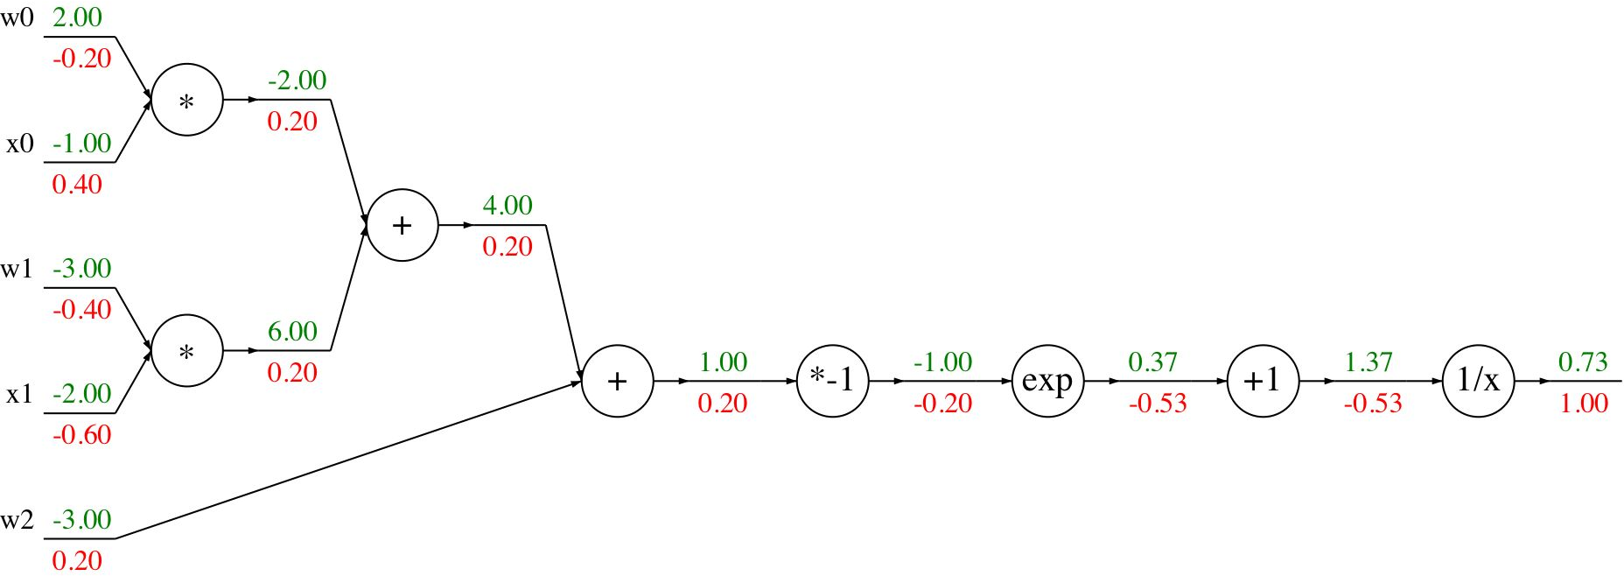
Another example:
[upstream gradient] x [local gradient] x0: [0.2] x [2] = 0.4
w0: [0.2] x [-1] = -0.2

Slide 44

Computational graph representation may not be unique. Choose one where local gradients at each node can be easily expressed!
sigmoid function
sigmoid gate

Slide 45
Computational graph representation may not be unique. Choose one where local gradients at each node can be easily expressed!
sigmoid function
sigmoid gate
[upstream gradient] x [local gradient] [1.00] x [(1 - 0.73) (0.73)]= 0.2

Slide 46
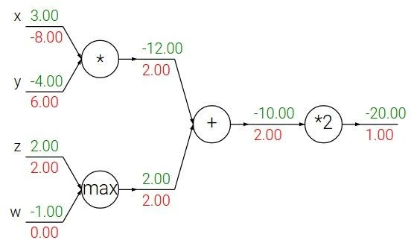
Patterns in backward flow
add gate: gradient distributor

Slide 47
Patterns in backward flow
add gate: gradient distributor Q: What is a max gate?

Slide 48
Patterns in backward flow
add gate: gradient distributor
max gate: gradient router

Slide 49
Patterns in backward flow
add gate: gradient distributor
max gate: gradient router Q: What is a mul gate?

Slide 50
Patterns in backward flow
add gate: gradient distributor max gate: gradient router mul gate: gradient switcher

Slide 51
Gradients add at branches
+

Slide 52
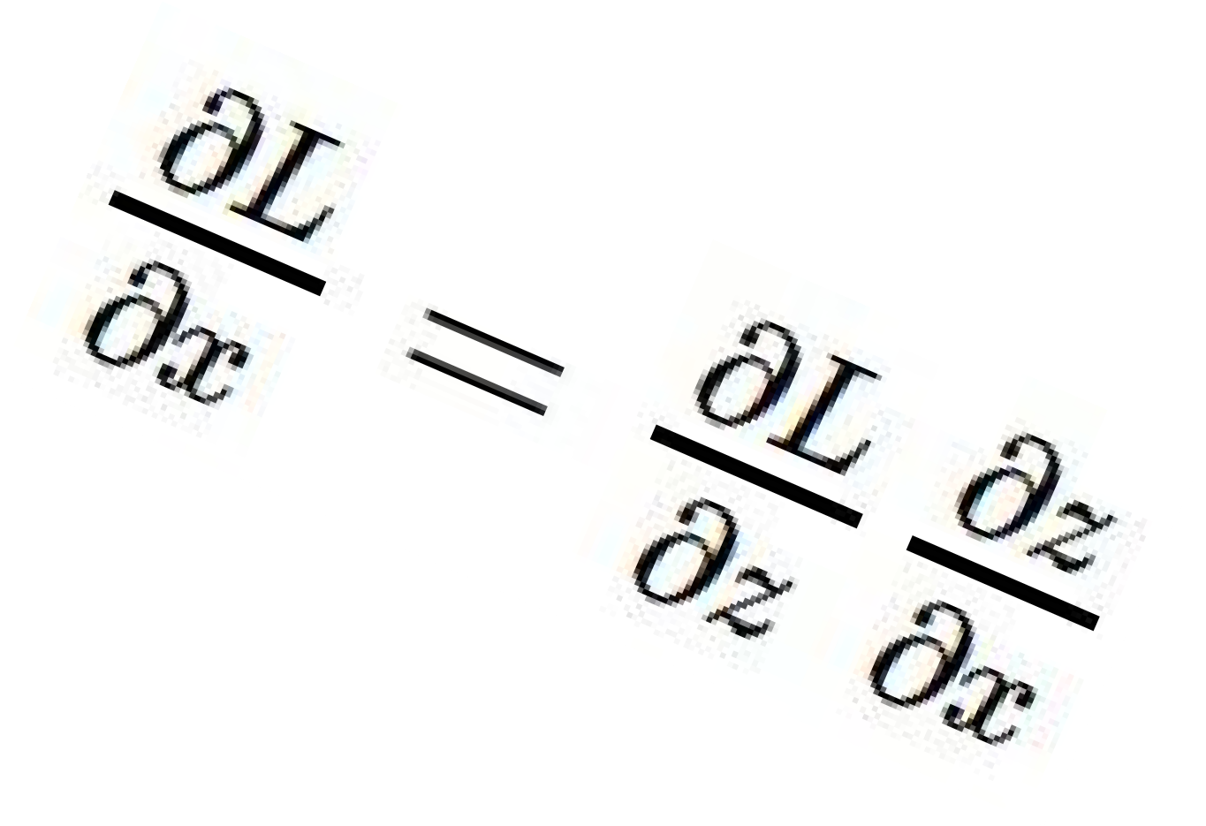
Gradients for vectorized code
(x,y,z are now vectors)
This is now the Jacobian matrix (derivative of each element of z w.r.t. each element of x)
“local gradient”
f
gradients

Slide 53
Vectorized operations
f(x) = max(0,x) (elementwise)
4096-d
input vector
4096-d
output vector

Slide 54

Vectorized operations
f(x) = max(0,x) (elementwise)
Jacobian matrix
4096-d
input vector
Q: what is the size of the Jacobian matrix?
4096-d
output vector

Slide 55
Vectorized operations
f(x) = max(0,x) (elementwise)
Jacobian matrix
4096-d
input vector
Q: what is the size of the Jacobian matrix? [4096 x 4096!]
4096-d
output vector

Slide 56
Vectorized operations
f(x) = max(0,x) (elementwise)
4096-d
input vector
Q: what is the size of the Jacobian matrix? [4096 x 4096!]
4096-d
output vector
in practice we process an entire minibatch (e.g. 100) of examples at one time:
i.e. Jacobian would technically be a [409,600 x 409,600] matrix :\
Lecture 4 -

Slide 57
Vectorized operations
f(x) = max(0,x) (elementwise)
Jacobian matrix
4096-d
output vector
Q2: what does it look like?
4096-d
input vector
Q: what is the size of the Jacobian matrix? [4096 x 4096!]
Lecture 4 -

Slide 58
A vectorized example:

Slide 59
A vectorized example:

Slide 60
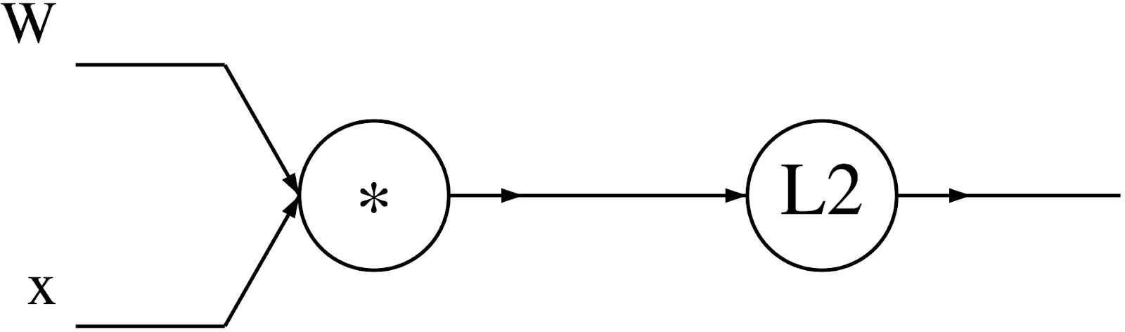
A vectorized example:

Slide 61


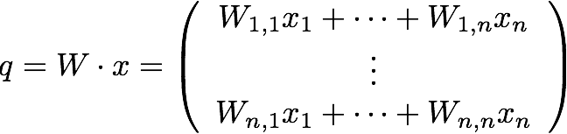
A vectorized example:

Slide 62

A vectorized example:

Slide 63
A vectorized example:

Slide 64


A vectorized example:

Slide 65

A vectorized example:

Slide 66

A vectorized example:

Slide 67



A vectorized example:

Slide 68

A vectorized example:

Slide 69

A vectorized example:

Slide 70
A vectorized example:
Always check: The gradient with respect to a variable should have the same shape as the variable

Slide 71

A vectorized example:

Slide 72


A vectorized example:

Slide 73


A vectorized example:

Slide 74
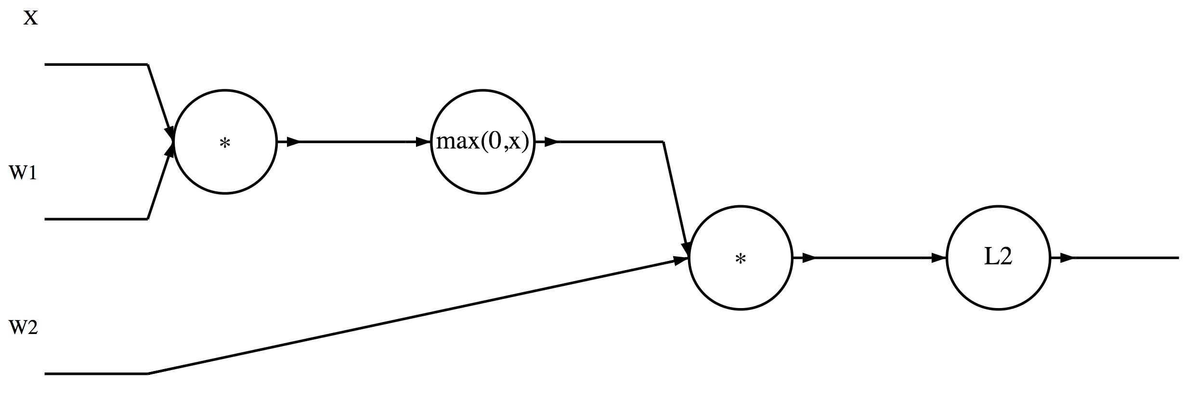
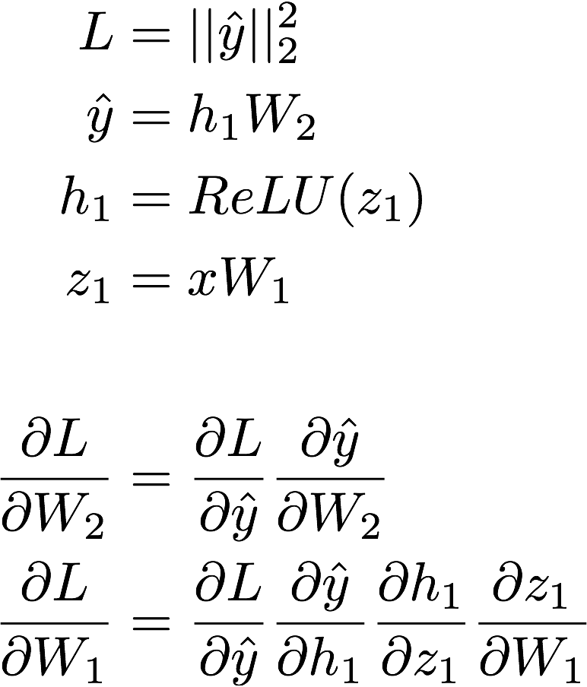
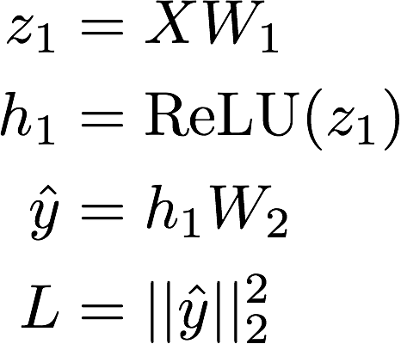
In discussion section: A matrix example...
?
?
April 13, 2017

Slide 75
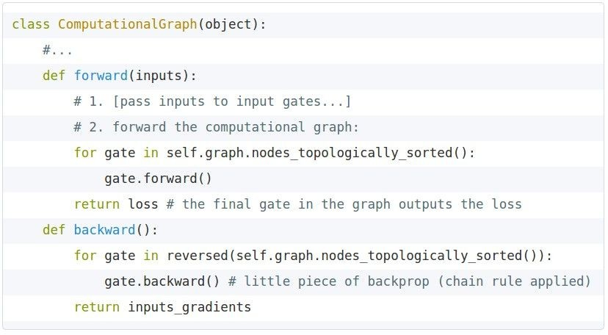
Modularized implementation: forward / backward API
Graph (or Net) object (rough pseudo code)

Slide 76
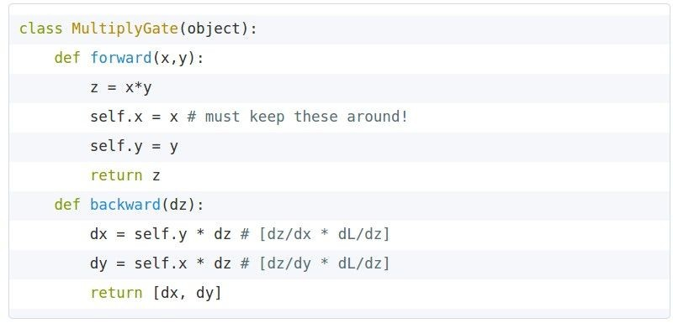
Modularized implementation: forward / backward API
x
z
*
y
(x,y,z are scalars)
Local gradient
Upstream gradient variable

Slide 77
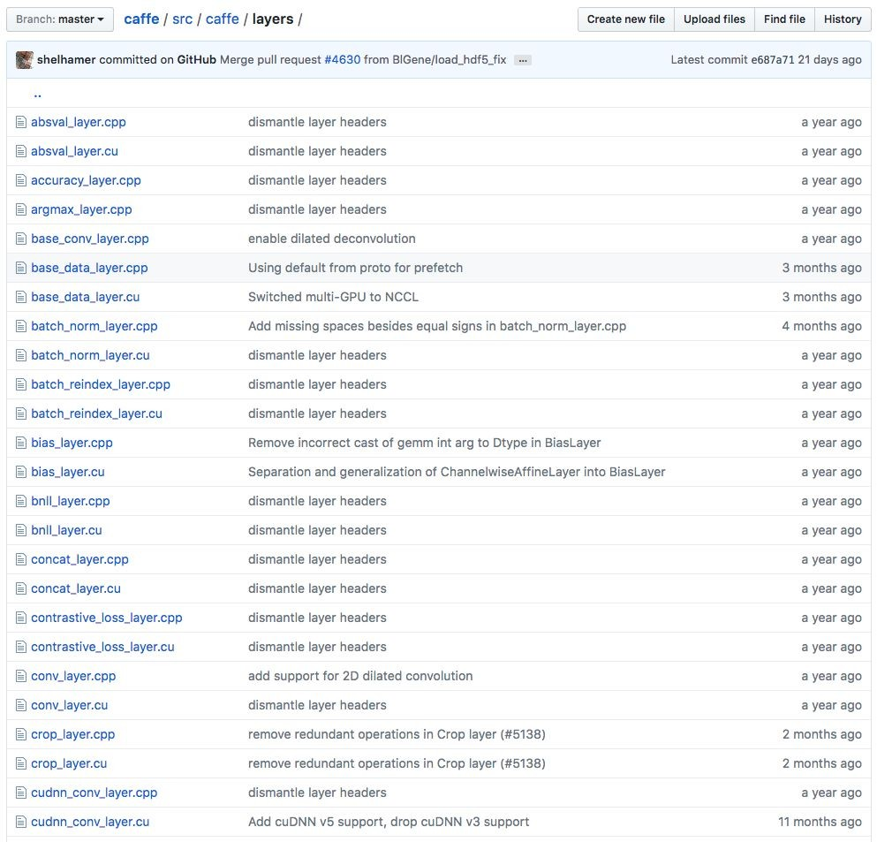
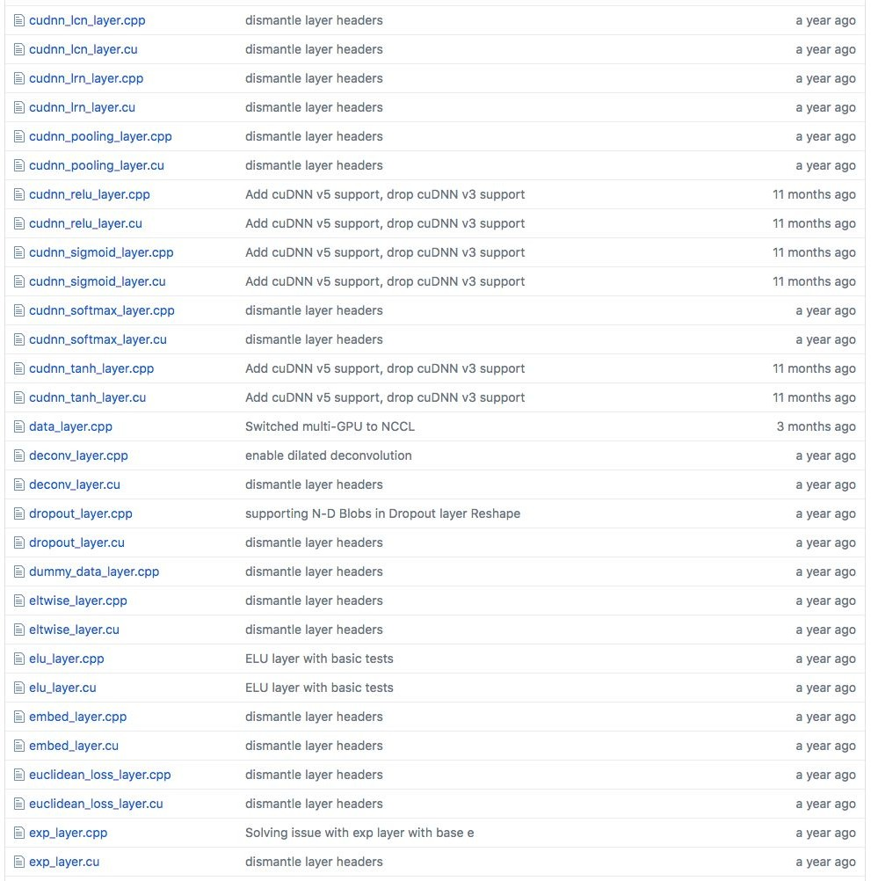
Example: Caffe layers
Caffe is licensed under BSD 2-Clause

Slide 78
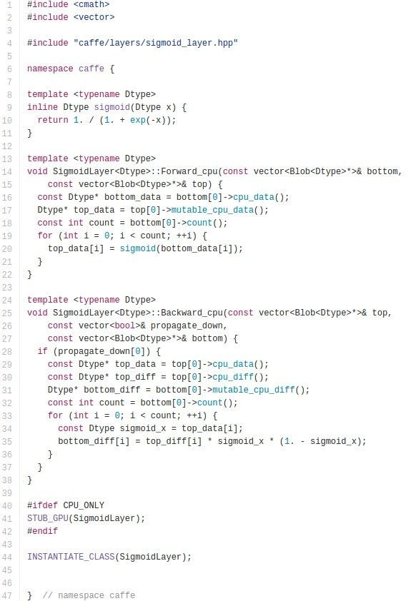

Caffe Sigmoid Layer
* top_diff (chain rule)
Caffe is licensed under BSD 2-Clause

Slide 79
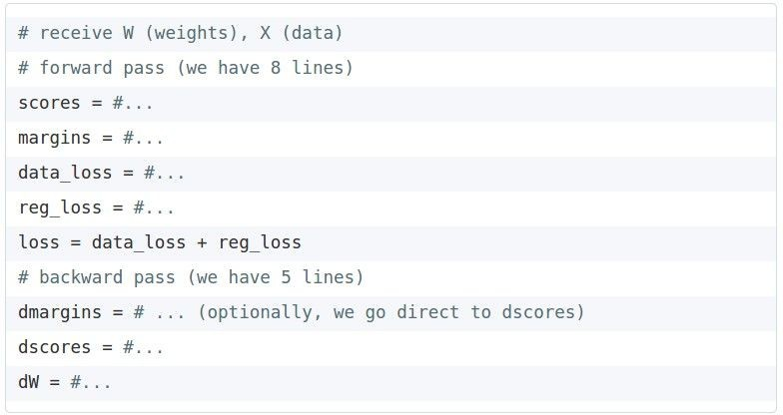
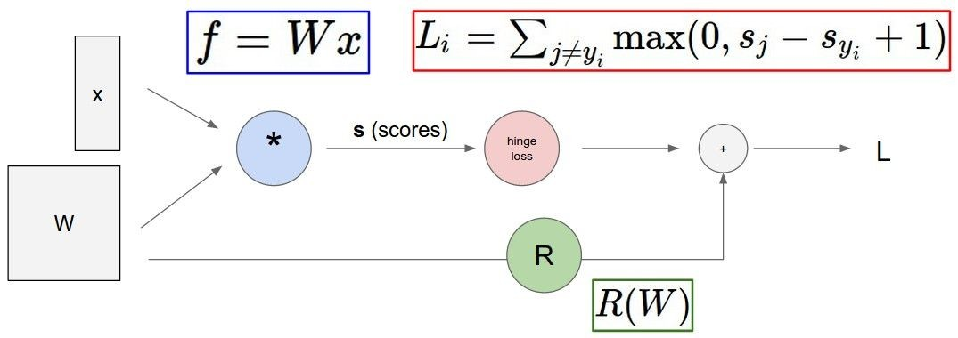
In Assignment 1: Writing SVM / Softmax
Stage your forward/backward computation!
E.g. for the SVM:
margins

Slide 80
Summary so far...
neural nets will be very large: impractical to write down gradient formula by hand for all parameters
backpropagation = recursive application of the chain rule along a computational graph to compute the gradients of all inputs/parameters/intermediates
implementations maintain a graph structure, where the nodes implement the forward() / backward() API
forward: compute result of an operation and save any intermediates needed for gradient computation in memory
backward: apply the chain rule to compute the gradient of the loss function with respect to the inputs

Slide 81
Next: Neural Networks

Slide 82

Neural networks: without the brain stuff
(Before) Linear score function:

Slide 83

Neural networks: without the brain stuff
(Before) Linear score function: (Now) 2-layer Neural Network

Slide 84
Neural networks: without the brain stuff
(Before) Linear score function: (Now) 2-layer Neural Network
x
h
W1
W2
s
3072
100
10

Slide 85

Neural networks: without the brain stuff
(Before) Linear score function: (Now) 2-layer Neural Network
x
h
W1
W2
s
3072
100
10

Slide 86
Neural networks: without the brain stuff
(Before) Linear score function: (Now) 2-layer Neural Network
or 3-layer Neural Network

Slide 87
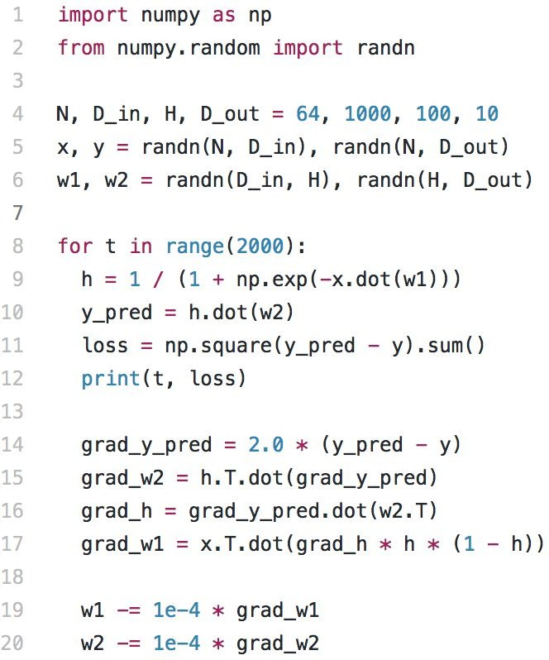
Full implementation of training a 2-layer Neural Network needs ~20 lines:

Slide 88
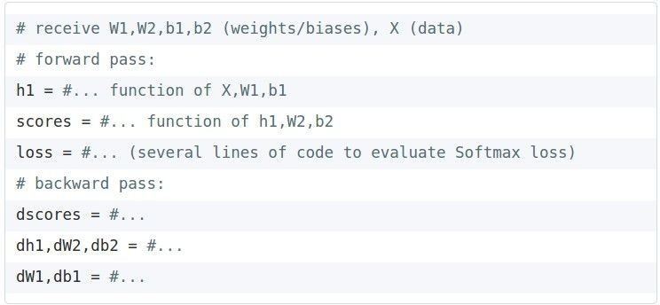
In HW: Writing a 2-layer net

Slide 89
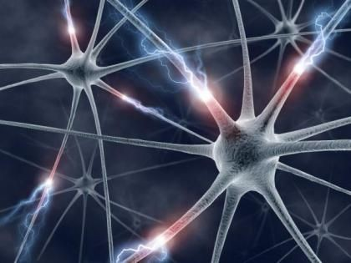
This image by Fotis Bobolas is licensed under CC-BY 2.0

Slide 90
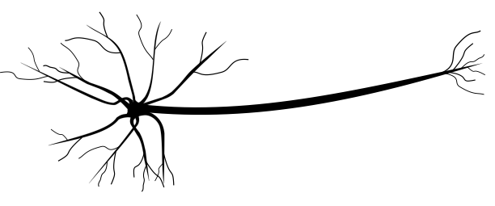
Impulses carried toward cell body
dendrite
presynaptic terminal
axon
cell body
Impulses carried away from cell body
This image by Felipe Perucho is licensed under CC-BY 3.0

Slide 91
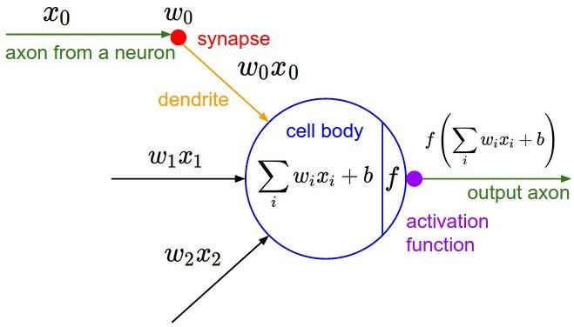
Impulses carried toward cell body
dendrite
presynaptic terminal
axon
cell body
Impulses carried away from cell body
This image by Felipe Perucho is licensed under CC-BY 3.0

Slide 92
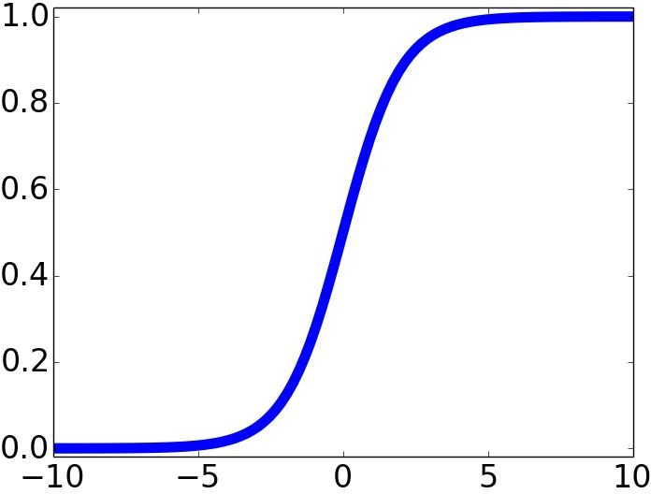

Impulses carried toward cell body
dendrite
presynaptic terminal
axon
cell body
Impulses carried away from cell body
This image by Felipe Perucho is licensed under CC-BY 3.0
sigmoid activation function

Slide 93
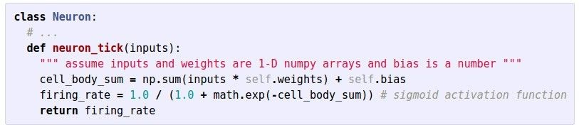
Impulses carried toward cell body
dendrite
presynaptic terminal
axon
cell body
Impulses carried away from cell body
This image by Felipe Perucho is licensed under CC-BY 3.0

Slide 94
Be very careful with your brain analogies!
Biological Neurons:
Many different types
Dendrites can perform complex non-linear computations
Synapses are not a single weight but a complex non-linear dynamical system
Rate code may not be adequate
[Dendritic Computation. London and Hausser]

Slide 95
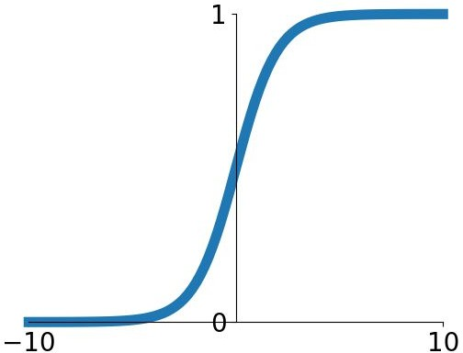
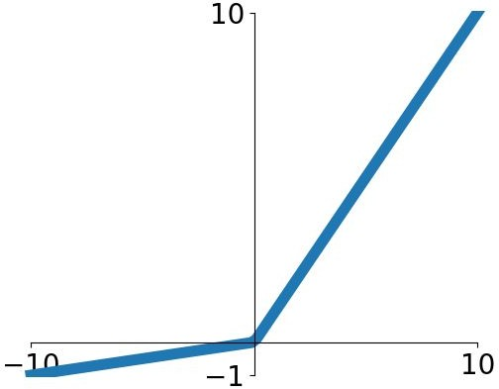


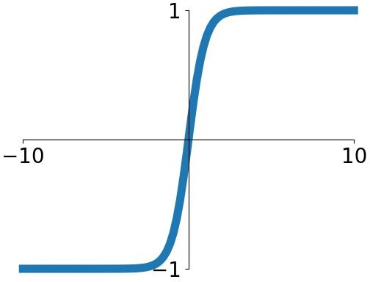


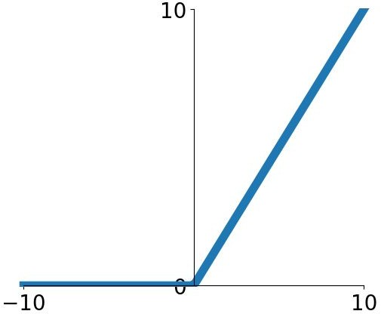
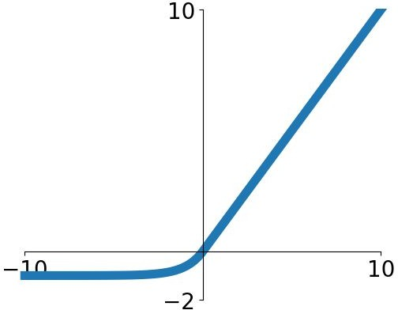
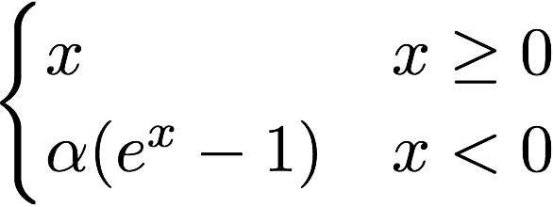

Activation functions
Sigmoid
tanh
Leaky ReLU
Maxout
ReLU
ELU

Slide 96
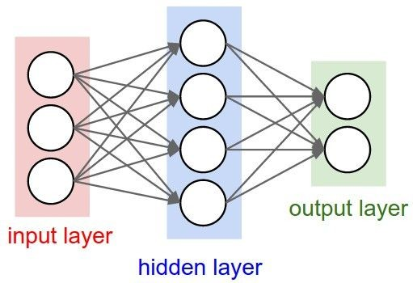
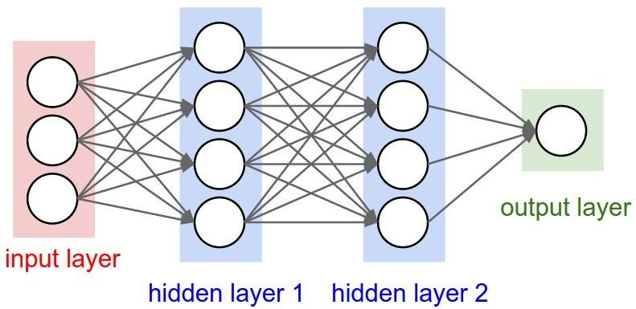
Neural networks: Architectures
“3-layer Neural Net”, or
“2-hidden-layer Neural Net”
“Fully-connected” layers
“2-layer Neural Net”, or
“1-hidden-layer Neural Net”

Slide 97
Example feed-forward computation of a neural network
We can efficiently evaluate an entire layer of neurons.

Slide 98
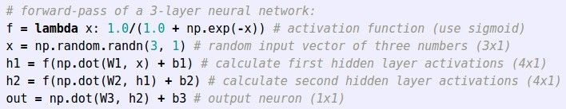
Example feed-forward computation of a neural network
Lecture 4 - ¹⁰
0

Slide 99
Summary
We arrange neurons into fully-connected layers
The abstraction of a layer has the nice property that it allows us to use efficient vectorized code (e.g. matrix multiplies)
Neural networks are not really neural
- Next time: Convolutional Neural Networks
Lecture 4 - ¹⁰
1

