Slide 1
CPSC 4430/5440: Machine Learning Lesson D02(b): Backpropagation of MLP
Derived from Hung-yi Lee

Slide 2
Gradient Descent
Network parameters
Starting Parameters
……
Millions of parameters ……
To compute the gradients efficiently, we use backpropagation.
Notes:
A network can have millions of parameters.
Backpropagation is the way to compute the gradients efficiently (not today)
Ref: http://speech.ee.ntu.edu.tw/~tlkagk/courses/MLDS_2015_2/Lecture/DNN%20backprop.ecm.mp4/index.html
What is the suitable value for η?
I don’t know. Depend on C(θ)

Slide 3
Chain Rule
Case 1
Case 2

Slide 4

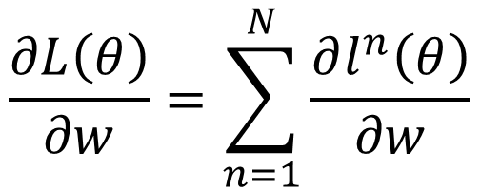

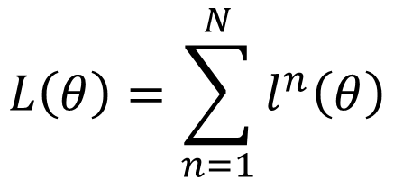





Backpropagation
x^{n}
NN
$$θ$$
y^{n}
$${\hat{y}}^{n}$$
$$l^{n}$$
$$L\left(θ\right)=\sum_{n=1}^{N}{l^{n}\left(θ\right)}$$
$$\frac{∂L\left(θ\right)}{∂w}=\sum_{n=1}^{N}{\frac{∂l^{n}\left(θ\right)}{∂w}}$$
$$y_{1}$$
$$x_{1}$$
$$x_{2}$$
$$y_{2}$$

Slide 5
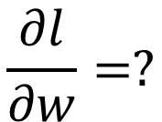


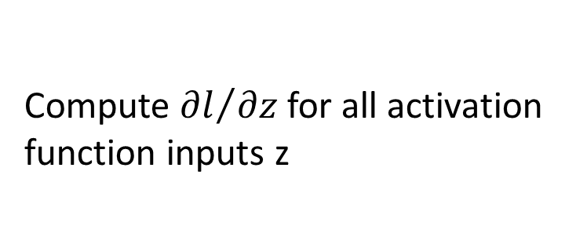



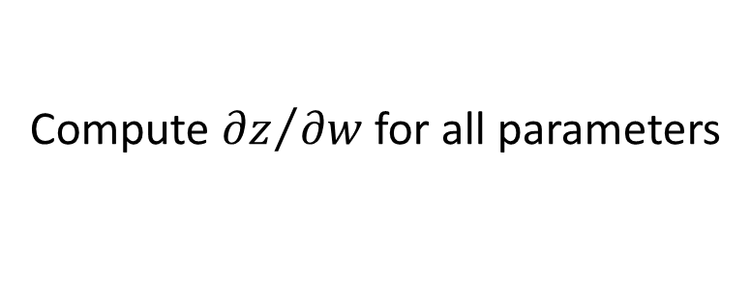


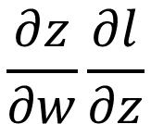

Backpropagation
$$w_{1}$$
$$z$$
$$x_{1}$$
……
$$y_{1}$$
$$w_{2}$$
b
……
$$z=x_{1}w_{1}+x_{2}w_{2}+b$$
$$x_{2}$$
$$y_{2}$$
Forward pass:
$$\frac{∂l}{∂w}=?$$
$$\frac{∂z}{∂w}\frac{∂l}{∂z}$$
Compute ${∂z}/{∂w}$ for all parameters
Backward pass:
(Chain rule)
Compute ${∂l}/{∂z}$ for all activation function inputs z
Notes:
後面的值很大

Slide 6













Backpropagation – Forward pass
Compute ${∂z}/{∂w}$ for all parameters
$$w_{1}$$
$$z$$
$$x_{1}$$
……
$$y_{1}$$
$$w_{2}$$
b
……
$$z=x_{1}w_{1}+x_{2}w_{2}+b$$
$$x_{2}$$
$$y_{2}$$
$${∂z}/{∂w_{1}}=?$$
$$x_{1}$$
The value of the input connected by the weight
$${∂z}/{∂w_{2}}=?$$
$$x_{2}$$

Slide 7
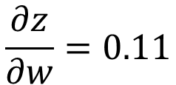
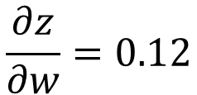
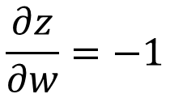
Backpropagation – Forward pass
Compute ${∂z}/{∂w}$ for all parameters
1
0.98
2
0.86
3
1
-2
-1
-1
1
0
-2
-1
0.12
-2
0.11
-1
-1
1
-1
4
0
0
2
$$\frac{∂z}{∂w}=−1$$
$$\frac{∂z}{∂w}=0.12$$
$$\frac{∂z}{∂w}=0.11$$
Notes:
That’s it. We have done the forward pass.

Slide 8
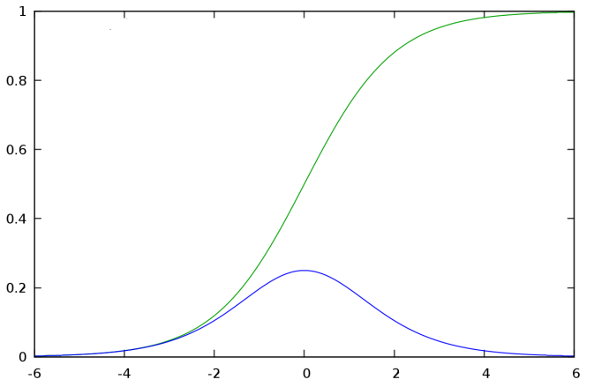









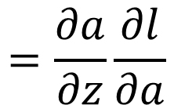


Backpropagation – Backward pass
Compute ${∂l}/{∂z}$ for all activation function inputs z
$$w_{1}$$
$$z$$
$$a$$
$$x_{1}$$
$$a=σ\left(z\right)$$
$$w_{2}$$
b
$$x_{2}$$
$$σ\left(z\right)$$
$$\frac{∂l}{∂z}$$
$$=\frac{∂a}{∂z}\frac{∂l}{∂a}$$
$$σ′\left(z\right)$$
$$σ′\left(z\right)$$

Slide 9







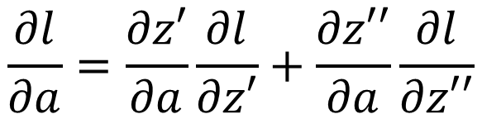
Backpropagation – Backward pass
Compute ${∂l}/{∂z}$ for all activation function inputs z
$$w_{1}$$
$$z$$
$$a$$
$$w_{3}$$
$$z′$$
$$x_{1}$$
$$a=σ\left(z\right)$$
$$z′=aw_{3}+⋯$$
$$w_{2}$$
b
$$w_{4}$$
$z$’’
$$x_{2}$$
$$\frac{∂l}{∂z}$$
$$=\frac{∂a}{∂z}\frac{∂l}{∂a}$$
$$\frac{∂l}{∂a}=\frac{∂z′}{∂a}\frac{∂l}{∂z′}+\frac{∂z′′}{∂a}\frac{∂l}{∂z′′}$$
(Chain rule)
?
?
Assumed it’s known
$$w_{3}$$
$$w_{4}$$
Notes:
How to explain this chain rule

Slide 10

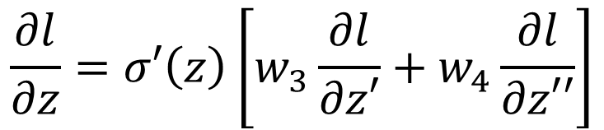

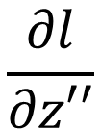
Backpropagation – Backward pass
Compute ${∂l}/{∂z}$ for all activation function inputs z
$$w_{1}$$
$$z$$
$$a$$
$$w_{3}$$
$$z′$$
$$x_{1}$$
$$\frac{∂l}{∂z}$$
$$\frac{∂l}{∂z′}$$
$$w_{2}$$
b
$$w_{4}$$
$z$’’
$$x_{2}$$
$$\frac{∂l}{∂z′′}$$
$$\frac{∂l}{∂z}=σ′\left(z\right)\left[w_{3}\frac{∂l}{∂z′}+w_{4}\frac{∂l}{∂z′′}\right]$$
Notes:
How to explain this chain rule

Slide 11

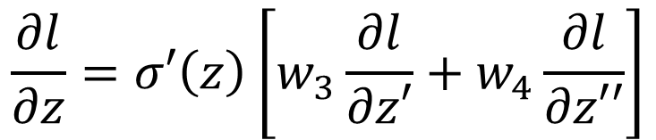
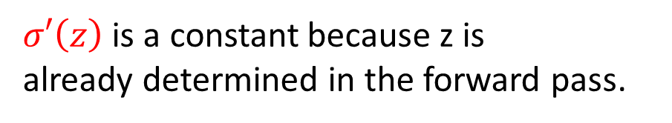
Backpropagation – Backward pass
$$σ′\left(z\right)$$
$$w_{3}$$
$$\frac{∂l}{∂z}$$
$$\frac{∂l}{∂z′}$$
$$w_{4}$$
$σ′\left(z\right)$ is a constant because z is
already determined in the forward pass.
$$\frac{∂l}{∂z′′}$$
$$\frac{∂l}{∂z}=σ′\left(z\right)\left[w_{3}\frac{∂l}{∂z′}+w_{4}\frac{∂l}{∂z′′}\right]$$
Notes:
How to explain this chain rule

Slide 12
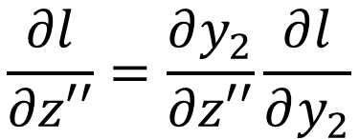
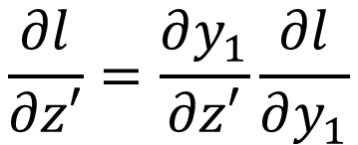


Backpropagation – Backward pass
Compute ${∂l}/{∂z}$ for all activation function inputs z
$$w_{1}$$
$$z$$
$$a$$
$$w_{3}$$
$$z′$$
$$x_{1}$$
$$y_{1}$$
$$\frac{∂l}{∂z}$$
$$\frac{∂l}{∂z′}$$
$$w_{2}$$
b
$$w_{4}$$
$z$’’
$$y_{2}$$
$$x_{2}$$
$$\frac{∂l}{∂z′′}$$
Case 1. Output Layer
$$\frac{∂l}{∂z′}=\frac{∂y_{1}}{∂z′}\frac{∂l}{∂y_{1}}$$
$$\frac{∂l}{∂z′′}=\frac{∂y_{2}}{∂z′′}\frac{∂l}{∂y_{2}}$$
Done!
Notes:
How to explain this chain rule

Slide 13


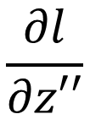

Backpropagation – Backward pass
Compute ${∂l}/{∂z}$ for all activation function inputs z
Case 2. Not Output Layer
$$z′$$
……
$$\frac{∂l}{∂z′}$$
$z$’’
……
$$\frac{∂l}{∂z′′}$$
Notes:
How to explain this chain rule

Slide 14

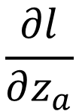

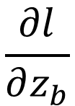



Backpropagation – Backward pass
Compute ${∂l}/{∂z}$ for all activation function inputs z
Case 2. Not Output Layer
$$z′$$
$$a′$$
$$w_{5}$$
$$z_{a}$$
$$\frac{∂l}{∂z′}$$
$$\frac{∂l}{∂z_{a}}$$
$$w_{6}$$
$z$’’
$$z_{b}$$
$$\frac{∂l}{∂z′′}$$
$$\frac{∂l}{∂z_{b}}$$
Notes:
How to explain this chain rule

Slide 15

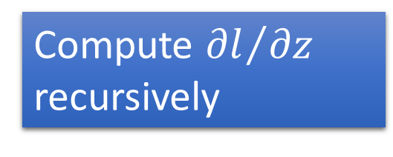
Backpropagation – Backward pass
Compute ${∂l}/{∂z}$ for all activation function inputs z
Case 2. Not Output Layer
Compute ${∂l}/{∂z}$ recursively
$$z′$$
$$a′$$
$$w_{5}$$
$$z_{a}$$
$$\frac{∂l}{∂z′}$$
$$\frac{∂l}{∂z_{a}}$$
$$σ′\left(z′\right)$$
Until we reach the output layer ……
$$w_{6}$$
$z$’’
$$z_{b}$$
$$\frac{∂l}{∂z′′}$$
$$\frac{∂l}{∂z_{b}}$$
Notes:
How to explain this chain rule

Slide 16

















Backpropagation – Backward Pass
Compute ${∂l}/{∂z}$ for all activation function inputs z
Compute ${∂l}/{∂z}$ from the output layer
$$\frac{∂l}{∂z_{1}}$$
$$\frac{∂l}{∂z_{3}}$$
$$\frac{∂l}{∂z_{5}}$$
$$z_{1}$$
$$z_{3}$$
$$z_{5}$$
$$y_{1}$$
$$x_{1}$$
$$x_{2}$$
$$y_{2}$$
$$z_{2}$$
$$z_{4}$$
$$z_{6}$$
$$\frac{∂l}{∂z_{2}}$$
$$\frac{∂l}{∂z_{4}}$$
$$\frac{∂l}{∂z_{6}}$$

Slide 17







Backpropagation – Backward Pass
Compute ${∂l}/{∂z}$ for all activation function inputs z
Compute ${∂l}/{∂z}$ from the output layer
$$\frac{∂l}{∂z_{1}}$$
$$\frac{∂l}{∂z_{3}}$$
$$\frac{∂l}{∂z_{5}}$$
$$z_{1}$$
$$z_{3}$$
$$z_{5}$$
$$y_{1}$$
$$x_{1}$$
$$σ′\left(z_{1}\right)$$
$$σ′\left(z_{3}\right)$$
$$σ′\left(z_{2}\right)$$
$$σ′\left(z_{4}\right)$$
$$x_{2}$$
$$y_{2}$$
$$z_{2}$$
$$z_{4}$$
$$z_{6}$$
$$\frac{∂l}{∂z_{2}}$$
$$\frac{∂l}{∂z_{4}}$$
$$\frac{∂l}{∂z_{6}}$$

Slide 18



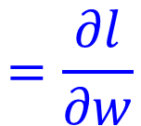

Backpropagation – Summary
Forward Pass
Backward Pass
…
…
…
…
$$a$$
$$\frac{∂z}{∂w}$$
X
$$\frac{∂l}{∂z}$$
$$=\frac{∂l}{∂w}$$
$$=a$$
for all w

Slide 19
Computational Graph for Feedforward Net

Slide 20
Review: Backpropagation
Error signal
Layer
Layer
Forward Pass
Backward Pass
…
…
…
…

Slide 21
Review: Backpropagation
Layer L-1
Layer L
Error signal
……
……
Backward Pass
…
…
……
…
…
(we do not use softmax here)

Slide 22





Feedforward Network
y
W^{L}
…
W²
W¹
x
b¹
b²
…
b^{L}
+
+
+
$$σ\left( \right)$$
$$=σ\left( \right)$$
$$σ\left( \right)$$
$$z^{1}=W^{1}x+b^{1}$$
$$z^{2}=W^{2}a^{1}+b^{2}$$
x
z¹
a¹
z²
y
$$σ$$
$$σ$$
W¹
W²
b¹
b²

Slide 23

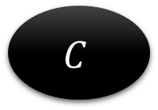
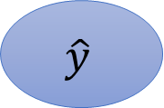
Loss Function of Feedforward Network
$$C=L\left(y,\hat{y} \right)$$
$$\hat{y}$$
$$C$$
$$z^{1}=W^{1}x+b^{1}$$
$$z^{2}=W^{2}a^{1}+b^{2}$$
x
z¹
a¹
z²
y
$$σ$$
$$σ$$
W¹
W²
b¹
b²

Slide 24



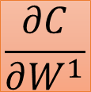
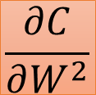
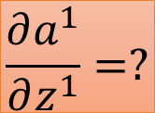
Gradient of Cost Function
$$C=L\left(y,\hat{y} \right)$$
To compute the gradient …
$$\hat{y}$$
$$C$$
Computing the partial derivative on the edge
Using reverse mode
Output is always a scalar
x
z¹
a¹
z²
y
$$σ$$
$$σ$$
$$\frac{∂C}{∂W^{1}}$$
W¹
$$\frac{∂C}{∂W^{2}}$$
W²
vector
$$\frac{∂a^{1}}{∂z^{1}}=?$$
$$\frac{∂C}{∂b^{1}}$$
b¹
$$\frac{∂C}{∂b^{2}}$$
b²
vector

Slide 25
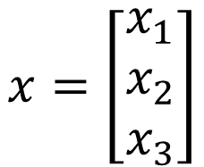
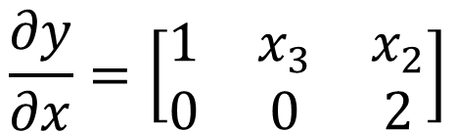

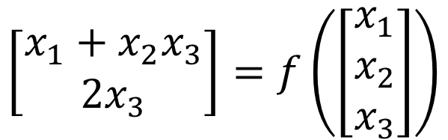
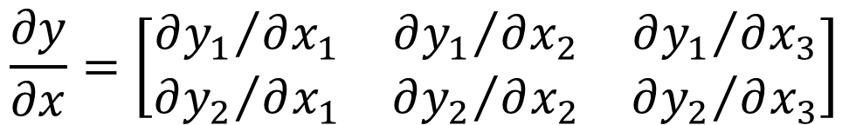
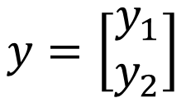
Jacobian Matrix
$$x=\left[\begin{aligned}x_{1} \\ x_{2} \\ x_{3}\end{aligned}\right]$$
$$y=\left[\begin{aligned}y_{1} \\ y_{2}\end{aligned}\right]$$
$$y=f\left(x\right)$$
$$\frac{∂y}{∂x}=\left[\begin{matrix}{∂y_{1}}/{∂x_{1}} & {∂y_{1}}/{∂x_{2}} & {∂y_{1}}/{∂x_{3}} \\ {∂y_{2}}/{∂x_{1}} & {∂y_{2}}/{∂x_{2}} & {∂y_{2}}/{∂x_{3}}\end{matrix}\right]$$
size of y
Example
size of x
$$\left[\begin{aligned}x_{1}+x_{2}x_{3} \\ 2x_{3}\end{aligned}\right]=f\left(\left[\begin{aligned}x_{1} \\ x_{2} \\ x_{3}\end{aligned}\right]\right)$$
$$\frac{∂y}{∂x}=\left[\begin{matrix}1 & x_{3} & x_{2} \\ 0 & 0 & 2\end{matrix}\right]$$

Slide 26


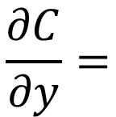
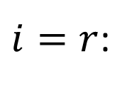



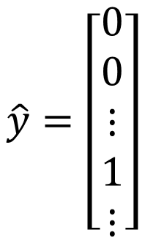
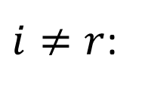
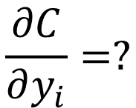
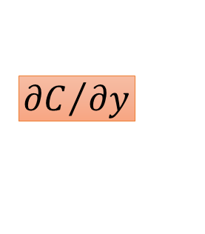
Gradient of Cost Function
$$C=L\left(y,\hat{y} \right)$$
$$\hat{y}$$
$$C$$
$$\hat{y}=\left[\begin{aligned}0 \\ 0 \\ ⋮ \\ 1 \\ ⋮\end{aligned}\right]$$
Last Layer
$${∂C}/{∂y}$$
…
…
$$r$$
y
$$\frac{∂C}{∂y_{i}}=?$$
…
…
Cross Entropy:
$$C=−logy_{r}$$
$i=r$:
$$\frac{∂C}{∂y}=$$
$${∂C}/{∂y_{r}}=−1/y_{r}$$
$$\left[\begin{matrix}\begin{matrix}0 & ⋯\end{matrix} & \begin{matrix}−1/y_{r} & ⋯\end{matrix}\end{matrix}\right]$$
$i≠r$:
$${∂C}/{∂y_{i}}=0$$
Notes:
Only one dimension is 1, and others are all 0
Index of the dimension which is 1
Do we have to consider other dimensions?

Slide 27
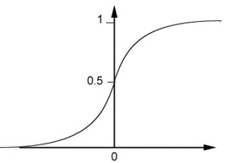
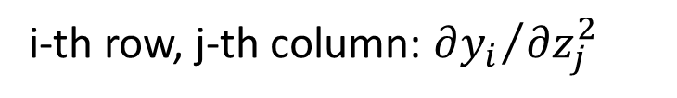




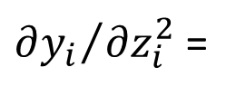

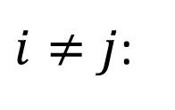

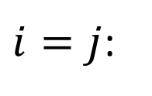



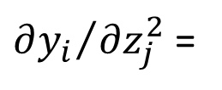


Gradient of Cost Function
square
$$C=L\left(y,\hat{y} \right)$$
$$\frac{∂y}{∂z^{2}}$$
$$y$$
is a Jacobian matrix
$$\hat{y}$$
$$C$$
$$z^{2}$$
i-th row, j-th column: ${∂y_{i}}/{∂z_{j}^{2}}$
$${∂C}/{∂y}$$
$$\frac{∂y}{∂z^{2}}$$
$i≠j$:
${∂y_{i}}/{∂z_{j}^{2}}$ =
z²
y
$i=j$:
${∂y_{i}}/{∂z_{i}^{2}}$ =
$$σ′\left(z_{i}^{2}\right)$$
$$σ$$
$$y_{i}=σ\left(z_{i}^{2}\right)$$
$$y$$
$$σ′\left(z_{i}^{2}\right)$$
How about softmax? ☺
Diagonal
Matrix
$$z_{i}^{2}$$
$$z$$

Slide 28










$$\frac{∂z^{2}}{∂a^{1}}$$
is a Jacobian matrix
$$a^{1}$$
$$z^{2}$$
$$C=L\left(y,\hat{y} \right)$$
i-th row, j-th column:
$$\hat{y}$$
$$C$$
$$\frac{∂z_{i}^{2}}{∂a_{j}^{1}}=W_{ij}^{2}$$
$${∂C}/{∂y}$$
$$z^{2}=W^{2}a^{1}$$
$$\frac{∂y}{∂z^{2}}$$
$$\frac{∂z^{2}}{∂a^{1}}$$
$$z_{i}^{2}=w_{i1}^{2}a_{1}^{1}+w_{i2}^{2}a_{2}^{1}+$$
a¹
z²
y
$$σ$$
$$⋯+w_{in}^{2}a_{n}^{1}$$
$$\frac{∂z^{2}}{∂W^{2}}$$
W²
$$W^{2}$$

Slide 29

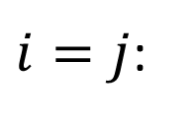
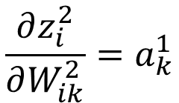







mxn
$$\frac{∂z_{i}^{2}}{∂W_{jk}^{2}}$$
$$\frac{∂z^{2}}{∂W^{2}}=$$
(j-1)xn+k
m
i
$$C=L\left(y,\hat{y} \right)$$
$$\frac{∂z_{i}^{2}}{∂W_{jk}^{2}}=?$$
$$\frac{∂z_{i}^{2}}{∂W_{jk}^{2}}=0$$
$$\hat{y}$$
$$C$$
$i≠j$:
$$\frac{∂z_{i}^{2}}{∂W_{ik}^{2}}=a_{k}^{1}$$
$${∂C}/{∂y}$$
$i=j$:
$$z^{2}=W^{2}a^{1}$$
$$\frac{∂y}{∂z^{2}}$$
$$z_{i}^{2}=w_{i1}^{2}a_{1}^{1}+w_{i2}^{2}a_{2}^{1}+$$
a¹
$$W^{2}$$
z²
y
$$σ$$
$$⋯+w_{in}^{2}a_{n}^{1}$$
n
m
$$\frac{∂z^{2}}{∂W^{2}}$$
W²
Considering W² as a mxn vector
mxn
(considering ${∂z^{2}}/{∂W^{2}}$ as a tensor makes thing easier)

Slide 30










mxn
$$\frac{∂z_{i}^{2}}{∂W_{jk}^{2}}$$
$$\frac{∂z^{2}}{∂W^{2}}=$$
(j-1)xn+k
m
i
$$C=L\left(y,\hat{y} \right)$$
$$\frac{∂z_{i}^{2}}{∂W_{jk}^{2}}=?$$
$$\frac{∂z_{i}^{2}}{∂W_{jk}^{2}}=0$$
$$\hat{y}$$
$$C$$
$i≠j$:
$$\frac{∂z_{i}^{2}}{∂W_{ik}^{2}}=a_{k}^{1}$$
$${∂C}/{∂y}$$
$i=j$:
$$z^{2}=W^{2}a^{1}$$
$$\frac{∂y}{∂z^{2}}$$
$$j=1$$
$$j=2$$
$$j=3$$
a¹
$$W^{2}$$
z²
y
$$σ$$
i=1
n
m
$$a$$
$$\frac{∂z^{2}}{∂W^{2}}$$
$$0$$
$$a$$
i=2
W²
Considering W² as a mxn vector
$$m$$
$$a$$
mxn
$$0$$
$$m×n$$

Slide 31
















$$\frac{∂C}{∂W^{1}}$$
$$\frac{∂C}{∂y}$$
$$\frac{∂y}{∂z^{2}}$$
$$\frac{∂a^{1}}{∂z^{1}}$$
$$\frac{∂z^{1}}{∂W^{1}}$$
$$=[\begin{matrix}⋯ & \frac{∂C}{∂W_{ij}^{1}} & ⋯\end{matrix}]$$
$$=$$
$$W^{2}$$
$$C=L\left(y,\hat{y} \right)$$
$$\hat{y}$$
$$C$$
$${∂C}/{∂y}$$
$$\frac{∂a^{1}}{∂z^{1}}$$
$$\frac{∂y}{∂z^{2}}$$
$$W^{1}$$
$$W^{2}$$
x
z¹
a¹
z²
y
$$σ$$
$$σ$$
$$\frac{∂z^{1}}{∂W^{1}}$$
$$\frac{∂z^{2}}{∂W^{2}}$$
W¹
W²
$$\frac{∂C}{∂W^{1}}$$

Slide 32


Question
Q: Only backward pass for computational graph?
Q: Do we get the same results from the two different approaches?

