Slide 1
CPSC 4430/5440: Introduction to Machine Learning
Lesson D03(b): Representative CNN Architecture
Derived from Feifei Li

Slide 2
Last time: Deep learning frameworks
Easily build big computational graphs
Easily compute gradients in computational graphs
Run it all efficiently on GPU (wrap cuDNN, cuBLAS, etc)
Lecture 9 -
2

Slide 3
Representative CNN Architectures
Case Studies
AlexNet
VGG
GoogLeNet
ResNet
Also....
NiN (Network in Network)
Wide ResNet
ResNeXT
Stochastic Depth
Squeeze-and-Excitation Network
DenseNet
FractalNet
SqueezeNet
NASNet
Lecture 9 -
3

Slide 4
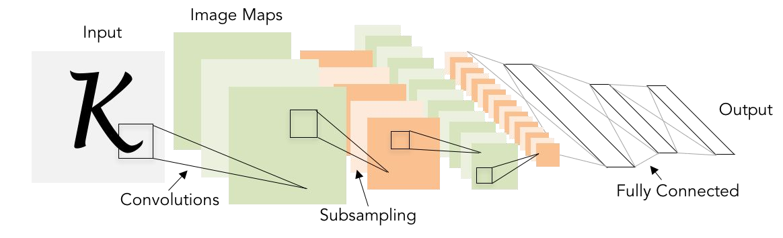
Review: LeNet-5
[LeCun et al., 1998]
Conv filters were 5x5, applied at stride 1
Subsampling (Pooling) layers were 2x2 applied at stride 2
i.e. architecture is [CONV-POOL-CONV-POOL-FC-FC]
Lecture 9 -
4

Slide 5
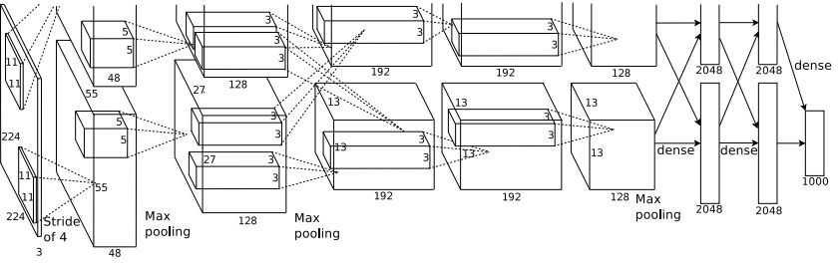
Case Study: AlexNet
[Krizhevsky et al. 2012]
Architecture:
CONV1 MAX POOL1 NORM1 CONV2 MAX POOL2 NORM2 CONV3 CONV4 CONV5
Max POOL3 FC6
FC7 FC8
Lecture 9 -
5
Fei-Fei Li & Justin Johnson & Serena Yeung Lecture 9 - May 1, 2018

Slide 6
Case Study: AlexNet
[Krizhevsky et al. 2012]
Input: 227x227x3 images
First layer (CONV1): 96 11x11 filters applied at stride 4
=>
Q: what is the output volume size? Hint: (227-11)/4+1 = 55
Lecture 9 -
6
Fei-Fei Li & Justin Johnson & Serena Yeung Lecture 9 - May 1, 2018

Slide 7
Case Study: AlexNet
[Krizhevsky et al. 2012]
Input: 227x227x3 images
First layer (CONV1): 96 11x11 filters applied at stride 4
=>
Output volume [55x55x96]
Q: What is the total number of parameters in this layer?
Lecture 9 -
7
Fei-Fei Li & Justin Johnson & Serena Yeung Lecture 9 - May 1, 2018

Slide 8
Case Study: AlexNet
[Krizhevsky et al. 2012]
Input: 227x227x3 images
First layer (CONV1): 96 11x11 filters applied at stride 4
=>
Output volume [55x55x96]
Parameters: (11*11*3)*96 = 35K
Fei-Fei Li & Justin Johnson & Serena Yeung Lecture 9 - May 1, 2018

Slide 9
Case Study: AlexNet
[Krizhevsky et al. 2012]
Input: 227x227x3 images After CONV1: 55x55x96
Second layer (POOL1): 3x3 filters applied at stride 2 Q: what is the output volume size? Hint: (55-3)/2+1 = 27
Fei-Fei Li & Justin Johnson & Serena Yeung Lecture 9 - May 1, 2018

Slide 10
Case Study: AlexNet
[Krizhevsky et al. 2012]
Input: 227x227x3 images After CONV1: 55x55x96
Second layer (POOL1): 3x3 filters applied at stride 2 Output volume: 27x27x96
Q: what is the number of parameters in this layer?
Fei-Fei Li & Justin Johnson & Serena Yeung Lecture 9 - May 1, 2018

Slide 11
Case Study: AlexNet
[Krizhevsky et al. 2012]
Input: 227x227x3 images After CONV1: 55x55x96
Second layer (POOL1): 3x3 filters applied at stride 2 Output volume: 27x27x96
Parameters: 0!
Fei-Fei Li & Justin Johnson & Serena Yeung Lecture 9 - May 1, 2018

Slide 12
Case Study: AlexNet
[Krizhevsky et al. 2012]
Input: 227x227x3 images After CONV1: 55x55x96 After POOL1: 27x27x96
...
Fei-Fei Li & Justin Johnson & Serena Yeung Lecture 9 - May 1, 2018

Slide 13
Case Study: AlexNet
[Krizhevsky et al. 2012]
Full (simplified) AlexNet architecture: [227x227x3] INPUT
[55x55x96] CONV1: 96 11x11 filters at stride 4, pad 0 [27x27x96] MAX POOL1: 3x3 filters at stride 2 [27x27x96] NORM1: Normalization layer
[27x27x256] CONV2: 256 5x5 filters at stride 1, pad 2 [13x13x256] MAX POOL2: 3x3 filters at stride 2 [13x13x256] NORM2: Normalization layer [13x13x384] CONV3: 384 3x3 filters at stride 1, pad 1 [13x13x384] CONV4: 384 3x3 filters at stride 1, pad 1 [13x13x256] CONV5: 256 3x3 filters at stride 1, pad 1 [6x6x256] MAX POOL3: 3x3 filters at stride 2
[4096] FC6: 4096 neurons
[4096] FC7: 4096 neurons
[1000] FC8: 1000 neurons (class scores)
Fei-Fei Li & Justin Johnson & Serena Yeung Lecture 9 - May 1, 2018

Slide 14
Case Study: AlexNet
[Krizhevsky et al. 2012]
Full (simplified) AlexNet architecture: [227x227x3] INPUT
[55x55x96] CONV1: 96 11x11 filters at stride 4, pad 0 [27x27x96] MAX POOL1: 3x3 filters at stride 2 [27x27x96] NORM1: Normalization layer
[27x27x256] CONV2: 256 5x5 filters at stride 1, pad 2 [13x13x256] MAX POOL2: 3x3 filters at stride 2 [13x13x256] NORM2: Normalization layer [13x13x384] CONV3: 384 3x3 filters at stride 1, pad 1 [13x13x384] CONV4: 384 3x3 filters at stride 1, pad 1 [13x13x256] CONV5: 256 3x3 filters at stride 1, pad 1 [6x6x256] MAX POOL3: 3x3 filters at stride 2
Details/Retrospectives:
first use of ReLU
used Norm layers (not common anymore)
heavy data augmentation
dropout 0.5
batch size 128
SGD Momentum 0.9
Learning rate 1e-2, reduced by 10 manually when val accuracy plateaus
L2 weight decay 5e-4
[4096] FC6: 4096 neurons
[4096] FC7: 4096 neurons
[1000] FC8: 1000 neurons (class scores)
- 7 CNN ensemble: 18.2% -> 15.4%
Fei-Fei Li & Justin Johnson & Serena Yeung Lecture 9 - May 1, 2018

Slide 15
Case Study: AlexNet
[Krizhevsky et al. 2012]
Full (simplified) AlexNet architecture: [227x227x3] INPUT
[55x55x96] CONV1: 96 11x11 filters at stride 4, pad 0 [27x27x96] MAX POOL1: 3x3 filters at stride 2
[55x55x48] x 2
[27x27x96] NORM1: Normalization layer
[27x27x256] CONV2: 256 5x5 filters at stride 1, pad 2 [13x13x256] MAX POOL2: 3x3 filters at stride 2 [13x13x256] NORM2: Normalization layer [13x13x384] CONV3: 384 3x3 filters at stride 1, pad 1 [13x13x384] CONV4: 384 3x3 filters at stride 1, pad 1 [13x13x256] CONV5: 256 3x3 filters at stride 1, pad 1
Historical note: Trained on GTX 580 GPU with only 3 GB of memory.
Network spread across 2 GPUs, half the neurons (feature maps) on each GPU.
[6x6x256] MAX POOL3: 3x3 filters at stride 2 [4096] FC6: 4096 neurons
[4096] FC7: 4096 neurons
[1000] FC8: 1000 neurons (class scores)
Fei-Fei Li & Justin Johnson & Serena Yeung Lecture 9 - May 1, 2018

Slide 16
Case Study: AlexNet
[Krizhevsky et al. 2012]
Full (simplified) AlexNet architecture: [227x227x3] INPUT
[55x55x96] CONV1: 96 11x11 filters at stride 4, pad 0 [27x27x96] MAX POOL1: 3x3 filters at stride 2 [27x27x96] NORM1: Normalization layer
[27x27x256] CONV2: 256 5x5 filters at stride 1, pad 2 [13x13x256] MAX POOL2: 3x3 filters at stride 2 [13x13x256] NORM2: Normalization layer [13x13x384] CONV3: 384 3x3 filters at stride 1, pad 1 [13x13x384] CONV4: 384 3x3 filters at stride 1, pad 1 [13x13x256] CONV5: 256 3x3 filters at stride 1, pad 1
CONV1, CONV2, CONV4, CONV5:
Connections only with feature maps on same GPU
[6x6x256] MAX POOL3: 3x3 filters at stride 2 [4096] FC6: 4096 neurons
[4096] FC7: 4096 neurons
[1000] FC8: 1000 neurons (class scores)
Fei-Fei Li & Justin Johnson & Serena Yeung Lecture 9 - May 1, 2018

Slide 17
Case Study: AlexNet
[Krizhevsky et al. 2012]
Full (simplified) AlexNet architecture: [227x227x3] INPUT
[55x55x96] CONV1: 96 11x11 filters at stride 4, pad 0 [27x27x96] MAX POOL1: 3x3 filters at stride 2 [27x27x96] NORM1: Normalization layer
[27x27x256] CONV2: 256 5x5 filters at stride 1, pad 2 [13x13x256] MAX POOL2: 3x3 filters at stride 2 [13x13x256] NORM2: Normalization layer [13x13x384] CONV3: 384 3x3 filters at stride 1, pad 1 [13x13x384] CONV4: 384 3x3 filters at stride 1, pad 1 [13x13x256] CONV5: 256 3x3 filters at stride 1, pad 1 [6x6x256] MAX POOL3: 3x3 filters at stride 2
[4096] FC6: 4096 neurons
[4096] FC7: 4096 neurons
[1000] FC8: 1000 neurons (class scores)
CONV3, FC6, FC7, FC8:
Connections with all feature maps in preceding layer, communication across GPUs
Fei-Fei Li & Justin Johnson & Serena Yeung Lecture 9 - May 1, 2018

Slide 18
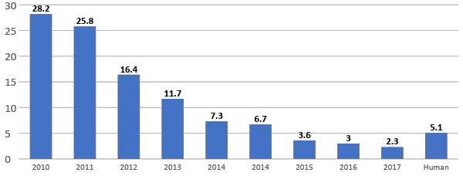



ImageNet Large Scale Visual Recognition Challenge (ILSVRC) winners
152 layers
152 layers
152 layers
19 layers
22 layers
shallow
8 layers
8 layers
Fei-Fei Li & Justin Johnson & Serena Yeung Lecture 9 - May 1, 2018

Slide 19
ImageNet Large Scale Visual Recognition Challenge (ILSVRC) winners
First CNN-based winner
152 layers
152 layers
152 layers
19 layers
22 layers
shallow
8 layers
8 layers
Fei-Fei Li & Justin Johnson & Serena Yeung Lecture 9 - May 1, 2018

Slide 20
ImageNet Large Scale Visual Recognition Challenge (ILSVRC) winners
ZFNet: Improved hyperparameters over AlexNet
152 layers
152 layers
152 layers
19 layers
22 layers
shallow
8 layers
8 layers
Fei-Fei Li & Justin Johnson & Serena Yeung Lecture 9 - May 1, 2018

Slide 21
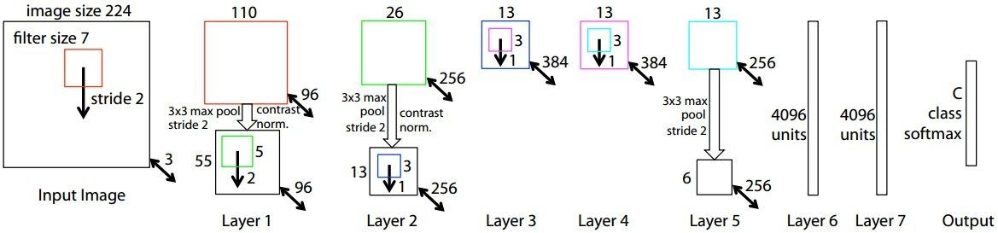
ZFNet
[Zeiler and Fergus, 2013]
AlexNet but:
CONV1: change from (11x11 stride 4) to (7x7 stride 2) CONV3,4,5: instead of 384, 384, 256 filters use 512, 1024, 512
ImageNet top 5 error: 16.4% -> 11.7%
Fei-Fei Li & Justin Johnson & Serena Yeung Lecture 9 - May 1, 2018

Slide 22
ImageNet Large Scale Visual Recognition Challenge (ILSVRC) winners
Deeper Networks
152 layers
152 layers
152 layers
19 layers
22 layers
shallow
8 layers
8 layers
Fei-Fei Li & Justin Johnson & Serena Yeung Lecture 9 - May 1, 2018

Slide 23
Case Study: VGGNet
[Simonyan and Zisserman, 2014]
Small filters, Deeper networks
8 layers (AlexNet)
-> 16 - 19 layers (VGG16Net)
Only 3x3 CONV stride 1, pad 1 and 2x2 MAX POOL stride 2
11.7% top 5 error in ILSVRC’13 (ZFNet)
-> 7.3% top 5 error in ILSVRC’14
AlexNet
VGG16
VGG19
Fei-Fei Li & Justin Johnson & Serena Yeung Lecture 9 - May 1, 2018

Slide 24
Case Study: VGGNet
[Simonyan and Zisserman, 2014]
Q: Why use smaller filters? (3x3 conv)
AlexNet
VGG16
VGG19
Fei-Fei Li & Justin Johnson & Serena Yeung Lecture 9 - May 1, 2018

Slide 25
Case Study: VGGNet
[Simonyan and Zisserman, 2014]
Q: Why use smaller filters? (3x3 conv)
Stack of three 3x3 conv (stride 1) layers has same effective receptive field as one 7x7 conv layer
Q: What is the effective receptive field of three 3x3 conv (stride 1) layers?
AlexNet
VGG16
VGG19
Fei-Fei Li & Justin Johnson & Serena Yeung Lecture 9 - May 1, 2018

Slide 26
Case Study: VGGNet
[Simonyan and Zisserman, 2014]
Q: Why use smaller filters? (3x3 conv)
Stack of three 3x3 conv (stride 1) layers has same effective receptive field as one 7x7 conv layer
[7x7]
AlexNet
VGG16
VGG19
Fei-Fei Li & Justin Johnson & Serena Yeung Lecture 9 - May 1, 2018

Slide 27
Case Study: VGGNet
[Simonyan and Zisserman, 2014]
Q: Why use smaller filters? (3x3 conv)
Stack of three 3x3 conv (stride 1) layers has same effective receptive field as one 7x7 conv layer
But deeper, more non-linearities
And fewer parameters: 3 * (3²C²) vs. 7²C² for C channels per layer
AlexNet
VGG16
VGG19
Fei-Fei Li & Justin Johnson & Serena Yeung Lecture 9 - May 1, 2018

Slide 28
(not counting biases)
INPUT: [224x224x3] memory: 224*224*3=150K params: 0
CONV3-64: [224x224x64] memory: 224*224*64=3.2M params: (3*3*3)*64 = 1,728 CONV3-64: [224x224x64] memory: 224*224*64=3.2M params: (3*3*64)*64 = 36,864
POOL2: [112x112x64] memory: 112*112*64=800K params: 0
CONV3-128: [112x112x128] memory: 112*112*128=1.6M params: (3*3*64)*128 = 73,728 CONV3-128: [112x112x128] memory: 112*112*128=1.6M params: (3*3*128)*128 = 147,456
POOL2: [56x56x128] memory: 56*56*128=400K params: 0
CONV3-256: [56x56x256] memory: 56*56*256=800K params: (3*3*128)*256 = 294,912 CONV3-256: [56x56x256] memory: 56*56*256=800K params: (3*3*256)*256 = 589,824 CONV3-256: [56x56x256] memory: 56*56*256=800K params: (3*3*256)*256 = 589,824
POOL2: [28x28x256] memory: 28*28*256=200K params: 0
CONV3-512: [28x28x512] memory: 28*28*512=400K params: (3*3*256)*512 = 1,179,648 CONV3-512: [28x28x512] memory: 28*28*512=400K params: (3*3*512)*512 = 2,359,296 CONV3-512: [28x28x512] memory: 28*28*512=400K params: (3*3*512)*512 = 2,359,296
POOL2: [14x14x512] memory: 14*14*512=100K params: 0
CONV3-512: [14x14x512] memory: 14*14*512=100K params: (3*3*512)*512 = 2,359,296 CONV3-512: [14x14x512] memory: 14*14*512=100K params: (3*3*512)*512 = 2,359,296 CONV3-512: [14x14x512] memory: 14*14*512=100K params: (3*3*512)*512 = 2,359,296
POOL2: [7x7x512] memory: 7*7*512=25K params: 0
FC: [1x1x4096] memory: 4096 params: 7*7*512*4096 = 102,760,448 FC: [1x1x4096] memory: 4096 params: 4096*4096 = 16,777,216
FC: [1x1x1000] memory: 1000 params: 4096*1000 = 4,096,000
VGG16
Fei-Fei Li & Justin Johnson & Serena Yeung Lecture 9 - May 1, 2018

Slide 29
(not counting biases)
INPUT: [224x224x3] memory: 224*224*3=150K params: 0
CONV3-64: [224x224x64] memory: 224*224*64=3.2M params: (3*3*3)*64 = 1,728 CONV3-64: [224x224x64] memory: 224*224*64=3.2M params: (3*3*64)*64 = 36,864
POOL2: [112x112x64] memory: 112*112*64=800K params: 0
CONV3-128: [112x112x128] memory: 112*112*128=1.6M params: (3*3*64)*128 = 73,728 CONV3-128: [112x112x128] memory: 112*112*128=1.6M params: (3*3*128)*128 = 147,456
POOL2: [56x56x128] memory: 56*56*128=400K params: 0
CONV3-256: [56x56x256] memory: 56*56*256=800K params: (3*3*128)*256 = 294,912 CONV3-256: [56x56x256] memory: 56*56*256=800K params: (3*3*256)*256 = 589,824 CONV3-256: [56x56x256] memory: 56*56*256=800K params: (3*3*256)*256 = 589,824
POOL2: [28x28x256] memory: 28*28*256=200K params: 0
CONV3-512: [28x28x512] memory: 28*28*512=400K params: (3*3*256)*512 = 1,179,648 CONV3-512: [28x28x512] memory: 28*28*512=400K params: (3*3*512)*512 = 2,359,296 CONV3-512: [28x28x512] memory: 28*28*512=400K params: (3*3*512)*512 = 2,359,296
POOL2: [14x14x512] memory: 14*14*512=100K params: 0
CONV3-512: [14x14x512] memory: 14*14*512=100K params: (3*3*512)*512 = 2,359,296 CONV3-512: [14x14x512] memory: 14*14*512=100K params: (3*3*512)*512 = 2,359,296 CONV3-512: [14x14x512] memory: 14*14*512=100K params: (3*3*512)*512 = 2,359,296
POOL2: [7x7x512] memory: 7*7*512=25K params: 0
FC: [1x1x4096] memory: 4096 params: 7*7*512*4096 = 102,760,448 FC: [1x1x4096] memory: 4096 params: 4096*4096 = 16,777,216
FC: [1x1x1000] memory: 1000 params: 4096*1000 = 4,096,000
TOTAL memory: 24M * 4 bytes ~= 96MB / image (for a forward pass) TOTAL params: 138M parameters
VGG16
Fei-Fei Li & Justin Johnson & Serena Yeung Lecture 9 - May 1, 2018

Slide 30
(not counting biases)
INPUT: [224x224x3] memory: 224*224*3=150K params: 0
CONV3-64: [224x224x64] memory: 224*224*64=3.2M params: (3*3*3)*64 = 1,728 CONV3-64: [224x224x64] memory: 224*224*64=3.2M params: (3*3*64)*64 = 36,864
POOL2: [112x112x64] memory: 112*112*64=800K params: 0
CONV3-128: [112x112x128] memory: 112*112*128=1.6M params: (3*3*64)*128 = 73,728 CONV3-128: [112x112x128] memory: 112*112*128=1.6M params: (3*3*128)*128 = 147,456
POOL2: [56x56x128] memory: 56*56*128=400K params: 0
CONV3-256: [56x56x256] memory: 56*56*256=800K params: (3*3*128)*256 = 294,912 CONV3-256: [56x56x256] memory: 56*56*256=800K params: (3*3*256)*256 = 589,824 CONV3-256: [56x56x256] memory: 56*56*256=800K params: (3*3*256)*256 = 589,824
POOL2: [28x28x256] memory: 28*28*256=200K params: 0
CONV3-512: [28x28x512] memory: 28*28*512=400K params: (3*3*256)*512 = 1,179,648 CONV3-512: [28x28x512] memory: 28*28*512=400K params: (3*3*512)*512 = 2,359,296 CONV3-512: [28x28x512] memory: 28*28*512=400K params: (3*3*512)*512 = 2,359,296
POOL2: [14x14x512] memory: 14*14*512=100K params: 0
CONV3-512: [14x14x512] memory: 14*14*512=100K params: (3*3*512)*512 = 2,359,296 CONV3-512: [14x14x512] memory: 14*14*512=100K params: (3*3*512)*512 = 2,359,296 CONV3-512: [14x14x512] memory: 14*14*512=100K params: (3*3*512)*512 = 2,359,296
POOL2: [7x7x512] memory: 7*7*512=25K params: 0
FC: [1x1x4096] memory: 4096 params: 7*7*512*4096 = 102,760,448
FC: [1x1x4096] memory: 4096 params: 4096*4096 = 16,777,216 FC: [1x1x1000] memory: 1000 params: 4096*1000 = 4,096,000
TOTAL memory: 24M * 4 bytes ~= 96MB / image (only forward! ~*2 for bwd) TOTAL params: 138M parameters
Note:
Most memory is in early CONV
Most params are in late FC
Lecture 9 - 32
Fei-Fei Li & Justin Johnson & Serena Yeung Lecture 9 - May 1, 2018

Slide 31
(not counting biases)
INPUT: [224x224x3] memory: 224*224*3=150K params: 0
CONV3-64: [224x224x64] memory: 224*224*64=3.2M params: (3*3*3)*64 = 1,728 CONV3-64: [224x224x64] memory: 224*224*64=3.2M params: (3*3*64)*64 = 36,864
POOL2: [112x112x64] memory: 112*112*64=800K params: 0
CONV3-128: [112x112x128] memory: 112*112*128=1.6M params: (3*3*64)*128 = 73,728 CONV3-128: [112x112x128] memory: 112*112*128=1.6M params: (3*3*128)*128 = 147,456
POOL2: [56x56x128] memory: 56*56*128=400K params: 0
CONV3-256: [56x56x256] memory: 56*56*256=800K params: (3*3*128)*256 = 294,912 CONV3-256: [56x56x256] memory: 56*56*256=800K params: (3*3*256)*256 = 589,824 CONV3-256: [56x56x256] memory: 56*56*256=800K params: (3*3*256)*256 = 589,824
POOL2: [28x28x256] memory: 28*28*256=200K params: 0
CONV3-512: [28x28x512] memory: 28*28*512=400K params: (3*3*256)*512 = 1,179,648 CONV3-512: [28x28x512] memory: 28*28*512=400K params: (3*3*512)*512 = 2,359,296 CONV3-512: [28x28x512] memory: 28*28*512=400K params: (3*3*512)*512 = 2,359,296
POOL2: [14x14x512] memory: 14*14*512=100K params: 0
CONV3-512: [14x14x512] memory: 14*14*512=100K params: (3*3*512)*512 = 2,359,296 CONV3-512: [14x14x512] memory: 14*14*512=100K params: (3*3*512)*512 = 2,359,296 CONV3-512: [14x14x512] memory: 14*14*512=100K params: (3*3*512)*512 = 2,359,296
POOL2: [7x7x512] memory: 7*7*512=25K params: 0
FC: [1x1x4096] memory: 4096 params: 7*7*512*4096 = 102,760,448 FC: [1x1x4096] memory: 4096 params: 4096*4096 = 16,777,216
FC: [1x1x1000] memory: 1000 params: 4096*1000 = 4,096,000
TOTAL memory: 24M * 4 bytes ~= 96MB / image (only forward! ~*2 for bwd) TOTAL params: 138M parameters
VGG16
Common names
Fei-Fei Li & Justin Johnson & Serena Yeung Lecture 9 - May 1, 2018

Slide 32
Case Study: VGGNet
[Simonyan and Zisserman, 2014]
Details:
ILSVRC’14 2nd in classification, 1st in localization
Similar training procedure as Krizhevsky 2012
No Local Response Normalisation (LRN)
Use VGG16 or VGG19 (VGG19 only slightly better, more memory)
Use ensembles for best results
FC7 features generalize well to other tasks
AlexNet
VGG16
VGG19
Fei-Fei Li & Justin Johnson & Serena Yeung Lecture 9 - May 1, 2018

Slide 33
ImageNet Large Scale Visual Recognition Challenge (ILSVRC) winners
Deeper Networks
152 layers
152 layers
152 layers
19 layers
22 layers
shallow
8 layers
8 layers
Fei-Fei Li & Justin Johnson & Serena Yeung Lecture 9 - May 1, 2018

Slide 34
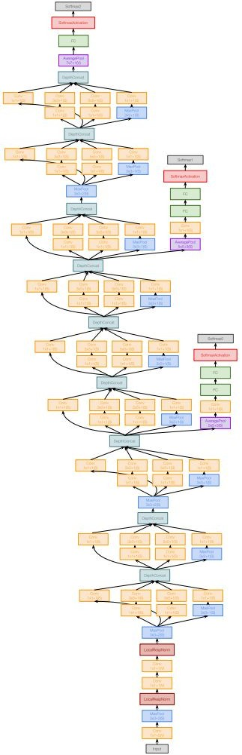
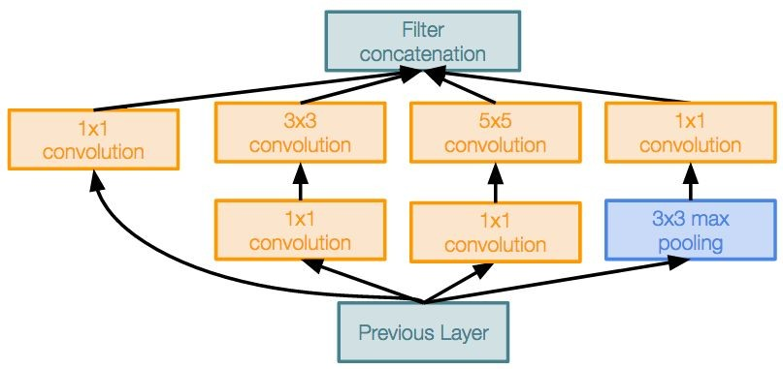
Case Study: GoogLeNet
[Szegedy et al., 2014]
Deeper networks, with computational efficiency
22 layers
Efficient “Inception” module
No FC layers
Only 5 million parameters!
12x less than AlexNet
ILSVRC’14 classification winner (6.7% top 5 error)
Inception module
Fei-Fei Li & Justin Johnson & Serena Yeung Lecture 9 - May 1, 2018

Slide 35
Case Study: GoogLeNet
[Szegedy et al., 2014]
“Inception module”: design a good local network topology (network within a network) and then stack these modules on top of each other
Inception module
Fei-Fei Li & Justin Johnson & Serena Yeung Lecture 9 - May 1, 2018

Slide 36
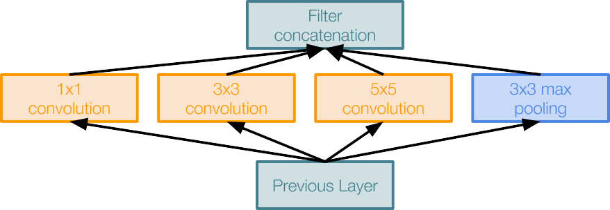
Case Study: GoogLeNet
[Szegedy et al., 2014]
Apply parallel filter operations on the input from previous layer:
Multiple receptive field sizes for convolution (1x1, 3x3, 5x5)
Pooling operation (3x3)
Concatenate all filter outputs together depth-wise
Naive Inception module
Fei-Fei Li & Justin Johnson & Serena Yeung Lecture 9 - May 1, 2018

Slide 37
Case Study: GoogLeNet
[Szegedy et al., 2014]
Apply parallel filter operations on the input from previous layer:
Multiple receptive field sizes for convolution (1x1, 3x3, 5x5)
Pooling operation (3x3)
Concatenate all filter outputs together depth-wise
Naive Inception module
Q: What is the problem with this? [Hint: Computational complexity]
Fei-Fei Li & Justin Johnson & Serena Yeung Lecture 9 - May 1, 2018

Slide 38
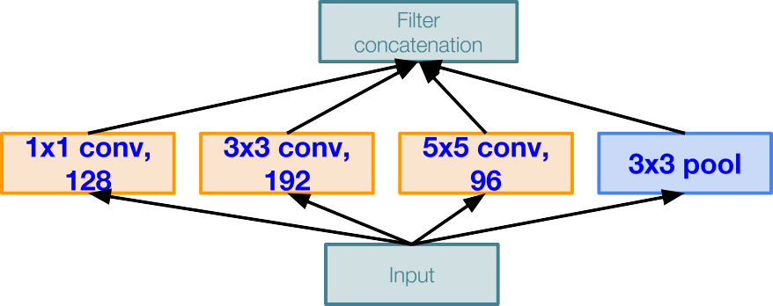
Case Study: GoogLeNet
[Szegedy et al., 2014]
Q: What is the problem with this? [Hint: Computational complexity]
Example:
Module input: 28x28x256
Naive Inception module
Fei-Fei Li & Justin Johnson & Serena Yeung Lecture 9 - May 1, 2018

Slide 39
Case Study: GoogLeNet
Q: What is the problem with this? [Hint: Computational complexity]
[Szegedy et al., 2014]
Example:
Q1: What is the output size of the 1x1 conv, with 128 filters?
Module input: 28x28x256
Naive Inception module
Fei-Fei Li & Justin Johnson & Serena Yeung Lecture 9 - May 1, 2018

Slide 40
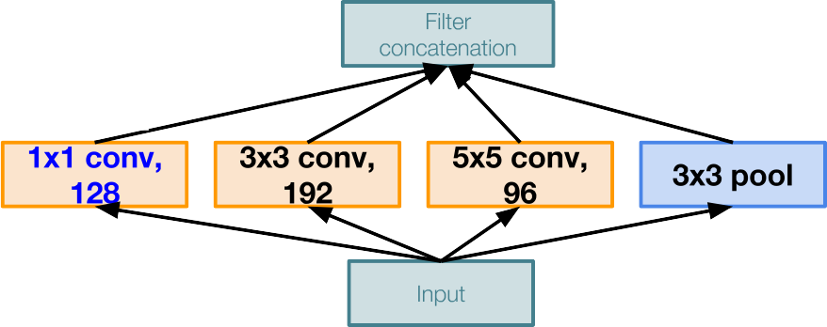
Case Study: GoogLeNet
Q: What is the problem with this? [Hint: Computational complexity]
[Szegedy et al., 2014]
Example:
Q1: What is the output size of the 1x1 conv, with 128 filters?
28x28x128
Module input: 28x28x256
Naive Inception module
Fei-Fei Li & Justin Johnson & Serena Yeung Lecture 9 - May 1, 2018

Slide 41
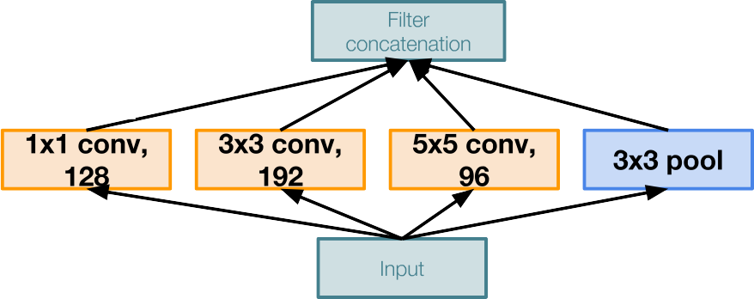
Case Study: GoogLeNet
Q: What is the problem with this? [Hint: Computational complexity]
[Szegedy et al., 2014]
Example:
Q2: What are the output sizes of all different filter operations?
28x28x128
Module input: 28x28x256
Naive Inception module
Fei-Fei Li & Justin Johnson & Serena Yeung Lecture 9 - May 1, 2018

Slide 42
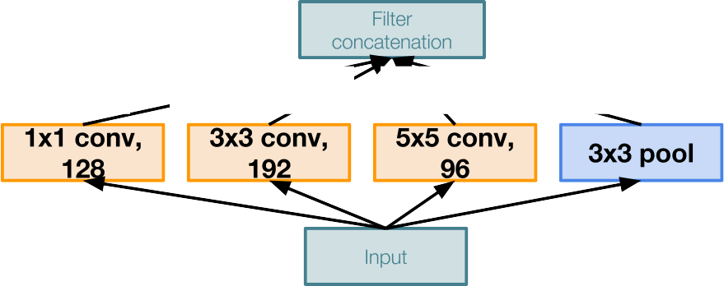
Case Study: GoogLeNet
Q: What is the problem with this? [Hint: Computational complexity]
[Szegedy et al., 2014]
Example:
Q2: What are the output sizes of all different filter operations?
28x28x128
28x28x192
28x28x96
28x28x256
Module input: 28x28x256
Naive Inception module
Fei-Fei Li & Justin Johnson & Serena Yeung Lecture 9 - May 1, 2018

Slide 43
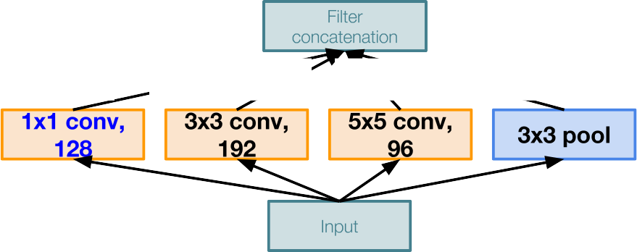
Case Study: GoogLeNet
Q: What is the problem with this? [Hint: Computational complexity]
[Szegedy et al., 2014]
Example:
Q3:What is output size after filter concatenation?
28x28x128
28x28x192
28x28x96
28x28x256
Module input: 28x28x256
Naive Inception module
Fei-Fei Li & Justin Johnson & Serena Yeung Lecture 9 - May 1, 2018

Slide 44
Case Study: GoogLeNet
Q: What is the problem with this? [Hint: Computational complexity]
[Szegedy et al., 2014]
Example:
Q3:What is output size after filter concatenation?
28x28x(128+192+96+256) = 28x28x672
28x28x128
28x28x192
28x28x96
28x28x256
Module input: 28x28x256
Naive Inception module
Fei-Fei Li & Justin Johnson & Serena Yeung Lecture 9 - May 1, 2018

Slide 45
Case Study: GoogLeNet
Q: What is the problem with this? [Hint: Computational complexity]
[Szegedy et al., 2014]
Example:
Q3:What is output size after filter concatenation?
Conv Ops:
[1x1 conv, 128] 28x28x128x1x1x256 [3x3 conv, 192] 28x28x192x3x3x256 [5x5 conv, 96] 28x28x96x5x5x256 Total: 854M ops
28x28x(128+192+96+256) = 28x28x672
28x28x128
28x28x192
28x28x96
28x28x256
Module input: 28x28x256
Naive Inception module
Fei-Fei Li & Justin Johnson & Serena Yeung Lecture 9 - May 1, 2018

Slide 46
Case Study: GoogLeNet
Q: What is the problem with this? [Hint: Computational complexity]
[Szegedy et al., 2014]
Example:
Q3:What is output size after filter concatenation?
Conv Ops:
[1x1 conv, 128] 28x28x128x1x1x256 [3x3 conv, 192] 28x28x192x3x3x256 [5x5 conv, 96] 28x28x96x5x5x256 Total: 854M ops
28x28x(128+192+96+256) = 28x28x672
28x28x128
28x28x192
28x28x96
28x28x256
Very expensive compute
Module input: 28x28x256
Pooling layer also preserves feature depth, which means total depth after concatenation can only grow at every layer!
Naive Inception module
Fei-Fei Li & Justin Johnson & Serena Yeung Lecture 9 - May 1, 2018

Slide 47
Case Study: GoogLeNet
Q: What is the problem with this? [Hint: Computational complexity]
[Szegedy et al., 2014]
Example:
Q3:What is output size after filter concatenation?
28x28x(128+192+96+256) = 529k
Solution: “bottleneck” layers that use 1x1 convolutions to reduce feature depth
28x28x128
28x28x192
28x28x96
28x28x256
Module input: 28x28x256
Naive Inception module
Fei-Fei Li & Justin Johnson & Serena Yeung Lecture 9 - May 1, 2018

Slide 48
Reminder: 1x1 convolutions
1x1 CONV
with 32 filters
56
56
(each filter has size 1x1x64, and performs a 64-dimensional dot product)
56
56
64
32
Fei-Fei Li & Justin Johnson & Serena Yeung Lecture 9 - May 1, 2018

Slide 49
Reminder: 1x1 convolutions
1x1 CONV
with 32 filters
56
56
preserves spatial dimensions, reduces depth!
56
Projects depth to lower dimension (combination of feature maps)
56
64
32
Fei-Fei Li & Justin Johnson & Serena Yeung Lecture 9 - May 1, 2018

Slide 50

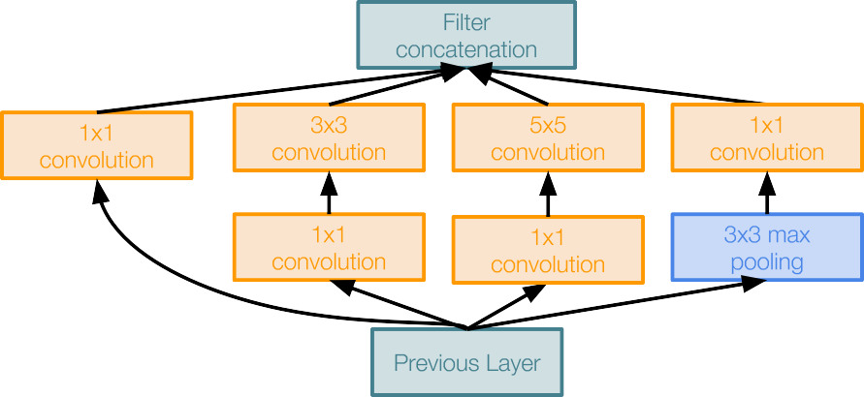
Case Study: GoogLeNet
[Szegedy et al., 2014]
Naive Inception module
Inception module with dimension reduction
Fei-Fei Li & Justin Johnson & Serena Yeung Lecture 9 - May 1, 2018

Slide 51
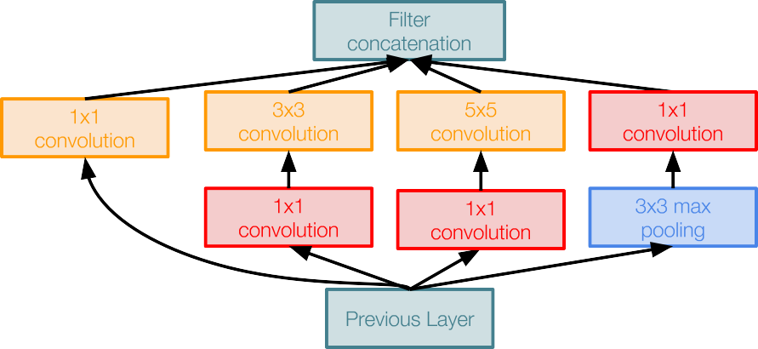
Case Study: GoogLeNet
[Szegedy et al., 2014]
1x1 conv “bottleneck” layers
Naive Inception module
Inception module with dimension reduction
Fei-Fei Li & Justin Johnson & Serena Yeung Lecture 9 - May 1, 2018

Slide 52
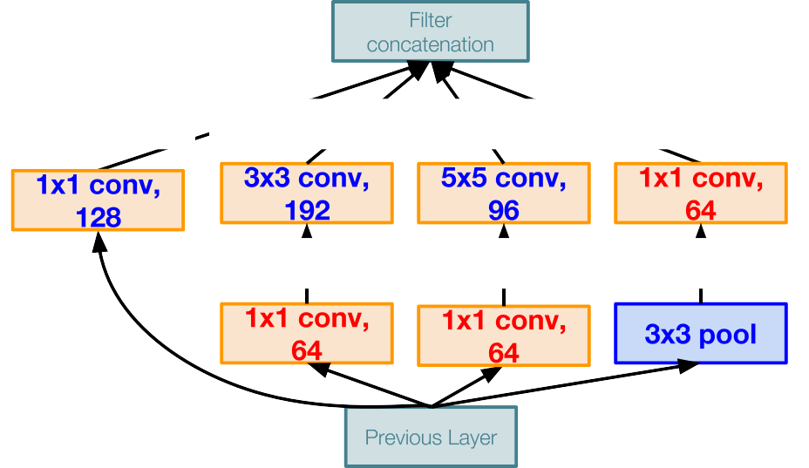
Case Study: GoogLeNet
[Szegedy et al., 2014]
Using same parallel layers as naive example, and adding “1x1 conv, 64 filter” bottlenecks:
28x28x480
Conv Ops:
[1x1 conv, 64] 28x28x64x1x1x256 [1x1 conv, 64] 28x28x64x1x1x256 [1x1 conv, 128] 28x28x128x1x1x256 [3x3 conv, 192] 28x28x192x3x3x64 [5x5 conv, 96] 28x28x96x5x5x64 [1x1 conv, 64] 28x28x64x1x1x256 Total: 358M ops
28x28x128
28x28x192
28x28x96
28x28x64
28x28x64
28x28x64
28x28x256
Module input: 28x28x256
Compared to 854M ops for naive version Bottleneck can also reduce depth after pooling layer
Inception module with dimension reduction
Fei-Fei Li & Justin Johnson & Serena Yeung Lecture 9 - May 1, 2018

Slide 53
Case Study: GoogLeNet
[Szegedy et al., 2014]
Stack Inception modules with dimension reduction on top of each other
Inception module
Fei-Fei Li & Justin Johnson & Serena Yeung Lecture 9 - May 1, 2018

Slide 54
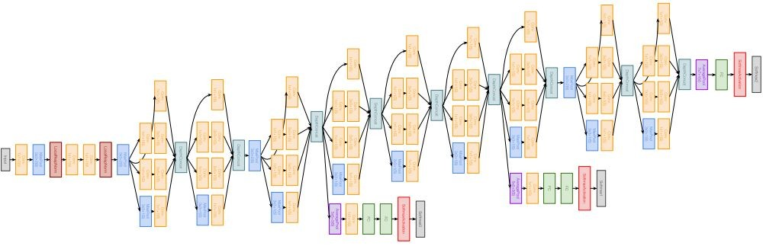
Case Study: GoogLeNet
[Szegedy et al., 2014]
Full GoogLeNet architecture
Stem Network: Conv-Pool- 2x Conv-Pool
Fei-Fei Li & Justin Johnson & Serena Yeung Lecture 9 - May 1, 2018

Slide 55
Case Study: GoogLeNet
[Szegedy et al., 2014]
Full GoogLeNet architecture
Stacked Inception Modules
Fei-Fei Li & Justin Johnson & Serena Yeung Lecture 9 - May 1, 2018

Slide 56
Case Study: GoogLeNet
[Szegedy et al., 2014]
Full GoogLeNet architecture
Classifier output
Fei-Fei Li & Justin Johnson & Serena Yeung Lecture 9 - May 1, 2018

Slide 57
Case Study: GoogLeNet
[Szegedy et al., 2014]
Full GoogLeNet architecture
Classifier output (removed expensive FC layers!)
Fei-Fei Li & Justin Johnson & Serena Yeung Lecture 9 - May 1, 2018

Slide 58
Case Study: GoogLeNet
[Szegedy et al., 2014]
Full GoogLeNet architecture
Auxiliary classification outputs to inject additional gradient at lower layers (AvgPool-1x1Conv-FC-FC-Softmax)
Fei-Fei Li & Justin Johnson & Serena Yeung Lecture 9 - May 1, 2018

Slide 59
Case Study: GoogLeNet
[Szegedy et al., 2014]
Full GoogLeNet architecture
22 total layers with weights
(parallel layers count as 1 layer => 2 layers per Inception module. Don’t count auxiliary output layers)
Fei-Fei Li & Justin Johnson & Serena Yeung Lecture 9 - May 1, 2018

Slide 60
Case Study: GoogLeNet
[Szegedy et al., 2014]
Deeper networks, with computational efficiency
22 layers
Efficient “Inception” module
No FC layers
12x less params than AlexNet
ILSVRC’14 classification winner (6.7% top 5 error)
Inception module
Fei-Fei Li & Justin Johnson & Serena Yeung Lecture 9 - May 1, 2018

Slide 61
ImageNet Large Scale Visual Recognition Challenge (ILSVRC) winners
“Revolution of Depth”
152 layers 152 layers
152 layers
19 layers
22 layers
shallow
8 layers
8 layers
Fei-Fei Li & Justin Johnson & Serena Yeung Lecture 9 - May 1, 2018

Slide 62
Case Study: ResNet
[He et al., 2015]
Very deep networks using residual connections
relu
F(x) + x
..
.
152-layer model for ImageNet
ILSVRC’15 classification winner (3.57% top 5 error)
Swept all classification and detection competitions in ILSVRC’15 and COCO’15!
F(x)
X
identity
relu
X
Residual block
Fei-Fei Li & Justin Johnson & Serena Yeung Lecture 9 - May 1, 2018

Slide 63
Case Study: ResNet
[He et al., 2015]
What happens when we continue stacking deeper layers on a “plain” convolutional neural network?
Fei-Fei Li & Justin Johnson & Serena Yeung Lecture 9 - May 1, 2018

Slide 64
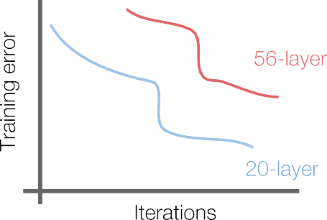
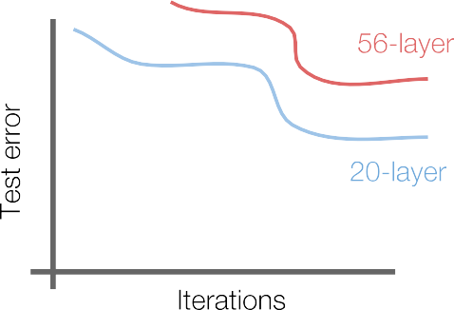
Case Study: ResNet
[He et al., 2015]
What happens when we continue stacking deeper layers on a “plain” convolutional neural network?
Q: What’s strange about these training and test curves? [Hint: look at the order of the curves]
Fei-Fei Li & Justin Johnson & Serena Yeung Lecture 9 - May 1, 2018

Slide 65
Case Study: ResNet
[He et al., 2015]
What happens when we continue stacking deeper layers on a “plain” convolutional neural network?
56-layer model performs worse on both training and test error
-> The deeper model performs worse, but it’s not caused by overfitting!
Fei-Fei Li & Justin Johnson & Serena Yeung Lecture 9 - May 1, 2018

Slide 66
Case Study: ResNet
[He et al., 2015]
Hypothesis: the problem is an optimization problem, deeper models are harder to optimize
Fei-Fei Li & Justin Johnson & Serena Yeung Lecture 9 - May 1, 2018

Slide 67
Case Study: ResNet
[He et al., 2015]
Hypothesis: the problem is an optimization problem, deeper models are harder to optimize
The deeper model should be able to perform at least as well as the shallower model.
A solution by construction is copying the learned layers from the shallower model and setting additional layers to identity mapping.
Fei-Fei Li & Justin Johnson & Serena Yeung Lecture 9 - May 1, 2018

Slide 68
Case Study: ResNet
[He et al., 2015]
Solution: Use network layers to fit a residual mapping instead of directly trying to fit a desired underlying mapping
relu
H(x)
F(x) + x
F(x)
X
identity
relu
relu
X
“Plain” layers
X
Residual block
Fei-Fei Li & Justin Johnson & Serena Yeung Lecture 9 - May 1, 2018

Slide 69
Case Study: ResNet
[He et al., 2015]
Solution: Use network layers to fit a residual mapping instead of directly trying to fit a desired underlying mapping
H(x) = F(x) + x
relu
H(x)
F(x) + x
Use layers to fit residual F(x) = H(x) - x
instead of H(x) directly
F(x)
X
identity
relu
relu
X
“Plain” layers
X
Residual block
Fei-Fei Li & Justin Johnson & Serena Yeung Lecture 9 - May 1, 2018

Slide 70
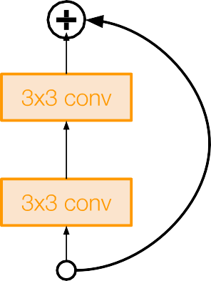
Case Study: ResNet
[He et al., 2015]
Full ResNet architecture:
Stack residual blocks
Every residual block has two 3x3 conv layers
relu
F(x) + x
..
.
F(x)
X
identity
relu
X
Residual block
Fei-Fei Li & Justin Johnson & Serena Yeung Lecture 9 - May 1, 2018

Slide 71
Case Study: ResNet
[He et al., 2015]
Full ResNet architecture:
Stack residual blocks
Every residual block has two 3x3 conv layers
Periodically, double # of filters and downsample spatially using stride 2 (/2 in each dimension)
relu
F(x) + x
..
.
X
identity
3x3 conv, 128 filters, /2 spatially with stride 2
F(x)
relu
3x3 conv, 64 filters
X
Residual block
Fei-Fei Li & Justin Johnson & Serena Yeung Lecture 9 - May 1, 2018

Slide 72
Case Study: ResNet
[He et al., 2015]
Full ResNet architecture:
Stack residual blocks
Every residual block has two 3x3 conv layers
Periodically, double # of filters and downsample spatially using stride 2 (/2 in each dimension)
Additional conv layer at the beginning
relu
F(x) + x
..
.
F(x)
X
identity
relu
X
Residual block
Beginning
conv layer
Fei-Fei Li & Justin Johnson & Serena Yeung Lecture 9 - May 1, 2018

Slide 73
Case Study: ResNet
[He et al., 2015]
No FC layers
besides FC 1000 to output classes
Full ResNet architecture:
Global average pooling layer after last conv layer
Stack residual blocks
Every residual block has two 3x3 conv layers
Periodically, double # of filters and downsample spatially using stride 2 (/2 in each dimension)
Additional conv layer at the beginning
No FC layers at the end (only FC 1000 to output classes)
relu
F(x) + x
..
.
F(x)
X
identity
relu
X
Residual block
Fei-Fei Li & Justin Johnson & Serena Yeung Lecture 9 - May 1, 2018

Slide 74
Case Study: ResNet
[He et al., 2015]
Total depths of 34, 50, 101, or 152 layers for ImageNet
..
.
Fei-Fei Li & Justin Johnson & Serena Yeung Lecture 9 - May 1, 2018

Slide 75
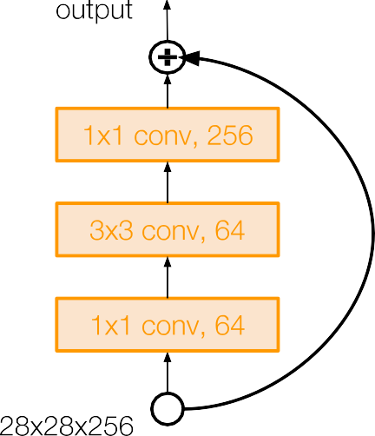
Case Study: ResNet
[He et al., 2015]
For deeper networks
(ResNet-50+), use “bottleneck” layer to improve efficiency (similar to GoogLeNet)
Fei-Fei Li & Justin Johnson & Serena Yeung Lecture 9 - May 1, 2018

Slide 76
Case Study: ResNet
[He et al., 2015]
1x1 conv, 256 filters projects back to 256 feature maps (28x28x256)
For deeper networks
(ResNet-50+), use “bottleneck” layer to improve efficiency (similar to GoogLeNet)
3x3 conv operates over only 64 feature maps
1x1 conv, 64 filters to project to 28x28x64
Fei-Fei Li & Justin Johnson & Serena Yeung Lecture 9 - May 1, 2018

Slide 77
Case Study: ResNet
[He et al., 2015]
Training ResNet in practice:
Batch Normalization after every CONV layer
Xavier 2/ initialization from He et al.
SGD + Momentum (0.9)
Learning rate: 0.1, divided by 10 when validation error plateaus
Mini-batch size 256
Weight decay of 1e-5
No dropout used
Fei-Fei Li & Justin Johnson & Serena Yeung Lecture 9 - May 1, 2018

Slide 78
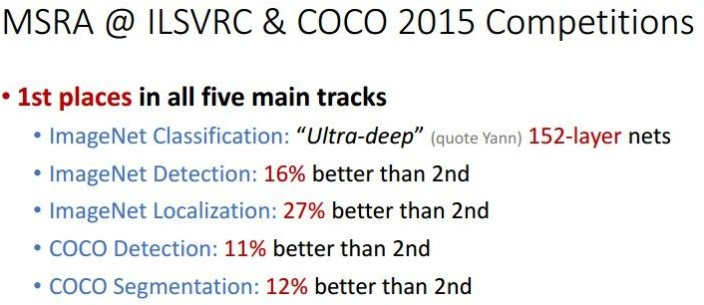
Case Study: ResNet
[He et al., 2015]
Experimental Results
Able to train very deep networks without degrading (152 layers on ImageNet, 1202 on Cifar)
Deeper networks now achieve lowing training error as expected
Swept 1st place in all ILSVRC and COCO 2015 competitions
Fei-Fei Li & Justin Johnson & Serena Yeung Lecture 9 - May 1, 2018

Slide 79
Case Study: ResNet
[He et al., 2015]
Experimental Results
Able to train very deep networks without degrading (152 layers on ImageNet, 1202 on Cifar)
Deeper networks now achieve lowing training error as expected
Swept 1st place in all ILSVRC and COCO 2015 competitions
ILSVRC 2015 classification winner (3.6% top 5 error) -- better than “human performance”! (Russakovsky 2014)
Fei-Fei Li & Justin Johnson & Serena Yeung Lecture 9 - May 1, 2018

Slide 80
ImageNet Large Scale Visual Recognition Challenge (ILSVRC) winners
152 layers
152 layers
152 layers
19 layers
22 layers
shallow
8 layers
8 layers
Fei-Fei Li & Justin Johnson & Serena Yeung Lecture 9 - May 1, 2018

Slide 81
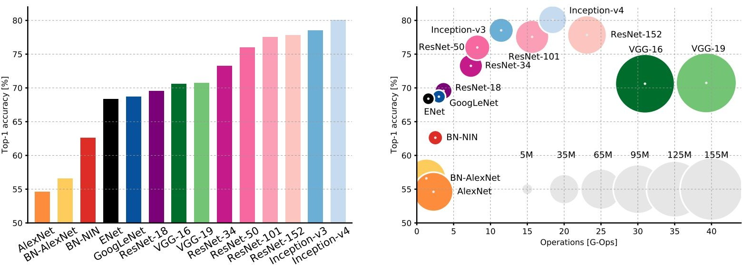
Comparing complexity...
An Analysis of Deep Neural Network Models for Practical Applications, 2017.
Figures copyright Alfredo Canziani, Adam Paszke, Eugenio Culurciello, 2017. Reproduced with permission.
Fei-Fei Li & Justin Johnson & Serena Yeung Lecture 9 - May 1, 2018

Slide 82
Comparing complexity...
Inception-v4: Resnet + Inception!
An Analysis of Deep Neural Network Models for Practical Applications, 2017.
Figures copyright Alfredo Canziani, Adam Paszke, Eugenio Culurciello, 2017. Reproduced with permission.
Fei-Fei Li & Justin Johnson & Serena Yeung Lecture 9 - May 1, 2018

Slide 83
Comparing complexity...
VGG: Highest memory, most operations
An Analysis of Deep Neural Network Models for Practical Applications, 2017.
Figures copyright Alfredo Canziani, Adam Paszke, Eugenio Culurciello, 2017. Reproduced with permission.
Fei-Fei Li & Justin Johnson & Serena Yeung Lecture 9 - May 1, 2018

Slide 84
GoogLeNet: most efficient
Comparing complexity...
An Analysis of Deep Neural Network Models for Practical Applications, 2017.
Figures copyright Alfredo Canziani, Adam Paszke, Eugenio Culurciello, 2017. Reproduced with permission.
Fei-Fei Li & Justin Johnson & Serena Yeung Lecture 9 - May 1, 2018

Slide 85
AlexNet:
Smaller compute, still memory heavy, lower accuracy
Comparing complexity...
An Analysis of Deep Neural Network Models for Practical Applications, 2017.
Figures copyright Alfredo Canziani, Adam Paszke, Eugenio Culurciello, 2017. Reproduced with permission.
Fei-Fei Li & Justin Johnson & Serena Yeung Lecture 9 - May 1, 2018

Slide 86
ResNet:
Moderate efficiency depending on model, highest accuracy
Comparing complexity...
An Analysis of Deep Neural Network Models for Practical Applications, 2017.
Figures copyright Alfredo Canziani, Adam Paszke, Eugenio Culurciello, 2017. Reproduced with permission.
Fei-Fei Li & Justin Johnson & Serena Yeung Lecture 9 - May 1, 2018

Slide 87
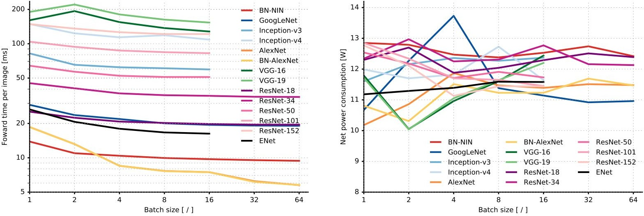
Forward pass time and power consumption
An Analysis of Deep Neural Network Models for Practical Applications, 2017.
Figures copyright Alfredo Canziani, Adam Paszke, Eugenio Culurciello, 2017. Reproduced with permission.
Fei-Fei Li & Justin Johnson & Serena Yeung Lecture 9 - May 1, 2018

Slide 88
Other architectures to know...

Slide 89
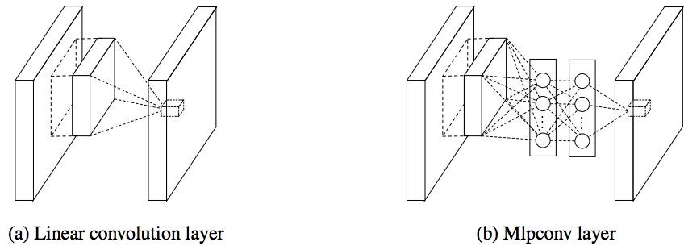
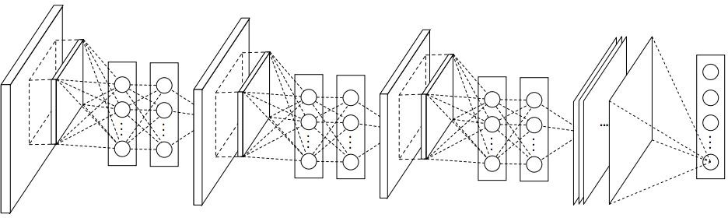
Network in Network (NiN)
[Lin et al. 2014]
Mlpconv layer with “micronetwork” within each conv layer to compute more abstract features for local patches
Micronetwork uses multilayer perceptron (FC, i.e. 1x1 conv layers)
Precursor to GoogLeNet and ResNet “bottleneck” layers
Philosophical inspiration for GoogLeNet
Figures copyright Lin et al., 2014. Reproduced with permission.

Slide 90
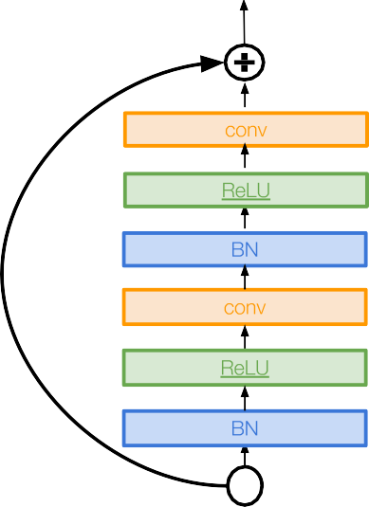
Improving ResNets...
Identity Mappings in Deep Residual Networks
[He et al. 2016]
Improved ResNet block design from creators of ResNet
Creates a more direct path for propagating information throughout network (moves activation to residual mapping pathway)
Gives better performance

Slide 91
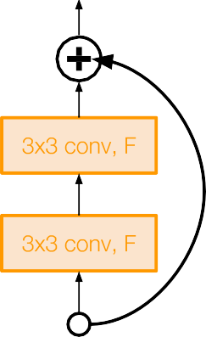
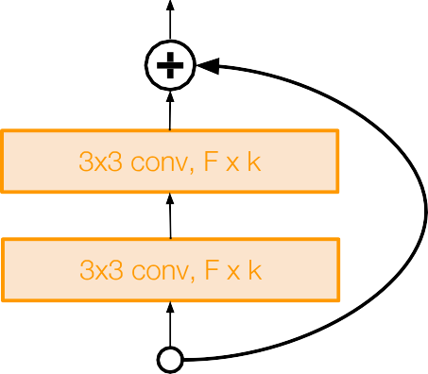
Improving ResNets...
Wide Residual Networks
[Zagoruyko et al. 2016]
Argues that residuals are the important factor, not depth
User wider residual blocks (F x k filters instead of F filters in each layer)
50-layer wide ResNet outperforms 152-layer original ResNet
Increasing width instead of depth more computationally efficient (parallelizable)
Basic residual block
Wide residual block

Slide 92
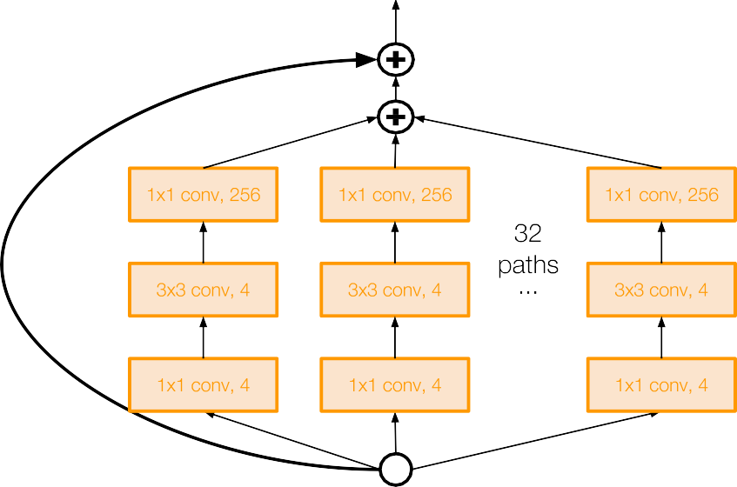
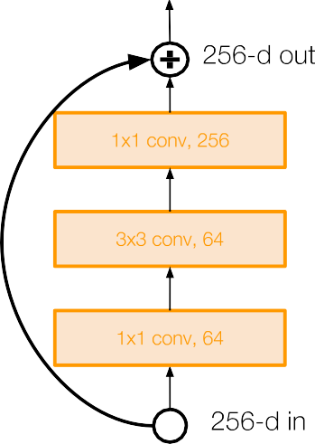
Improving ResNets...
Aggregated Residual Transformations for Deep
Neural Networks (ResNeXt)
[Xie et al. 2016]
Also from creators of ResNet
Increases width of residual block through multiple parallel pathways (“cardinality”)
Parallel pathways similar in spirit to Inception module

Slide 93
Improving ResNets...
Deep Networks with Stochastic Depth
[Huang et al. 2016]
Motivation: reduce vanishing gradients and training time through short networks during training
Randomly drop a subset of layers during each training pass
Bypass with identity function
Use full deep network at test time

Slide 94
ImageNet Large Scale Visual Recognition Challenge (ILSVRC) winners
Network ensembling
152 layers
152 layers
152 layers
19 layers
22 layers
shallow
8 layers
8 layers
Lecture 9 - 96
Fei-Fei Li & Justin Johnson & Serena Yeung Lecture 9 - May 1, 2018

Slide 95
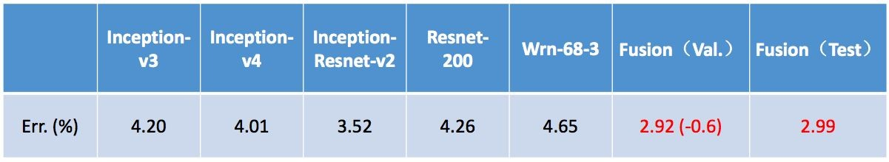
Improving ResNets...
“Good Practices for Deep Feature Fusion”
[Shao et al. 2016]
Multi-scale ensembling of Inception, Inception-Resnet, Resnet, Wide Resnet models
ILSVRC’16 classification winner
Lecture 9 - 97

Slide 96
ImageNet Large Scale Visual Recognition Challenge (ILSVRC) winners
Adaptive feature map reweighting
152 layers
152 layers 152 layers
19 layers
22 layers
shallow
8 layers
8 layers
Lecture 9 - 98
Fei-Fei Li & Justin Johnson & Serena Yeung Lecture 9 - May 1, 2018

Slide 97
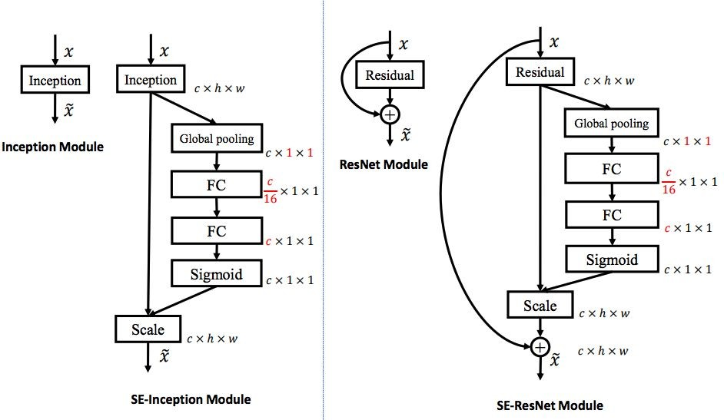
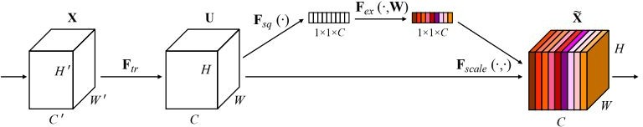
Improving ResNets...
Squeeze-and-Excitation Networks (SENet)
[Hu et al. 2017]
Add a “feature recalibration” module that learns to adaptively reweight feature maps
Global information (global avg. pooling layer) + 2 FC layers used to determine feature map weights
ILSVRC’17 classification winner (using ResNeXt-152 as a base architecture)
Lecture 9 - 99

Slide 98
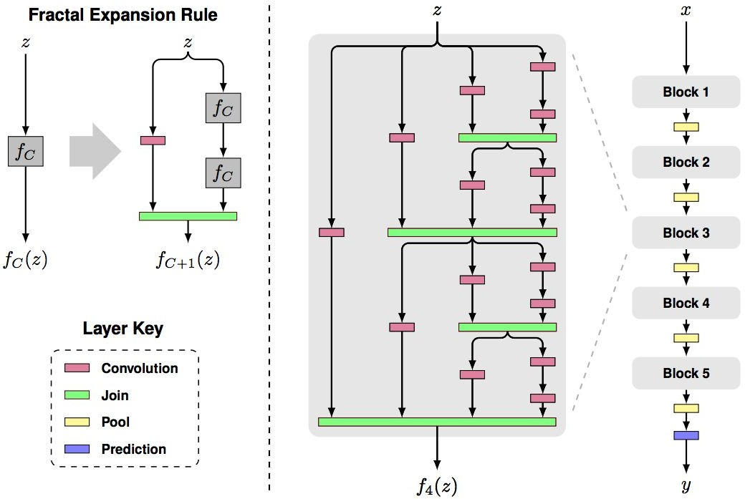
Beyond ResNets...
FractalNet: Ultra-Deep Neural Networks without Residuals
[Larsson et al. 2017]
Argues that key is transitioning effectively from shallow to deep and residual representations are not necessary
Fractal architecture with both shallow and deep paths to output
Trained with dropping out sub-paths
Full network at test time
Figures copyright Larsson et al., 2017. Reproduced with permission.
Lecture 9 - ¹⁰
0

Slide 99
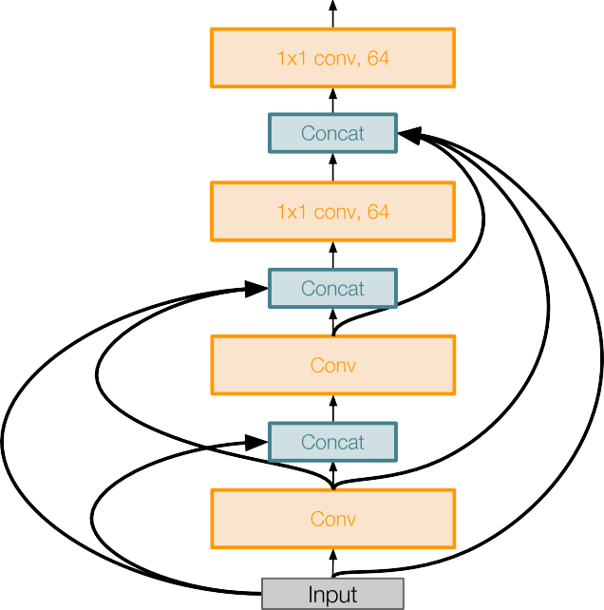
Beyond ResNets...
Densely Connected Convolutional Networks
[Huang et al. 2017]
Dense blocks where each layer is connected to every other layer in feedforward fashion
Alleviates vanishing gradient, strengthens feature propagation, encourages feature reuse
Lecture 9 -
Fei-Fei Li & Justin Johnson & Serena Yeung Lecture 9 - May 1, 2018

Slide 100
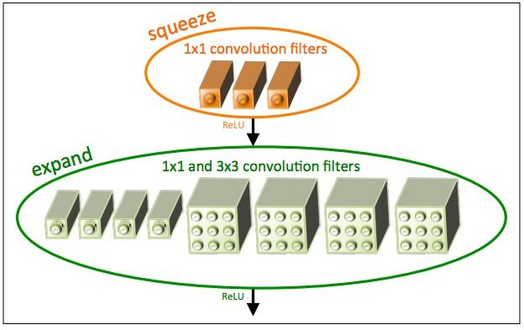
Efficient networks...
SqueezeNet: AlexNet-level Accuracy With 50x Fewer Parameters and <0.5Mb Model Size
[Iandola et al. 2017]
Fire modules consisting of a ‘squeeze’ layer with 1x1 filters feeding an ‘expand’ layer with 1x1 and 3x3 filters
AlexNet level accuracy on ImageNet with 50x fewer parameters
Can compress to 510x smaller than AlexNet (0.5Mb)
Figure copyright Iandola, Han, Moskewicz, Ashraf, Dally, Keutzer, 2017. Reproduced with permission.
Lecture 9 -
Fei-Fei Li & Justin Johnson & Serena Yeung Lecture 9 - May 1, 2018

Slide 101
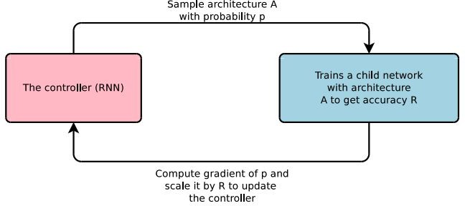
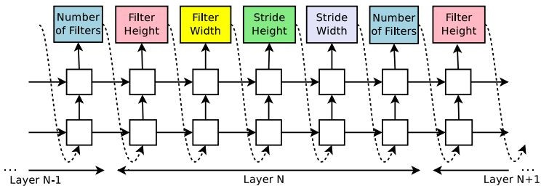
Meta-learning: Learning to learn network architectures...
Neural Architecture Search with Reinforcement Learning (NAS)
[Zoph et al. 2016]
“Controller” network that learns to design a good network architecture (output a string corresponding to network design)
Iterate:
Sample an architecture from search space
Train the architecture to get a “reward” R corresponding to accuracy
Compute gradient of sample probability, and scale by R to perform controller parameter update (i.e. increase likelihood of good architecture being sampled, decrease likelihood of bad architecture)
Lecture 9 - ¹⁰
3

Slide 102
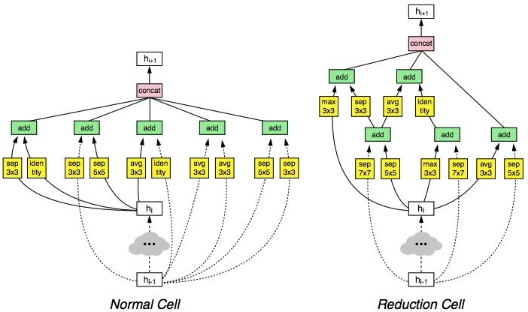
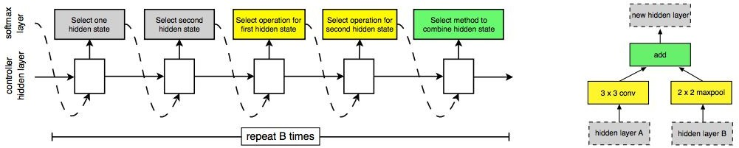
Meta-learning: Learning to learn network architectures... Learning Transferable Architectures for Scalable Image Recognition
[Zoph et al. 2017]
Applying neural architecture search (NAS) to a large dataset like ImageNet is expensive
Design a search space of building blocks (“cells”) that can be flexibly stacked
NASNet: Use NAS to find best cell structure on smaller CIFAR-10 dataset, then transfer architecture to ImageNet
Lecture 9 - ¹⁰
4

Slide 103
Summary: CNN Architectures
Case Studies
AlexNet
VGG
GoogLeNet
ResNet
Also....
NiN (Network in Network)
Wide ResNet
ResNeXT
Stochastic Depth
Squeeze-and-Excitation Network
DenseNet
FractalNet
SqueezeNet
NASNet
Lecture 9 - ¹⁰
5

Slide 104
Summary: CNN Architectures
VGG, GoogLeNet, ResNet all in wide use, available in model zoos
ResNet current best default, also consider SENet when available
Trend towards extremely deep networks
Significant research centers around design of layer / skip connections and improving gradient flow
Efforts to investigate necessity of depth vs. width and residual connections
Even more recent trend towards meta-learning
Next time: Recurrent neural networks
Lecture 9 -
106

