Slide 1
CPSC 4430/5440: Machine Learning Lesson C01D: Coding for CNN
Yu Liang

Slide 2
Outline
Architecture Configuration
Define Loss Function
Train
Testing and Evaluation
Upsampling and deconvolutional network

Slide 3
Model Defined by Keras Functional API
https://machinelearningmastery.com/keras-functional-api-deep-learning/
Keras Sequential Models: create models layer-by-layer for most problems
Keras Functional API: more flexibility as you can easily define models where layers connect to more than just the previous and next layers
Standard Network Models: MLP, CNN , RNN
Shared Layers Model
Multiple Input and Output Models

Slide 4
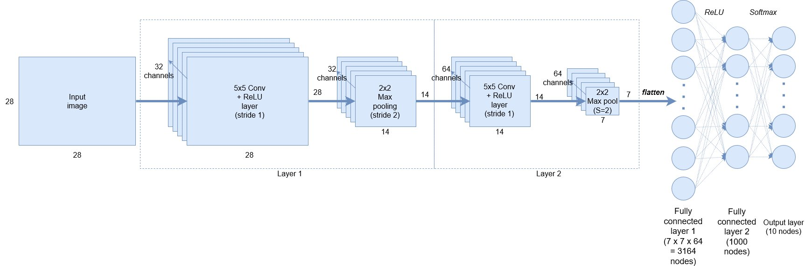
Architecture of CNN

Slide 5
Code for CNN Architecture
model = Sequential()
model.add(Conv2D(32, kernel_size=(5, 5), strides=(1, 1), activation='relu', input_shape=input_shape)) model.add(MaxPooling2D(pool_size=(2, 2), strides=(2, 2)))
model.add(Conv2D(64, (5, 5), activation='relu')) model.add(MaxPooling2D(pool_size=(2, 2)))
model.add(Flatten())
model.add(Dense(1000, activation='relu’))
model.add(Dense(num_classes, activation='softmax'))

Slide 6
Define the Loss Function
Specify the loss function, or told the framework what type of optimizer to use (i.e. gradient descent, Adam optimizer etc.).
model.compile(loss=keras.losses.categorical_crossentropy,
optimizer=keras.optimizers.SGD(lr=0.01),
metrics=['accuracy'])

Slide 7
Train the Model
Training data – in this case x_train and y_train.
Batch size in this case we are using a batch size of 128.
The number of training epochs (10 in this case).
The verbose flag, set to 1 here, specifies if you want detailed information being printed in the console about the progress of the training.
Validation or test data to the fit function so Keras knows what data to test the metric against when evaluate() is run on the model
model.fit(x_train, y_train,
batch_size=batch_size,
epochs=epochs,
verbose=1,
validation_data=(x_test, y_test),
callbacks=[history])

Slide 8
Evaluate it and Print the Results:
score = model.evaluate(x_test, y_test, verbose=0)
print('Test loss:', score[0])
print('Test accuracy:', score[1])

Slide 9
Reference
https://adventuresinmachinelearning.com/keras-tutorial-cnn-11-lines/

Slide 10
Model Defined by Keras Functional API
https://machinelearningmastery.com/keras-functional-api-deep-learning/
More flexibility as you can easily define models where layers connect to more than just the previous and next layers
Shared Layers Model
Multiple Input and Output Models

Slide 11
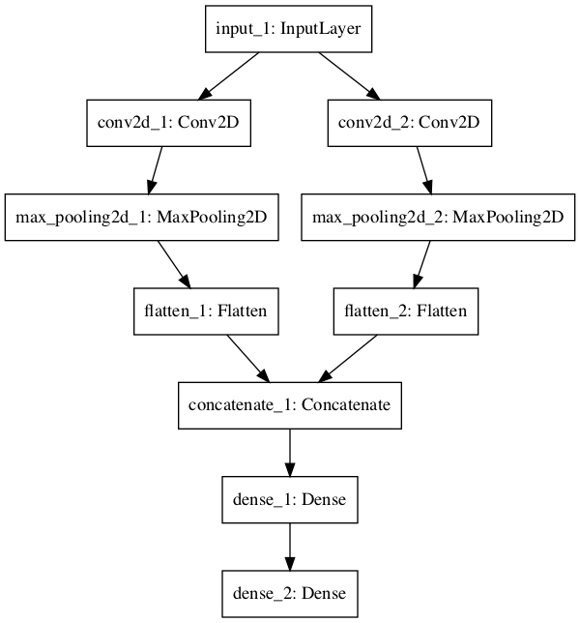
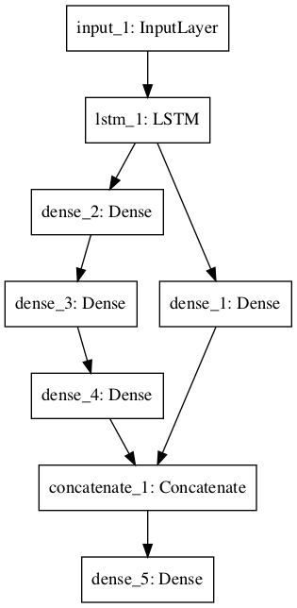
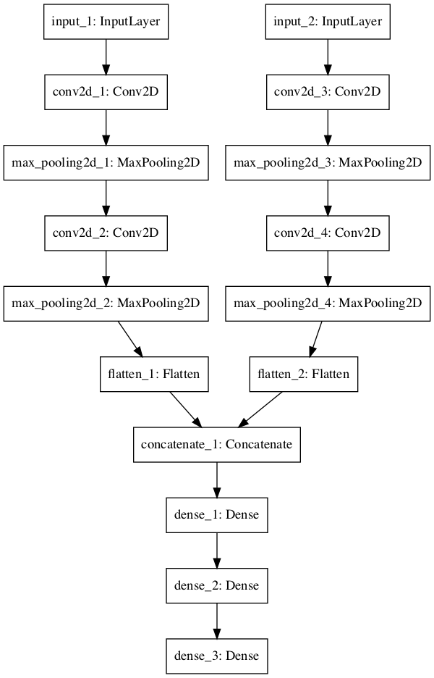
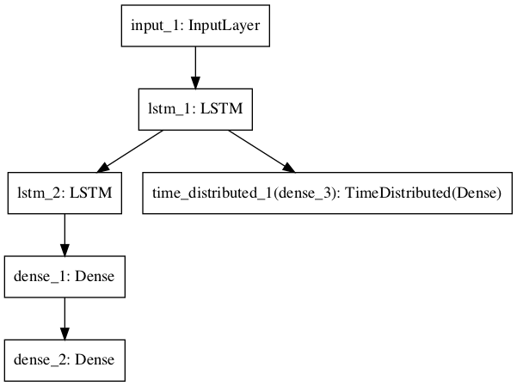
More Complicated Architecture in
Shared Input Layer
Shared Feature Extraction Layer
Multiple Input
Multiple Output

Slide 12
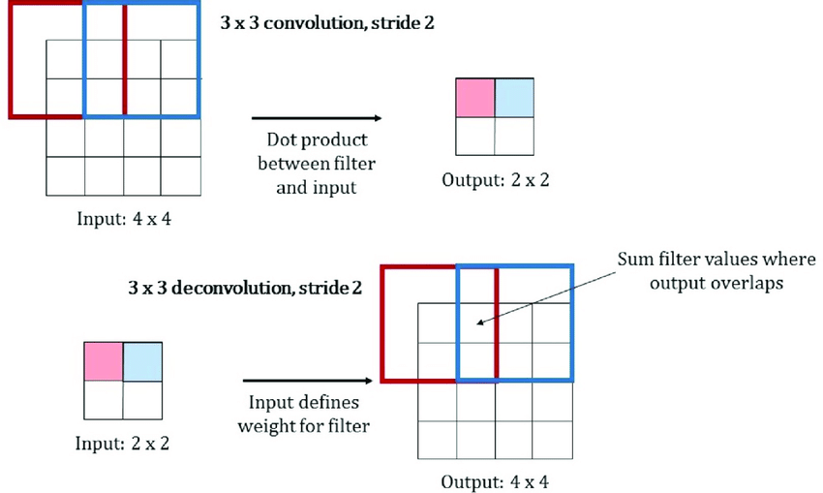
Transposed Convolution and Upsampling
https://www.youtube.com/watch?v=96_oGE8WyPg

