Slide 1
CPSC 4430/5440: Machine Learning Lesson D04(a): Training Neural Networks, Part I
Derived from Feifei Lee
Lecture 6 -
1
Fei-Fei Li & Justin Johnson & Serena Yeung Lecture 6 - April 19, 2018

Slide 2



Computational graphs
Where we are now...
x
*
s (scores)
hinge loss
+
L
W
R
Lecture 6 -
3

Slide 3



Where we are now...
Neural Networks
Linear score function:
2-layer Neural Network
x
h
W1
W2
s
3072
100
10
Lecture 6 -
4
Fei-Fei Li & Justin Johnson & Serena Yeung Lecture 6 - April 19, 2018

Slide 4
Where we are now...
Convolutional Neural Networks
Illustration of LeCun et al. 1998 from CS231n 2017 Lecture 1
Lecture 6 -
4

Slide 5
Where we are now...
Convolutional Layer
activation map
32x32x3 image 5x5x3 filter
32
28
convolve (slide) over all spatial locations
32
28
3
1
Lecture 6 -
5

Slide 6
Where we are now...
Convolutional Layer
For example, if we had 6 5x5 filters, we’ll get 6 separate activation maps:
activation maps
32
28
Convolution Layer
32
28
3
6
We stack these up to get a “new image” of size 28x28x6!
Lecture 6 -
7

Slide 7

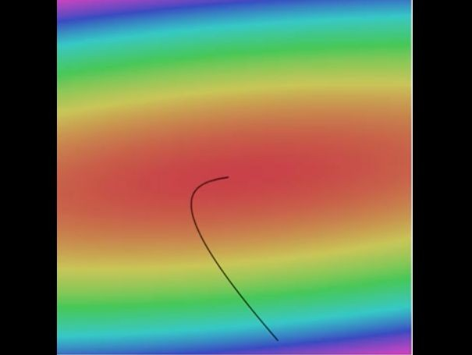

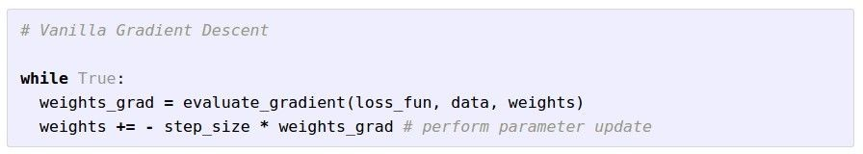
Where we are now...
Learning network parameters through optimization
Landscape image is CC0 1.0 public domain Walking man image is CC0 1.0 public domain
Lecture 6 -
7

Slide 8
Mini-batch SGD
Where we are now...
Loop:
Sample a batch of data
Forward prop it through the graph (network), get loss
Backprop to calculate the gradients
Update the parameters using the gradient
Lecture 6 -
8

Slide 9
Next: Training Neural Networks
Fei-Fei Li & Justin Johnson & Serena Yeung Lecture 6 - April 19, 2018

Slide 10
Overview
One time setup
activation functions, preprocessing, weight initialization, regularization, gradient checking
Training dynamics
babysitting the learning process,
parameter updates, hyperparameter optimization
Evaluation
model ensembles
Fei-Fei Li & Justin Johnson & Serena Yeung Lecture 6 - April 19, 2018

Slide 11
Part 1
Activation Functions
Data Preprocessing
Weight Initialization
Batch Normalization
Babysitting the Learning Process
Hyperparameter Optimization
Fei-Fei Li & Justin Johnson & Serena Yeung Lecture 6 - April 19, 2018

Slide 12
Activation Functions
Fei-Fei Li & Justin Johnson & Serena Yeung Lecture 6 - April 19, 2018

Slide 13
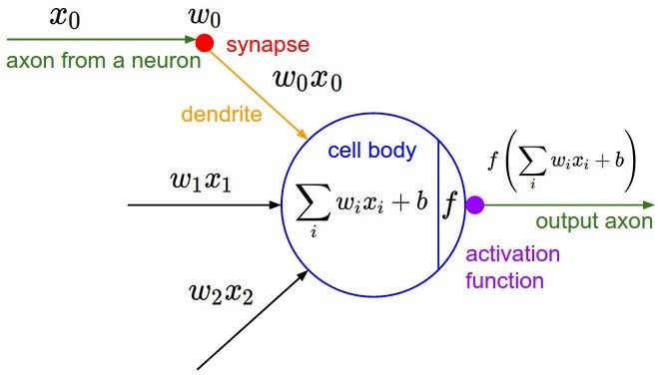
Activation Functions
Fei-Fei Li & Justin Johnson & Serena Yeung Lecture 6 - April 19, 2018

Slide 14
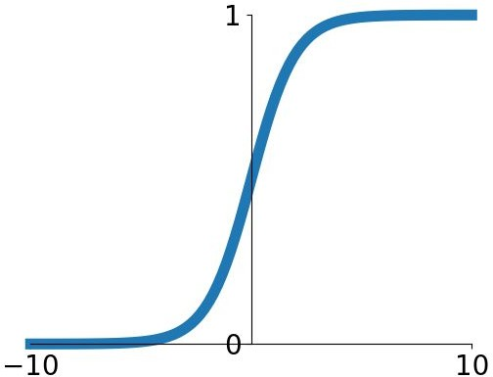
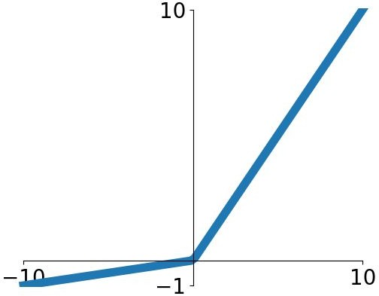


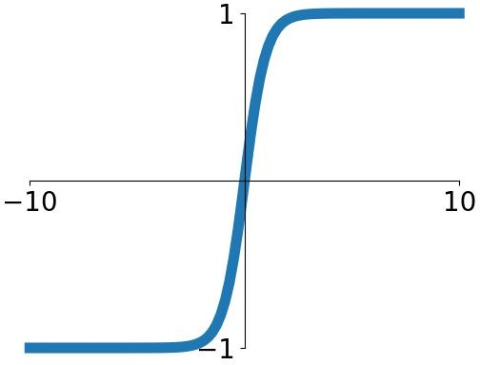


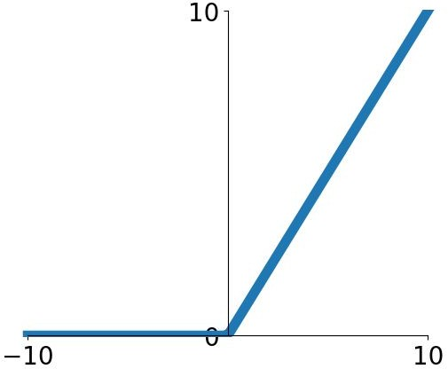
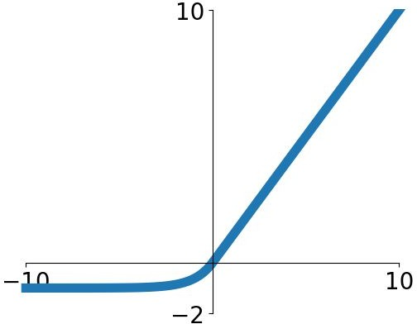
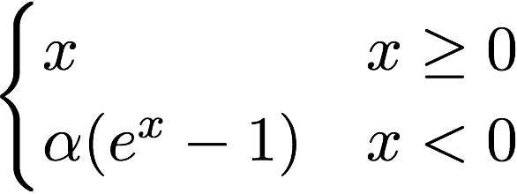

Activation Functions
Sigmoid
tanh
Leaky ReLU
Maxout
ReLU
ELU
Fei-Fei Li & Justin Johnson & Serena Yeung Lecture 6 - April 19, 2018

Slide 15

Activation Functions
Squashes numbers to range [0,1]
Historically popular since they have nice interpretation as a saturating “firing rate” of a neuron
Sigmoid
Fei-Fei Li & Justin Johnson & Serena Yeung Lecture 6 - April 19, 2018

Slide 16
Activation Functions
Squashes numbers to range [0,1]
Historically popular since they have nice interpretation as a saturating “firing rate” of a neuron
3 problems:
1. Saturated neurons “kill” the gradients
Sigmoid
Fei-Fei Li & Justin Johnson & Serena Yeung Lecture 6 - April 19, 2018

Slide 17
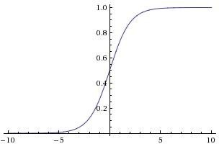



sigmoid gate
x
What happens when x = -10? What happens when x = 0?
What happens when x = 10?
Fei-Fei Li & Justin Johnson & Serena Yeung Lecture 6 - April 19, 2018

Slide 18
Activation Functions
Squashes numbers to range [0,1]
Historically popular since they have nice interpretation as a saturating “firing rate” of a neuron
3 problems:
Saturated neurons “kill” the gradients
Sigmoid outputs are not zero-centered
Sigmoid
Fei-Fei Li & Justin Johnson & Serena Yeung Lecture 6 - April 19, 2018

Slide 19
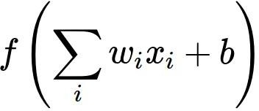
Consider what happens when the input to a neuron (x) is always positive:
What can we say about the gradients on w?
Fei-Fei Li & Justin Johnson & Serena Yeung Lecture 6 - April 19, 2018

Slide 20

Consider what happens when the input to a neuron is
always positive...
allowed gradient update directions
allowed gradient update directions
zig zag path
hypothetical optimal w vector
What can we say about the gradients on w? Always all positive or all negative :(
(this is also why you want zero-mean data!)
Fei-Fei Li & Justin Johnson & Serena Yeung Lecture 6 - April 19, 2018

Slide 21
Activation Functions
Squashes numbers to range [0,1]
Historically popular since they have nice interpretation as a saturating “firing rate” of a neuron
3 problems:
Saturated neurons “kill” the gradients
Sigmoid outputs are not zero-centered
exp() is a bit compute expensive
Sigmoid
Fei-Fei Li & Justin Johnson & Serena Yeung Lecture 6 - April 19, 2018

Slide 22
Activation Functions
Squashes numbers to range [-1,1]
zero centered (nice)
still kills gradients when saturated :(
tanh(x)
[LeCun et al., 1991]
Fei-Fei Li & Justin Johnson & Serena Yeung Lecture 6 - April 19, 2018

Slide 23
- Computes f(x) = max(0,x)
Activation Functions
Does not saturate (in +region)
Very computationally efficient
Converges much faster than sigmoid/tanh in practice (e.g. 6x)
Actually more biologically plausible than sigmoid
ReLU
(Rectified Linear Unit)
[Krizhevsky et al., 2012]
Fei-Fei Li & Justin Johnson & Serena Yeung Lecture 6 - April 19, 2018

Slide 24
- Computes f(x) = max(0,x)
Activation Functions
Does not saturate (in +region)
Very computationally efficient
Converges much faster than sigmoid/tanh in practice (e.g. 6x)
Actually more biologically plausible than sigmoid
Not zero-centered output
ReLU
(Rectified Linear Unit)
Fei-Fei Li & Justin Johnson & Serena Yeung Lecture 6 - April 19, 2018

Slide 25
- Computes f(x) = max(0,x)
Activation Functions
Does not saturate (in +region)
Very computationally efficient
Converges much faster than sigmoid/tanh in practice (e.g. 6x)
Actually more biologically plausible than sigmoid
Not zero-centered output
An annoyance:
hint: what is the gradient when x < 0?
ReLU
(Rectified Linear Unit)
Fei-Fei Li & Justin Johnson & Serena Yeung Lecture 6 - April 19, 2018

Slide 26

x
ReLU
gate
What happens when x = -10? What happens when x = 0?
What happens when x = 10?
Fei-Fei Li & Justin Johnson & Serena Yeung Lecture 6 - April 19, 2018

Slide 27


active ReLU
DATA CLOUD
dead ReLU
will never activate
=> never update
Fei-Fei Li & Justin Johnson & Serena Yeung Lecture 6 - April 19, 2018

Slide 28
active ReLU
DATA CLOUD
=> people like to initialize ReLU neurons with slightly positive biases (e.g. 0.01)
dead ReLU
will never activate
=> never update
Fei-Fei Li & Justin Johnson & Serena Yeung Lecture 6 - April 19, 2018

Slide 29

Activation Functions
[Mass et al., 2013] [He et al., 2015]
Does not saturate
Computationally efficient
Converges much faster than sigmoid/tanh in practice! (e.g. 6x)
- will not “die”.
Leaky ReLU
Fei-Fei Li & Justin Johnson & Serena Yeung Lecture 6 - April 19, 2018

Slide 30

Activation Functions
[Mass et al., 2013] [He et al., 2015]
Does not saturate
Computationally efficient
Converges much faster than sigmoid/tanh in practice! (e.g. 6x)
- will not “die”.
Parametric Rectifier (PReLU)
Leaky ReLU
backprop into \alpha (parameter)
Fei-Fei Li & Justin Johnson & Serena Yeung Lecture 6 - April 19, 2018

Slide 31

Activation Functions
[Clevert et al., 2015]
Exponential Linear Units (ELU)
- All benefits of ReLU
Closer to zero mean outputs
Negative saturation regime compared with Leaky ReLU adds some robustness to noise
Computation requires exp()
Fei-Fei Li & Justin Johnson & Serena Yeung Lecture 6 - April 19, 2018

Slide 32

Maxout “Neuron”
[Goodfellow et al., 2013]
Does not have the basic form of dot product -> nonlinearity
Generalizes ReLU and Leaky ReLU
Linear Regime! Does not saturate! Does not die!
Problem: doubles the number of parameters/neuron :(
Fei-Fei Li & Justin Johnson & Serena Yeung Lecture 6 - April 19, 2018

Slide 33
TLDR: In practice:
Use ReLU. Be careful with your learning rates
Try out Leaky ReLU / Maxout / ELU
Try out tanh but don’t expect much
Don’t use sigmoid
Fei-Fei Li & Justin Johnson & Serena Yeung Lecture 6 - April 19, 2018

Slide 34
Data Preprocessing
Fei-Fei Li & Justin Johnson & Serena Yeung Lecture 6 - April 19, 2018

Slide 35
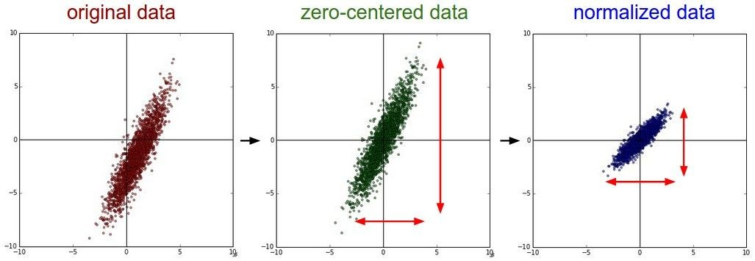


Step 1: Preprocess the data
(Assume X [NxD] is data matrix, each example in a row)
Fei-Fei Li & Justin Johnson & Serena Yeung Lecture 6 - April 19, 2018

Slide 36
Remember: Consider what happens when the input to a
neuron is always positive...
allowed gradient update directions
allowed gradient update directions
zig zag path
hypothetical optimal w vector
What can we say about the gradients on w? Always all positive or all negative :(
(this is also why you want zero-mean data!)
Fei-Fei Li & Justin Johnson & Serena Yeung Lecture 6 - April 19, 2018

Slide 37
Step 1: Preprocess the data
(Assume X [NxD] is data matrix,
each example in a row)
Fei-Fei Li & Justin Johnson & Serena Yeung
Fei-Fei Li & Justin Johnson & Serena Yeung Lecture 6 - April 19, 2018

Slide 38
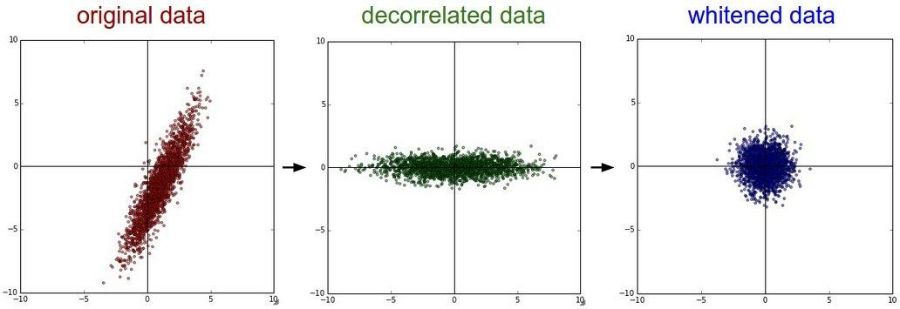
Step 1: Preprocess the data
In practice, you may also see PCA and Whitening of the data
(data has diagonal covariance matrix)
(covariance matrix is the identity matrix)
Lecture 6 - 39
Fei-Fei Li & Justin Johnson & Serena Yeung Lecture 6 - April 19, 2018

Slide 39
TLDR: In practice for Images: center only
e.g. consider CIFAR-10 example with [32,32,3] images
Subtract the mean image (e.g. AlexNet) (mean image = [32,32,3] array)
Subtract per-channel mean (e.g. VGGNet) (mean along each channel = 3 numbers)
Not common to normalize variance, to do PCA or whitening
Fei-Fei Li & Justin Johnson & Serena Yeung Lecture 6 - April 19, 2018

Slide 40
Weight Initialization
Fei-Fei Li & Justin Johnson & Serena Yeung Lecture 6 - April 19, 2018

Slide 41
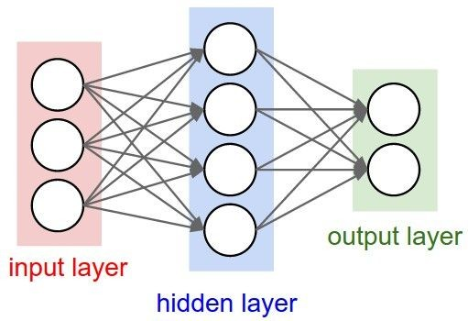
- Q: what happens when W=constant init is used?
Fei-Fei Li & Justin Johnson & Serena Yeung Lecture 6 - April 19, 2018

Slide 42
- First idea: Small random numbers
(gaussian with zero mean and 1e-2 standard deviation)
Fei-Fei Li & Justin Johnson & Serena Yeung Lecture 6 - April 19, 2018

Slide 43
- First idea: Small random numbers
(gaussian with zero mean and 1e-2 standard deviation)
Works ~okay for small networks, but problems with deeper networks.
Fei-Fei Li & Justin Johnson & Serena Yeung Lecture 6 - April 19, 2018

Slide 44
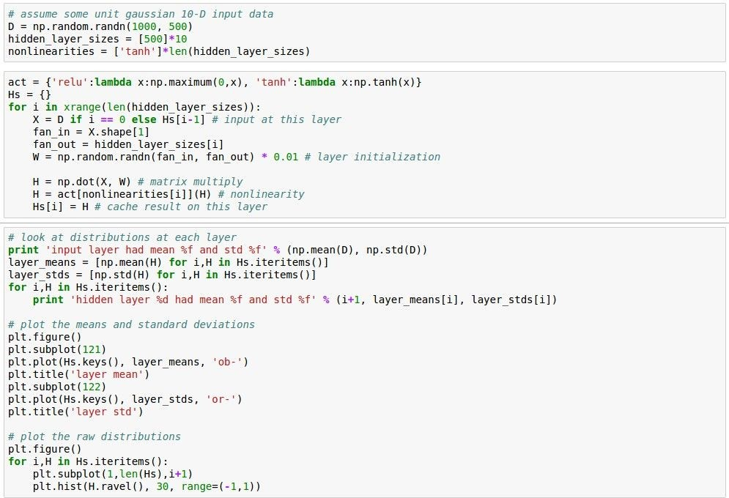
Lets look at some activation statistics
E.g. 10-layer net with 500 neurons on each layer, using tanh
non-linearities, and initializing as described in last slide.
Fei-Fei Li & Justin Johnson & Serena Yeung Lecture 6 - April 19, 2018

Slide 45
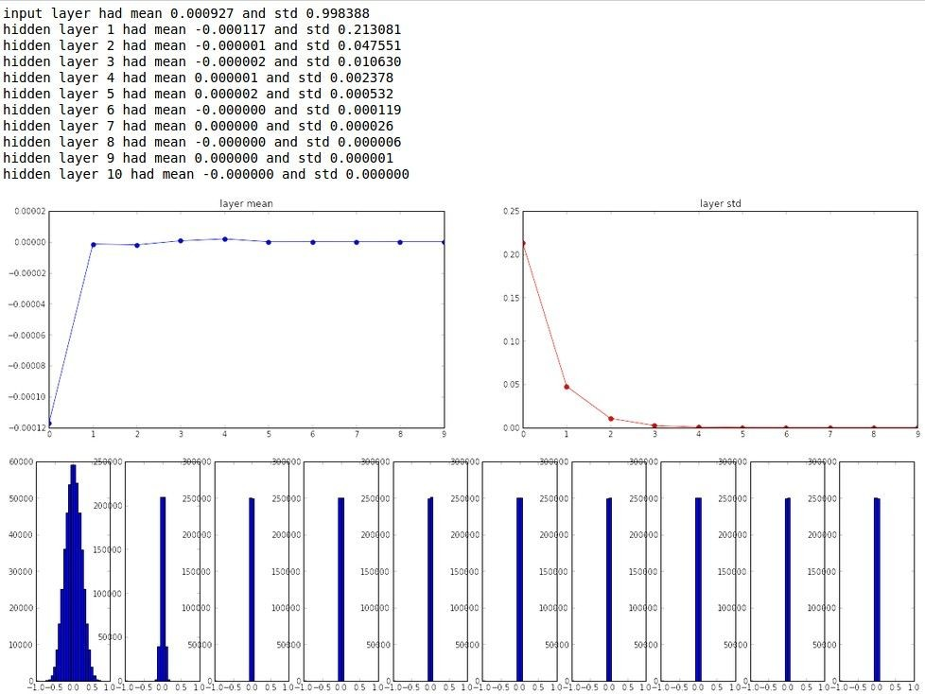
Fei-Fei Li & Justin Johnson & Serena Yeung Lecture 6 - April 19, 2018

Slide 46
All activations become zero!
Q: think about the backward pass.
What do the gradients look like?
Hint: think about backward pass for a W*X gate.
Fei-Fei Li & Justin Johnson & Serena Yeung Lecture 6 - April 19, 2018

Slide 47
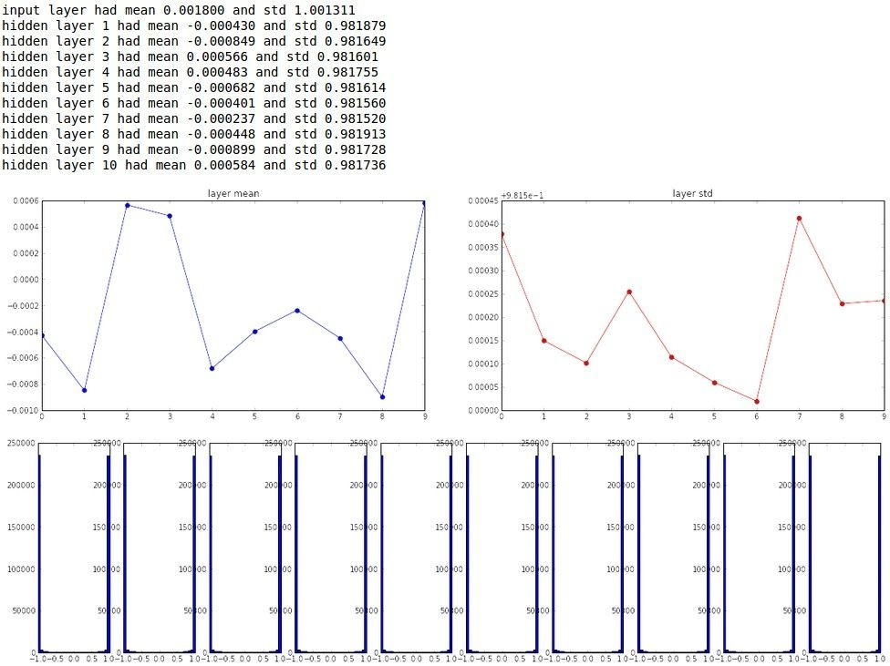
Almost all neurons completely saturated, either -1
and 1. Gradients will be all zero.
*1.0 instead of *0.01
Fei-Fei Li & Justin Johnson & Serena Yeung Lecture 6 - April 19, 2018

Slide 48
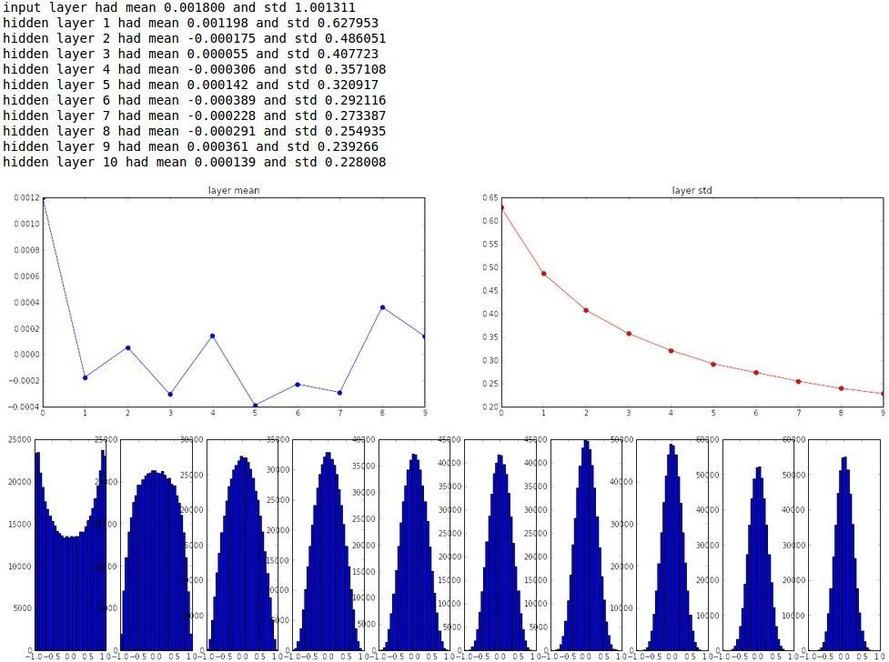
“Xavier initialization” [Glorot et al., 2010]
Reasonable initialization. (Mathematical derivation assumes linear activations)
Fei-Fei Li & Justin Johnson & Serena Yeung Lecture 6 - April 19, 2018

Slide 49
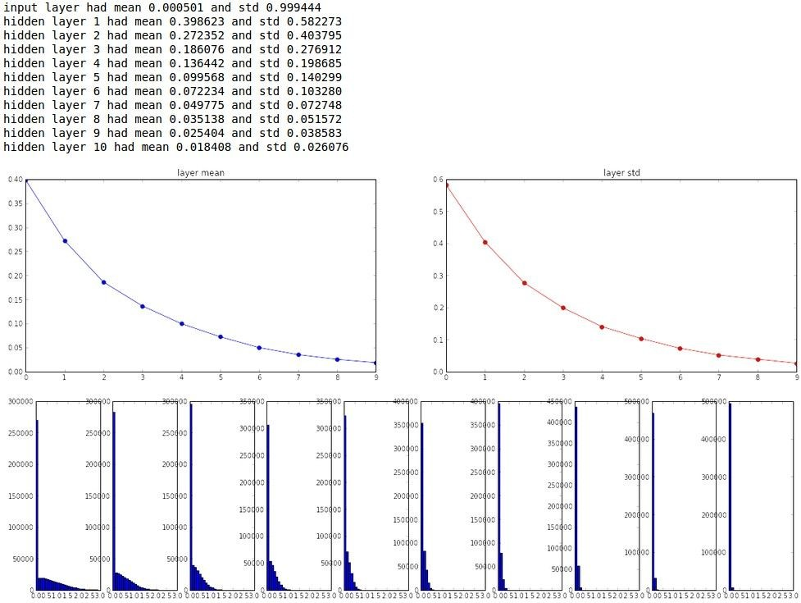
but when using the ReLU nonlinearity it breaks.
Fei-Fei Li & Justin Johnson & Serena Yeung Lecture 6 - April 19, 2018

Slide 50
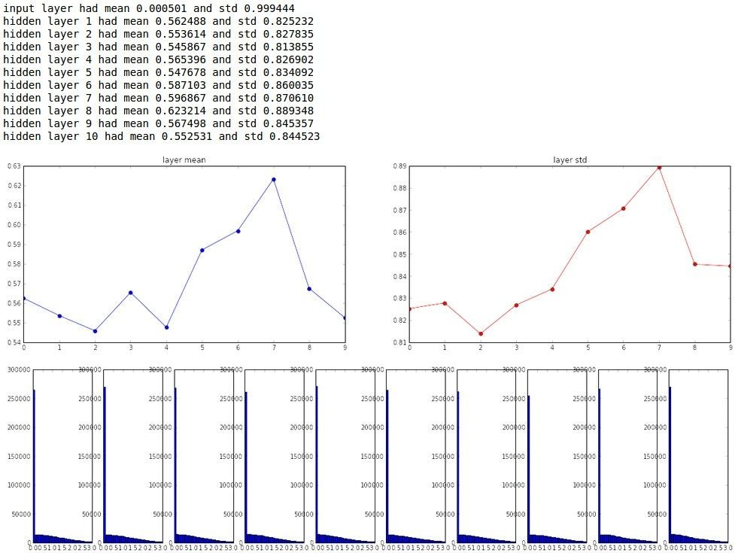
He et al., 2015 (note additional 2/)
Fei-Fei Li & Justin Johnson & Serena Yeung Lecture 6 - April 19, 2018

Slide 51
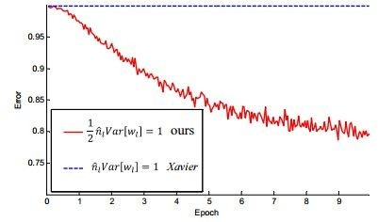
He et al., 2015 (note additional 2/)
Fei-Fei Li & Justin Johnson & Serena Yeung Lecture 6 - April 19, 2018

Slide 52
Proper initialization is an active area of research…
Understanding the difficulty of training deep feedforward neural networks
by Glorot and Bengio, 2010
Exact solutions to the nonlinear dynamics of learning in deep linear neural networks by Saxe et al, 2013
Random walk initialization for training very deep feedforward networks by Sussillo and Abbott, 2014
Delving deep into rectifiers: Surpassing human-level performance on ImageNet classification by He et al., 2015
Data-dependent Initializations of Convolutional Neural Networks by Krähenbühl et al., 2015
All you need is a good init, Mishkin and Matas, 2015
…
Fei-Fei Li & Justin Johnson & Serena Yeung Lecture 6 - April 19, 2018

Slide 53
Batch Normalization
Fei-Fei Li & Justin Johnson & Serena Yeung Lecture 6 - April 19, 2018

Slide 54

Batch Normalization
[Ioffe and Szegedy, 2015]
“you want zero-mean unit-variance activations? just make them so.”
consider a batch of activations at some layer. To make each dimension zero-mean unit-variance, apply:
this is a vanilla differentiable function...
Fei-Fei Li & Justin Johnson & Serena Yeung Lecture 6 - April 19, 2018

Slide 55


Batch Normalization
[Ioffe and Szegedy, 2015]
“you want zero-mean unit-variance activations? just make them so.”
1. compute the empirical mean and variance independently for each dimension.
X
N
2. Normalize
D
Fei-Fei Li & Justin Johnson & Serena Yeung Lecture 6 - April 19, 2018

Slide 56
Batch Normalization
[Ioffe and Szegedy, 2015]
FC
Usually inserted after Fully Connected or Convolutional layers, and before nonlinearity.
BN
tanh
FC
BN
tanh
...
Fei-Fei Li & Justin Johnson & Serena Yeung Lecture 6 - April 19, 2018

Slide 57
Batch Normalization
[Ioffe and Szegedy, 2015]
FC
Usually inserted after Fully Connected or Convolutional layers, and before nonlinearity.
BN
tanh
FC
BN
Problem: do we necessarily want a
zero-mean unit-variance input?
tanh
...
Fei-Fei Li & Justin Johnson & Serena Yeung Lecture 6 - April 19, 2018

Slide 58



Batch Normalization
[Ioffe and Szegedy, 2015]
Normalize:
Note, the network can learn:
to recover the identity mapping.
And then allow the network to squash the range if it wants to:
Fei-Fei Li & Justin Johnson & Serena Yeung Lecture 6 - April 19, 2018

Slide 59
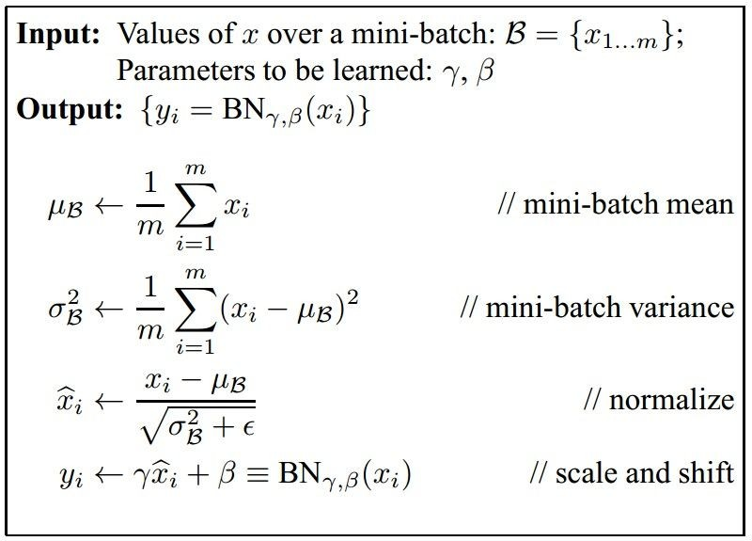
Batch Normalization
[Ioffe and Szegedy, 2015]
Improves gradient flow through the network
Allows higher learning rates
Reduces the strong dependence on initialization
Acts as a form of regularization in a funny way, and slightly reduces the need for dropout, maybe
Fei-Fei Li & Justin Johnson & Serena Yeung Lecture 6 - April 19, 2018

Slide 60
Batch Normalization
[Ioffe and Szegedy, 2015]
Note: at test time BatchNorm layer functions differently:
The mean/std are not computed based on the batch. Instead, a single fixed empirical mean of activations during training is used.
(e.g. can be estimated during training with running averages)
Fei-Fei Li & Justin Johnson & Serena Yeung Lecture 6 - April 19, 2018

Slide 61
Babysitting the Learning Process
Fei-Fei Li & Justin Johnson & Serena Yeung Lecture 6 - April 19, 2018

Slide 62
Step 1: Preprocess the data
(Assume X [NxD] is data matrix, each example in a row)
Fei-Fei Li & Justin Johnson & Serena Yeung Lecture 6 - April 19, 2018

Slide 63
Step 2: Choose the architecture:
say we start with one hidden layer of 50 neurons:
50 hidden neurons
10 output neurons, one per class
output layer
CIFAR-10
images, 3072
numbers
input layer
hidden layer
Fei-Fei Li & Justin Johnson & Serena Yeung Lecture 6 - April 19, 2018

Slide 64
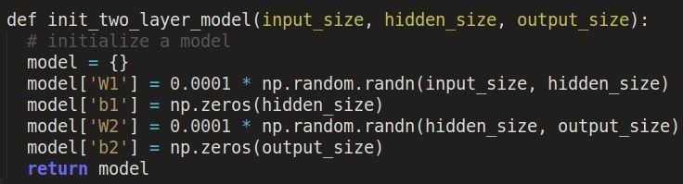

Double check that the loss is reasonable:
disable regularization
loss ~2.3. “correct” for 10 classes
returns the loss and the gradient for all parameters
Fei-Fei Li & Justin Johnson & Serena Yeung Lecture 6 - April 19, 2018

Slide 65

Double check that the loss is reasonable:
crank up regularization
loss went up, good. (sanity check)
Fei-Fei Li & Justin Johnson & Serena Yeung Lecture 6 - April 19, 2018

Slide 66
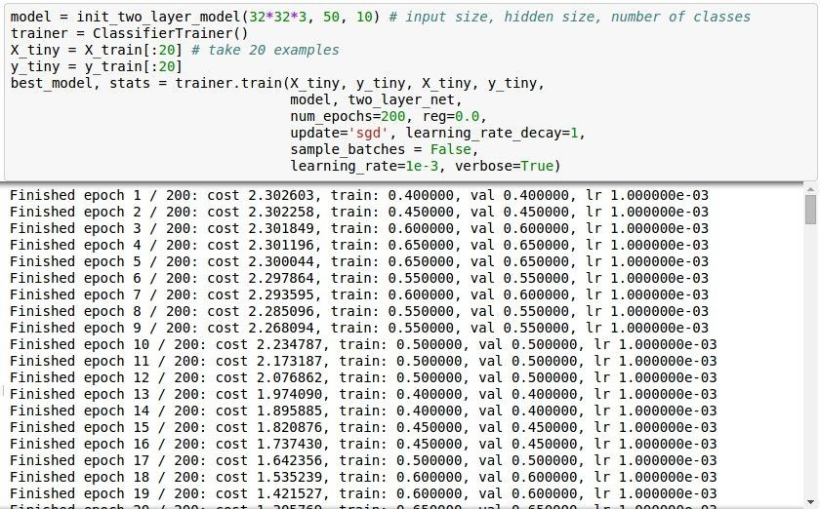
Lets try to train now…
Tip: Make sure that you can overfit very small portion of the training data
The above code:
take the first 20 examples from CIFAR-10
turn off regularization (reg = 0.0)
use simple vanilla ‘sgd’
Fei-Fei Li & Justin Johnson & Serena Yeung Lecture 6 - April 19, 2018

Slide 67
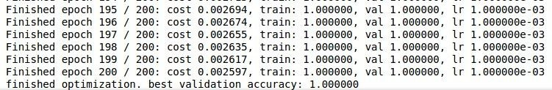

Lets try to train now…
Tip: Make sure that you can overfit very small portion of the training data
Very small loss, train accuracy 1.00, nice!
Fei-Fei Li & Justin Johnson & Serena Yeung Lecture 6 - April 19, 2018

Slide 68
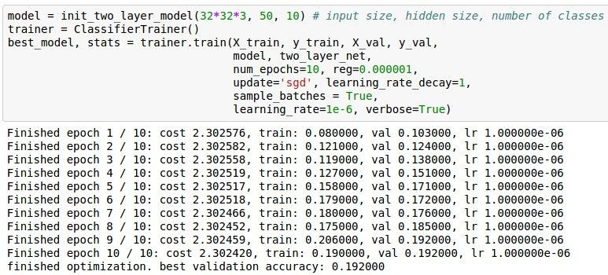
Lets try to train now…
Start with small regularization and find learning rate that makes the loss go down.
Fei-Fei Li & Justin Johnson & Serena Yeung Lecture 6 - April 19, 2018

Slide 69
Lets try to train now…
Start with small regularization and find learning rate that makes the loss go down.
Loss barely changing
Fei-Fei Li & Justin Johnson & Serena Yeung Lecture 6 - April 19, 2018

Slide 70
Lets try to train now…
Start with small regularization and find learning rate that makes the loss go down.
Loss barely changing: Learning rate is probably too low
loss not going down:
learning rate too low
Fei-Fei Li & Justin Johnson & Serena Yeung Lecture 6 - April 19, 2018

Slide 71
Lets try to train now…
Start with small regularization and find learning rate that makes the loss go down.
Loss barely changing: Learning rate is probably too low
loss not going down:
learning rate too low
Notice train/val accuracy goes to 20% though, what’s up with that? (remember this is softmax)
Fei-Fei Li & Justin Johnson & Serena Yeung Lecture 6 - April 19, 2018

Slide 72
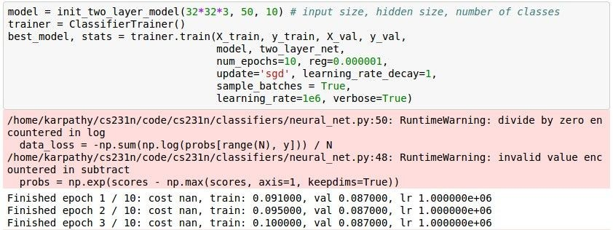
Lets try to train now…
Start with small regularization and find learning rate that makes the loss go down.
loss not going down:
learning rate too low
Now let’s try learning rate 1e6.
Fei-Fei Li & Justin Johnson & Serena Yeung Lecture 6 - April 19, 2018

Slide 73
Lets try to train now…
Start with small regularization and find learning rate that makes the loss go down.
cost: NaN almost always means high learning rate...
loss not going down: learning rate too low loss exploding: learning rate too high
Fei-Fei Li & Justin Johnson & Serena Yeung Lecture 6 - April 19, 2018

Slide 74
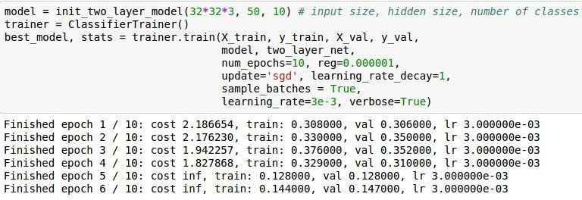
Lets try to train now…
Start with small regularization and find learning rate that makes the loss go down.
3e-3 is still too high. Cost explodes….
loss not going down: learning rate too low loss exploding: learning rate too high
=> Rough range for learning rate we should be cross-validating is somewhere [1e-3 … 1e-5]
Fei-Fei Li & Justin Johnson & Serena Yeung Lecture 6 - April 19, 2018

Slide 75
Hyperparameter Optimization
Fei-Fei Li & Justin Johnson & Serena Yeung Lecture 6 - April 19, 2018

Slide 76
Cross-validation strategy
coarse -> fine cross-validation in stages
First stage: only a few epochs to get rough idea of what params work
Second stage: longer running time, finer search
… (repeat as necessary)
Tip for detecting explosions in the solver:
If the cost is ever > 3 * original cost, break out early
Fei-Fei Li & Justin Johnson & Serena Yeung Lecture 6 - April 19, 2018

Slide 77
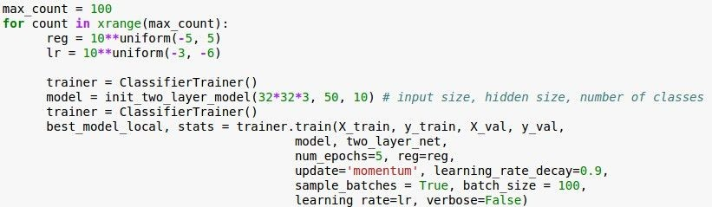
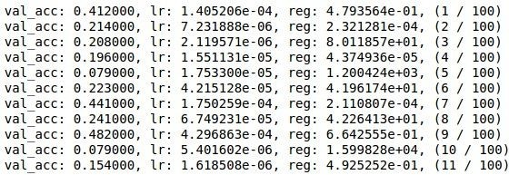
For example: run coarse search for 5 epochs
note it’s best to optimize
in log space!
nice
Fei-Fei Li & Justin Johnson & Serena Yeung Lecture 6 - April 19, 2018

Slide 78

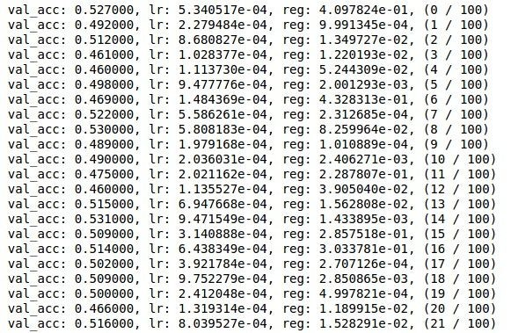
Now run finer search...
adjust range
53% - relatively good for a 2-layer neural net with 50 hidden neurons.
Fei-Fei Li & Justin Johnson & Serena Yeung Lecture 6 - April 19, 2018

Slide 79
Now run finer search...
adjust range
53% - relatively good for a 2-layer neural net with 50 hidden neurons.
But this best
cross-validation result is worrying. Why?
Fei-Fei Li & Justin Johnson & Serena Yeung Lecture 6 - April 19, 2018

Slide 80
Random Search for
Random Search vs. Grid Search
Hyper-Parameter Optimization
Bergstra and Bengio, 2012
Grid Layout Random Layout
Unimportant Parameter
Unimportant Parameter
Important Parameter
Important Parameter
Illustration of Bergstra et al., 2012 by Shayne Longpre, copyright CS231n 2017
Fei-Fei Li & Justin Johnson & Serena Yeung Lecture 6 - April 19, 2018

Slide 81

Hyperparameters to play with:
- network architecture
learning rate, its decay schedule, update type
regularization (L2/Dropout strength)
neural networks practitioner music = loss function
This image by Paolo Guereta is licensed under CC-BY 2.0
Fei-Fei Li & Justin Johnson & Serena Yeung Lecture 6 - April 19, 2018

Slide 82
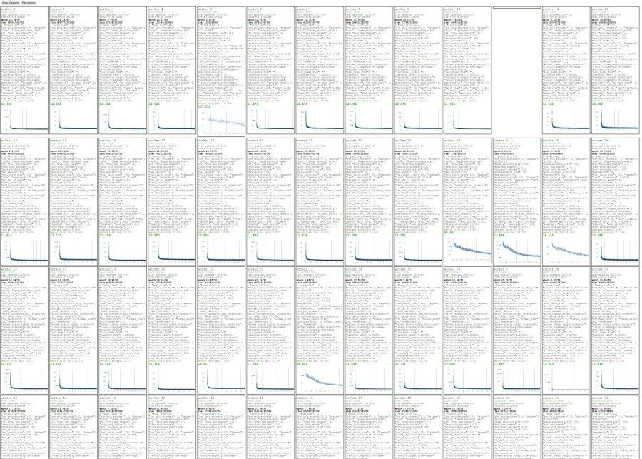
Cross-validation “command center”
Fei-Fei Li & Justin Johnson & Serena Yeung Lecture 6 - April 19, 2018

Slide 83
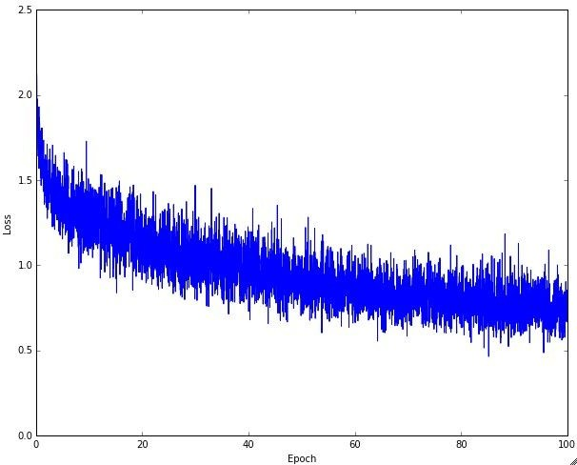
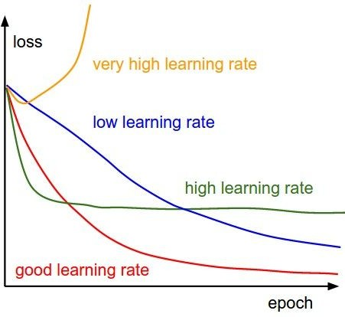
Monitor and visualize the loss curve
Fei-Fei Li & Justin Johnson & Serena Yeung Lecture 6 - April 19, 2018

Slide 84
Loss
Bad initialization a prime suspect
time
Fei-Fei Li & Justin Johnson & Serena Yeung Lecture 6 - April 19, 2018

Slide 85
Loss
time
Fei-Fei Li & Justin Johnson & Serena Yeung Lecture 6 - April 19, 2018

Slide 86
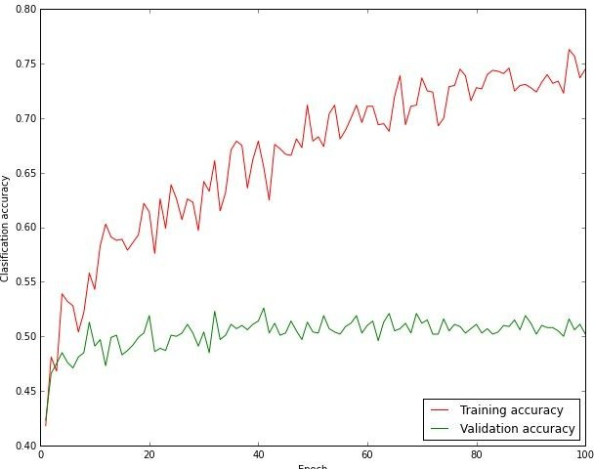
Monitor and visualize the accuracy:
big gap = overfitting
=> increase regularization strength?
no gap
=> increase model capacity?
Fei-Fei Li & Justin Johnson & Serena Yeung Lecture 6 - April 19, 2018

Slide 87
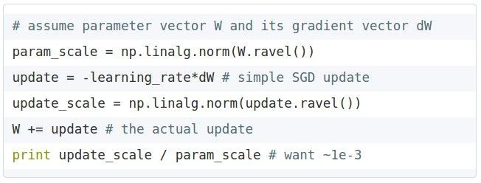
Track the ratio of weight updates / weight magnitudes:
ratio between the updates and values: ~ 0.0002 / 0.02 = 0.01 (about okay)
want this to be somewhere around 0.001 or so
Fei-Fei Li & Justin Johnson & Serena Yeung Lecture 6 - April 19, 2018

Slide 88
Summary
TLDRs
We looked in detail at:
Activation Functions (use ReLU)
Data Preprocessing (images: subtract mean)
Weight Initialization (use Xavier/He init)
Batch Normalization (use)
Babysitting the Learning process
Hyperparameter Optimization
(random sample hyperparams, in log space when appropriate)
Fei-Fei Li & Justin Johnson & Serena Yeung Lecture 6 - April 19, 2018

Slide 89
Next time:
Training Neural Networks, Part 2
Parameter update schemes
Learning rate schedules
Gradient checking
Regularization (Dropout etc.)
Evaluation (Ensembles etc.)
Transfer learning / fine-tuning
Fei-Fei Li & Justin Johnson & Serena Yeung Lecture 6 - April 19, 2018

