Slide 1

CPSC 5440: Introduction Machine Learning Lesson E02: Reinforcement Learning
Derived from Karan Kathpalia (CMU)

Slide 2
Overview
Introduction to Reinforcement Learning
Finite Markov Decision Processes
Temporal-Difference Learning (SARSA, Q-learning, Deep Q-Networks)
Policy Gradient Methods (Finite Difference Policy Gradient, REINFORCE, Actor-Critic)
Asynchronous Reinforcement Learning

Slide 3
What is Reinforcement Learning?
Learning from interaction with an environment to achieve some long-term goal that is related to the state of the environment
The goal is defined by reward signal, which must be maximized
Agent must be able to partially/fully sense the environment state and take actions to influence the environment state
The state is typically described with a feature-vector

Slide 4
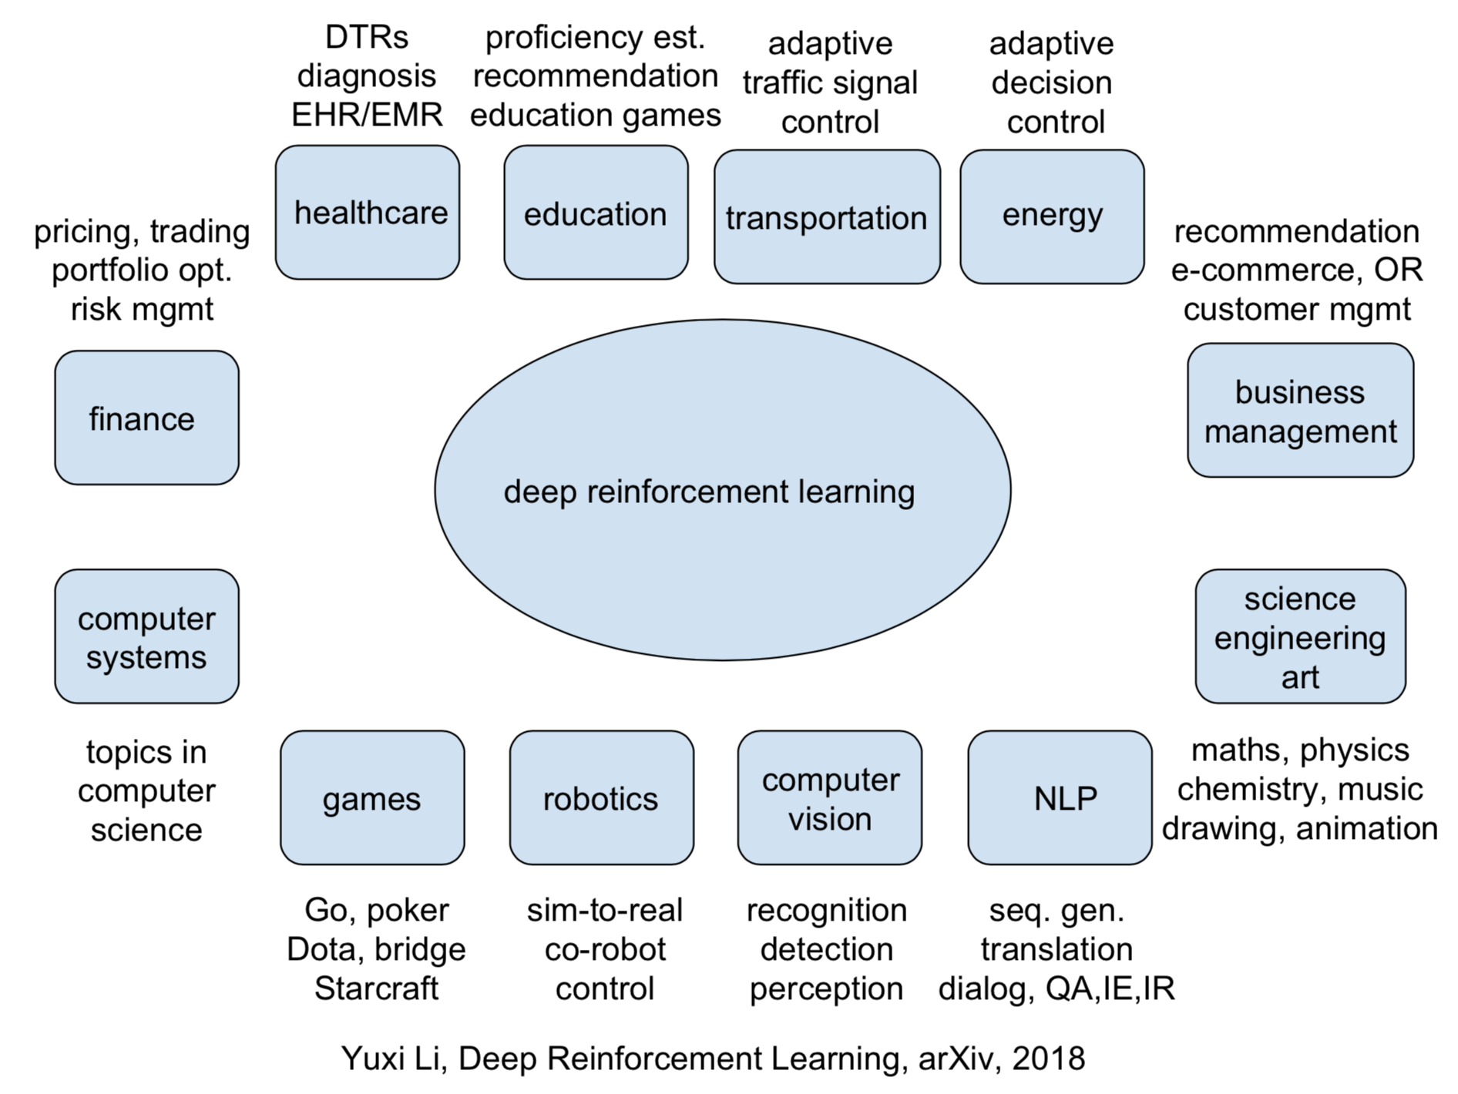
Applications of Deep Reinforcement Learning

Slide 5
Exploration versus Exploitation
We want a reinforcement learning agent to earn lots of reward
The agent must prefer past actions that have been found to be effective at producing reward
The agent must exploit what it already knows to obtain reward
The agent must select untested actions to discover reward-producing actions
The agent must explore actions to make better action selections in the future
Trade-off between exploration and exploitation

Slide 6
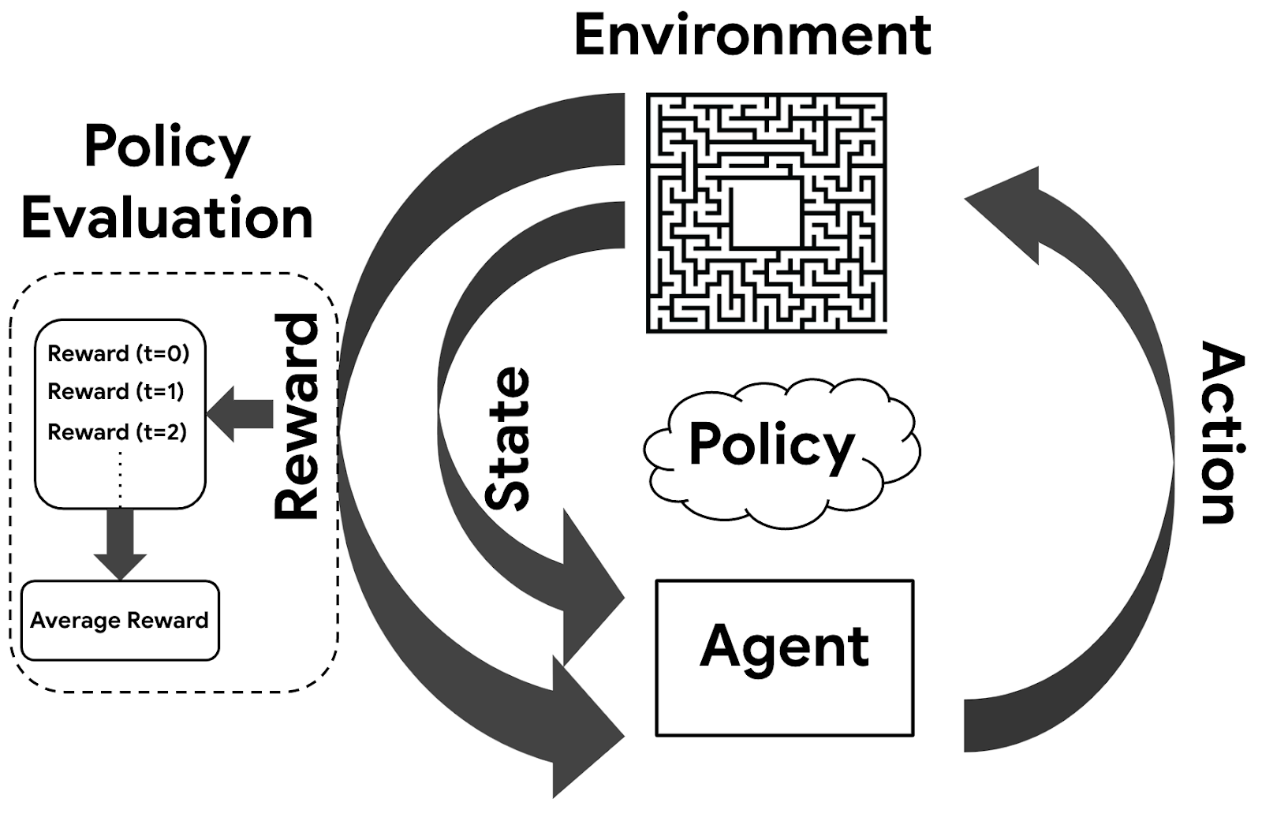
Reinforcement Learning Systems
Reinforcement learning systems have 4 main elements:
Policy
Reward signal
Value function
Optional model of the environment

Slide 7
Policy
A policy is a mapping from the perceived states of the environment to actions to be taken when in those states
A reinforcement learning agent uses a policy to select actions given the current environment state

Slide 8
Reward Signal
The reward signal defines the goal
On each time step, the environment sends a single number called the reward to the reinforcement learning agent
The agent’s objective is to maximise the total reward that it receives over the long run
The reward signal is used to alter the policy

Slide 9
Value Function (1)
The reward signal indicates what is good in the short run while the value function indicates what is good in the long run
The value of a state is the total amount of reward an agent can expect to accumulate over the future, starting in that state
Compute the value using the states that are likely to follow the current state and the rewards available in those states
Future rewards may be time-discounted with a factor in the interval [0, 1]

Slide 10
Value Function (2)
Use the values to make and evaluate decisions
Action choices are made based on value judgements
Prefer actions that bring about states of highest value instead of highest reward
Rewards are given directly by the environment
Values must continually be re-estimated from the sequence of observations that an agent makes over its lifetime

Slide 11
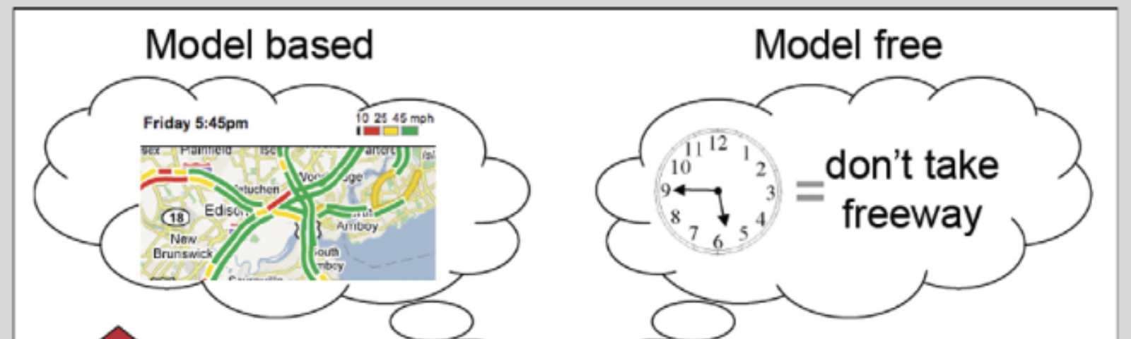
Model-free versus Model-based
A model of the environment allows inferences to be made about how the environment will behave
Example: Given a state and an action to be taken while in that state, the model could predict the next state and the next reward
Models are used for planning, which means deciding on a course of action by considering possible future situations before they are experienced
Model-based methods use models and planning. Think of this as modelling the dynamics p(s’ | s, a)
Model-free methods learn exclusively from trial-and-error (i.e. no modelling of the environment)
This presentation focuses on model-free methods

Slide 12
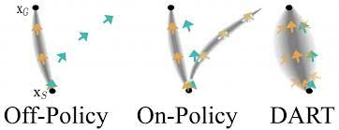
On-policy versus Off-policy
An on-policy agent learns only about the policy that it is executing
An off-policy agent learns about a policy or policies different from the one that it is executing

Slide 13
Credit Assignment Problem
Given a sequence of states and actions, and the final sum of time-discounted future rewards, how do we infer which actions were effective at producing lots of reward and which actions were not effective?
How do we assign credit for the observed rewards given a sequence of actions over time?
Every reinforcement learning algorithm must address this problem

Slide 14
Reward Design
We need rewards to guide the agent to achieve its goal
Option 1: Hand-designed reward functions
This is a black art
Option 2: Learn rewards from demonstrations
Instead of having a human expert tune a system to achieve the desired behaviour, the expert can demonstrate desired behaviour and the robot can tune itself to match the demonstration

Slide 15
What is Deep Reinforcement Learning?
Deep reinforcement learning is standard reinforcement learning where a deep neural network is used to approximate either a policy or a value function
Deep neural networks require lots of real/simulated interaction with the environment to learn
Lots of trials/interactions is possible in simulated environments
We can easily parallelise the trials/interaction in simulated environments
We cannot do this with robotics (no simulations) because action execution takes time, accidents/failures are expensive and there are safety concerns

Slide 16
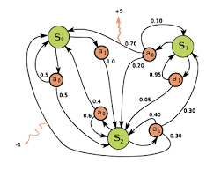
Finite Markov Decision Processes
Chapter 3 – Reinforcement Learning: An Introduction

Slide 17
Markov Decision Process (MDP)
Set of states S
Set of actions A
State transition probabilities p(s’ | s, a). This is the probability distribution over the state space given we take action a in state s
Discount factor γ in [0, 1]
Reward function R: S x A -> set of real numbers
For simplicity, assume discrete rewards
Finite MDP if both S and A are finite

Slide 18
Time Discounting
The undiscounted formulation γ = 0 across episodes is appropriate for episodic tasks in which agent-environment interaction breaks into episodes (multiple trials to perform a task).
Example: Playing Breakout (each run of the game is an episode)
The discounted formulation 0 < γ <= 1 is appropriate for continuing tasks, in which the interaction continues without limit
Example: Vacuum cleaner robot
This presentation focuses on episodic tasks

Slide 19
Agent-Environment Interaction (1)
The agent and environment interact at each of a sequence of discrete time steps t = {0, 1, 2, 3, …, T} where T can be infinite
At each time step t, the agent receives some representation of the environment state S_{t} in S and uses this to select an action A_{t} in the set A(S_{t}) of available actions given that state
One step later, the agent receives a numerical reward R_{t+1} and finds itself in a new state S_{t+1}

Slide 20
Agent-Environment Interaction (2)
At each time step, the agent implements a stochastic policy or mapping from states to probabilities of selecting each possible action
The policy is denoted π_{t} where π_{t}(a | s) is the probability of taking action a when in state s
A policy is a stochastic rule by which the agent selects actions as a function of states
Reinforcement learning methods specify how the agent changes its policy using its experience

Slide 21
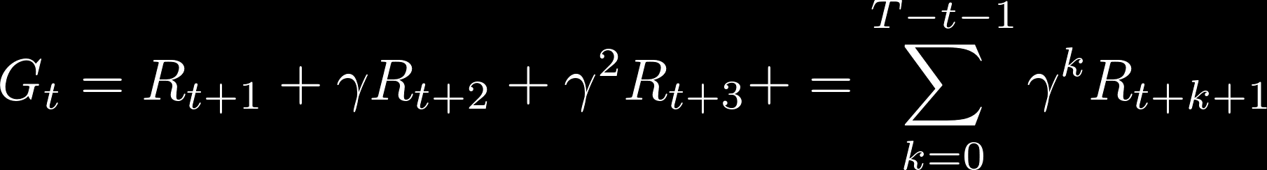
Action Selection
At time t, the agent tries to select an action to maximise the sum G_{t} of discounted rewards received in the future

Slide 22
MDP Dynamics
Given current state s and action a in that state, the probability of the next state s’ and the next reward r is given by:

Slide 23
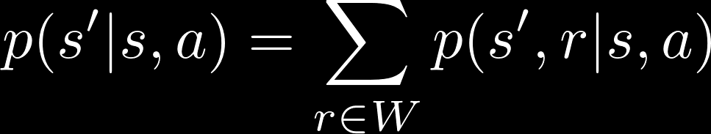
State Transition Probabilities
Suppose the reward function is discrete and maps from S x A to W
The state transition probability or probability of transitioning to state s’ given current state s and action a in that state is given by:

Slide 24
Expected Rewards
The expected reward for a given state-action pair is given by:

Slide 25
State-Value Function (1)
Value functions are defined with respect to particular policies because future rewards depend on the agent’s actions
Value functions give the expected return of a particular policy
The value v_{π}(s) of a state s under a policy π is the expected return when starting in state s and following the policy π from that state onwards

Slide 26

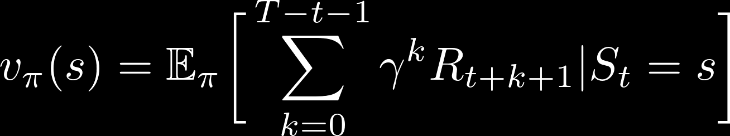
State-Value Function (2)
The state-value function v_{π}(s) for the policy π is given below. Note that the value of the terminal state (if any) is always zero.

Slide 27
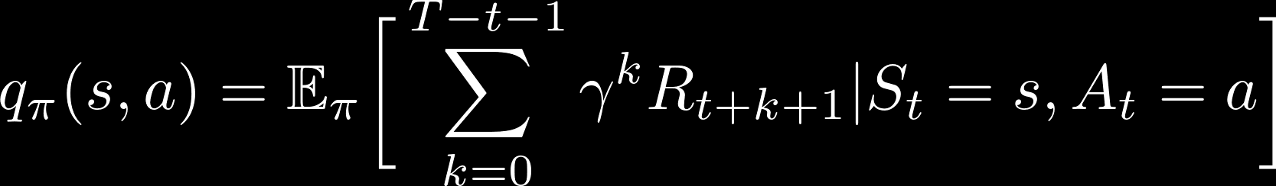
Action-Value Function
The value q_{π}(s, a) of taking action a in state s under a policy π is defined as the expected return starting from s, taking the action a and thereafter following policy π
q_{π} is the action-value function for policy π

Slide 28
Bellman Equation (1)
The equation expresses the relationship between the value of a state s and the values of its successor states
The value of the next state must equal the discounted value of the expected next state, plus the reward expected along the way

Slide 29
Bellman Equation (2)
The value of state s is the expected value of the sum of time-discounted rewards (starting at current state) given current state s
This is expected value of r plus the sum of time-discounted rewards (starting at successor state) over all successor states s’ and all next rewards r and over all possible actions a in current state s

Slide 30
Optimality
A policy is defined to be better than or equal to another policy if its expected return is greater than or equal to that of the other policy for all states
There is always at least one optimal policy π* that is better than or equal to all other policies
All optimal policies share the same optimal state-value function v*, which gives the maximum expected return for any state s over all possible policies
All optimal policies share the same optimal action-value function q*, which gives the maximum expected return for any state-action pair (s, a) over all possible policies

Slide 31
Temporal-Difference Learning
Chapter 6 – Reinforcement Learning: An Introduction
Playing Atari with Deep Reinforcement Learning
Asynchronous Methods for Deep Reinforcement Learning
David Silver’s Tutorial on Deep Reinforcement Learning

Slide 32
What is TD learning?
Temporal-Difference learning = TD learning
The prediction problem is that of estimating the value function for a policy π
The control problem is the problem of finding an optimal policy π*
Given some experience following a policy π, update estimate v of v_{π} for non-terminal states occurring in that experience
Given current step t, TD methods wait until the next time step to update V(S_{t})
Learn from partial returns

Slide 33
Value-based Reinforcement Learning
We want to estimate the optimal value V*(s) or action-value function Q*(s, a) using a function approximator V(s; θ) or Q(s, a; θ) with parameters θ
This function approximator can be any parametric supervised machine learning model
Recall that the optimal value is the maximum value achievable under any policy

Slide 34
Update Rule for TD(0)
At time t + 1, TD methods immediately form a target R_{t+1} + γ V(S_{t+1}) and make a useful update with step size α using the observed reward R_{t+1} and the estimate V(S_{t+1})
The update is the step size times the difference between the target output and the actual output

Slide 35
Update Rule Intuition
The target output is a more accurate estimate of V(S_{t}) given the reward R_{t+1} is known
The actual output is our current estimate of V(S_{t})
We simply take one step with our current value function estimate to get a more accurate estimate of V(S_{t}) and then perform an update to move V(S_{t}) closer towards the more accurate estimate (i.e. temporal difference)

Slide 36
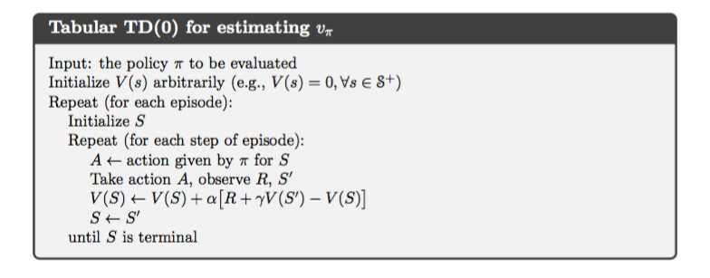
Tabular TD(0) Algorithm

Slide 37
SARSA – On-policy TD Control
SARSA = State-Action-Reward-State-Action
Learn an action-value function instead of a state-value function
q_{π} is the action-value function for policy π
Q-values are the values q_{π}(s, a) for s in S, a in A
SARSA experiences are used to update Q-values
Use TD methods for the prediction problem

Slide 38
SARSA Update Rule
We want to estimate q_{π}(s, a) for the current policy π, and for all states s and action a
The update rule is similar to that for TD(0) but we transition from state-action pair to state-action pair, and learn the values of state-action pairs
The update is performed after every transition from a non-terminal state S_{t}
If S_{t+1} is terminal, then Q(S_{t+1}, A_{t+1}) is zero
The update rule uses (S_{t}, A_{t}, R_{t+1}, S_{t+1}, A_{t+1})

Slide 39
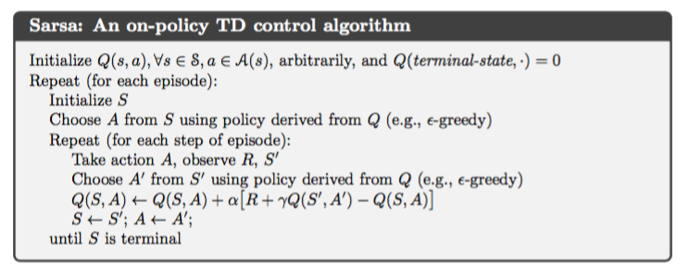
SARSA Algorithm

Slide 40
Q-learning – Off-policy TD Control
Similar to SARSA but off-policy updates
The learned action-value function Q directly approximates the optimal action-value function q* independent of the policy being followed
In update rule, choose action a that maximises Q given S_{t+1} and use the resulting Q-value (i.e. estimated value given by optimal action-value function) plus the observed reward as the target
This method is off-policy because we do not have a fixed policy that maps from states to actions. This is why A_{t+1} is not used in the update rule

Slide 41
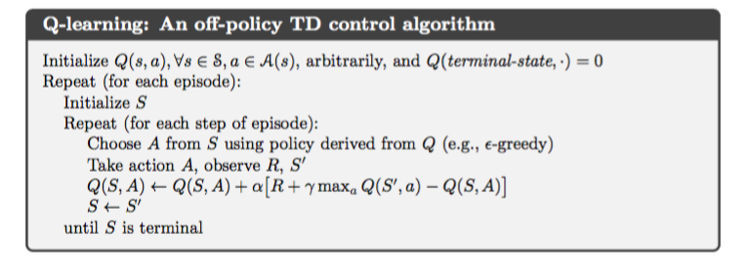
One-step Q-learning Algorithm

Slide 42
Epsilon-greedy Policy
At each time step, the agent selects an action
The agent follows the greedy strategy with probability 1 – epsilon
The agent selects a random action with probability epsilon
With Q-learning, the greedy strategy is the action a that maximises Q given S_{t+1}

Slide 43
Deep Q-Networks (DQN)
Introduced deep reinforcement learning
It is common to use a function approximator Q(s, a; θ) to approximate the action-value function in Q-learning
Deep Q-Networks is Q-learning with a deep neural network function approximator called the Q-network
Discrete and finite set of actions A
Example: Breakout has 3 actions – move left, move right, no movement
Uses epsilon-greedy policy to select actions

Slide 44
Q-Networks
Core idea: We want the neural network to learn a non-linear hierarchy of features or feature representation that gives accurate Q-value estimates
The neural network has a separate output unit for each possible action, which gives the Q-value estimate for that action given the input state
The neural network is trained using mini-batch stochastic gradient updates and experience replay

Slide 45
Experience Replay
The state is a sequence of actions and observations s_{t} = x₁, a₁, x₂, …, a_{t-1}, x_{t}
Store the agent’s experiences at each time step e_{t} = (s_{t}, a_{t}, r_{t}, s_{t+1}) in a dataset D = e₁, ..., e_{n} pooled over many episodes into a replay memory
In practice, only store the last N experience tuples in the replay memory and sample uniformly from D when performing updates

Slide 46
State representation
It is difficult to give the neural network a sequence of arbitrary length as input
Use fixed length representation of sequence/history produced by a function ϕ(s_{t})
Example: The last 4 image frames in the sequence of Breakout gameplay

Slide 47
Q-Network Training
Sample random mini-batch of experience tuples uniformly at random from D
Similar to Q-learning update rule but:
Use mini-batch stochastic gradient updates
The gradient of the loss function for a given iteration with respect to the parameter θ_{i} is the difference between the target value and the actual value is multiplied by the gradient of the Q function approximator Q(s, a; θ) with respect to that specific parameter
Use the gradient of the loss function to update the Q function approximator

Slide 48
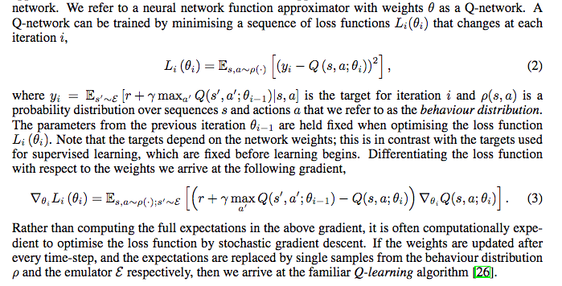
Loss Function Gradient Derivation

Slide 49
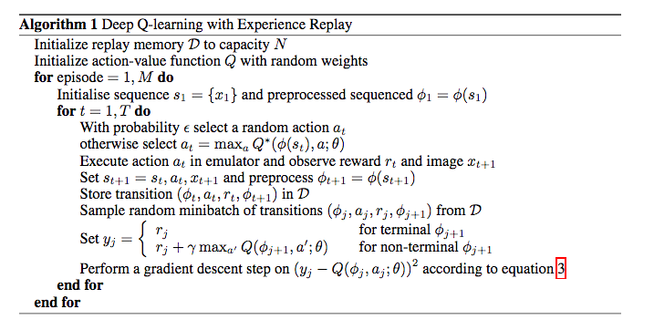
DQN Algorithm

Slide 50
Comments
It was previously thought that the combination of simple online reinforcement learning algorithms with deep neural networks was fundamentally unstable
The sequence of observed data (states) encountered by an online reinforcement learning agent is non-stationary and online updates are strongly correlated
The technique of DQN is stable because it stores the agent’s data in experience replay memory so that it can be randomly sampled from different time-steps
Aggregating over memory reduces non-stationarity and decorrelates updates but limits methods to off-policy reinforcement learning algorithms
Experience replay updates use more memory and computation per real interaction than online updates, and require off-policy learning algorithms that can update from data generated by an older policy

Slide 51
Policy Gradient Methods
Chapter 13 – Reinforcement Learning: An Introduction
Policy Gradient Lecture Slides from David Silver’s Reinforcement Learning Course
David Silver’s Tutorial on Deep Reinforcement Learning

Slide 52
What are Policy Gradient Methods?
Before: Learn the values of actions and then select actions based on their estimated action-values. The policy was generated directly from the value function
We want to learn a parameterised policy that can select actions without consulting a value function. The parameters of the policy are called policy weights
A value function may be used to learn the policy weights but this is not required for action selection
Policy gradient methods are methods for learning the policy weights using the gradient of some performance measure with respect to the policy weights
Policy gradient methods seek to maximise performance and so the policy weights are updated using gradient ascent

Slide 53
Policy-based Reinforcement Learning
Search directly for the optimal policy π*
Can use any parametric supervised machine learning model to learn policies π(a |s; θ) where θ represents the learned parameters
Recall that the optimal policy is the policy that achieves maximum future return

Slide 54
Notation
Policy weight vector θ
The policy is π(a | s, θ), which represents the probability that action a is taken in state s with policy weight vector θ
If using learned value functions, the value function’s weight vector is w
Performance measure η(θ)
Episodic case: η(θ) = v_{π}(s₀)
Performance is defined as the value of the start state under the parameterised policy

Slide 55

Policy Approximation
The policy can be parameterised in any way provided π(a | s, θ) is differentiable with respect to its weights
To ensure exploration, we generally require that the policy never becomes deterministic and so π(a | s, θ) is in interval (0, 1)
Assume discrete and finite set of actions
Form parameterised numerical preferences h(s, a, θ) for each state-action pair
Can use a deep neural network as the policy approximator
Use softmax so that the most preferred actions in each state are given the highest probability of being selected

Slide 56
Types of Policy Gradient Method
Finite Difference Policy Gradient
Monte Carlo Policy Gradient
Actor-Critic Policy Gradient

Slide 57
Finite Difference Policy Gradient
Compute the partial derivative of the performance measure η(θ) with respect to θ_{k} using finite difference gradient approximation
Compute performance measure η(θ)
Perturb θ by small positive amount epsilon in the kth dimension and compute performance measure η(θ + u_{k}ε) where u_{k} is unit vector that is 1 in kth component and 0 elsewhere
The partial derivative is approximated by
( η(θ + u_{k}ε) - η(θ) ) / ε
θ_{k} <- θ_{k} + α ( η(θ + u_{k}ε) - η(θ) ) / ε
Perform gradient ascent using the partial derivative
Simple, noisy and inefficient procedure that is sometimes effective
This procedure works for arbitrary policies (can be non-differentiable)

Slide 58

REINFORCE: Monte Carlo Policy Gradient
We want a quantity that we can sample on each time step whose expectation is equal to the gradient
We can then perform stochastic gradient ascent with this quantity

Slide 59
REINFORCE Properties
On-policy method
Uses the complete return from time t, which includes all future rewards until the end of the episode
REINFORCE is thus a Monte Carlo algorithm and is only well-defined for the episodic case with all updates made in retrospect after the episode is completed
Note that the gradient of log x is the gradient of x divided by x by the chain rule

Slide 60
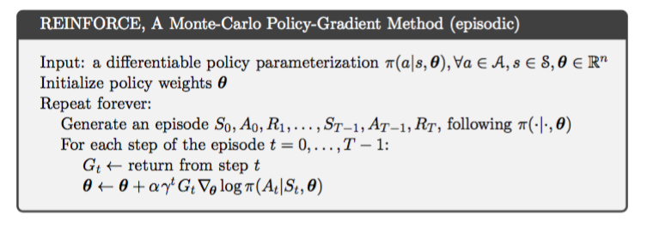
REINFORCE Algorithm

Slide 61
Actor-Critic Methods
Methods that learn approximations to both policy and value functions are called actor-critic methods
Actor refers to the learned policy
Critic refers to the learned value function, which is usually a state-value function
The critic is bootstrapped – the state-values are updated using the estimated state-values of subsequent states
The number of steps in the actor-critic method controls the degree of bootstrapping

Slide 62
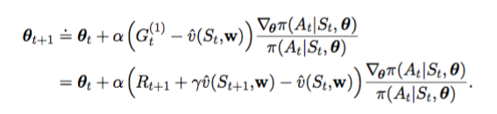
One-step Actor-Critic Update Rules
On-policy method
The state-value function update rule is the TD(0) update rule
The policy function update rule is shown below.
For n-step Actor-Critic, simply replace G_{t}⁽¹⁾ with G_{t}^{(n)}

Slide 63
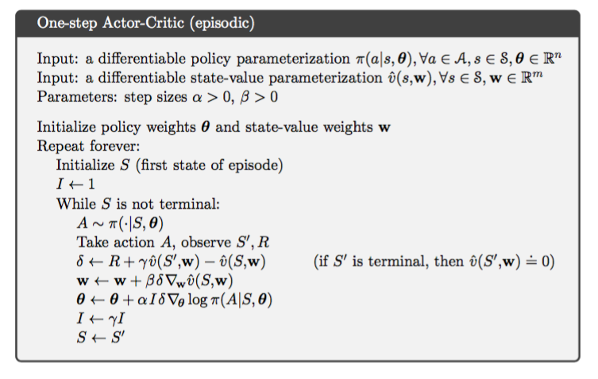
One-step Actor-Critic Algorithm

Slide 64
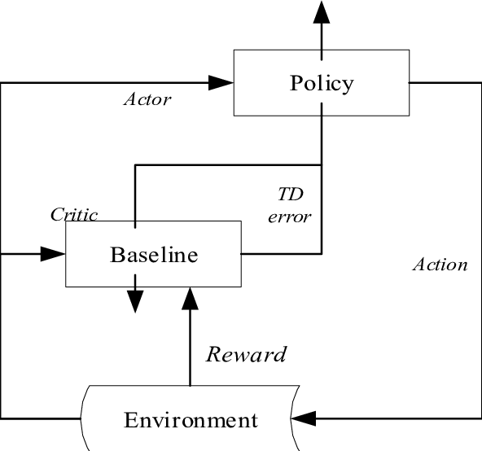
Asynchronous Reinforcement Learning
Asynchronous Methods for Deep Reinforcement Learning

Slide 65
What is Asynchronous Reinforcement Learning?
Use asynchronous gradient descent to optimise controllers
This is useful for deep reinforcement learning where the controllers are deep neural networks, which take a long time to train
Asynchronous gradient descent speeds up the learning process
Can use one multi-core CPU to train deep neural networks asynchronously instead of multiple GPUs

Slide 66
Parallelism (1)
Asynchronously execute multiple agents in parallel on multiple instances of the environment
This parallelism decorrelates the agents’ data into a more stationary process since at any given time-step, the agents will be experiencing a variety of different states
This approach enables a larger spectrum of fundamental on-policy and off-policy reinforcement learning algorithms to be applied robustly and effectively using deep neural networks
Use asynchronous actor-learners (i.e. agents). Think of each actor-learner as a thread
Run everything on a single multi-core CPU to avoid communication costs of sending gradients and parameters

Slide 67
Parallelism (2)
Multiple actor-learners running in parallel are likely to be exploring different parts of the environment
We can explicitly use different exploration policies in each actor-learner to maximise this diversity
By running different exploration policies in different threads, the overall changes made to the parameters by multiple actor-learners applying updates in parallel are less likely to be correlated in time than a single agent applying online updates

Slide 68
No Experience Replay
No need for a replay memory. We instead rely on parallel actors employing different exploration policies to perform the stabilising role undertaken by experience replay in the DQN training algorithm
Since we no longer rely on experience replay for stabilising learning, we are able to use on-policy reinforcement learning methods to train neural networks in a stable way

Slide 69
Asynchronous Algorithms
Asynchronous one-step Q-learning
Asynchronous one-step SARSA
Asynchronous n-step Q-learning
Asynchronous Advantage Actor-Critic (A3C)

Slide 70
Asynchronous one-step Q-learning
Each thread interacts with its own copy of the environment and at each step, computes the gradient of the Q-learning loss
Use a globally shared and slowly changing target network with parameters θ⁻ when computing the Q-learning loss
DQN uses a globally shared and slowly changing target network too – the network is updated using a mini-batch of experience tuples drawn from replay memory
The gradients are accumulated over multiple time-steps before being applied (similar to using mini-batches), which reduces chance of multiple actor-learners overwriting each other’s updates

Slide 71
Exploration
Giving each thread a different exploration policy helps improve robustness and generally improves performance through better exploration
Use epsilon-greedy exploration with epsilon periodically sampled from some distribution by each thread

Slide 72
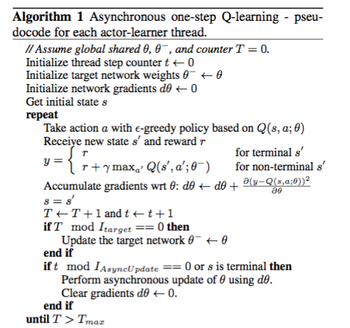
Asynchronous one-step Q-learning Algorithm

Slide 73
Asynchronous one-step SARSA
This is the same algorithm as Asynchronous one-step Q-learning except the target value used for Q(s, a) is different
One-step SARSA uses r + γ Q(s’, a’; θ⁻) as the target value

Slide 74
n-step Q-learning
So far we have been using one-step Q-learning
One-step Q-learning updates the action value Q(s, a) towards r + γ max_{a’} Q(s’, a’; θ), which is the one-step return
Obtaining a reward r only directly affects the value of the state-action pair (s, a) that led to the reward
The values of the other state-action pairs are affected only indirectly through the updated value Q(s, a)
This can make the learning process slow since many updates are required to propagate a reward to the relevant preceding states and actions
Use n-step returns to propagate the rewards faster

Slide 75
n-step Returns
In n-step Q-learning, Q(s, a) is updated towards the n-step return:
r_{t} + γ r_{t+1} + … + γ^{n-1} r_{t+n-1} + max_{a} γ^{n} Q(s_{t+n}, a)
This results in a single reward directly affecting the values of n preceding state-action pairs
This makes the process of propagating rewards to relevant state-action pairs potentially much more efficient
One-step update for the last state, two-step update for the second last state, and so on until n-step update for the nth last state
Accumulated updates are applied in a single step

Slide 76
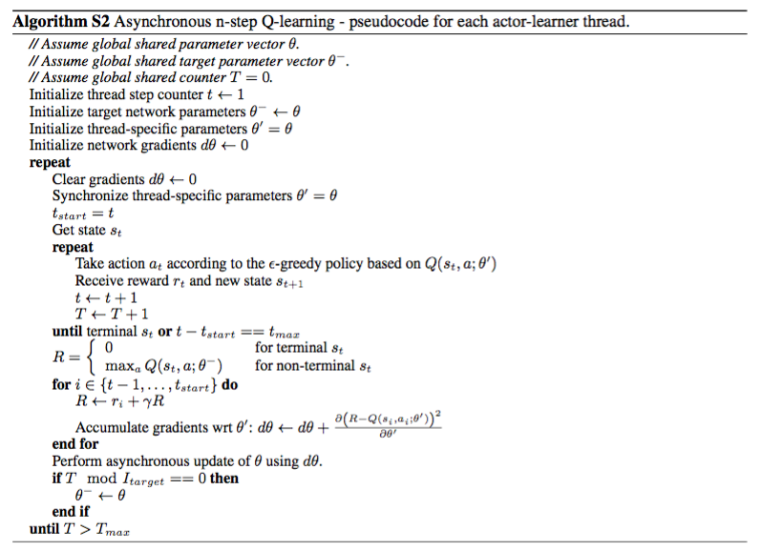
Asynchronous n-step Q-learning Algorithm

Slide 77
A3C
Maintains a policy π(a_{t}| s_{t}; θ) and an estimate of the value function V(s_{t}; θ_{v})
n-step Actor-Critic method
As with value-based methods, use parallel actor-learners and accumulate updates to improve training stability
In practice, the policy approximation and the value function share some parameters
Use a neural network that has one softmax output for the policy π(a_{t}| s_{t}; θ) and one linear output for the value function V(s_{t}; θ_{v}) with all non-output parameters shared

Slide 78
Advantage Definition
For a one-step actor-critic method with a learned policy and a learned value function, the advantage is defined as follows:
A(a_{t}, s_{t}) = Q(a_{t}, s_{t}) – V(s_{t})
The quantity r_{t} – V(s_{t}; θ_{v}) is an estimate of the advantage
This estimate is used to scale the policy gradient in an actor-critic method
The advantage estimate for a n-step actor-critic method is shown below:

Slide 79
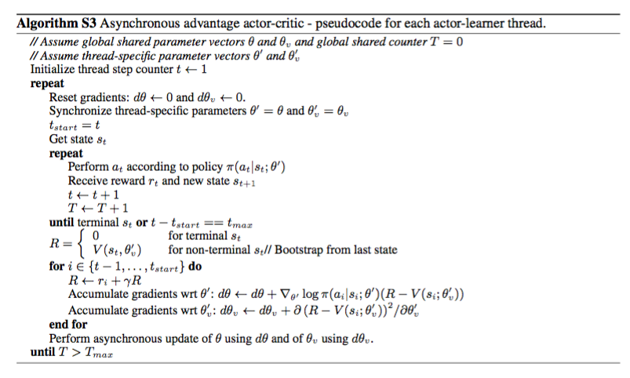
A3C Algorithm

Slide 80
Summary
Get faster training because of parallelism
Can use on-policy reinforcement learning methods
Diversity in exploration can lead to better performance than synchronous methods
In practice, the on-policy A3C algorithm appears to be the best performing asynchronous reinforcement learning method in terms of performance and training speed

