Slide 1
Pattern Programs

Slide 2
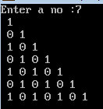
Pattern 18

Slide 3
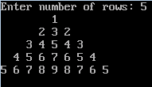
Pattern 22

Slide 4

Pattern 24

Slide 5
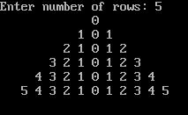
Pattern 25

Slide 6

Pattern 28

Slide 7
Pattern 28

Slide 8

Pattern 29

Slide 9

Pattern 30

Slide 10
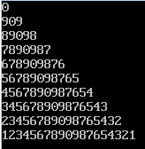
Pattern 31

Slide 11

Pattern 32

Slide 12

Pattern 33

Slide 13

Pattern 34

Slide 14

Pattern 35

Slide 15

Pattern 36

Slide 16

Pattern 38

Slide 17

Pattern 39

Slide 18

Pattern 40

