Slide 1

Exercises
Let us practice the concepts learned by solving some problems.

Slide 2
Problem Statement
  Write an algorithm to accept two numbers, divide the first number by the second, and display their quotient.
  Allocated time to solve the problem is 10 minutes.
Notes:
Explain the meaning of pseudocode. Using the example of adding two numbers explain how easily an pseudocode can be rewritten to program using a specific programming language.

Slide 3

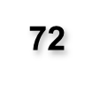


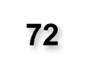

Solution
  Start the algorithm.
  Get the first number.
  Get the second number.
  Divide the first number by the
  second.
  5. Display the quotient.
  6. End the algorithm.
Notes:
Explain the meaning of pseudocode. Using the example of adding two numbers explain how easily an pseudocode can be rewritten to program using a specific programming language.

Slide 4
Problem Statement
  Write an algorithm that accepts distance in kilometers, converts it into meters, and then displays the result.
  Hint: Distance in meters = Distance in kilometers * 1000
  Allocated time to solve the problem is 10 minutes.
Notes:
Explain the meaning of pseudocode. Using the example of adding two numbers explain how easily an pseudocode can be rewritten to program using a specific programming language.

Slide 5
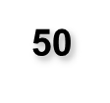


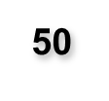
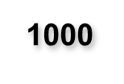
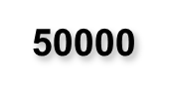
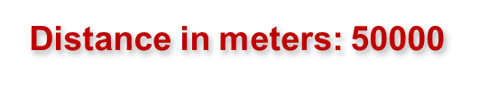
Solution
  Start the algorithm.
  Get the distance in kilometers.
  Multiply the distance by 1000.
  Display the result of
  multiplication as distance
  in meters.
  5. End the algorithm.
Notes:
Explain the meaning of pseudocode. Using the example of adding two numbers explain how easily an pseudocode can be rewritten to program using a specific programming language.

Slide 6
Problem Statement
  Write an algorithm that accepts five numbers and displays the sum and average of the numbers.
  Allocated time to solve the problem is 15 minutes.
Notes:
Explain the meaning of pseudocode. Using the example of adding two numbers explain how easily an pseudocode can be rewritten to program using a specific programming language.

Slide 7

Solution
3
  Start the algorithm.
  Get the first number.
  Get the second number.
  Get the third number.
  Get the fourth number.
  Get the fifth number.
  Add the five numbers.
  Divide the sum by 5.
  Display the addition as sum
  and result of division as average.
  10. End the algorithm.
1
6
20
2
8
20
5
4
Sum = 20
Average = 4
Notes:
Explain the meaning of pseudocode. Using the example of adding two numbers explain how easily an pseudocode can be rewritten to program using a specific programming language.

