Slide 1

Project Presentation Spend Analytics Submitted towards the partial fulfillment of the criteria for award of KPMG Data Science Prodegree by Imarticus Submitted By: Kunj Shah Vijitha Raj V J Course and Batch: DSP 33 2020

Slide 2
Topics
Introduction
Objectives
Data Dictionary
Data Analysis
Conclusions

Slide 3
Introduction
In this project, we have to analyze and classify the spend data for the procurement function of a company. This will enable the company to identify the scope for efficiency improvement and better strategic planning.

Slide 4
Objectives
1. Analyze the data and identify purchasing trends and patterns
2. Identify the cost saving opportunities by using the data of procurement
3. Create dashboards using any Visualization tool; e.g. Tableau
4. Make a report describing all the findings.

Slide 5
Data Dictionary
CoCd | organisation code
Plnt | Plant Code- who has send the requirement
SLoc | Storage location
TrackingNo | request tracking number
Matl Group | Material Group
PO Quantity | distribute to this account assignment item
OUn | Base Unit of Measure information
OPU | Order Price Unit information
Eq. To | Counter information - the number of units of the base unit
Net Price | Net Order Price information
Per | Price Unit information
Net Value | net value of the item, after any discounts and surcharges are taken into account
Gross value | Gross order value information. Order value = order quantity X order price.
GRT | GR Processing Time information. Number of workdays required after receiving the material for inspection and placement into storage
DCI | Delivery Completed information. Indicates that the item is to be regarded as closed.
Volume | Volume information. Space that the material occupies per unit of volume
Net Value | Net order value information
S | Statistical information.- including its length, data type, description text, associated , search help etc.

Slide 6
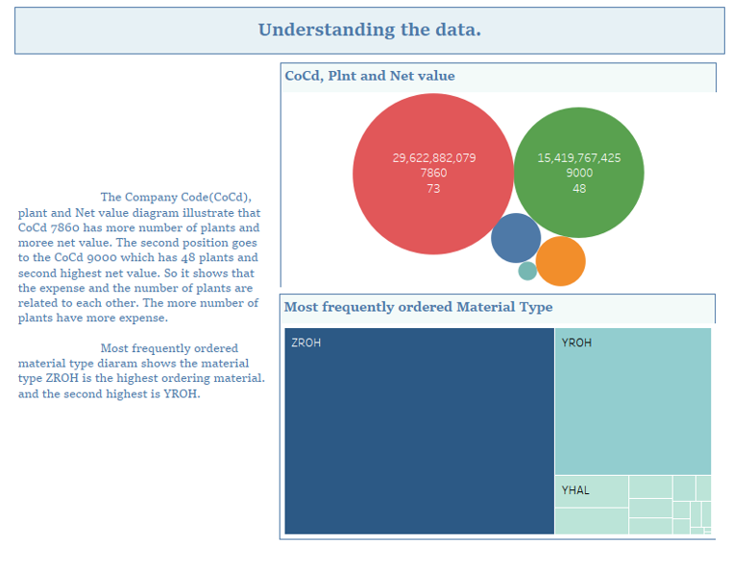
Data Analysis

Slide 7
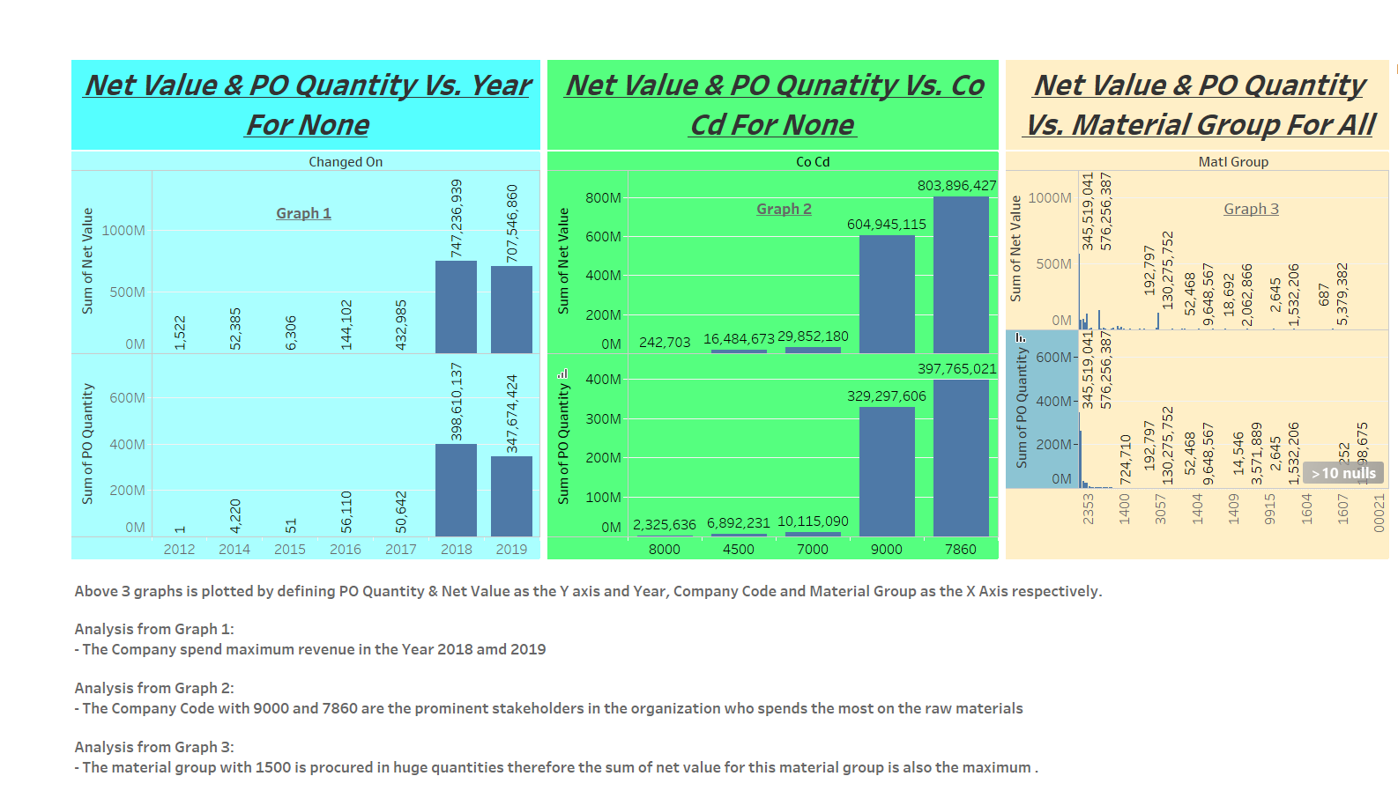
Data Analysis

Slide 8
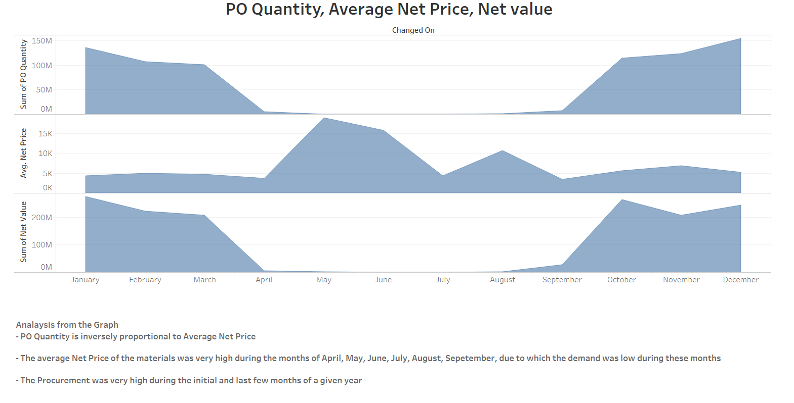
Data Analysis – Trends

Slide 9
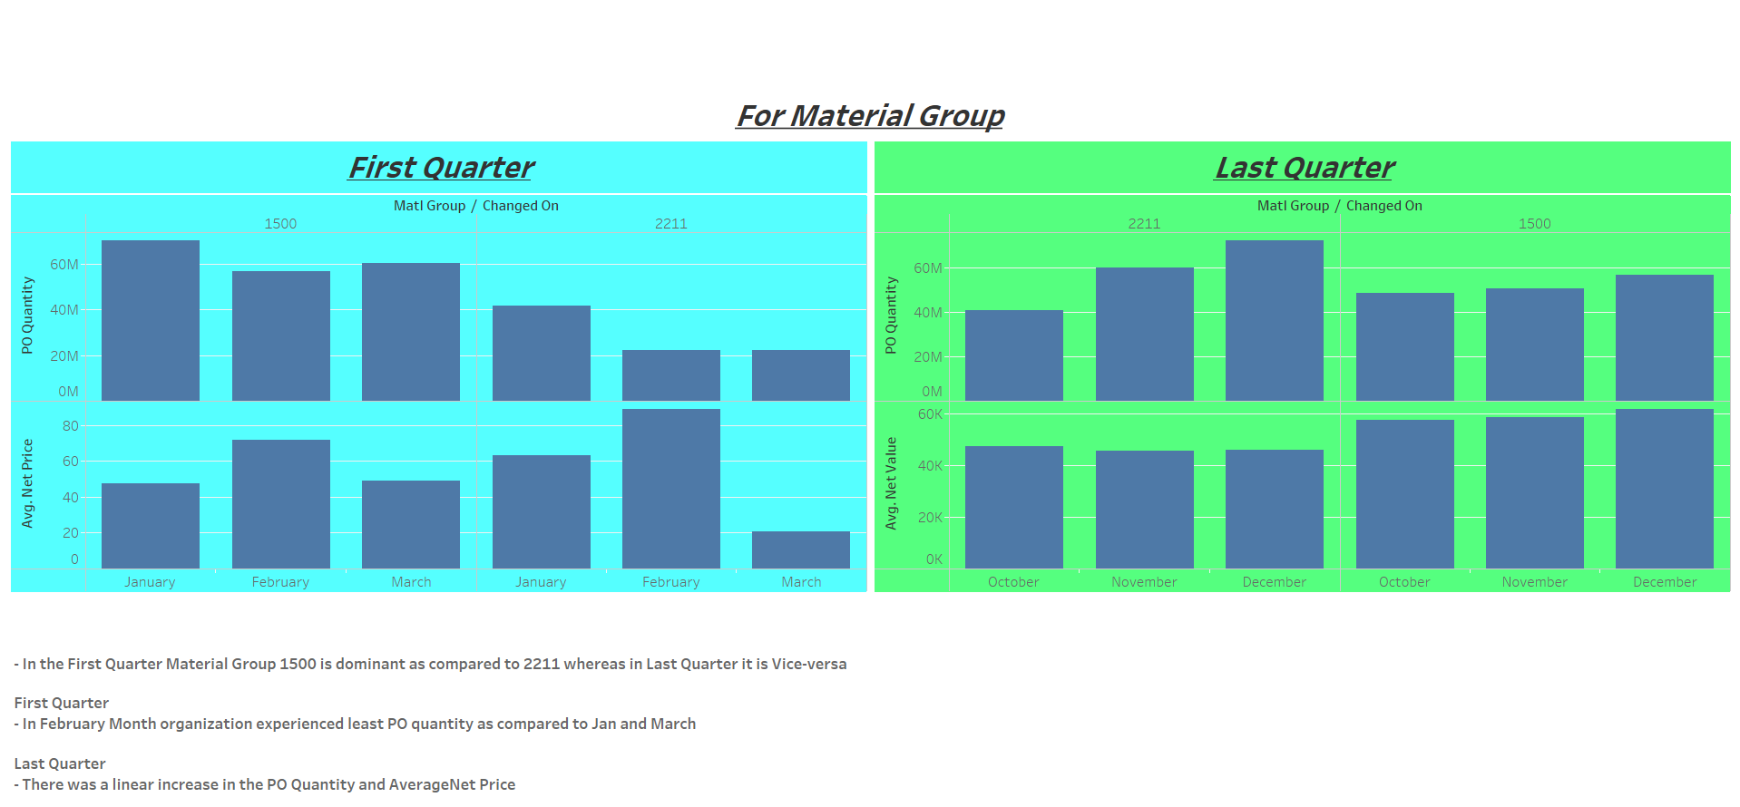
Data Analysis - Trends

Slide 10
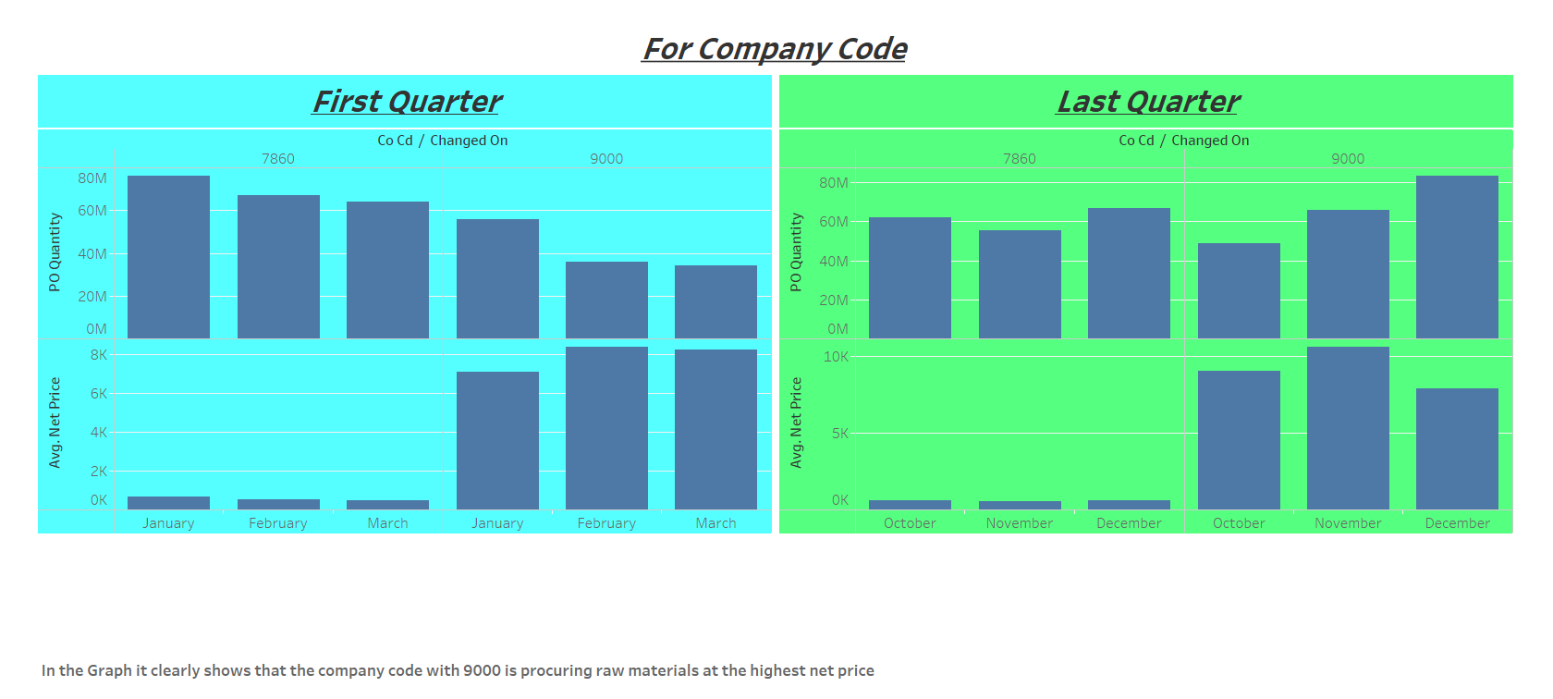
Data Analysis - Trends

Slide 11
Conclusions
After the overall analysis, it is clear that the highest ordered material type is ZROH by the company with code 9000.
It is clear from the graphs that the procurement was done maximum at the first and last quarter of a given year
Procurement was done significantly in 2018 and 2019
There is a positive correlation with the number of plants versus Material Quantity. For example, the company COCD 7860, which order the highest material quantity, has the highest number of plants (73 plants).
It is clear from the graph that the plant 9120 and 9126 is ordering same material for different price. We can assume that plant 9126 is negotiating for lower price.
We can see in the graph that there is an increase in the quantity of materials ordered over the period. Trend rather looks declining.
The material price contributes to the major expense of the company. There is a good variation in the price of the materials over the months. Few materials like Broiler Feed, Soy Bean, Maize etc. are ordered only during October to March. If the company can manage to buy the materials when the price is low, it can help to reduce the cost considerably.
Finally yet importantly, the cost of Petrol and Diesel is very high. The company can reduce the cost by replacing the mode of transportation to electric when the distance is short. If there are frequent long distance journey required. The company can introduce fuel card to track the expense digitally and also install GPS device to track the vehicle movement.

