Slide 1
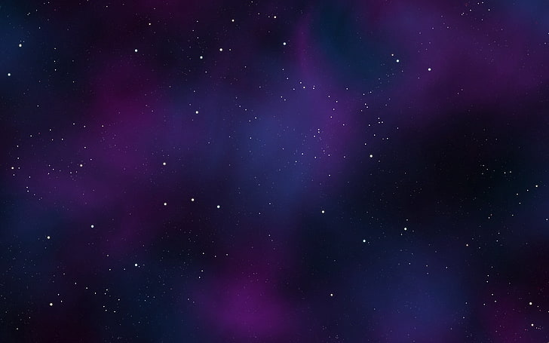

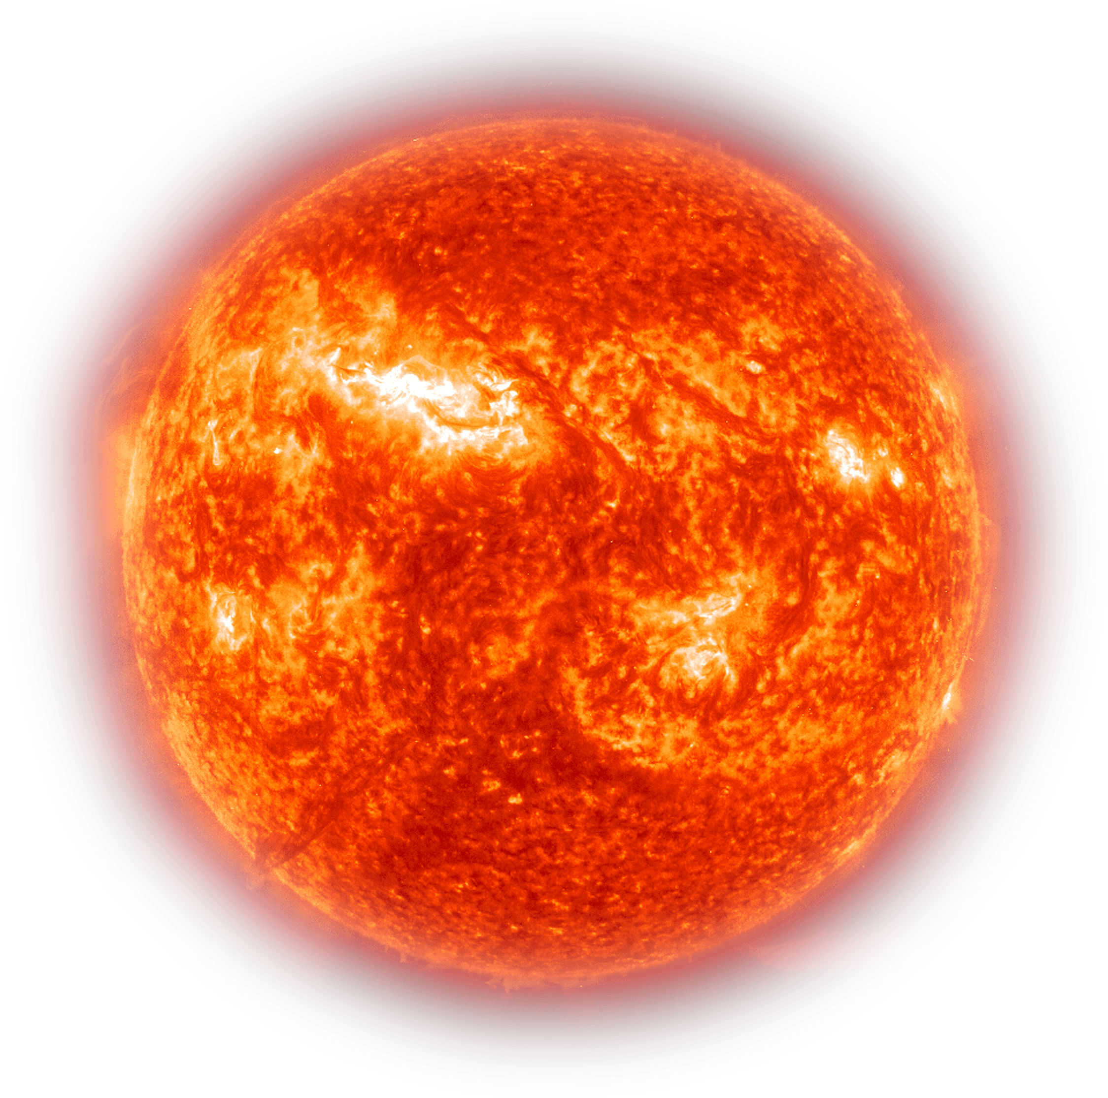
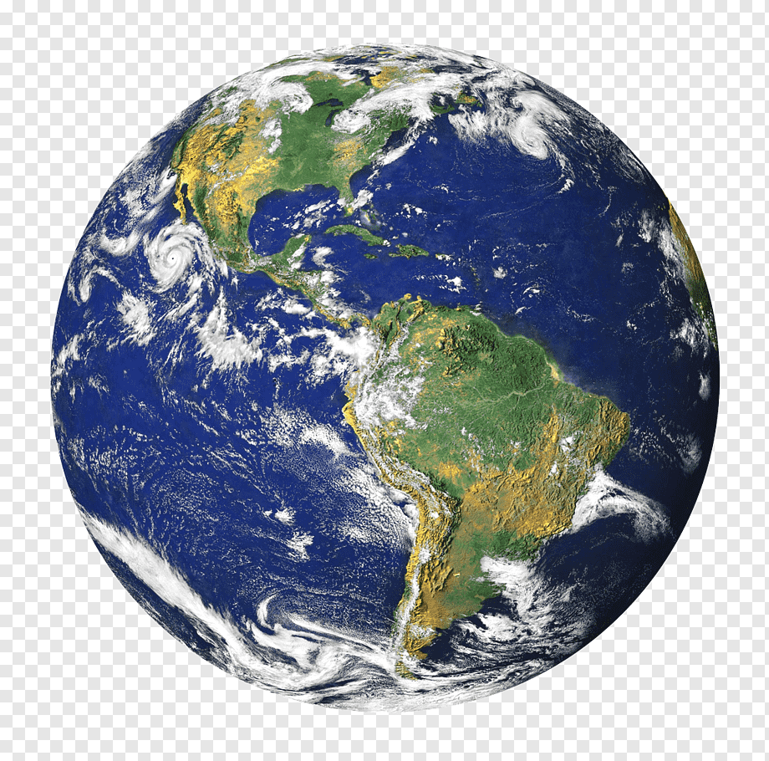
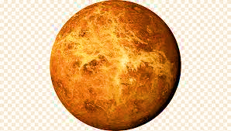
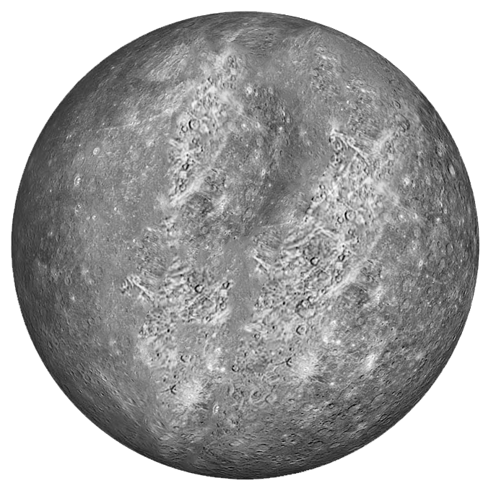
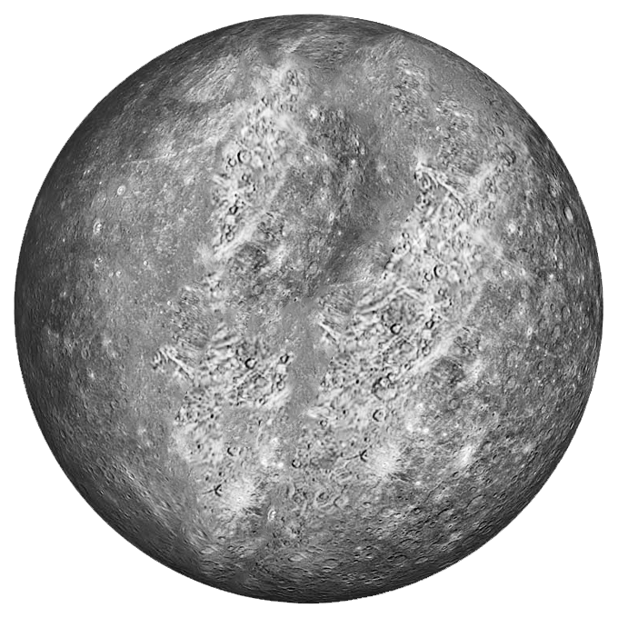


planets
mercury
venus
earth
The smallest planet in our solar system and nearest to the Sun, Mercury is only slightly larger than Earth's Moon.
Venus is the second planet from the Sun and is Earth’s closest planetary neighbor. It’s one of the four inner, terrestrial planets,
Our home planet is the third planet from the Sun, and the only place we know of so far that’s inhabited by living things.

Slide 2
g
mercury
venus
earth
The smallest planet in our solar system and nearest to the Sun, Mercury is only slightly larger than Earth's Moon.
Venus is the second planet from the Sun and is Earth’s closest planetary neighbor. It’s one of the four inner, terrestrial planets,
Our home planet is the third planet from the Sun, and the only place we know of so far that’s inhabited by living things.

Slide 3
mercury
g
The smallest planet in our solar system and nearest to the Sun, Mercury is only slightly larger than Earth's Moon.
From the surface of Mercury, the Sun would appear more than three times as large as it does when viewed from Earth, and the sunlight would be as much as seven times brighter. Despite its proximity to the Sun, Mercury is not the hottest planet in our solar system – that title belongs to nearby Venus, thanks to its dense atmosphere.
venus
earth
Venus is the second planet from the Sun and is Earth’s closest planetary neighbor. It’s one of the four inner, terrestrial planets,
Our home planet is the third planet from the Sun, and the only place we know of so far that’s inhabited by living things.

Slide 4
venus
g
Venus is the second planet from the Sun and is Earth’s closest planetary neighbor. It’s one of the four inner, terrestrial (or rocky) planets, and it’s often called Earth’s twin because it’s similar in size and density. These are not identical twins, however – there are radical differences between the two worlds..
venus
earth
Venus is the second planet from the Sun and is Earth’s closest planetary neighbor. It’s one of the four inner, terrestrial planets,
Our home planet is the third planet from the Sun, and the only place we know of so far that’s inhabited by living things.

Slide 5
earth
g
Earth—our home planet—is the only place we know of so far that’s inhabited by living things. It's also the only planet in our solar system with liquid water on the surface.
venus
earth
Venus is the second planet from the Sun and is Earth’s closest planetary neighbor. It’s one of the four inner, terrestrial planets,
Our home planet is the third planet from the Sun, and the only place we know of so far that’s inhabited by living things.

