Slide 1




Python Programming Part - II
Pandas

Slide 2
Contents
What is Pandas?
Installing & Configuring Pandas
Data Structures in Pandas
---
---

Slide 3
Pandas Intro
What is Pandas?
Pandas is a Python library used for working with data sets.
It has functions for analyzing, cleaning, exploring, and manipulating data.
The name "Pandas" has a reference to both "Panel Data", and ”Python Data Analysis" and was created by Wes McKinney in 2008.
What Can Pandas Do?
Pandas gives you answers about the data. Like:
Is there a correlation between two or more columns?
What is average value?
Max value?
Min value?
Pandas are also able to delete rows that are not relevant, or contains wrong values, like empty or NULL values. This is called cleaning the data.

Slide 4
Installing Pandas
If Python is already installed with your system, it is very easy to install Pandas and its must-have dependencies
To Check whether python is installed already and its version
> python –version
To install Pandas on top of Python
> pip install pandas
Installing Pandas with PyCharm IDE (MacOS)
Click on PyCharm shown on the Menu bar
-> Click Preferences
-> Click Project Interpreter under your Project
-> Click '+'
-> Search for 'pandas'/'numpy' (you can specify specific version you want to install)
-> Click install underneath.
Now you're done!!

Slide 5
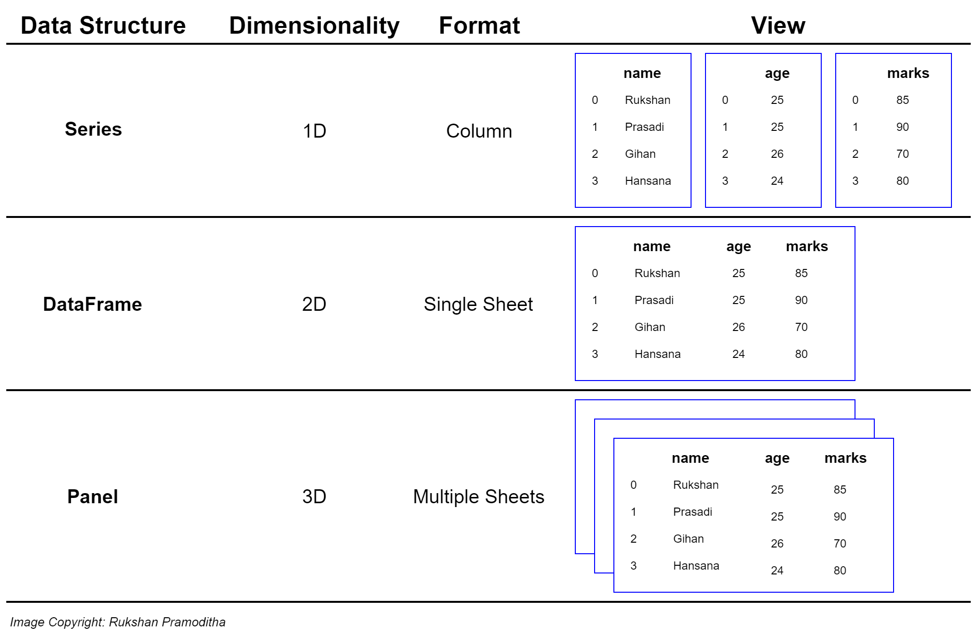
Pandas Data Structures

Slide 6
Pandas Data Structures - Series
What is a Series?
A Pandas Series is like a column in a table.
It is a one-dimensional array holding data of any type.
Labels (Named Indexes)
If noting else is specified, the values are labelled with their index number.
This label can be used to access a specified value.
Creating Labels
With the index argument, you can name your own labels.
When you have created labels, you can access an item by referring to the label.
First value has index 0, second value has index 1 etc.
import pandas as pd print (‘A simple Python Dictionary’)
calories = {"day1": 420, "day2": 380, "day3": 390}
print(calories) # creating a Pandas series from a python dictionary # The keys of the dictionary become the labels. print('Creating a Pandas Series from Python Dictionary’)
myvar = pd.Series(calories)
print(myvar) # Create a Series using only data from "day1" and "day2": print('Creating partial Series from Python Dictionary’)
myvar = pd.Series(calories, index = ["day1", "day2"])
print(myvar)

Slide 7
Important Links
W3School – Pandas Tutorial
https://www.w3schools.com/python/pandas_tutorial.asp
Youtube – CBSE Class XII – IP Tutorial (Beginning)
https://www.youtube.com/watch?v=C6tFC3CwUvA
Pandas Official Site Tutorials
https://pandas.pydata.org/pandas-docs/stable/getting_started/intro_tutorials/index.html

