Slide 1
CSE121 project
By vijval(2022569), himanshu(2022217), sargun(2022450)

Slide 2

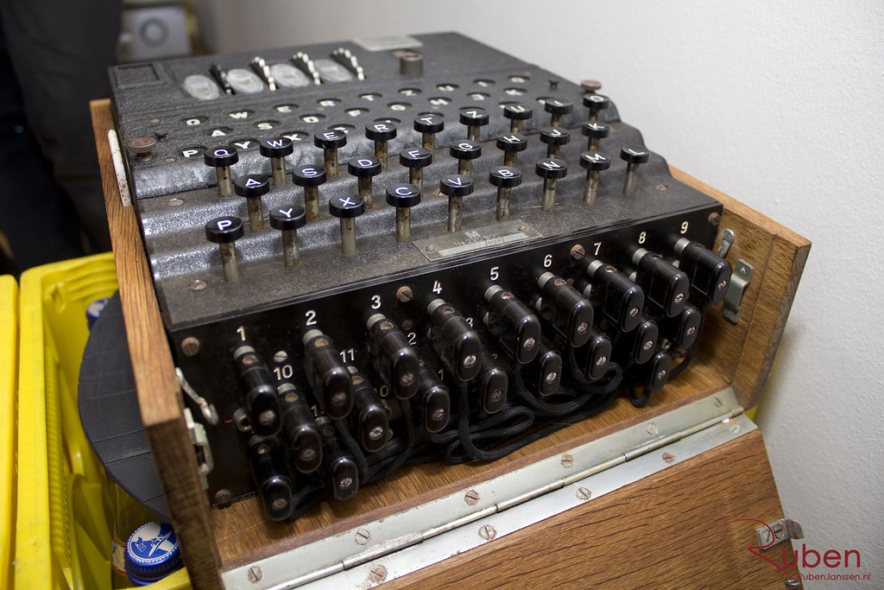
WORKING OF THE ENIGMA:
the Enigma Machine used a lot of circuits for its functioning. Wires ran throughout the machine and it was the order of these connections that actually scrambled the input letter and thus encrypted it.
https://gigazine.net/gsc_news/en/20180227-cryptography-public-domain/
Notes:
In the next few slides we discuss some of the main components of the Enigma and associated mathematical analysis:

Slide 3
1.Input Keyboard
THIS IS WHERE THE LETTER WHICH WAS TO BE ENCRYPTED/DECRYPTED WOULD BE ENTERED.

Slide 4
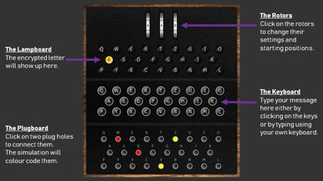
SIMULATION
https://www.101computing.net/enigma-machine-emulator/

Slide 5
2. Plugboard
This was the first step in the encryption process. 10 wires were used to form 10 pairs of letters. These letters would be interchanged whenever the signal reached the plugboard.
The number of possible plugboard settings is:
Notes:
For example, “A” was paired with “W”, then whenever “A” was entered it would be changed to “W” and then passed onto the next step in the process. And whenever an “A” would reach the plugboard (as the scrambled output from the rotors), it would be changed to a “W”. “W” would also be changed to “A” in a similar fashion.

Slide 6
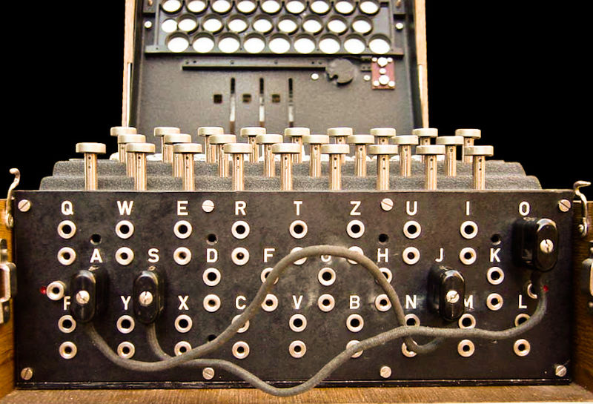
https://en.m.wikipedia.org/wiki/File:Enigma-plugboard.jpg

Slide 7
3. Rings
Each Rotor also had 2 rings connected to it. These would help in further substitution of the lette r before passing it to the rotors.
Since there were 3 sets of rings, one for each rotor, the ring settings could be done in
26 x 26 x 26 = 26³ = 17576 ways
Notes:
Now, if the rotor setting was “B”, the rings for this rotor would in a way have shifted by one position. Now the path of “W” would be w - v - p - q.

Slide 8
4. Rotors
These are in a way the heart of this machine. This is where the majority of the scrambling would take place. Each Rotor had a letter-letter mapping, and every rotor had a different mapping. The M3 Enigma had a total of 8 rotors, out of which any 3 would be used at a time. There were 8 rotors, out of which 3 had to be chosen and arranged in the slots.
This could be done in ⁸C₃ x 3! = ⁸P₃ = 336 ways
for the initial settings, there were 26 of them possible for each rotor, and thus these settings had 26 x 26 x 26 = 26³ = 17576 possible combinations.
All in all, the rotors contributed a total of 336 x 17576 = 5905536 combinations
Notes:
Taking the above example with a ring setting of “A”, a “b” would be mapped to a “k”.
An important feature of the rotors was that they used to rotate. The rightmost rotor would rotate once step every time a key was pressed on the keyboard. Every rotor also had a notch, which would help it turn after a specified number of rotations of the previous rotor. Rotor 1 to 5 had one notch each, and rotors 6 to 8 had 2 notches each for more frequent rotation. The purpose of the rotation was to make sure that no letter was mapped to the same letter again, so if “f” was mapped to “a” once, then it would be mapped to something else the next time. While the Germans thought that this mechanism was behind the strength of the Enigma, this was actually what helped Turing and his team crack the code, as we will see later. The rotors would also have an initial setting which would determine how the encryption would process. Without knowledge of this initial setting, the code cannot be cracked.

Slide 9
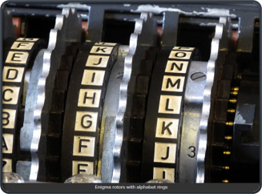
https://hackaday.com/2017/08/22/the-enigma-enigma-how-the-enigma-machine-worked/

Slide 10
5. The Reflector
THIS WAS THE COMPONENT THAT GAVE THE ENIGMA ITS RECIPROCAL QUALITY. IT WOULD RECEIVE A LETTER, MAP IT TO ITS CORRESPONDING LETTER, AND THEN PASS IT TO THE LEFT-MOST ROTOR. THIS WOULD ENSURE THAT THE INPUT WOULD PASS THROUGH THE ROTORS SETUP TWICE.

Slide 11
Mathematical Concepts Involved-
1. Ring Settings and Modular Arithmetic
2. Plugboard Settings and Combinatorics
3. Graph Theory

Slide 12
1. Ring Settings and Modular Arithmetic:
The ring settings introduce a shift in the starting position of the rotors. Modular arithmetic is employed to handle the cyclical nature of the Enigma machine's rotor movement. In this case, modular arithmetic is performed modulo 26, corresponding to the number of letters in the alphabet.
Mathematically, if R represents the original position of the rotor, and S represents the ring setting, the new position (R′ ) after the shift can be expressed as:
R′=(R+S)mod26
This formula ensures that the position wraps around to the beginning after reaching the end of the rotor.

Slide 13
2. Plugboard Settings and Combinatorics:
The plugboard settings involve connecting pairs of letters, effectively creating a permutation of letter pairs.
If there are n distinct letters and k pairs to be formed, the number of possible combinations is given by the formula:
C(n,k)= n!/(k!(n−k)!)
The Enigma plugboard has 26 letters and 10 pairs.
Therefore, the number of ways the plugboard connections can be configured = C(26,10).

Slide 14
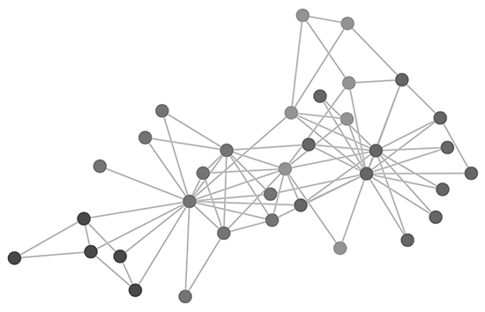
3. Graph Theory
Graph theory is employed to represent relationships between plaintext and ciphertext letters based on identified cribs.
Loops in the graph serve as testing points for rotor settings, and the Bombe is used to iterate through potential configurations.
The Bombe stops when circuits are completed with the loops, indicating successful decryption and aiding in the deduction of rotor and plugboard settings.(discussed later)

Slide 15
WORKING OF THE TURING BOMBE
techniques employed by the Turing Bombe in the process of breaking the Enigma code
Notes:
The Bombe had a set of 36 Enigma rotors which helped it to crack the code in under 20 minutes.

Slide 16
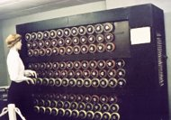
TURING BOMBE​
https://en.m.wikipedia.org/wiki/File:TuringBombeBletchleyPark.jpg

Slide 17
Crib Matching
Initial Guess:
The process begins with an initial guess, often related to common phrases like greetings or weather reports that were likely to be present in the encrypted messages.
Iterative Crib Matching:
The Bombe iterates through same-sized windows of the cipher text based on the length of the initial guess.
If any portion of the encrypted text maps a letter to itself in the guess, it is discarded.
The window is then shifted by one place to the right, and the process continues.
Optimal Guess Length:
Shorter guesses are more likely to produce multiple cribs, increasing the search space.
Longer guesses are more optimal as they reduce the chances of false positives and decrease the overall search space.

Slide 18
Menu Creation
Graph Construction:
Once cribs are identified, a menu is created for each crib.
The menu is a weighted undirected graph formed by the letters of the crib and their corresponding letters in the cipher text.
Loop Detection:
Loops in the graph are detected, and these loops are used to test rotor settings.
The back of the Bombe is connected in a similar fashion to the loop.
Rotor Setting Testing:
Some initial rotor settings are chosen, and the Bombe is run.
The Bombe stops whenever a circuit is completed with the loop, and all loops are satisfied.
Deducing Plugboard Settings:
The process of completing circuits and satisfying loops helps deduce rotor settings.
It also aids in deducing plugboard settings, which were a crucial part of the Enigma machine's configuration.

Slide 19
THANK YOU!

