Slide 1
Voc-Notes : A Free-to-use AI Notebook Tool
Team Members:
Imon Bera ib385@drexel.edu
Precious Orekha poo27@drexel.edu
Priyanka Patil pp673@drexel.edu
Vijval Vemula vv354@drexel.edu

Slide 2
Introduction and Overview

Slide 3
Project Overview
Project Objective: Transform live lecture audio into structured, insightful educational content using state-of-the-art LLM technology.
Goals:
Provide structured and insightful Class Notes from live lectures.
Ensure efficiency and scalability throughout the system and generate hyper file for data analysis with Tableau.

Slide 4
System Components
Audio Capture/Upload: Capture live lecture audio or provide your own.
Audio-to-Text Conversion: Convert audio into text using Google Cloud Speech-to-Text.
Data Preprocessing: Clean and preprocess the text data using PySpark.
Summarization: Summarize the text into concise class notes using groq inference on mixtral and llama 3 models.
Data Storage: Store and retrieve processed data in MongoDB.
Data Visualization: Generate .hyper file to visualize information for insights using Tableau.

Slide 5
Technologies Used
Streamlit for UI (front-end)
Whisper AI
Google Cloud Speech-to-Text
PySpark
Ollama
LLMs: Mixtral-8x7b (32768 token size) & Llama3-70b (8192 token size)
PyMongo
Tableau hyper API

Slide 6
Workflow and Architecture

Slide 7
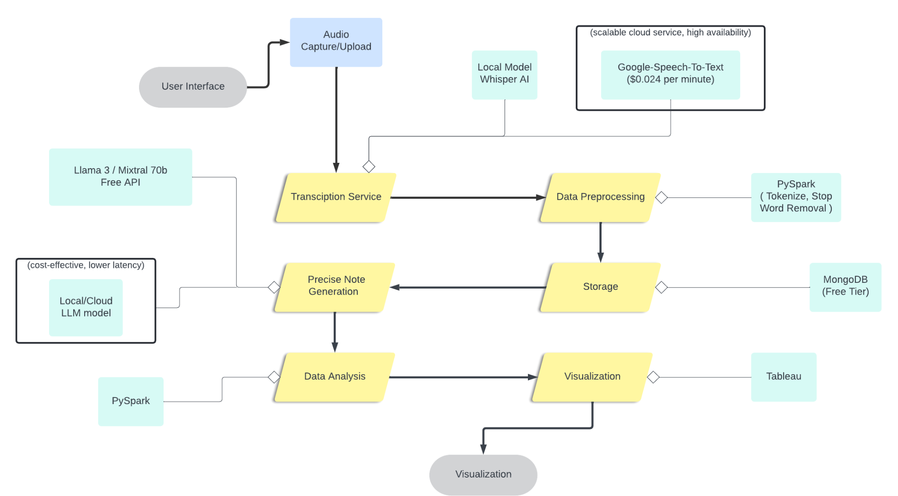
System Architecture

Slide 8
System Workflow Decision
Transcription Service Decision
Whisper AI (Local Model):
Pros: Cost-efficient, no additional service charges.
Cons: Resource-heavy for local systems.
Google Speech-to-Text:
Pros: High availability, scalable, cost-effective at $0.024 per minute.
Cons: Service charges apply.
Decision: Google Speech-to-Text was chosen for its scalability and reduced resource demand on local systems.

Slide 9
System Workflow Decision
LLM Model API Decision
Groq API:
Pros: External API, doesn't burden local resources.
Cons: Dependent on external service availability and potential costs.
Ollama API (Local Model):
Pros: No external dependencies, full control over the model.
Cons: Resource-heavy for local systems.
Decision: Groq API was chosen to avoid the resource-heavy demands of running a local model and to leverage external computational resources.

Slide 10
Key Components and Technologies

Slide 11
Application Frontend
Greets the user and provides links to the Record Audio and Upload Audio pages.
Record Audio Page
Displays options to start and stop audio recording.
Updates and displays recording status based on user actions.
Provides a link to the Generate Notes page.
Upload Audio Page
Asks the user for the local path of an audio file.
Provides a button to start generating notes from the uploaded audio.

Slide 12
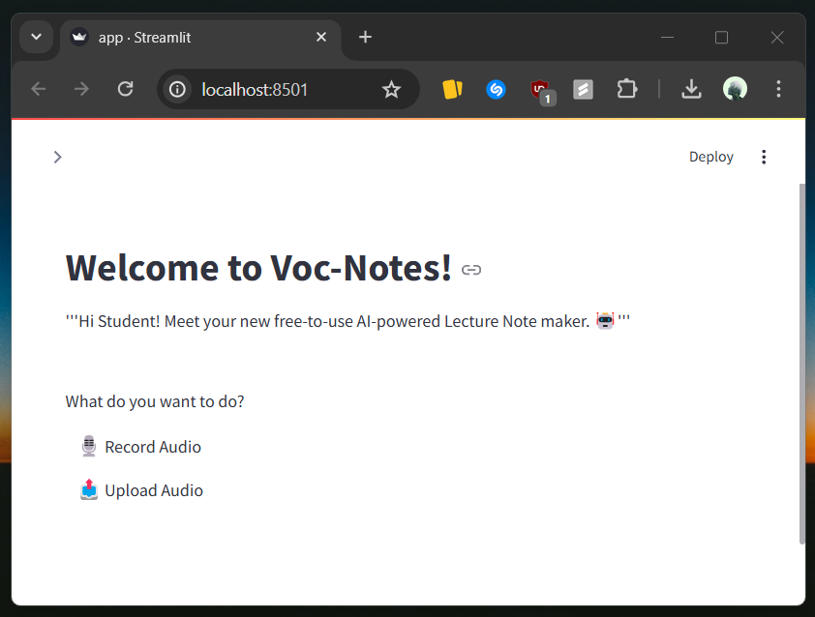
Audio Capture
Users can upload an audio file or record.
Recording Audio
Captures audio using an input stream.
Stores audio data in a queue.
Start and Stop Recording
Start Recording: Begins audio capture.
Stop Recording: Stops capture, normalizes, converts, and saves audio as an MP3 file (`recorded_audio.mp3`).
Users upload an audio file by providing its path, which is then processed.

Slide 13
Speech-to-Text Conversion
Initializes Google Speech-to-Text client with API key.
Audio Processing
Converts MP3 audio to multiple chunk to fit API size.
Reads and prepares audio data for recognition.
Sets sample rate, automatic punctuation, and language code.
Transcription
Sends audio to Google API.
Returns the transcribed text.

Slide 14
Data Preprocessing with PySpark
Starts a Spark session named "TextPreprocessing".
Load Data
Reads the lecture transcript from a text file.
Tokenization
Splits text into individual words.
Stop Words Removal
Removes common stop words from the tokenized text.
Writes the processed words to a text file (`processed_words.txt`).

Slide 15
Text Summarization
Reads the Groq API key and lecture text.
Split Lecture Text
Splits the text into 5000-character chunks.
Generate Notes using Mixtral 70b model
Uses Groq model to generate notes from text chunks.
Finalize Notes using Llama 3 8b model
Combines and formats the notes for coherence.
Writes the final notes to a markdown file (`Groq_ClassNote.md`).

Slide 16
Data Storage
Technology: MongoDB.
MongoDB is utilized for storing processed lecture transcripts and generated class notes, ensuring efficient data management and retrieval.
Users can easily interact with the system, viewing all saved notes and downloading specific ones by entering their filenames.
Uploaded notes and transcripts are automatically stored with timestamped filenames, ensuring unique and organized storage.

Slide 17
Data Analysis
Generating Insights with Tableau
A Hyper file is a high-performance, columnar data storage format developed by Tableau, designed for efficient data extraction, transformation, and loading (ETL) operations.
In this project, we process lecture transcript data to store in a Hyper file, which can be seamlessly imported into Tableau for advanced data analysis and visualization.
By integrating the Hyper file with Tableau, we can leverage Tableau's powerful visualization tools to create informative dashboards and reports that aid in understanding and decision-making.

Slide 18
Conclusion and Future Work

Slide 19
Conclusion
The Voc-Notes solution provides a comprehensive, user-friendly platform for capturing and converting lecture audio into detailed notes using advanced AI technologies.
The integration of Google Speech-to-Text and Groq's language models facilitates efficient and accurate transcription and note generation.
The streamlined text preprocessing workflow, utilizing PySpark, ensures high-quality data handling.
This solution empowers students to focus on learning while automating the tedious task of note-taking.

Slide 20
Future work
To enhance the Voc-Notes solution, several future improvements and expansions can be considered:
Multi-Language Support
Extend support to multiple languages to cater to a diverse user base.
Real-Time Transcription
Develop real-time transcription capabilities for live lecture note-taking.
Video Data Processing
Continuously update and optimize AI models for better performance and possible inclusion of video data.

Slide 21
Reference
Documentation and developer guides from Google Cloud Speech-to-Text, Whisper AI, PySpark, Groq, Streamlit, and MongoDB.
https://cloud.google.com/speech-to-text?hl=en
https://github.com/openai/whisper
https://arxiv.org/abs/2212.04356
https://console.groq.com/docs/models
https://spark.apache.org/docs/latest/api/python/index.html
https://pymongo.readthedocs.io/en/stable/
- Academic papers and articles on speech recognition, data processing, and educational data analysis.
https://www.researchgate.net/publication/369849536_Research_on_language_simulation_and_speech_recognition_based_on_data_simulation_of_Machine_Learning_System
https://www.ncbi.nlm.nih.gov/pmc/articles/PMC10346893/

Slide 22
Thank You

