Slide 1
HILLNET GUARDIAN SMART GSM RESCUE ALERT SYSTEM
AUTHOR VIJAY T

Slide 2
ABSTARCT
The Increasing Number of Accidents in Hilly and Remote Areas Highlights. The Need for a Reliable Emergency Alert System. Due to Poor Network Access and Delayed Communication, Rescue Operations are Often Slow, Leading to Severe Consequences. HILLNET GUARDIAN – SMART GSM RESCUE ALERT SYSTEM is designed to Provide Immediate Assistance by Automatically Detecting Accidents or Abnormal Conditions using Sensors Connected to a Microcontroller.
When an Emergency is Detected, The System sends an Alert Message through a GSM Module along with the Exact Location obtained from a GPS Module. This Enables Rescue Teams or Emergency Contacts to Quickly Identify the Accident Spot and Take Necessary Action. The Main Objective of this Project is to Ensure Faster Rescue Response and Improve Safety in Hilly Terrains.

Slide 3

PURPOSE
Accidents and emergencies in hilly and remote areas often go unnoticed due to poor communication and delayed reporting, increasing the risk to victims. Therefore, a reliable automated system is required to quickly detect such incidents and immediately alert rescue teams with accurate location details. Developing this system is essential to ensure faster response, reduce casualties, and improve safety in isolated regions.

Slide 4
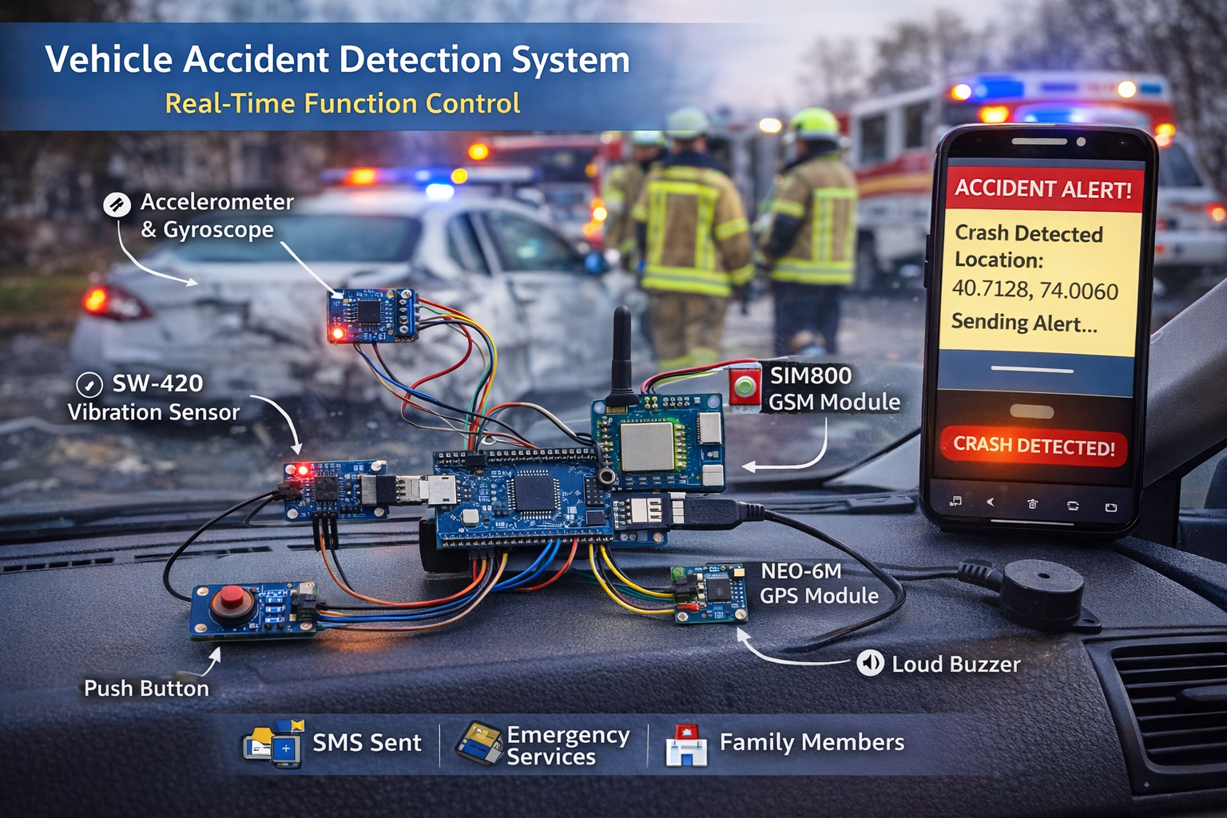
OBJECTIVES 1.INSTANT ACCIDENT NOTIFICATION. 2.ACCIDENT SPOT TRACKING. 3.SAFETY DRIVING. 4.REMOTE LOCATION ACCESS BY GSM & GPS.
COMPONENTS REQUIRED 1.ARDUINO NANO. 2.ADXL 345 - ACCELEROMETER GRAVITY SENSOR. 3.AC TO DC CONVERTER. 4.SIM800L GSM MODULE. 5.NEO - 6M GPS MODULE. 6.BUCK CONVERTER.

Slide 5

WORKING
The Accelerometer Continuously Monitors Movement, Tilt, and Vibration.
If Sudden Impact or Abnormal Motion is Detected, It Sends a Signal to the Arduino Nano.
The Arduino Processes the Signal and Confirms the Emergency Condition.
The Arduino Collects the Current Location from the NEO-6M GPS Module.
The Sim800L GSM Module sends an Alert Message with Location Details to Emergency Contacts.
Rescue Teams Receive the Message and Take Necessary Action Immediately.

Slide 6
APPLICATIONS
Used in hilly & mountainous regions to detect accidents & send emergency alerts.
Helpful for tourist vehicles traveling in remote areas.
Can be used in forest patrol vehicles and wildlife monitoring units.
Suitable for emergency safety systems in remote construction or mining sites.
Useful for personal safety devices for trekkers and adventure travelers.
Can be implemented in rural transportation systems for quick rescue response.

Slide 7
RESULT & CONCLUSION
The HILLNET GUARDIAN – SMART GSM RESCUE ALERT system effectively detects accidents or abnormal movements using the accelerometer sensor and immediately sends an alert message with accurate GPS location through the GSM module. The project demonstrates reliable performance in identifying emergencies and enabling faster rescue response in hilly and remote areas. Hence, it provides a cost-effective, efficient, and practical solution to improve safety and reduce response time during critical situations.

Slide 8
THANKYOU

