Slide 1
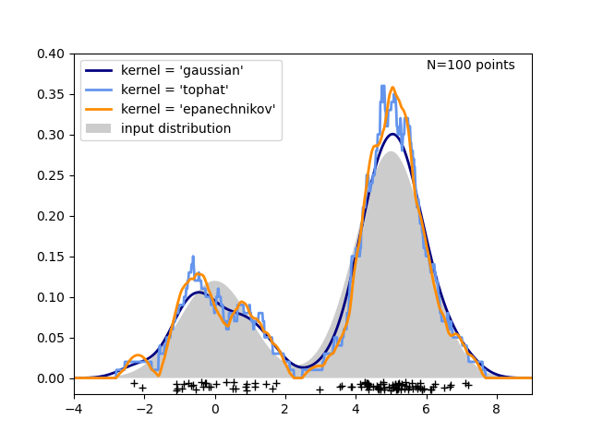
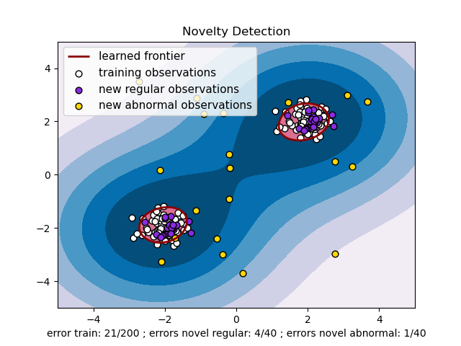
Predict Novel
Enzyme-Substrate
Interaction Propensity
Kernel Density Estimation
Ranked list of Enzyme-Substrate Interaction
Interacting
Enzyme -Substrate
Pairs
Predict Novel
Enzyme-Substrate
Interaction Propensity
Generate random Enzyme-Substrate Pairs
Novelty Detection Algorithm
Ranked list of Enzyme-Substrate Interaction

Slide 2
KDE Model Workflow
List of NovoStoic predicted enzymes
Ranked list of potentially interacting enzymes
Database of interacting
enzyme -substrate
pairs
Kernel Density Estimation
Predict novel enzyme-substrate interaction propensity

