Slide 1
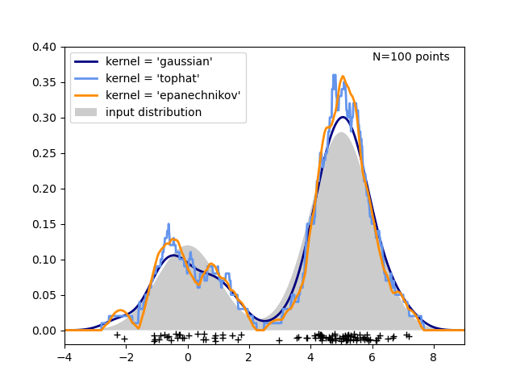
KDE Model Workflow
List of NovoStoic predicted enzymes
Ranked list of potentially interacting enzymes
Database of interacting
enzyme -substrate
pairs
Kernel Density Estimation
Predict novel enzyme-substrate interaction propensity

Slide 2
INPUT
TRAIN
OUTPUT
EVALUATE
KEGG
17415 Interacting Enzyme-Substrate Pairs
Unknown
Enzyme-Substrate Pair Interaction Propensity
51994 Interacting Enzyme-Substrate Pairs
Kernel Density Estimation
34085 Random (Non-Interacting) Enzyme-Substrate Pairs
Dataset \ Model | KDE | Similarity
Interacting Pairs | 53% | 40%
Random Pairs | 90% | 89%

Slide 3
KDE model trained on 51994 interacting Enzyme-Substrate pairs
Evaluated on 17415 interacting Enzyme-Substrate pairs and 34085 random (non-interacting) Enzyme-Substrate pairs
Predicted interacting Enzyme-Substrate pairs with 53% accuracy
Predicted non-interacting Enzyme-Substrate pairs with 90% accuracy
In comparison a Tanimoto index based similarity search model achieved 40% and 89% accuracy on interacting and non-interacting pair prediction
17415 Interacting Enzyme-Substrate pairs
51994 Interacting Enzyme-Substrate pairs
Dataset \ Model | KDE | Similarity
Interacting Pairs | 53% | 40%
Random Pairs | 90% | 89%
34085 Random (Non-Interacting) Enzyme-Substrate pairs

Slide 4

Tanimoto Similarity Model
Enzyme-Substrate
Positive Pairs: 9789
Negative Pairs: 9702
Unknown
Enzyme-Substrate Pair Interaction Propensity
Kernel Density Estimation
DeepConv-DTI

Slide 5
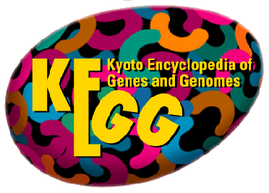
VALIDATION
TEST
Model | Accuracy
Tanimoto*
KDE | 0.54
DeepConv-DTI | 0.58
Model | Accuracy
Tanimoto*
KDE | 0.36
DeepConv-DTI | 0.46
Enzyme-Substrate
Positive Pairs: 3205
Negative Pairs: 3292
Enzyme-Substrate
Positive Pairs: 69410
Model Improvements
Deep Learning based feature embedding technique such as UniRep will be used for KDE model training to improve its performance
A Recurrent Neural Network layer will be added to DeepConv-DTI model architecture to extract contextual information from protein sequences

