Slide 1
“EVA”
VOICE ASSISTANT
Submitted in the partial fulfillment for the award of the degree of
BACHELOR OF ENGINEERING
IN
“CSE-BIGDATA & ANALYTICS,IBM”
Submitted by:
Princy Dutta
UID: 19BCS3904
Vikas Nehra
UID: 19BCS3872
Vanshika Grover
UID: 19BCS3898
Harshvardhan Dubey
UID: 19BCS3901
Tamanna Shori
UID: 19bcs3873
Under the Supervision of:
Dr. Rajiv Kumar
Department of AIT-CSE
DISCOVER . LEARN . EMPOWER

Slide 2
Outline
Introduction to Project
Problem Formulation
Objectives of the work
Methodology used
Results and Outputs
Conclusion
Future Scope
References

Slide 3
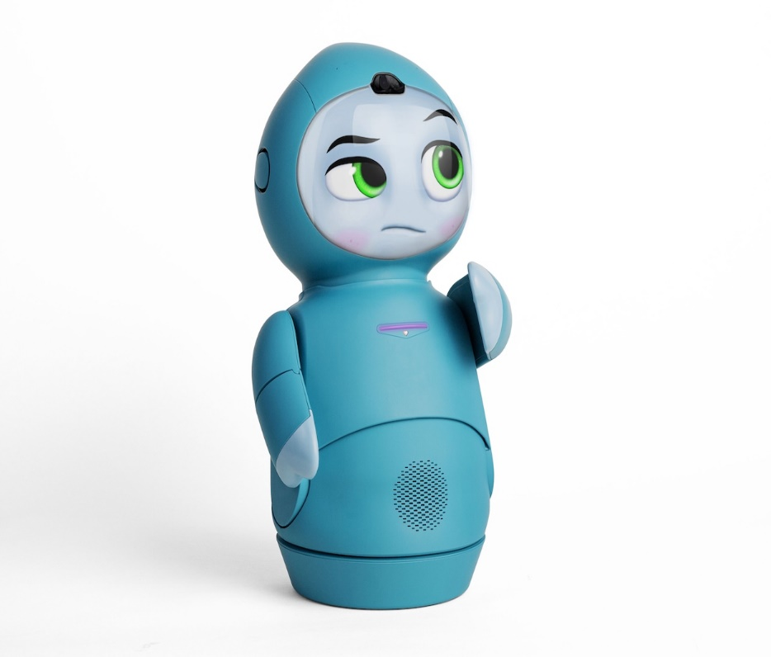
Introduction to Project
A project to build a personal voice/speech assistant using Python . The speech assistant interacts with the humans to perform basic tasks.
EVA is a personal voice assistant service built using Python. It can understand human speech and perform basic task designed by the client.
When the user specify the appropriate trigger words , The EVA gets activated and executes the user commands.

Slide 4
The implemented Speech assistant can perform the following tasks:
Opens a webpage : Youtube , G-Mail , Google Chrome , Stack Overflow
User : Hey Eva, Open Youtube
2.Predicts time
User : Hey Eva , What is the time?
3.Fetch Top headlines from Times of India
User : Hey Eva , what's the latest news?

Slide 5
4.Searches data from web
User: Hey Eva, Search Butterfly images from web
5.Ask geographical and computational questions
User: Hey Eva, What is the capital of California? / Hey Eva what is Sin 90?
6.Predict Weather of different Cities
User : Hey Eva , What is the weather likely now in Kerala?

Slide 6
7. Information from Wikipedia
User: Hey Eva, Who is Bill Gates according to Wikipedia. The voice assistant abstracts first 3 lines of Wikipedia and gives the information to the user.
8. Ask Eva about what task it can perform and who created it?
User: Hey Eva, Who created you? / Hey Eva, What can you do?
9.Turn off your pc when required!
User: Hey Eva, Please turn off my PC.

Slide 7

Benefits of our Personal Voice Assistant Technology?
In the past few years, more companies have been exploring personal voice assistant technology for app development and tech-business.
Voice assistants come in somewhat small packages and can perform a variety of actions after hearing a wake word or command. They can turn on lights, answer questions, play music, place online orders, etc.
Many devices we use every day utilize voice assistants. They’re on our smartphones and inside smart speakers in our homes. Many mobile apps and operating systems use them. Additionally, certain technology in cars, as well as in retail, education, healthcare, and telecommunications environments, can be operated by voices.
It does not track you back like other renowned assistant. Hence, maintains your privacy.

Slide 8
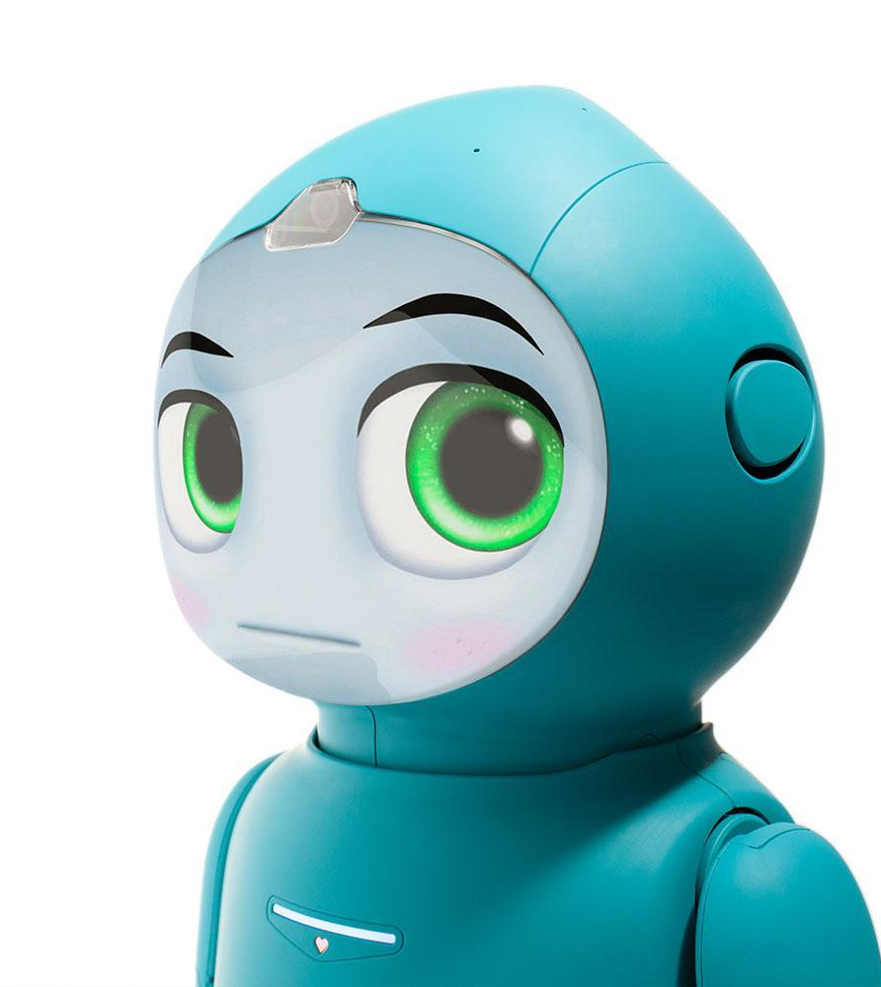
Platform Independent
Saves Time by Automating Repetitive Tasks
Aids Hand-free Operations

Slide 9
Objectives
The Speech Assistant is a digital assistant that uses voice recognition, language processing algorithms, and voice synthesis to listen to specific voice commands and return relevant information or perform specific functions as requested by the user.
Based on specific commands, sometimes called intents, spoken by the user, voice assistants can return relevant information by listening for specific keywords and filtering out the ambient noise.
There are many use cases for using a voice assistant in todays’ world. For example, when our hands are full and we are unable to use a touch screen or keyboard, or when we are driving. Let’s say we are driving and we need to change our music, we could just ask a voice assistant, “play my driving playlist”. This leads to a safer driving experience, and helps avoid the risk of distracted driving.

Slide 10
Methodology used:
(a) Data collection in the form of user’s voice
(b) Voice analysis and conversion to text
(c) Processes Your InPUT
(d) Generating the task to be done from the INPUT AND PROVIDES text/SPEECH output

Slide 11
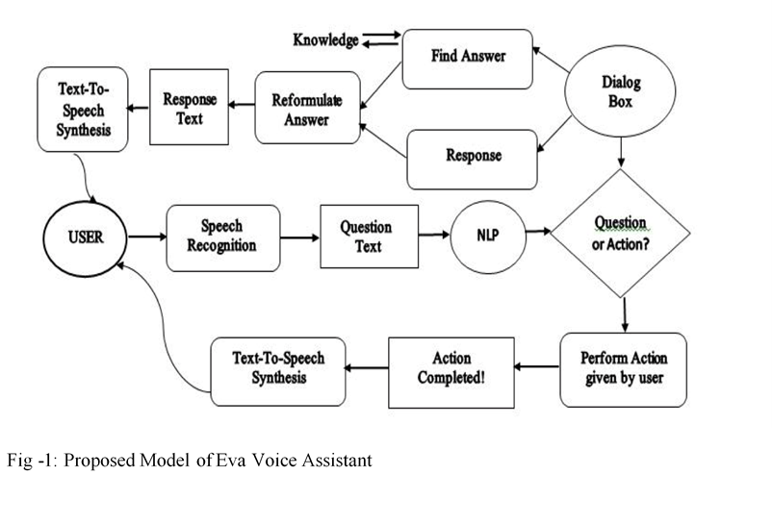

Slide 12
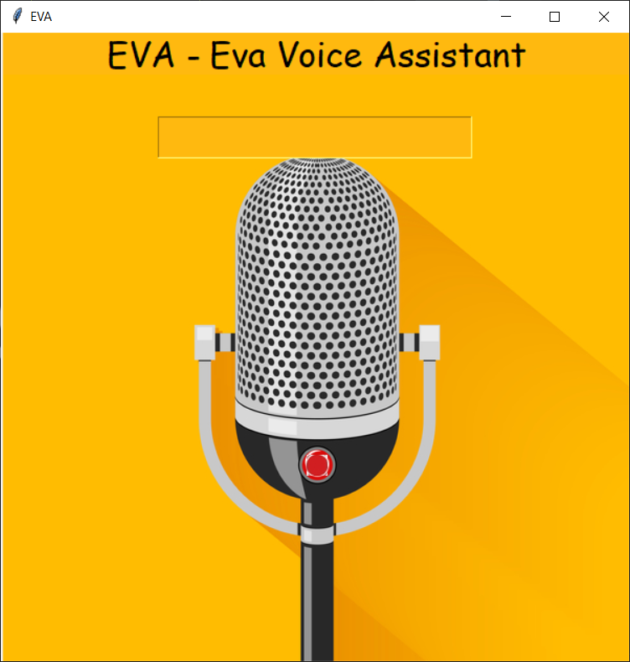
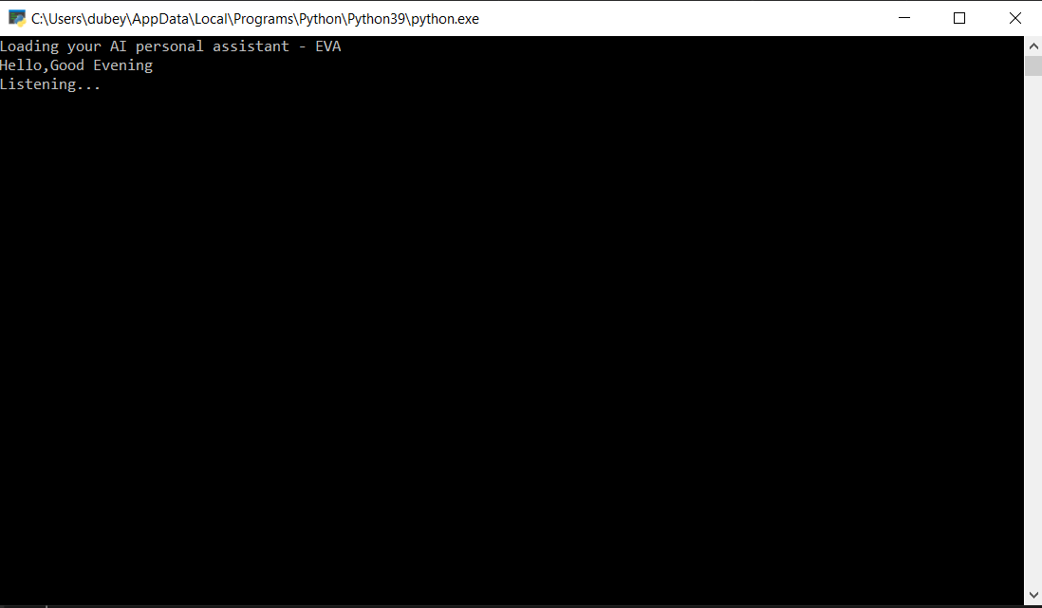
Results and Outputs:
Clicking the Red Button Opens EVA personal assistant

Slide 13
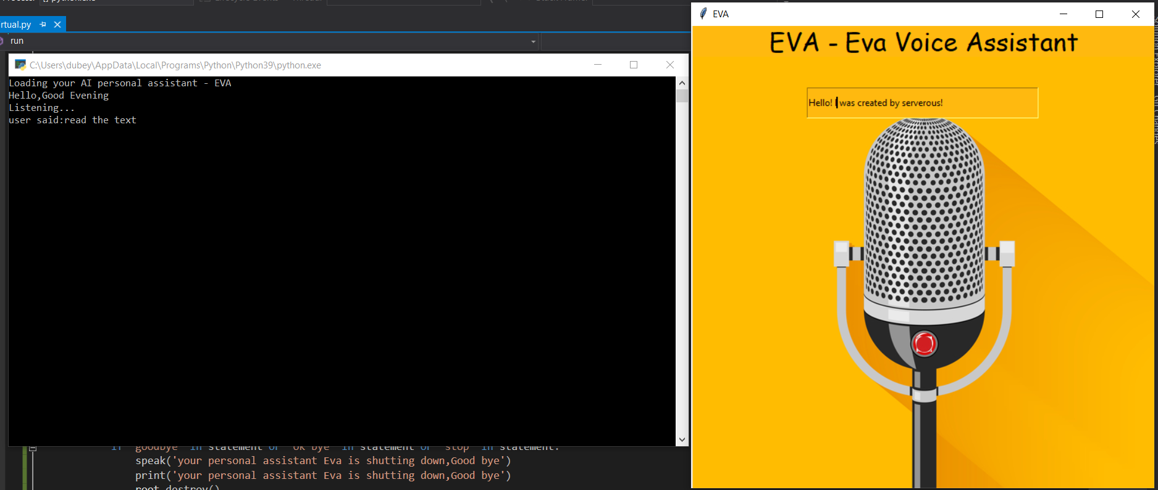
Reads out the text entered by user.

Slide 14
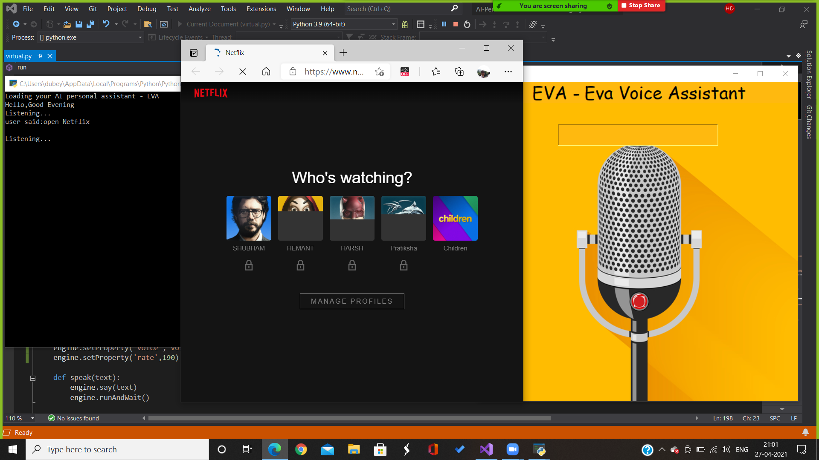
Opens a webpage: NETFLIX (for example)

Slide 15
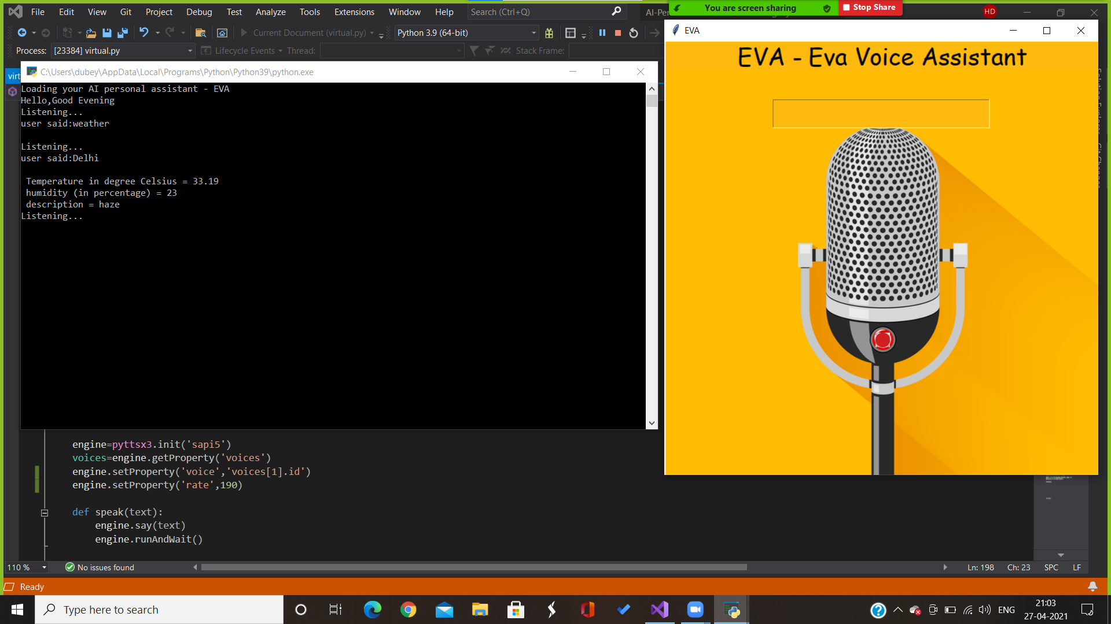
Predicts Weather of different Cities.

Slide 16
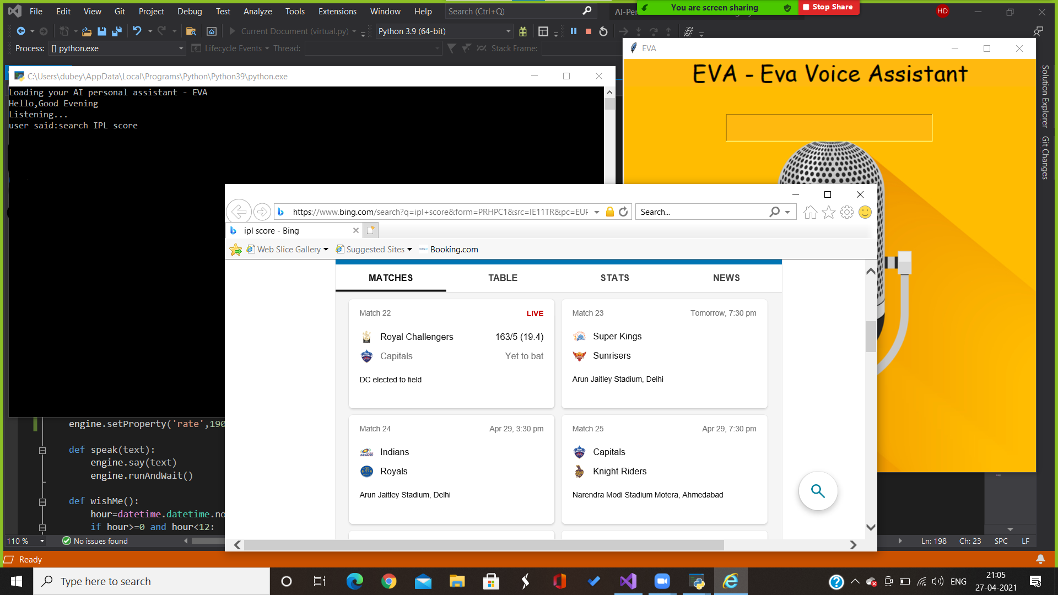
Tells LIVE IPL SCORE

Slide 17
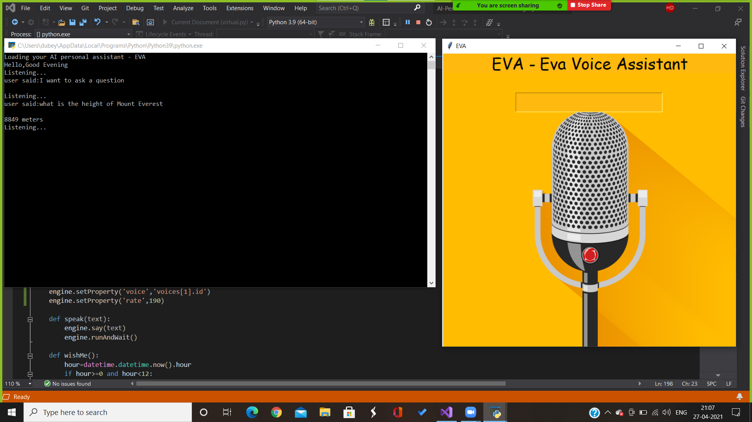
Answers geographical and computational questions

Slide 18
Conclusion
Personal voice assistance technology is here to stay. Just the simple thought of talking to a device to get some tasks done is an appealing innovation that presents multiple opportunities, most notably for businesses.
Benefits of Voice Assistants
Some examples of what a Voice Assistant can do include:
Check the weather
Turn on/off connected smart devices
Search databases
One of the main reasons of the growing popularity of Voice User Interfaces (VUI) is due to the growing complexity within mobile software, leading to a huge disadvantage in its functionality. As more iterations of phones come out, the screen sizes stay relatively the same, leading for very cramped interfaces and creating frustrating user experiences, which is why more and more developers are switching to Voice User Interfaces.
Cons of Voice Assistants
Does not work offline.
Security could be an issue.
Voice recognition isn't perfect.

Slide 19

Future Scope
“The future scope of voice assistants is bright and holds tremendous applicability in solving real-world problems”
Search Engine with voice interactions
Medical diagnosis with Medicine aid
Reminder and To-Do application.
Vocabulary App to show meanings and correct spelling errors.
Weather Forecasting Application.

Slide 20
References
[1] “Desktop Assistant from Wikipedia,” https://en.wikipedia.org/wiki/Desktop Assistant,
[2] Richard Krisztian Csaky,“Desktop Assistant and related Research paper Notes with Images,” https://github.com/ricsinaruto/Seq2seqDesktop Assistants/wiki/Desktop Assistant-and-Related- Research-Paper-Notes-eith-images,
[3] Yosua Alvin AdiSoetrisno, “Ticketing Desktop Assistant Service using Serverless NLP Technology,” http://www.academia.edu/Documents/in/Desktop Assistant,
[4] “Potential benefits of Desktop Assistants,” https://www.convinceandconvert.com/wp- content/uploads/2018/01/Critical-Desktop Assistant-Statistics-2018-2-e1516922252367.jpg,

Slide 21
[5] “Desktop Assistant Theory Explained,” https://www.geeksforgeeks.org/Desktop Assistant-theory- explained/,
[6] [“Freya Riki, “Future of Desktop Assistant in 2019,” https://yourstory.com/mystory/future-of-Desktop Assistant-in-2019-8wulieg1yx,

