Slide 1

Powerful intelligence to move your business forward.
04/27/2011
Capabilities Presentation for L.L. Bean
© 2011 American Express Travel Related Services Company, Inc. All rights reserved. CONFIDENTIAL, PROPRIETARY & TRADE SECRET INFORMATION. This document contains confidential, proprietary, and trade secret information of American Express Company and its subsidiaries and affiliates (“American Express”), and may not be disclosed in whole or in part to any third parties without prior written consent of American Express.

Slide 2


American Express Business Insights is an analytics and consulting organization that harnesses our wealth of global spend information to reveal powerful intelligence about your customers, competitors and marketplace.
© 2011 American Express Travel Related Services Company, Inc. All rights reserved. CONFIDENTIAL, PROPRIETARY & TRADE SECRET INFORMATION. This document contains confidential, proprietary, and trade secret information of American Express Company and its subsidiaries and affiliates (“American Express”), and may not be disclosed in whole or in part to any third parties without prior written consent of American Express.

Slide 3

A comprehensive solution from a unique perspective
unique data
+
analytical expertise
=
deeper insights
Actual behavior,
not self-reported
Highly trained &
experienced team
Better informed decisions
~90MM Cards
>5B annual transactions
~ 130 markets
Advanced data
modeling & analytics
Improved business
performance
Constantly refreshed

Slide 4
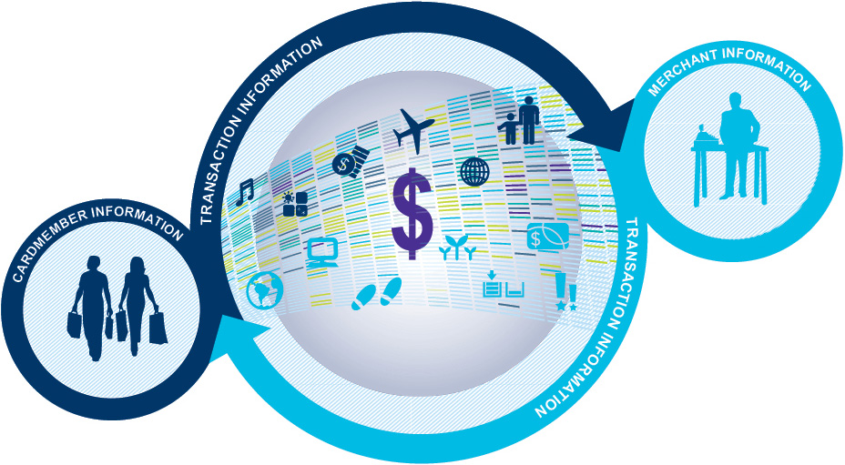
The complete picture from both sides of the transaction
We have direct relationships with both Cardmembers and merchants—giving us an
in-depth understanding of your customers and how prospects actually behave.

Slide 5

A rich understanding of Cardmembers
We have a wealth of detailed Cardmember information that cuts across several demographic, psychographic and behavioral categories.
DEMOGRAPHICS
GEOGRAPHY
LIFESTYLES
PSYCHOGRAPHICS
SPEND BEHAVIORS
AGE
REGION
WEALTH
LIFESTAGE
SHARE OF WALLET
GENDER
URBANICITY
PASSIONS & HOBBIES
SOCIAL GROUP
ONLINE
ETHNICITY
GLOBAL
HOME OWNERSHIP
PREFERENCES
BRAND AFFINITIES
CHILDREN
FEEDER MARKETS
TRAVEL DESTINATIONS
CHANNEL CONSUMPTION
SEASONALITY & HABITS

Slide 6

How your business benefits
CUSTOMER INTELLIGENCE
COMPETITIVE
INTELLIGENCE
MARKET
INTELLIGENCE
MARKETING
EFFECTIVENESS
Know your customers better
Track and
grow your
market share
Plan and forecast
Optimize your programs
What do my customers and best prospects look like?
How do they behave?
What is my market share?
How is it changing over time?
What are the key trends in my industry and marketplace?
How can I find and acquire the best customers?

Slide 7

Products & Solutions
© 2011 American Express Travel Related Services Company, Inc. All rights reserved. CONFIDENTIAL, PROPRIETARY & TRADE SECRET INFORMATION. This document contains confidential, proprietary, and trade secret information of American Express Company and its subsidiaries and affiliates (“American Express”), and may not be disclosed in whole or in part to any third parties without prior written consent of American Express.

Slide 8

Competitive Sales Channel Analysis
CUSTOMER INTELLIGENCE
Grow your revenue by understanding how your customers spend across sales channels and benchmark your performance against your peers
WHAT THE REPORT REVEALS
YOUR BUSINESS BENEFITS
Assessment of profitability by channel
Analysis of customer lifestyle characteristics by channel—showing shifts in channel preferences
Recommendations on strategies to migrate customers from low to high-profitability channels
An evaluation of your performance relative to the industry landscape
Retain and grow your sales in the strongest and most efficient channels
Identify ways to increase customer loyalty and engagement
Evaluate how your share of customer spend has changed over time
REPORT SNAPSHOT: SALES CHANNEL OVERLAP
Average Age: 52
Male: 41%
With Kids in Household: 23%
Homeowner: 87%
Total Annual Spend with You: $1,700
Opportunity to increase engagement through special offers
RETAIL ONLY
DUAL
ON-LINE ONLY
The sample chart above is demonstrative of the type of information found in a Sales Channel Analysis. All data is not reflective of any actual trends.

Slide 9
Catalog Research Analysis
CUSTOMER INTELLIGENCE
Identify L.L. Bean share of the retail catalog industry and uncover trends on who you have previously mailed catalogs to by leveraging a L.L. Bean / AXP data merge
WHAT THE REPORT REVEALS
YOUR BUSINESS BENEFITS
Assessment of catalog responders and non-responders
Analysis of customer lifestyle characteristics by responders, non-responders, duals, inactives and those only shopping with peers
Uncover data trends on what is driving a successful catalog mailing
Retain and grow your catalog sales with the best fit customer segments
Identify ways to increase customer loyalty and engagement
REPORT SNAPSHOT: CATALOG RESEARCH SHARE
The sample chart above is demonstrative of the type of information found in a Sales Channel Analysis. All data is not reflective of any actual trends.

Slide 10

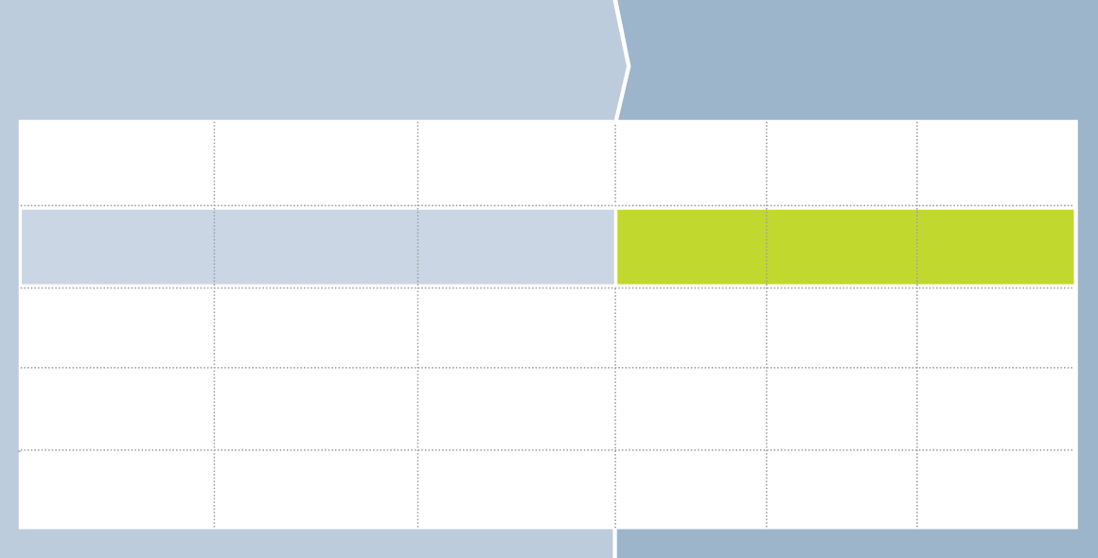
SpendSenseTM
MARKETING EFFECTIVENESS
Improve your direct marketing efforts by adding spend data to your customer or prospect database.
WHAT THE ANALYSIS ENABLES
YOUR BUSINESS BENEFITS
Improve acquisition efforts by more efficiently targeting highest potential prospects
Improve loyalty and CRM efforts by maximizing value from existing customers
Increase ROI of all marketing activities
Enhanced understanding of customer/prospect value and opportunity through real spend-derived indices
More precise market segmentation and targeting, whether those customers and prospects are Cardmembers or not
Ability to target the right customers and prospects with the most effective message and the proper level of investment
REPORT SNAPSHOT: SPEND BEHAVIOR BY CONSUMER GEOGRAPHY
1.
A client provides a list of anonymous consumers to American Express Business Insights
2.
Spend indices are then appended to that list for use in analytics and marketing
Age
Gender
ZIP +4
Industry Spend
Freq. of Trans
Share of Wallet
38
M
10055 - 2233
345
277
56
SpendSense shows that a 38-year old male living in 10055-2233 is likely to spend more than 3x the average in your industry, but is only half as likely to have transacted with you.
62
F
38875 - 1234
56
21
76
23
F
63525 - 5533
125
101
101
29
M
90235 - 0004
78
65
100
The sample chart above is demonstrative of the type of information found in SpendSense. All data is illustrative and not reflective of any actual trends. The SpendSense product uses aggregate spend data to estimate how consumers with certain attributes are likely to act. The purchasing activity estimate SpendSense provides is representative of consumers with those attributes and does not represent the spend of any unique consumer.

Slide 11
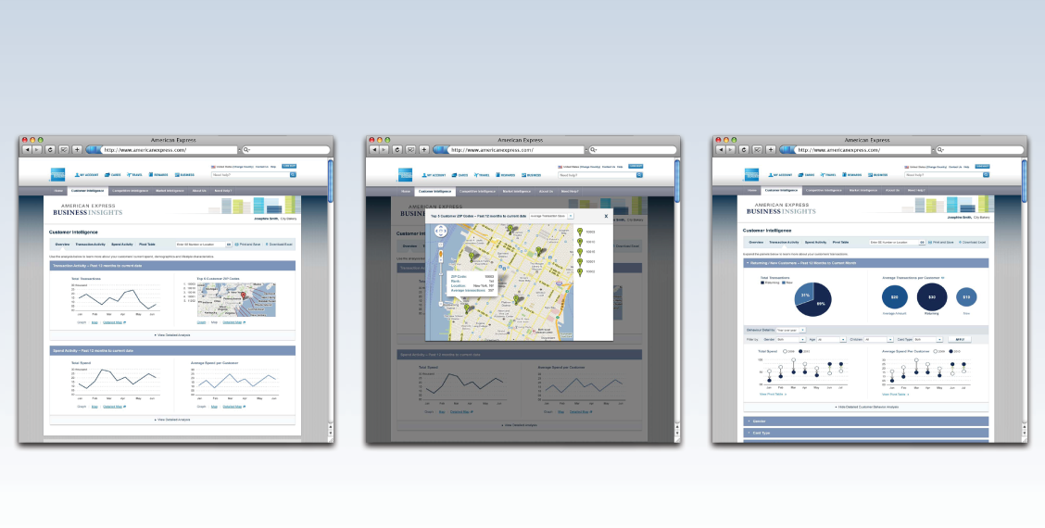
Insights Online
Gain valuable insights about your customers and marketplace through a dynamic, interactive, online portal.
WHAT THE SERVICE PROVIDES
YOUR BUSINESS BENEFITS
Monthly-refreshed data to support real-time decision making
Data analysis that can be viewed at a corporate, regional and location level
Intuitive interface that lets you view and manipulate data in a way that makes sense for your business
Understand current and potential customer base through actual spend behavior and maximize the spend of your most valuable customers
Drill down to determine customer demographic and lifestyle information
Create, print and export customized reports to support business needs
REPORT SNAPSHOT: INSIGHTS ONLINE INTUITIVE INTERFACE
High Level Dashboarding
Mapping Customer Zip Codes
Dynamic Data Analysis

Slide 12

Our strong commitment to privacy
We take customer privacy very seriously. Our products consist of aggregated information that is not specific to individual Cardmembers
or merchants, and do not contain any personally identifiable information.

Slide 13

Thank you
americanexpress.com/businessinsights
© 2011 American Express Travel Related Services Company, Inc. All rights reserved. CONFIDENTIAL, PROPRIETARY & TRADE SECRET INFORMATION. This document contains confidential, proprietary, and trade secret information of American Express Company and its subsidiaries and affiliates (“American Express”), and may not be disclosed in whole or in part to any third parties without prior written consent of American Express.

