Slide 1
Pinterest: online visual bookmarking tool
Testing Types
by Victoria Svyryd
IFQC-071
May 2016

Slide 2

Agenda:
‘Pinterest’ Application Overview.
Approaches of testing ‘Pinterest’:
Positive testing.
Negative testing.
Test Types by Objectives:
Functional testing.
‘Smoke’ test.
Non-functional Tests:
Localization and Internationalization Tests.
Compatibility Testing.
GUI Testing.
Security Testing.
Performance, Load and Stress Testing.

Slide 3

It is both a web and mobile visual bookmarking tool that helps you discover and save creative ideas.
Pinterest acts as a personalized media platform. A user can upload, save, sort, and manage images — known as pins — and other media content (e.g., videos) through collections known as pinboards.
Content can be found inside or outside of Pinterest and similarly uploaded to a board via the "Pin It" button which can be downloaded to the bookmark bar on a web browser.
Also, registered users can communicate via typing messages to each other.

Slide 4
Approaches of Testing
Pinterest

Slide 5
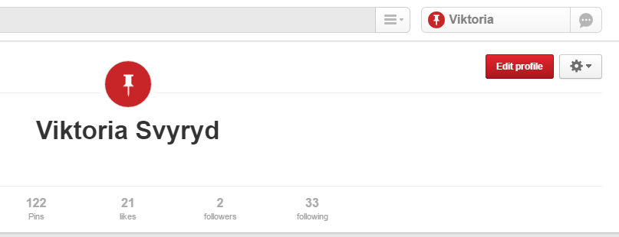
Positive Testing
User Story#1: As a user, I need to be able to register as a new user, so that I can have access to the site.
Task: Verify, that User can registrate on the site using valid credentials.
Steps:
1.Go to the site address: https://www.pinterest.com/
2.In ‘Email’ field enter real e-mail.
3.In ‘Create password’ enter more than 6 characters.
4.Press ‘Sign up’.
Expected result equals to Actual result: new user has been created.

Slide 6
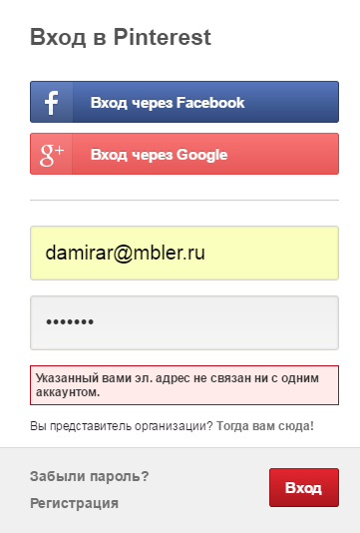
Negative Testing
User Story#2: As a user, I need to be able to login with my username/password, to gain access to the site.
Task: Verify that user can’t registrate with invalid credentials.
Steps:
1.Go to the site address: https://www.pinterest.com/
2.Enter invalid e-mail address.
3.Enter password (more than 6 characters).
4.Press ‘Login’.
Expected result equals to Actual result: the system doesn't allow user to login using invalid e-mail, error message is shown.

Slide 7
Test Types by Objectives

Slide 8
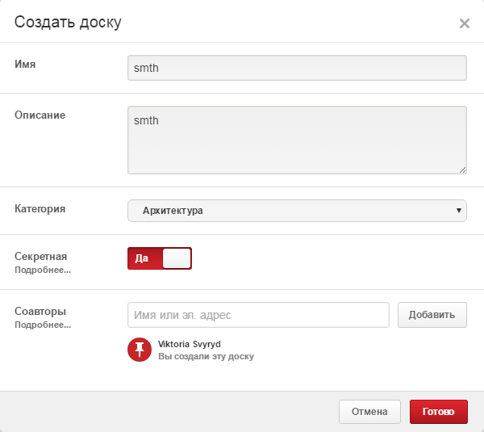
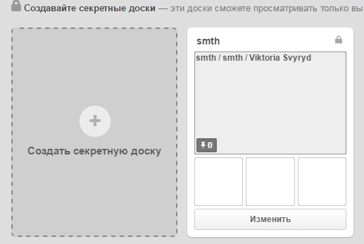
Functional Testing
User Story#3: As a registered User, I want to create secret board, so that only I can see and manage it.
Task: Verify secret board creation.
Steps:
1.Login at the site.
2.Click on ‘Create secret board’ icon.
3.Fill out all mandatory fields.
4.Press on ‘Create’ button.
Actual result equals to Expected result: registered user can create secret board which is invisible for other users.

Slide 9
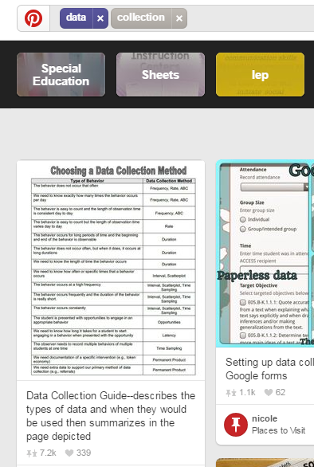
Smoke Testing
User Story#4: As a registered User, I need to be able to search items, to manage them.
Task: Verify search engine.
Steps:
1.Login at the site. 2.Click on search field. 3.Enter item name.4.Press Enter.
Actual result equals to Expected result: items with the specified name are shown on your page.

Slide 10
Non-functional Tests

Slide 11
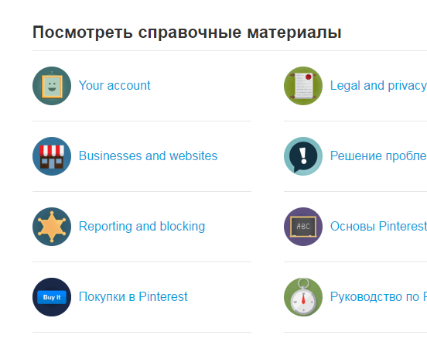
Localization testing
User Story#5: As a registered User, I want to be able to change language, to make site suitable.
Task: Verify if all labels change theirs name into Russian language.
Steps:
1.Login at the site.
2.Navigate to Help center https://help.pinterest.com/ru?source=question_mark
3.Select Russian language.
Actual result: ‘Your account’, ‘Legal and privacy’, ‘Business and websites’, ‘Reporting and blocking’ are not translated to Russian.
Expected result: All labels change theirs name on Russian.

Slide 12
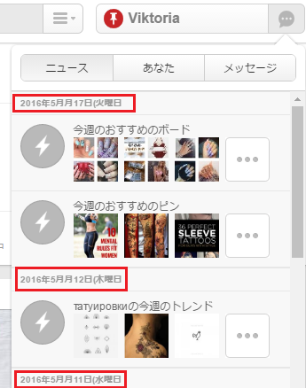
Internationalization testing
User Story#6: As a registered User, I want to be able to change my personal settings, to make navigation more convenient.
Task: Verify if the application customize as per the targeted language and country (USA).
Steps:
1.Login to the app.
2.Click on ‘Edit profile’ button and press ‘your settings’ link.
3.In a field ‘Language’ choose ‘English US’, in ‘Country’ choose ‘USA’.
Expected result meets to actual result: the app changed interface language and regional date standards.

Slide 13
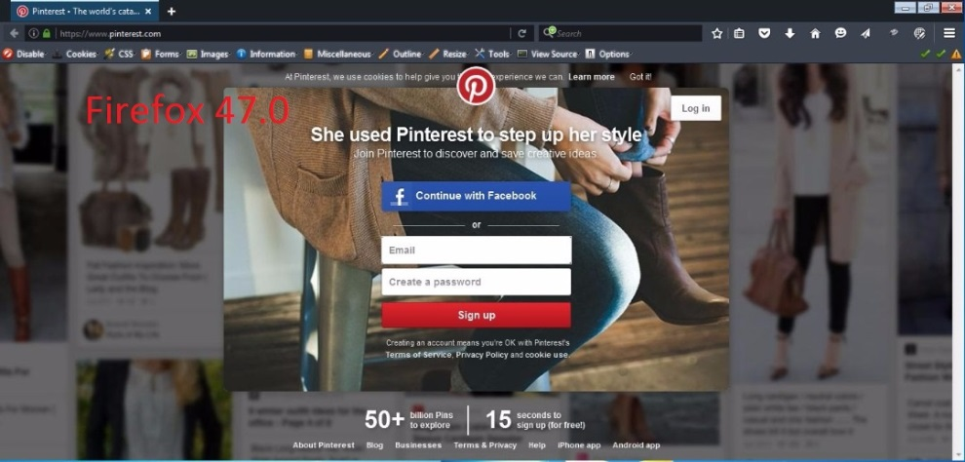
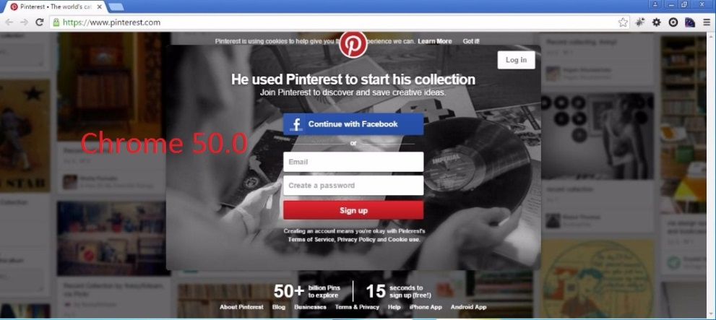
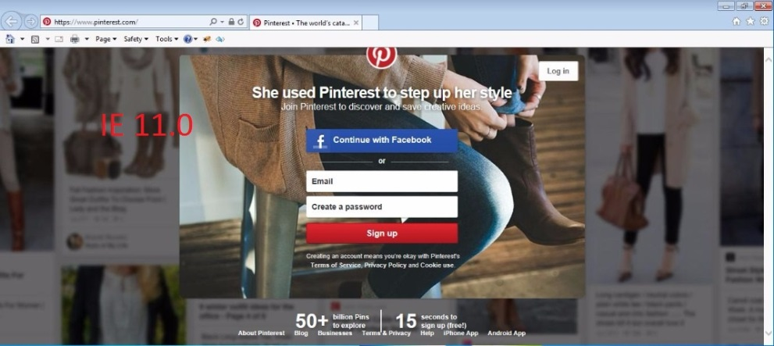
Compatibility Testing
User Story#7: As a registered User, I want to be able to run application, to use it.
Task: Verify compatibility of application with the latest versions of Firefox, Google Chrome, Internet Explorer browsers on Windows 7 platform (on Main page)
Needed tool: BrowserStack on-line cross-browser testing tool.
Steps:
1. Go to BrowserStack main page https://www.browserstack.com/start# and select trial version.
2.Choose cross-browser test execution on Windows 7 platform.
3.Check the latest versions of Firefox, Google Chrome, Internet Explorer browsers and run tests for the Main page of application.
Actual result equals to expected result: the application is displayed correctly on the latest versions of Firefox, Google Chrome, Internet Explorer browsers o Windows platform.

Slide 14
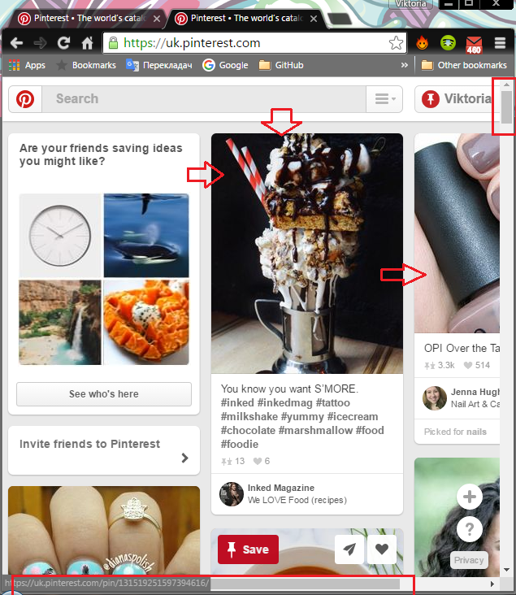
Graphical User Interface (GUI) Testing
User Story#8: As a registered User, I want to be able to navigate through the application.
Task: Check that the images are properly aligned when resizing screen (both manually and automatically on Google Chrome browser)
Steps:
1.Login at the site.
2.Resize screen by using arrow-pointer or ‘Restore/Down’ button of a browser.
Actual result equals expected result: navigate scrolls appear, pictures are displayed properly.

Slide 15
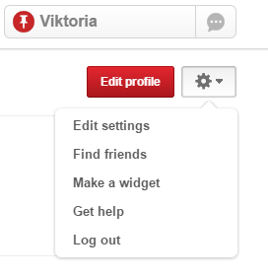
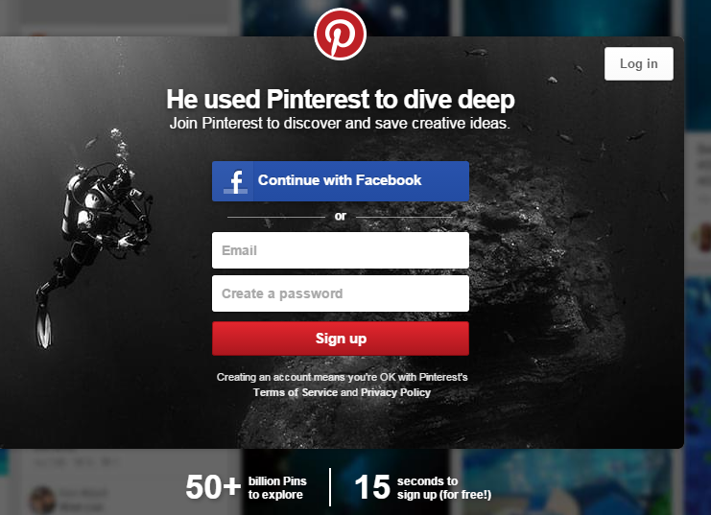
Security Testing
Task: Verify if a registered user loges out, ‘back’ browser button doesn’t bring him/her back into the last page.
Steps:
1.Login at the site.
2.Press on a button with your name at the site (right corner on the screen ).
3.Press ‘Settings’ button.
4.Press ‘Logout’ n dropdown list.
5.Press ‘Back’ arrow button of your browser.
Actual result equals expected result:
‘Back’ browser button doesn’t` work, user is not redirected on the last page, but on the ‘Main’ page.

Slide 16
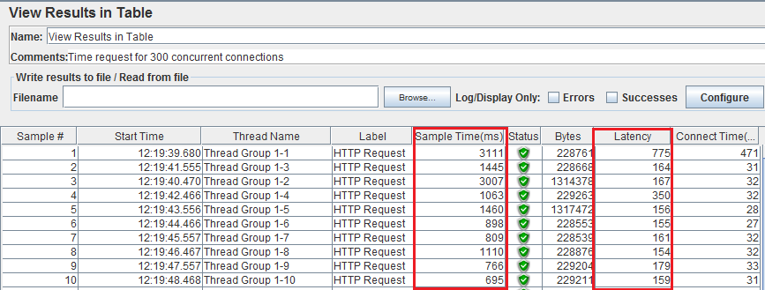
Performance Testing
Task: Verify server responds no more than 3 sec with 300 concurrent connections at the same time.
Needed tool: JMeter
Steps:
1.Using JMeter tool create new performance test emulating 3000 concurrent connections per 1 second.
2.Log actual result.
Note: Latency: The number of milliseconds that elapsed between when JMeter sent the request and when an initial response was received.
Sample Time: The number of milliseconds that the server took to fully serve the request (response + latency).
Actual result equals expected result: the average sample time is nearly 3 sec.

Slide 17
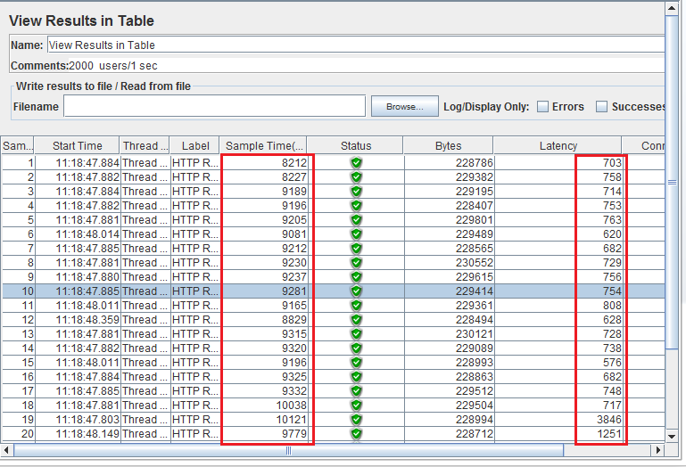
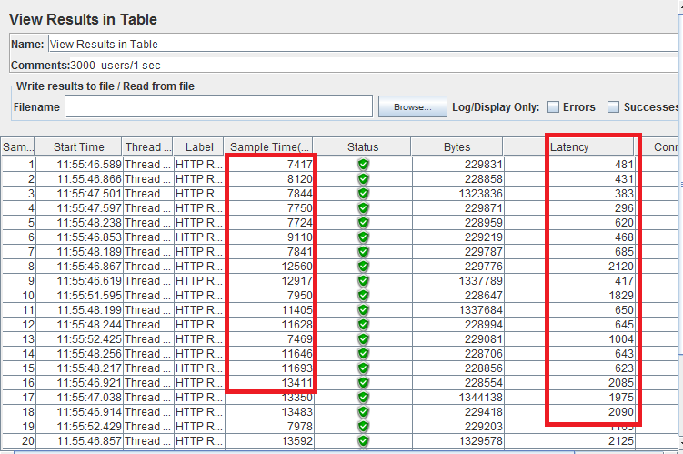
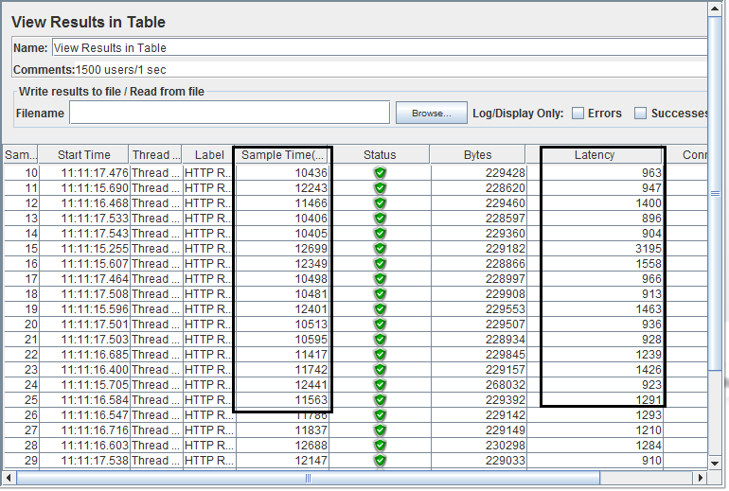
Load Testing
Task: Verify that server responding no more than 5 sec with 2000, 3000 concurrent connections at the same time.
Needed tool: JMeter
Steps:
1.Using JMeter tool create performance tests of https://www.pinterest.com , emulating 2000 and 3000 concurrent connections per 1 second (1 loop in every test).
2.Run each test and log actual results.
3.Compare actual results.
Latency: The number of milliseconds that elapsed between when JMeter sent the request and when an initial response was received.
Sample Time: The number of milliseconds that the server took to fully serve the request (response + latency)
Actual result is not equal to expected result: the average sample time is more than 5 sec.

Slide 18
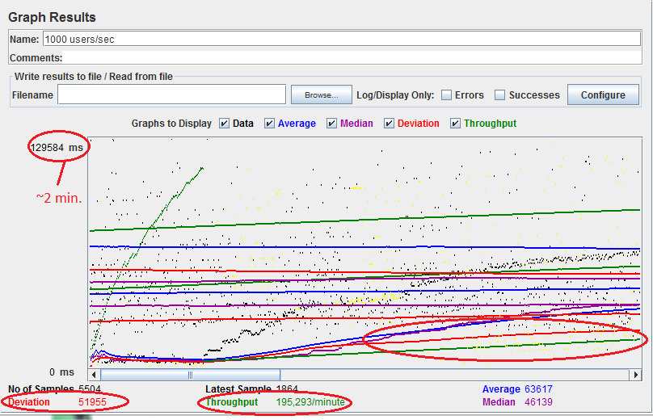
Stress Testing
Task: Verify if server responds with 2000 concurrent connections every second in 10 loops.
Needed tool: JMeter
Steps:
1.Create performance test, emulating 2000 concurrent connections per 1 second in 10 loops to https://www.pinterest.com .
2.Run test an log actual result.
Latency: The number of milliseconds that elapsed between when JMeter sent the request and when an initial response was received.
Sample Time: The number of milliseconds that the server took to fully serve the request (response + latency).
Actual result is not equal to expected result: respond time is nearly 2 minutes.

Slide 19
Thank You!

