Slide 1





Team Details
Team Name:
EdgeRestore-LK Stark Industries
SR. NO
ROLE
NAME
ACADEMIC YEAR
1
Team Leader
Vikaash R
3rd Year
2
Member 1
Mervin
2nd Year
3
Member 2
Nithilan T
3rd Year
4
Member 3
[ADD / REMOVE]
[ADD YEAR]
A team can have up to 4 members including the team leader. Add rows if necessary.
COLLEGE NAME
Chennai Institute of Technology
TEAM LEADER CONTACT NUMBER
TEAM LEADER EMAIL ADDRESS
9600039825
r.vikaash301@gmail.com
Notes:
[Sources]
- https://i4c.in/hackathon-2026/
[/Sources]

Slide 2


Problem Statement Addressed
PS01 | Joint denoising + 2x grayscale super-resolution
WHY THIS MATTERS
Restore 128x128 noisy inputs to faithful 256x256 outputs. Preserve real edges and rare structures while suppressing speckle and Gaussian noise; hidden sources test generalization and speed.
Notes:
[Sources]
- https://i4c.in/hackathon-2026/
[/Sources]

Slide 3



Idea Description - EdgeRestore-LK
One deterministic model handles compound noise and 2x upscaling while prioritizing faithful structure over visually plausible hallucination.
KEY CONCEPT & APPROACH
6 residual groups x 6 residual channel-attention blocks (96 channels), zero-initialised head so the untrained network is exact bicubic.
SOLUTION OVERVIEW
PixelShuffle restores 2x detail; a bicubic skip anchors fidelity. Challenge-range outliers are retained.
Notes:
[Sources]
- https://openaccess.thecvf.com/content/CVPR2026/html/Tan_UCAN_Unified_Convolutional_Attention_Network_for_Expansive_Receptive_Fields_in_CVPR_2026_paper.html
[/Sources]

Slide 4
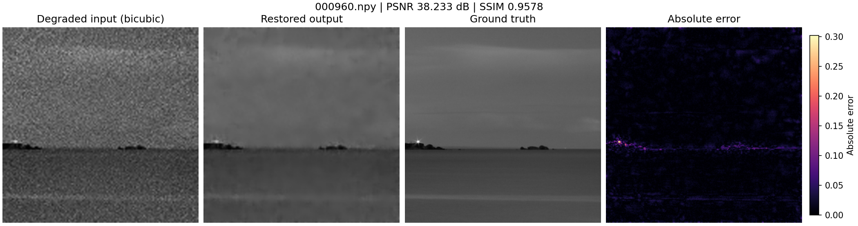
Proposed Solution - Model and Training
LR -> 6x[6 RCAB] channel-attention groups (96ch) -> PixelShuffle -> + bicubic. Charbonnier + FFT-L1 training selects EMA iter 22000 by held-out validation PSNR.
VISUAL PROOF
Sample 000960 | PSNR 40.83 dB | SSIM 0.9744 | held-out filename-random split
Notes:
[Sources]
- Local checkpoint and training logs; see README.md and artifacts/metrics/model_metrics.json
[/Sources]

Slide 5
Innovation and Empirical Advantage
A kernel-only controlled ablation improved PSNR, SSIM, and LPIPS; no GAN, diffusion, ensemble, or degradation router was added.
FINAL MODEL (EdgeRestore v2, submitted)
29.10 dB PSNR | 0.7784 SSIM | 0.2760 LPIPS | 0.9396 MS-SSIM (+6.111 dB over bicubic) 6,939,289 parameters | 27.9 MB | 29.35 ms model | 38.42 ms end-to-end
Notes:
[Sources]
- Local paired ablation reports: artifacts/metrics/model_metrics.json and outputs/validation/metrics.json
[/Sources]

Slide 6
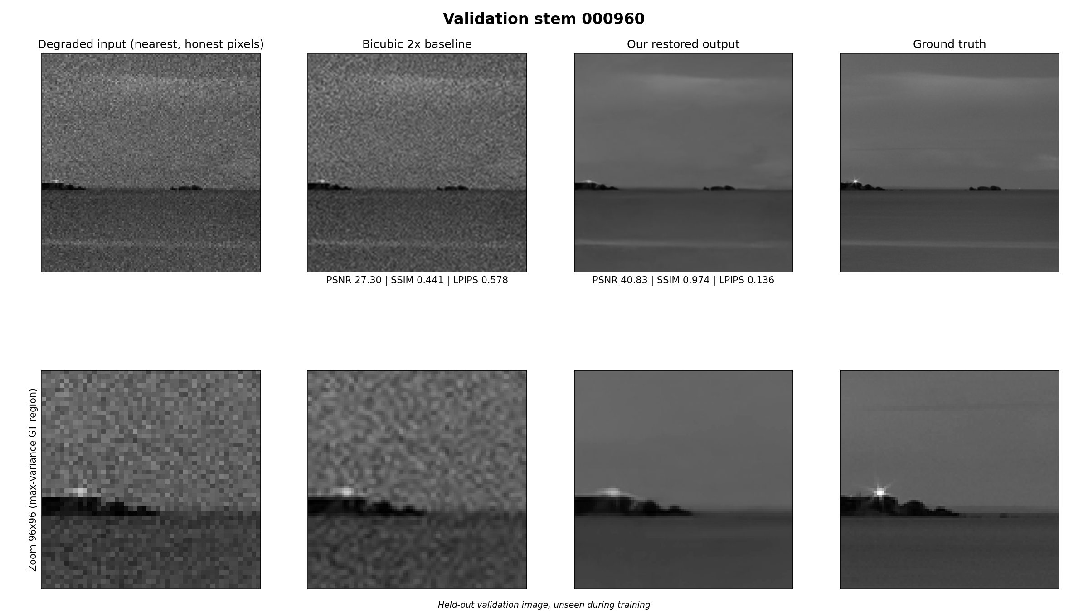
Results
Quantitative metrics and visual evidence on the 320-image held-out split, identical protocol for every row.
QUANTITATIVE METRICS (320-image held-out)
VISUAL EVIDENCE: 000960 | degraded -> restored -> ground truth
PSNR: 29.0989 dB (bicubic: 22.9877 dB) SSIM: 0.7784 (bicubic: 0.5193) LPIPS: 0.2760 (bicubic: 0.4435, lower is better) MS-SSIM: 0.9396 (bicubic: 0.7943) +6.111 dB PSNR over bicubic baseline 0/320 images lose to bicubic on PSNR or MS-SSIM
PSNR 40.83 dB | SSIM 0.9744

Slide 7




Technology, Feasibility and Impact
A trained, deterministic PyTorch pipeline restores every released test array with a standalone command and frozen checkpoint.
IMPLEMENTATION AND TRUST BOUNDARY
All 400 official test outputs verified finite and within [0,1] directly via the required inference.py entry point, 0 violations. Tests cover data, model, metrics, training and inference (257 tests). H100 and true OOD remain unverified.
PyTorch 2.11 | FP32
RTX 5070 Ti | 22,000 iters
+6.111 dB | 29.35 ms
Notes:
[Sources]
- Local benchmark: artifacts/metrics/benchmark_fp32.json
- https://i4c.in/hackathon-2026/
[/Sources]

Slide 8


GitHub & Video Link
Public Repository
Clone and run inference following the README - no manual edits required
GitHub: github.com/Vikaash301/kla-semicon Contains: README.md, standalone inference.py (accepts positional or --input-dir/--output-dir args), training script, checkpoints/edgerestore_v2.pt, restored_test_outputs/ (400 images), requirements.txt, and requirements-freeze.txt (literal pip freeze). Video: not provided (optional per template)

Slide 9
Research, Code and References
Research Basis + Reproducibility
Implemented evidence and submission links
2026 UCAN and ShiftLUT motivate wider spatial context; our 5x5 depthwise ablation is the measured adaptation. GitHub: github.com/Vikaash301/kla-semicon Video: [ADD OPTIONAL DEMO URL]
References & Citations
Primary sources; full verified list in REFERENCES.md
UCAN - Expansive Receptive Fields for Lightweight SR (CVPR 2026)
ShiftLUT - Spatial Shift Enhanced LUTs for Restoration (CVPR 2026)
I4C Hackathon 2026 challenge and released paired dataset (i4c.in)
Notes:
[Sources]
- https://openaccess.thecvf.com/content/CVPR2026/html/Tan_UCAN_Unified_Convolutional_Attention_Network_for_Expansive_Receptive_Fields_in_CVPR_2026_paper.html
- https://openaccess.thecvf.com/content/CVPR2026/html/Zeng_ShiftLUT_Spatial_Shift_Enhanced_Look-Up_Tables_for_Efficient_Image_Restoration_CVPR_2026_paper.html
- https://i4c.in/hackathon-2026/
[/Sources]

