Slide 1

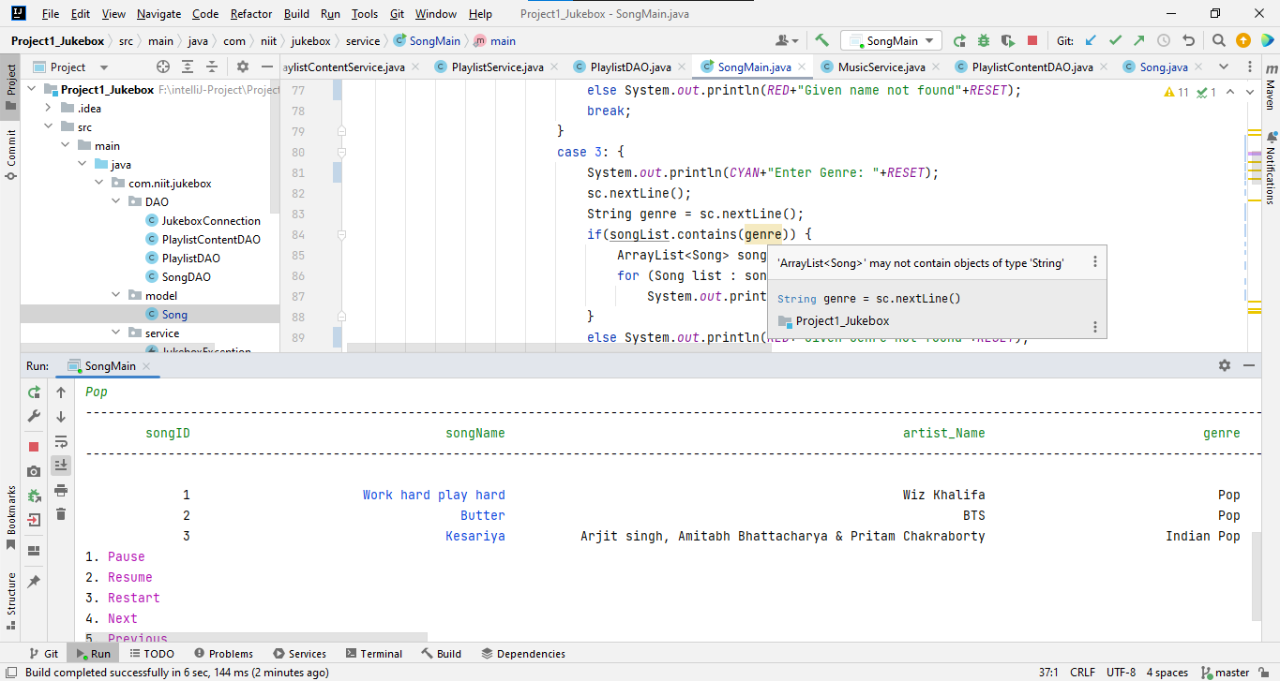

Jukebox Project Presentation

Slide 2


Hello world!
I AM VIKALP TYAGI
I am here to give a presentation on my java project: Boom-Box
Under the guidance of:
Mythreye Ragunathan
Shilpi Jain

Slide 3

Content
Introduction
Objective of Project
What is a jukebox
Database
Overview of Application

Slide 4
Introduction
My name is Vikalp Tyagi I am 23 years old, I was born and raised in the city of Kota of district Rajasthan.
I have completed my graduation in the year 2021 and am preparing for the job of a Full stack developer.
This project is the essence of what I have learned so far in my journey of learning java.

Slide 5

Objective Of the Project
The project aims to build a console-based application with the help of java language which replicates the functionality of a jukebox.
This project uses an offline database for music storage and uses java language to give program functionality.
This project requires students to use all the knowledge of java that we have learned so far and use it together in a systematic combination.

Slide 6
What is a Jukebox ?
A jukebox is a device that contains a database of songs in form of stacked music DVDs.
It takes user input through the physical navigation button present on the jukebox and based on a choice the mechanism plays the corresponding song DVD.
This gives users basic functionality of play, pause, stop, next and previous.
Jukeboxes were most popular from the 1940s through the mid-1960s, particularly during the 1950s.
These machines were very heavy and large and don’t have easy database updation features.

Slide 7

Database
A database is an organized collection of structured information, or data, typically stored electronically in a computer system. A database is usually controlled by a database management system (DBMS).
Here we use My Structured Query Language (MySQL), which is an open-source Structured Query Language.

Slide 8

My Structured Query Language (MySQL)
In MySQL, we are creating a database with the name Jukebox. This database will contain all our information regarding our application.
In the jukebox database, we are creating three tables: Songs, Playlist, and Playlist content.
Each of these tables contains different categories of resources that will be later on fetched and used by our application.

Slide 9
Overview of Application
We are using java language to create this console-based application that fetches the resources it requires from a local repository which is created with the help of MySQL.
This application takes input from user based on a simple console-based interface, where the user provides input based on the option provided on the interface.
Similar to a real jukebox this provides the functionality of play, pause, stop, next and previous while also adding the extra feature of creating a playlist based on user preferences.

Slide 10
Program
The program is divided into smaller packages based on their functionalities:
Model Package- This package contains the class that has all the attributes, of my program.
DAO Package- This package contains all my functional classes which will execute all my query’s on the database
Service Package- This will contain all my classes that will have implementation methods as well as classes which will execute my DAO package classes in a meaningful sequential order.

Slide 11

Thanks!
ANY QUESTIONS?
You can also find me at:
tyagivikalp99@gmail.com

