Slide 1
DATA ANALYTICS / MANAGEMENT REVIEW
E-Commerce Shopper
Behavior & Cart
Abandonment Analysis
What one million synthetic shopper profiles reveal — and what they cannot prove.
1,000,000 profiles • 60 fields • Executed Python EDA
Prepared from uploaded notebook, MySQL script and Power BI screenshots
01

Slide 2
01 / EXECUTIVE READOUT
02
The baseline is clear; the causal story is not.
Executed Python outputs establish a stable descriptive baseline for one million synthetic profiles.
SHOPPER PROFILES
MEAN ABANDONMENT
MEAN CONVERSION
CHECKOUT ABANDONS
AVG. PRODUCT VIEWS
AVERAGE CART ITEMS
1.0M
40.21%
50.00%
5.00
25.02
5.49
Distinct user IDs
Profile-level field
Profile-level field
Per shopper / month
Per day
Per profile
Decision: use this as a measurement and hypothesis-generation baseline. Do not treat the synthetic correlations as proven causes or the rates as session-level funnel metrics.
What stands out
• Mobile is the largest group (60.02%) and has the highest mean abandonment (40.23%).
• Device differences are tiny: mobile vs desktop is about 0.06 percentage points.
• The category range is similarly narrow: about 0.19 percentage points.
• Abandonment correlates strongly with synthetic impulse and stress scores.
Evidence: executed notebook outputs, cells 4–34. Raw CSV was not attached for an independent rerun.

Slide 3
02 / BUSINESS FRAMING
03
The project measures profile-level patterns, not checkout events.
A precise problem statement keeps the analysis useful without overstating what the dataset can tell us.
Business question
What the data cannot answer
Which shopper attributes and summarized behaviours are associated with higher cart-abandonment levels in the synthetic population?
– Exact drop-off stage in a live shopping journey
– Actual abandoned-cart value or revenue at risk
– Verified causes of abandonment
– Observed customer response to a UX or marketing intervention
PROFILE
COMPARE
VALIDATE
TEST
1 row per synthetic shopper
→
Device, age, category, scores
→
Rebuild bands and event metrics
→
Controlled changes on real event data
64% was used as an initial narrative premise in the earlier brief, but the executed dataset output reports a 40.21% average field. The report uses the executed result, not the unsupported premise.

Slide 4
03 / DATA ASSET
04
A million-row synthetic dataset is clean, broad and highly structured.
The executed notebook reports 60 columns, complete fields and unique shopper IDs.
ROWS
COLUMNS
MISSING VALUES
DUPLICATE ROWS
DUPLICATE IDS
1,000,000
60
0
0
0
Synthetic shopper profiles
45 integer / 15 text
Reported in initial checks
Exact duplicate check
user_id uniqueness check
Data coverage
Key data interpretation
• Demographics and household profile
The dataset is explicitly synthetic. Its designed relationships are useful for learning EDA and BI workflows, but do not establish real-market customer behaviour.
• Income and spending summaries
• Device and shopping activity
• Budgeting, impulse and stress scores
Recorded last_purchase_date spans 2025-01-01 to 2027-01-01; it is a profile date, not a transaction table.
• Returns, loyalty and purchase-date fields
Source: executed notebook cells 4, 6 and 8; dataset field summary provided with the project.

Slide 5
04 / METHOD & QUALITY
05
Preparation focused on types and rate scales — not missing-value imputation.
The notebook’s data-quality checks were already clean; the SQL script adds a reproducible MySQL view layer.
01
02
03
04
05
06
LOAD
PROFILE
CLEAN
NORMALIZE
ANALYZE
EXPORT
CSV → pandas
60 fields / 1M rows
Trim, exact dedupe, cast
Rates 0–100 → 0–1
Groupby, charts, corr.
Clean CSV + summaries
Rate fields observed in the raw CSV
Method boundary
Field
Raw min
Raw max
Clean scale
Python outputs are executed and embedded in the notebook. The MySQL script was reviewed, but no successful database execution log was supplied. The Power BI model itself was not available as a PBIX.
Abandonment
0
90
0–0.90
Conversion
0
100
0–1
Return
0
100
0–1
Notification response
0
100
0–1
Quality result: 0 missing values, 0 exact duplicates and 0 repeated user IDs in the notebook checks.

Slide 6
05 / KPI BASELINE
06
The profile-level baseline is 40.21% abandonment and 50.00% conversion.
The six core KPIs reconcile to the executed notebook outputs; monetary units remain unspecified.
TOTAL SHOPPERS
ABANDONMENT
CONVERSION
MONTHLY CHECKOUT ABANDONS
MONTHLY SPEND
ORDER VALUE
1.0M
40.21%
50.00%
5.00
2,498.78
255.03
Distinct profiles
Mean profile field
Mean profile field
Mean per profile
Dataset units
Dataset units
Activity indicators
Metric discipline
Do not add ₹ or $ symbols: the source files do not specify currency. These are user-level averages, not total business revenue or event-derived conversion.
25.02
5.49
60.01
Product views / day
Average cart items
Daily session time
per shopper
items
minutes
Source: notebook cells 18 and 22. Rounded display values; precise averages are retained in the report.

Slide 7
06 / DEVICE COMPARISON
07
Mobile is the largest segment, but its abandonment lead is only 0.06 pp.
Device differences are descriptive and small; the notebook contains no significance test.
Mean abandonment field by device
Device
Profiles
Share
Mean conversion
Mobile
40.23%
Mobile
600,247
60.02%
50.03%
Tablet
40.20%
Tablet
99,908
9.99%
50.03%
Desktop
40.17%
Desktop
299,845
29.98%
49.93%
Interpretation: mobile merits usability research because it represents the largest profile share, not because this dataset proves the mobile experience causes abandonment.
Source: executed notebook cell 28. Mobile vs desktop mean abandonment difference ≈ 0.06 percentage points.

Slide 8
07 / SEGMENT COMPARISON
08
Preferred-category and age-group abandonment rates are tightly clustered.
The largest category and age gaps are small in absolute percentage-point terms.
Preferred category abandonment
Age group abandonment
Sports
40.30%
18–24
40.16%
Toys
40.26%
25–34
40.20%
35–44
40.22%
Electronics
40.24%
45–54
40.19%
Home & Kitchen
40.24%
55–64
40.28%
65+
40.21%
Groceries
40.22%
Fashion
40.21%
Beauty
40.13%
Smallest segment gaps
Books
40.11%
Category spread: ~0.19 pp | Age spread: ~0.13 pp
Sports is highest among preferred categories (40.30%); Books is lowest (40.11%). Age 55–64 is highest (40.284%); age 18–24 is lowest (40.159%).

Slide 9
08 / BEHAVIOURAL SIGNALS
09
Behaviour-score correlations are strong — and explicitly built into the synthetic data.
The data description documents built-in links between financial stress, impulse buying and abandonment.
Pearson correlation with abandonment
Income is an amount, not a label
Impulse buying
0.961
Range 10,000–200,000
Q1 57,466 Median 105,013 Q3 152,497
Financial stress
0.940
188,991 distinct income values appeared when grouped exactly. Convert the field into documented sample-relative quartiles before using income segments.
The provider describes these relationships as built-in synthetic correlations. Treat them as a designed pattern to validate on real data—not as a causal discovery.
Correlation with monthly spend −0.0019, AOV −0.0008, and conversion 0.0007: effectively no linear association in the notebook output.

Slide 10
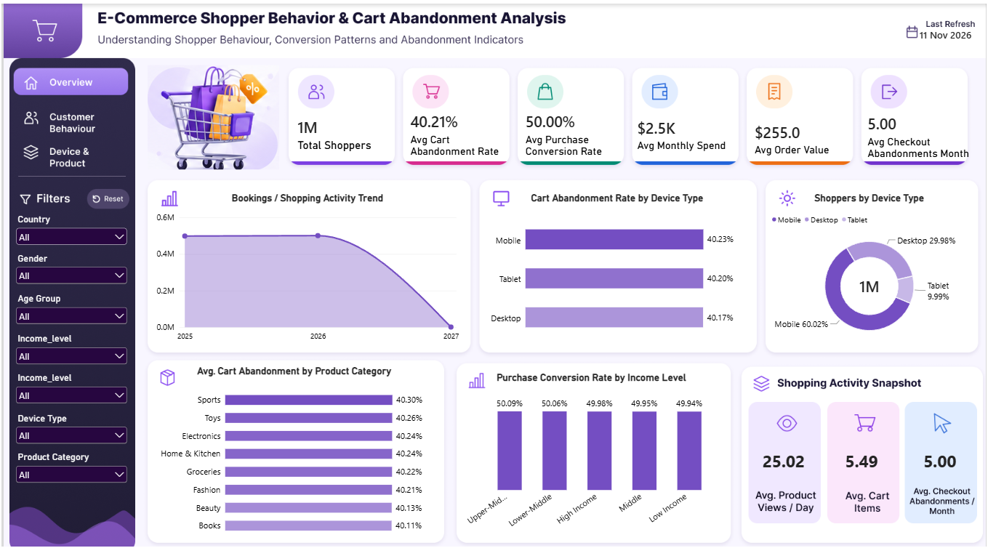
09 / DASHBOARD QA
10
The current report is visually coherent, but one trend chart needs a new definition.
Power BI Page 1 screenshot reviewed against Python outputs.
What reconciles
✓ 1M shopper profiles
✓ 40.21% mean abandonment
✓ 50.00% mean conversion
✓ 25.02 views/day; 5.49 cart items
✓ Device and preferred-category rates align with notebook outputs
What to fix
Rename it as “Shopper profiles by recorded last-purchase month” and count DISTINCT user_id; it is not a bookings or transaction trend.
The monetary KPIs use no currency symbol because the dataset unit is unspecified.

Slide 11
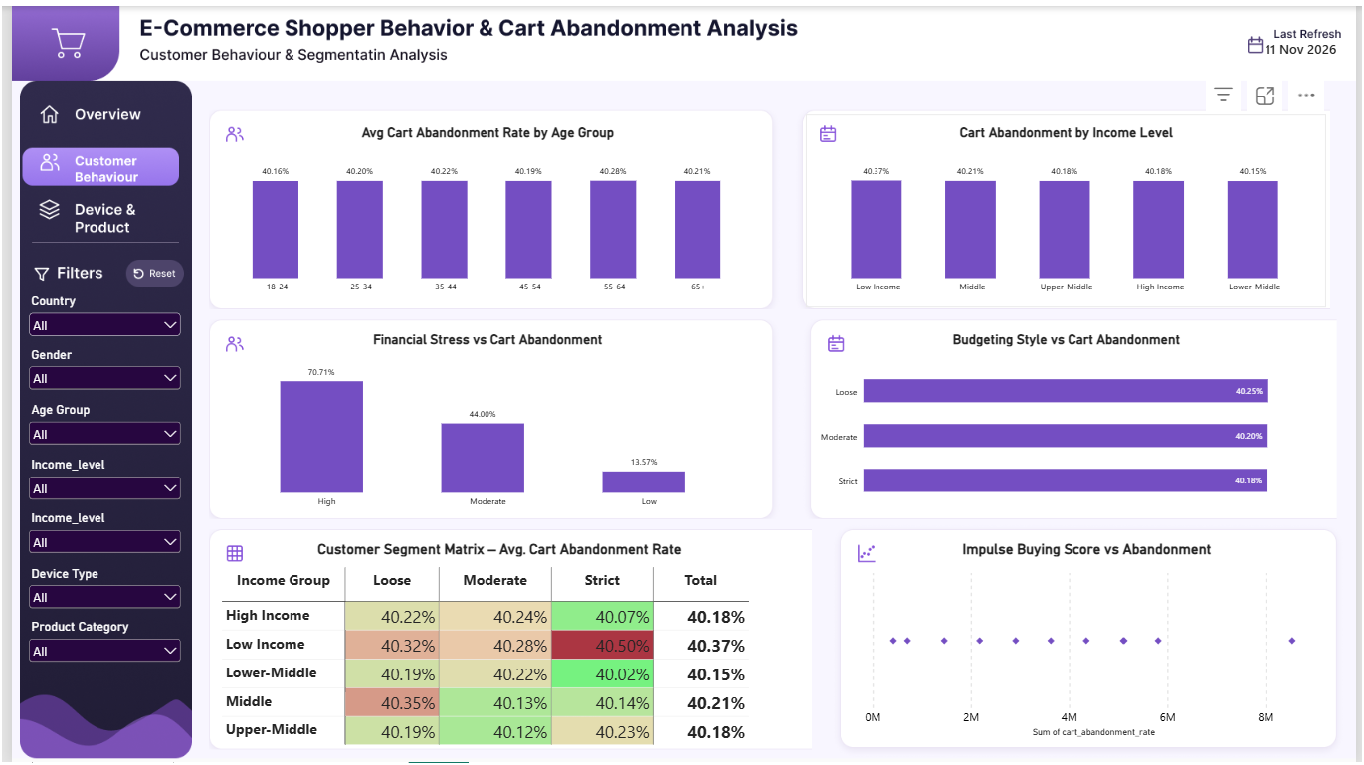
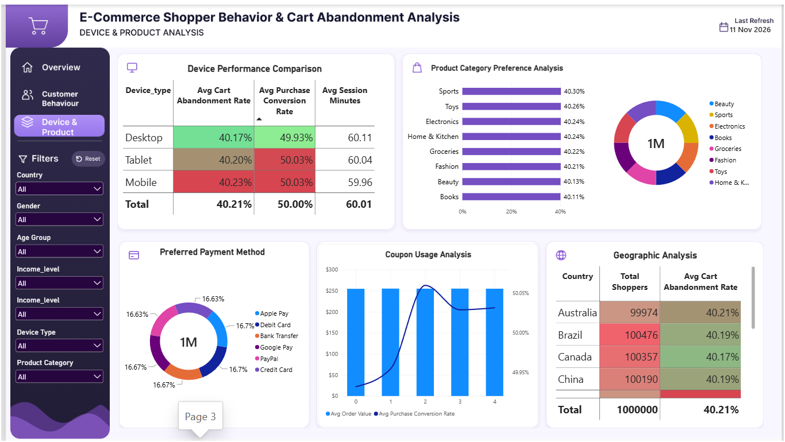
10 / DASHBOARD QA
11
Segmentation and payment visuals need reproducible grouping rules.
Pages 2 and 3 contain useful layouts, but not every chart can be validated from supplied outputs.
Required corrections
• Derive and document income bands; remove the duplicate Income_level slicer. • Replace Sum of cart_abandonment_rate scatter axis with impulse_buying_score vs mean abandonment.
• Rebuild the category donut from distinct shopper counts; payment, coupon and country results require exported query/measure validation.

Slide 12
11 / ACTION PLAN
12
The next step is stronger measurement, then targeted experiments.
Recommendations are prioritized by evidence strength and the current data limitations.
01
Instrument the journey
Capture session, cart, item value, add-to-cart, checkout, payment and purchase events.
P0
30 / 60 / 90
Run usability review and a controlled checkout experiment; current device gap is small.
0–30 days
02
Validate mobile UX
P1
Fix model, rates and segments.
31–60 days
03
Rebuild segmentation
Create income quartiles, rerun group summaries and add sample sizes to charts.
P1
Instrument events; run UX discovery.
61–90 days
Validate synthetic signals
Test stress/impulse relationships on real, consented data; do not infer causation.
Test interventions; report effects.
04
P2
Measure stage conversion, cart/checkout abandonment, abandoned-cart value, mobile completion, and event-data completeness. Scale only changes supported by controlled evidence.

