Slide 1
MARKET INTELLIGENCE / INDIA
CAPITAL
IN MOTION
Indian Startup Funding Analysis
2015–2020 | Funding concentration, data quality, and decision readiness
A source-led management review using 3,044 records and disclosed amounts only.
PREPARED 28 OCTOBER 2026 • DATA CURRENCY AS LABELED IN SOURCE
01

Slide 2
00 / EXECUTIVE READOUT
Funding is concentrated; confidence needs stronger controls
Observed results support a descriptive baseline, not unqualified market-wide claims.
DISCLOSED FUNDING
AMOUNT COVERAGE
PRIVATE EQUITY
TOP 5 CITY SHARE
$38.14B
68.1%
71.4%
84.0%
2,073 records with numeric amounts
971 rows remain undisclosed
share of disclosed USD total
funding in five highest city labels
THE DECISION STORY
READ THIS AS A DATASET VIEW
Records fall from 993 in 2016 to 111 in 2019 and 7 in January 2020. Without a completeness benchmark, that is not proof of a market contraction. Industry and investor rankings are also sensitive to naming inconsistencies.
A few large rounds and a few city labels drive much of the total.
• Largest recorded round: $3.90B (Rapido Bike Taxi); validate before interpretation.
• Mean deal size ($18.40M) is 10.5× the median ($1.75M).
02
SOURCE: CLEANED CSV — RECALCULATED; SQL/PBI RUNTIME NOT INDEPENDENTLY EXECUTED
02
SOURCE: CLEANED CSV — RECALCULATED; SQL/PBI RUNTIME NOT INDEPENDENTLY EXECUTED

Slide 3
01 / BUSINESS FRAME
Six questions, one decision objective
Preserve the original project scope: discover how recorded funding varies by time, industry, city, stage, investor, and deal size.
01
FUNDING OVER TIME
02
INDUSTRY MIX
How do deal records and dollar amounts change month-over-month and year-over-year?
Which industries received the most funding, and how did that shift?
03
CITY HUBS
04
FUNDING STAGE
Which cities are largest by funding volume?
How is disclosed capital distributed across Seed, Series A/B/C, Private Equity, Debt and other types?
05
INVESTOR LANDSCAPE
06
DEAL SIZE
Which investors appear in the most deal records and funding amounts?
How do mean and median amounts vary by industry and stage?
BOUNDARY
Describe what the supplied records show. Do not infer market coverage, root causes, or investment impact where the files do not support those claims.
03
SOURCE: CLEANED CSV — RECALCULATED; SQL/PBI RUNTIME NOT INDEPENDENTLY EXECUTED
03
SOURCE: CLEANED CSV — RECALCULATED; SQL/PBI RUNTIME NOT INDEPENDENTLY EXECUTED

Slide 4
02 / DATA READINESS
The table is usable; taxonomies and coverage still limit interpretation
Core numerical calculations reconcile to the cleaned CSV, but category-level analysis needs controls.
ROWS
AMOUNT VALUES
AMOUNT MISSING
3,044
2,073
971
all records
numeric disclosed values
31.9% of records
RAW INDUSTRY LABELS
CITY LABELS
INVESTOR STRINGS
822
73
2,364
long-tail labels
includes non-city/geography statuses
not individual investor count
WHAT THE CLEANING NOTEBOOK REPORTS
VALIDATION LIMIT
The raw_startup_funding.csv file referenced by the notebook was not supplied, so the full cleaning pipeline could not be re-executed. This review independently recalculated metrics from the cleaned CSV.
• 8 malformed date strings repaired; 0 unparseable dates in stored output.
• Amount strings parsed; missing values retained as null, not zero.
• 0 exact duplicates removed; low-value Remarks and serial index dropped.
04
SOURCE: CLEANED CSV — RECALCULATED; SQL/PBI RUNTIME NOT INDEPENDENTLY EXECUTED
04
SOURCE: CLEANED CSV — RECALCULATED; SQL/PBI RUNTIME NOT INDEPENDENTLY EXECUTED

Slide 5
03 / FUNDING ACTIVITY
2017 has the largest recorded annual total; coverage drops after 2016
USD as labeled in the supplied field; amounts with missing values are excluded.
2017 PEAK
$10.43B disclosed
2019 CONCENTRATION
$9.70B across 111 records; mean $92.4M
COMPARABILITY ALERT
2020 contains seven January records only. The -96.0% mechanical YoY change is not a full-year comparison. 2019-03 is absent from the monthly series.
RECORDS BY YEAR
2015
2016
2017
2018
2019
2020
936
993
687
310
111
7
05
SOURCE: CLEANED CSV — RECALCULATED; SQL/PBI RUNTIME NOT INDEPENDENTLY EXECUTED
05
SOURCE: CLEANED CSV — RECALCULATED; SQL/PBI RUNTIME NOT INDEPENDENTLY EXECUTED

Slide 6
04 / INDUSTRY MIX
Industry rankings change after exact label variants are consolidated
For the e-commerce group, only labels identical after lowercasing and removing punctuation were merged.
E-COMMERCE LABEL VARIANTS
299 records → $8.26B after exact case/punctuation normalization.
TRANSPORTATION OUTLIER
$3.92B across just four records; the $3.9B Rapido record dominates the total.
NEXT CONTROL
Create a governed industry dictionary. Keep raw labels, canonical labels, and mapping rationale side-by-side.
06
SOURCE: CLEANED CSV — RECALCULATED; SQL/PBI RUNTIME NOT INDEPENDENTLY EXECUTED
06
SOURCE: CLEANED CSV — RECALCULATED; SQL/PBI RUNTIME NOT INDEPENDENTLY EXECUTED

Slide 7
05 / GEOGRAPHY
Bengaluru alone accounts for nearly half of disclosed funding
The ranking uses city labels in the supplied cleaned CSV; city/state/country and foreign locations still require a geography-quality flag.
BENGALURU SHARE
48.6%
of all disclosed funding
TOP 5 CITY SHARE
84.0%
of all disclosed funding
GEOGRAPHY CONTROL
Add Country and State/Region; isolate valid Indian city records for the India-only view. Use maps only after geocoding is checked.
07
SOURCE: CLEANED CSV — RECALCULATED; SQL/PBI RUNTIME NOT INDEPENDENTLY EXECUTED
07
SOURCE: CLEANED CSV — RECALCULATED; SQL/PBI RUNTIME NOT INDEPENDENTLY EXECUTED

Slide 8
06 / FUNDING STAGE
Private Equity contributes 71.4% of disclosed capital
Stage results use Investment_Type_Clean as provided in the cleaned CSV, not the separate ad hoc Power BI stage grouping.
VALUE CONCENTRATION
Private Equity: $27.23B (71.4%) across 1,362 records.
VOLUME VS VALUE
Seed/Angel: 1,542 records but $1.06B disclosed. Record count and capital volume answer different questions.
MAPPING NOTE
Series D–H remain distinct in this chart; “Other” is the source clean-type bucket.
08
SOURCE: CLEANED CSV — RECALCULATED; SQL/PBI RUNTIME NOT INDEPENDENTLY EXECUTED
08
SOURCE: CLEANED CSV — RECALCULATED; SQL/PBI RUNTIME NOT INDEPENDENTLY EXECUTED

Slide 9
07 / DEAL SIZE
The median is the better “typical deal” headline
Numeric bands use the 2,073 records with disclosed amounts. Missing amounts are not assigned to a $0 band.
AVERAGE
$18.40M
per disclosed amount
MEDIAN
$1.75M
per disclosed amount
CONCENTRATION CHECK
Top 10 recorded deals total $13.27B, or 34.8% of disclosed funding. Validate the $3.9B record before business interpretation.
09
SOURCE: CLEANED CSV — RECALCULATED; SQL/PBI RUNTIME NOT INDEPENDENTLY EXECUTED
09
SOURCE: CLEANED CSV — RECALCULATED; SQL/PBI RUNTIME NOT INDEPENDENTLY EXECUTED

Slide 10
08 / INVESTOR LENS
Investor rankings are not yet entity-safe
The current text field represents strings on a funding record; several strings contain multiple co-investors.
DISTINCT STRINGS
UNKNOWN INVESTOR
UNDISCLOSED LABELS
2,364
24
115
not unique investor entities
records labeled Unknown
records labeled Undisclosed
WHY THE LEADERBOARD CAN MISLEAD
RECOMMENDED MODEL
• SQL groups by the full Investors_Name string.
• A joint string such as “Microsoft, eBay, Tencent Holdings” is counted as one label.
• Assigning the full funding amount to each split name would double-count unless defined as exposure.
• Funding_Round_ID + Investor dimension.
• FundingRoundInvestor bridge table for co-investors.
• Explicit attribution rule: full exposure vs allocated share.
• Keep Unknown/Undisclosed visible in the full view.
SQL review: query PDF inspected; live MySQL execution was not available. The MoM logic also needs a complete calendar-month spine.
10
SOURCE: CLEANED CSV — RECALCULATED; SQL/PBI RUNTIME NOT INDEPENDENTLY EXECUTED
10
SOURCE: CLEANED CSV — RECALCULATED; SQL/PBI RUNTIME NOT INDEPENDENTLY EXECUTED

Slide 11
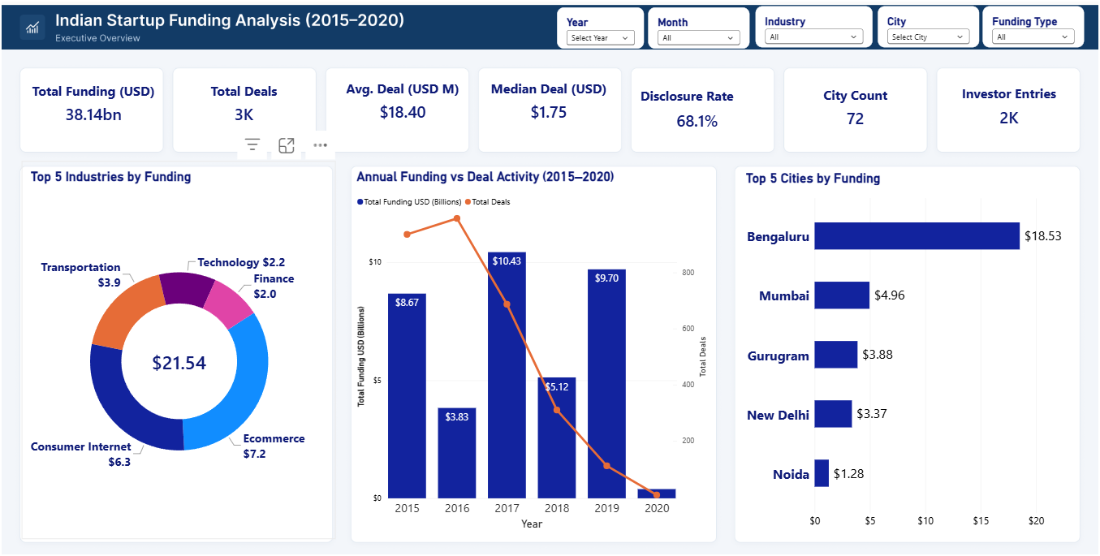
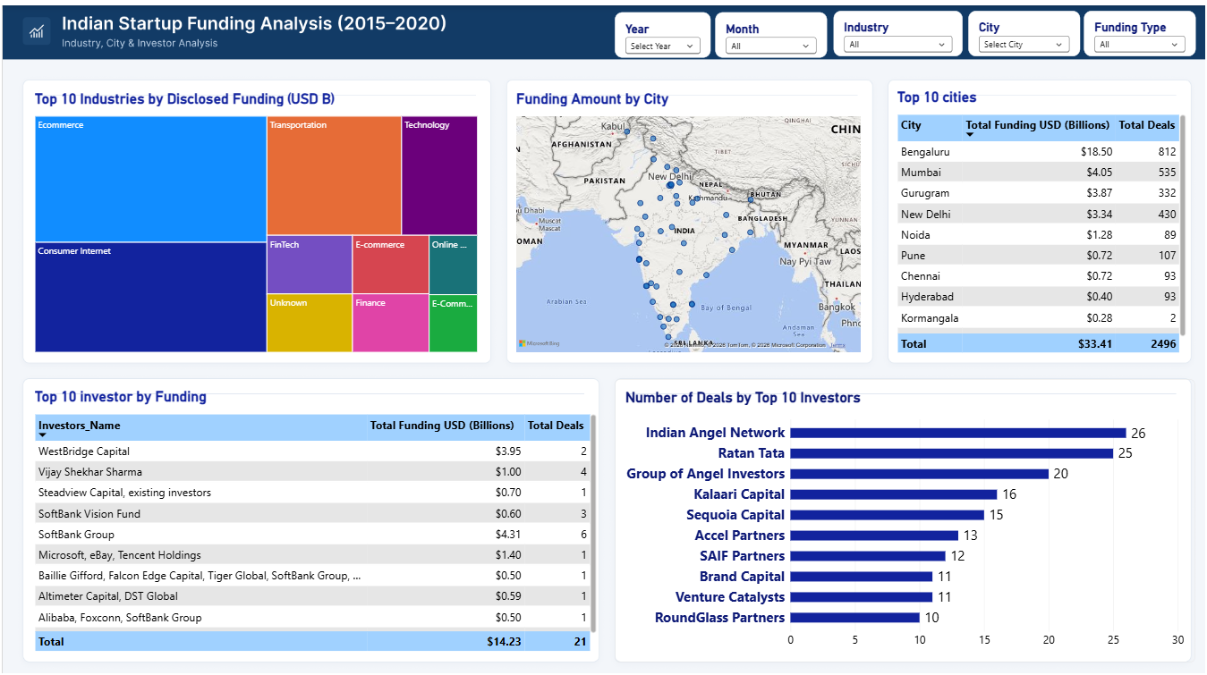
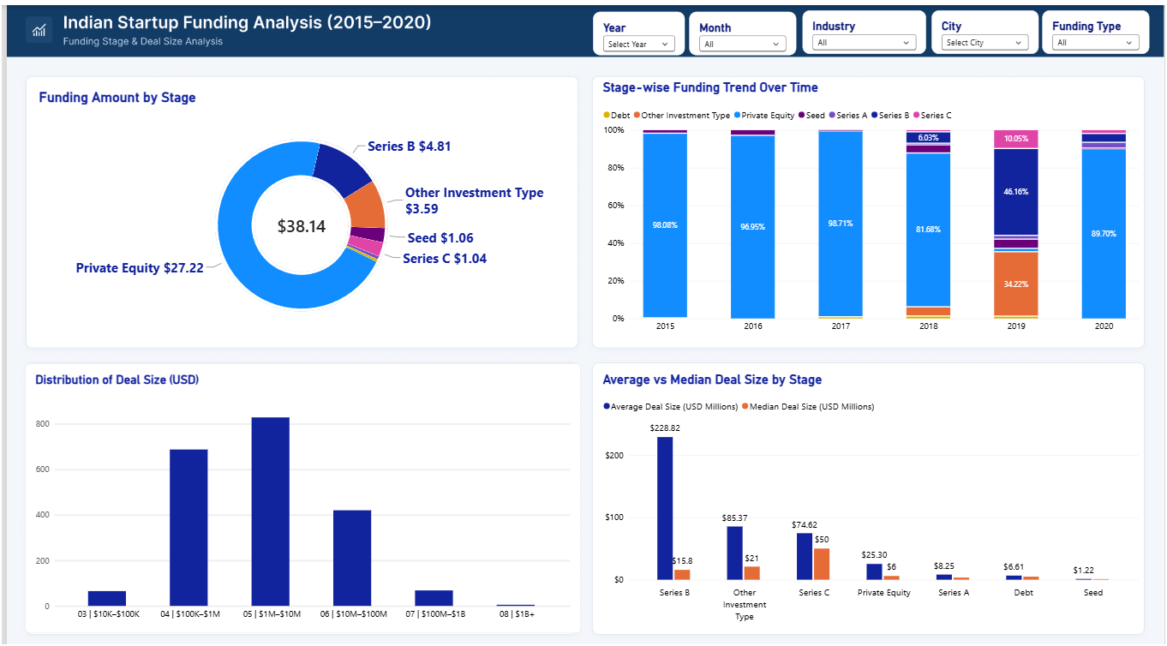
09 / POWER BI IMPLEMENTATION
Dashboards are built; reconciliation is the release gate
Screenshots show the current user-provided build; they are not the calculation source for reported findings.
01 Executive overview
02 Industry, city & investor
03 Stage & deal size
KPI check: CSV count is 73 distinct City labels; screenshot shows 72. Confirm the city-clean measure definition.
City-table totals differ from direct CSV aggregation in at least one row; investor table sort/attribution needs control.
Deal-size order is forced by numeric prefixes. Document the custom Funding Stage mapping and reconcile it to Investment_Type_Clean.
RELEASE GATE
Reconcile totals under identical filters, validate DAX and relationships in Power BI Desktop, then capture refreshed screenshots.
11
SOURCE: CLEANED CSV — RECALCULATED; SQL/PBI RUNTIME NOT INDEPENDENTLY EXECUTED
11
SOURCE: CLEANED CSV — RECALCULATED; SQL/PBI RUNTIME NOT INDEPENDENTLY EXECUTED

Slide 12
10 / DECISION ROADMAP
Make the next version audit-ready before adding complexity.
0–2 DAYS
WEEK 1
WEEK 1–2
WEEK 2–4
Reconcile
Standardize
Model investors
Release with QA
Totals, row counts, city totals, stage totals and slicers match the cleaned CSV.
Publish canonical industry and geography mappings with raw values retained.
Create investor dimension/bridge and approve attribution rules.
Calendar-safe MoM, 2020 partial-period caveat, outlier review, and repeatable refresh tests.
MONITOR EACH REFRESH
FUNDING
ROWS
AMOUNTS
DISCLOSURE
DUPLICATES
OUTLIER
$38.144B
3,044
2,073 / 3,044
68.1%
0
$3.9B max
BOTTOM LINE: disclosed capital is highly concentrated. Trustworthy action depends on source validation, taxonomy governance, and consistent period/attribution logic.
EVIDENCE STATUS: CLEANED CSV RE-CALCULATED; NOTEBOOK/SQL/DAX RUNTIME EXECUTION NOT INDEPENDENTLY COMPLETED
12

