Slide 1
RETENTION RISK ANALYTICS
BANK CUSTOMER
CHURN ANALYSIS
20.38%
HISTORICAL
CHURN RATE
Where historical churn concentrates - and what retention teams should investigate first.
PORTFOLIO PROJECT
Data-led customer segmentation • Executive review
10,000
CUSTOMER RECORDS
2,038
CUSTOMERS EXITED
BANK CUSTOMER CHURN • RETENTION RISK ANALYTICS
01

Slide 2
01 / EXECUTIVE READOUT
02 / 12
A 20.38% historical churn rate masks concentrated segment risk
The dataset identifies where a retention team should investigate first - not why customers left.
10,000
2,038
20.38%
3
CUSTOMER RECORDS
CUSTOMERS EXITED
HISTORICAL CHURN
GEOGRAPHIES
18 source columns
20.38% of file
2,038 / 10,000
France • Germany • Spain
GEOGRAPHY
AGE
Germany has 32.44% churn (814/2,509), about twice France and Spain.
The 50-59 band records 56.04% churn (487/869).
ENGAGEMENT
PRODUCT MIX
Inactive customers: 26.87%; active: 14.27%.
3-4 products show very high rates, but n=266 and n=60 respectively.
INTERPRETATION GUARDRAIL • Historical associations are not proof of causal drivers.
BANK CUSTOMER CHURN • RETENTION RISK ANALYTICS
02

Slide 3
02 / DECISION CONTEXT
03 / 12
The business needs a sharper view of where to investigate churn
A focused segmentation view helps replace broad, untargeted retention activity with evidence-led diagnostics.
THE ANALYSIS SHOULD ANSWER
BUSINESS PROBLEM
01
Where should teams investigate first?
The bank lacks a clear, evidence-led view of which customer profiles and engagement patterns are associated with account exit.
Compare within-segment churn rates and population sizes.
02
What customer patterns deserve review?
Examine geography, age, product count, engagement and balance.
The analysis converts historical customer records into measurable retention segments and identifies where teams should investigate before designing interventions.
03
What can be acted on responsibly?
Separate observed association, hypothesis, cause and tested intervention.
BANK CUSTOMER CHURN • RETENTION RISK ANALYTICS
03

Slide 4
03 / DATA FOUNDATION
04 / 12
The source file is complete for this cross-sectional EDA
10,000 records × 18 columns. The target is Exited (1 = exited, 0 = retained).
10,000
18
0
0
0
ROWS
COLUMNS
MISSING
DUPLICATE ROWS
DUPLICATE CUSTOMER IDs
ANALYTICAL WORKFLOW
01 / AUDIT
02 / EDA
03 / TEST
04 / REVIEW
Schema, target distribution, nulls, duplicates and identifiers.
Within-segment churn rates, counts and descriptive comparisons.
Chi-square and Mann-Whitney tests; effect-size context.
Static SQL logic review and Power BI screenshot audit.
SCOPE LIMIT • No date, event timestamp or defined lead time is supplied. Calendar trends, cohort churn curves and 30/60/90-day prediction cannot be supported.
BANK CUSTOMER CHURN • RETENTION RISK ANALYTICS
04

Slide 5
04 / GEOGRAPHY
05 / 12
Germany's churn rate is nearly double the other two markets
Germany has 814 exits on a base of 2,509; France has 811 exits on a base of 5,014.
Historical churn rate by geography
WHAT THE RATE REVEALS
Germany
32.44%
814 churned / 2,509 customers
814
German customers exited
Spain
16.67%
413 churned / 2,477 customers
France records 811 exits despite a customer base roughly twice as large.
France
16.17%
811 churned / 5,014 customers
Next step: compare German customer mix by age, tenure, products, balance and activity before attributing the gap to a cause.
BANK CUSTOMER CHURN • RETENTION RISK ANALYTICS
05

Slide 6
05 / CUSTOMER PROFILE
06 / 12
Churn peaks in the 50-59 age segment
The segment rate is 56.04% (487 churned out of 869); average age is also higher among exited customers.
Historical churn rate by age group
AVERAGE AGE
56.04%
44.84
Years • churned customers
30.83%
37.41
27.95%
Years • retained customers
10.88%
7.56%
Interpretation: investigate service fit and product needs across older cohorts; age is an association, not a proven cause.
Under 30
30-39
40-49
50-59
60+
n=1,641
n=4,346
n=2,618
n=869
n=526
BANK CUSTOMER CHURN • RETENTION RISK ANALYTICS
06

Slide 7
06 / PRODUCT AND ENGAGEMENT
07 / 12
Product count is uneven; inactivity offers a testable signal
Always pair the extreme rates with their denominators before deciding where to act.
Churn rate by number of products
Churn rate by membership status
1 product
27.71%
Inactive
26.87%
n=5,084
1,303 / 4,849
2 products
7.60%
n=4,590
3 products
82.71%
Active
14.27%
n=266
735 / 5,151
4 products
100.00%
n=60
ACTION • Audit the 3+ product journey; pilot inactivity-based outreach against a comparable control group.
BANK CUSTOMER CHURN • RETENTION RISK ANALYTICS
07

Slide 8
07 / ACCOUNT AND DEMOGRAPHIC PATTERNS
08 / 12
Balance and gender differences merit diagnosis; card type does not
The rates below are historical segment comparisons, not evidence of a causal mechanism.
Balance group
Gender
Card type
Has balance
24.10%
Female
25.07%
Diamond
21.78%
1,538 / 6,383
1,139 / 4,543
546 / 2,507
Platinum
20.36%
508 / 2,495
Zero balance
13.82%
Male
16.47%
Silver
20.11%
500 / 3,617
899 / 5,457
502 / 2,496
Gold
19.26%
482 / 2,502
STATISTICAL CHECK • Gender association: p < 0.001. Card type: p = 0.168 (not significant at 0.05). Avoid over-interpreting card-type differences.
BANK CUSTOMER CHURN • RETENTION RISK ANALYTICS
08

Slide 9
08 / EVIDENCE GUARDRAILS
09 / 12
Not every visible difference is a usable churn signal
Statistical significance, feature timing and sample design determine what can be interpreted responsibly.
NO SIGNIFICANT SIGNAL
LEAKAGE WARNING
Satisfaction score
Complaint status ≈ outcome
Rates range from 19.64% to 21.80%; chi-square p = 0.433.
2,034 of 2,044 complaint-flagged customers exited (99.51%); correlation with Exited = 0.9957.
MODEL / FORECASTING STATUS
Do not present the legacy model scores as validated results.
The attached EDA notebook explicitly excludes machine learning and has no saved outputs. Model scores in the separate brief are historical context only. No event timestamps or forecasting lead time exist in the CSV.
BANK CUSTOMER CHURN • RETENTION RISK ANALYTICS
09

Slide 10
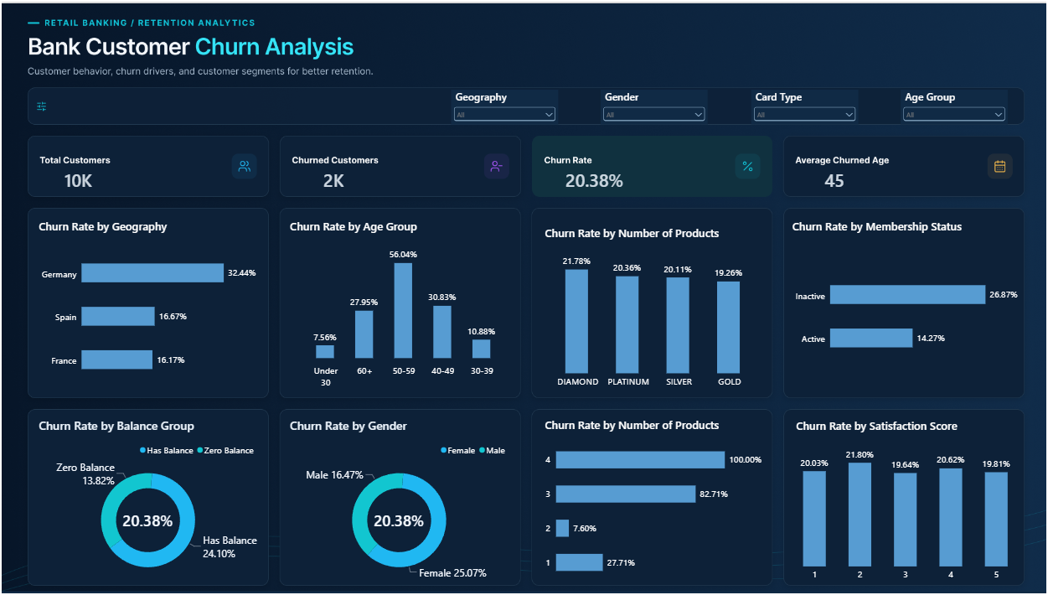
09 / POWER BI REVIEW
10 / 12
The current dashboard is close; tighten labels and encodings before submission
The screenshot is visually inspected; the underlying PBIX/DAX was not independently executed.
KEEP
Geography slicer
Gender slicer
Card Type slicer
Age Group slicer
FIX BEFORE SUBMISSION
Rename the Diamond/Platinum/Silver/Gold panel to 'Churn Rate by Card Type'.
Sort age bands chronologically.
Replace rate donuts with bars or clarify their denominator.
Show exact KPI values and add Reset Filters.
USER-SUPPLIED DASHBOARD SCREENSHOT
BANK CUSTOMER CHURN • RETENTION RISK ANALYTICS
10

Slide 11
10 / RECOMMENDED ACTION PLAN
11 / 12
Move from segment discovery to controlled retention tests
Prioritize the actions by evidence strength, sample size and ability to measure incremental impact.
01
Germany diagnostic
Compare geography after adjusting for age, tenure, product count, balance and activity mix.
Retention + Regional Banking
02
Multi-product journey review
Audit onboarding, bundling and servicing for 3+ product customers; begin with a focused sample.
Product + CX
03
Inactivity pilot
Test re-engagement with a control group; separate customers who still hold a balance.
CRM / Retention
04
Segment context
Review balance and gender differences using product mix, service experience and customer feedback.
Analytics + Risk
05
Data governance
Establish event timing, leakage controls and cohort validation before predictive use.
Data + Model Risk
BANK CUSTOMER CHURN • RETENTION RISK ANALYTICS
11

Slide 12
11 / MONITORING AND CLOSE
12 / 12
Measure incremental retention - not activity volume alone
The next decision should follow controlled evidence, not an untested segment label.
SUCCESS MEASURES
MANAGEMENT TAKEAWAY
Retention impact
Churn change vs. a comparable control group
Investigate.
Test.
Validate.
Targeting precision
Share of contacted customers who churn
Coverage
Churners reached at available outreach capacity
Efficiency
Churners identified per 100 outreach attempts
Commercial value
Retained value net of incentives and contact cost
Investigate high-rate segments with customer-mix controls. Test interventions against a control group. Validate timing and data quality before any predictive deployment.
Governance
Calibration, drift, fairness and segment performance
Evidence-led retention starts with the right questions - not the loudest chart.
BANK CUSTOMER CHURN • RETENTION RISK ANALYTICS
12

