Slide 1
BUSINESS ANALYTICS / MANAGEMENT REPORT
Retail Sales
Intelligence Platform
Global Superstore | 2011–2014
A data-led view of sales, profitability, customers, products and regional performance.
ANALYSIS BUILT FROM THE SUPPLIED CSV + PYTHON + SQL + POWER BI EVIDENCE
RETAIL SALES INTELLIGENCE • GLOBAL SUPERSTORE • 2011–2014
01

Slide 2
01 / EXECUTIVE READOUT
Growth is strong; margin discipline is the next management question
Verified baseline recalculated from the supplied cleaned CSV.
Total sales
Total profit
Profit margin
Orders
Customers
$12.64M
$1.47M
11.61%
25,035
1,590
Sales grew from $2.26M in 2011 to $4.30M in 2014; profit rose each year.
Technology leads category sales and profit; Central leads regional sales and profit; Consumer is the largest segment.
Profitability varies sharply by sub-category, product and discount level; investigate weak-margin combinations before changing policy.
1,580 of 1,590 customers placed more than one distinct order in the full dataset (99.37% repeat-customer rate).
RETAIL SALES INTELLIGENCE • GLOBAL SUPERSTORE • 2011–2014
02

Slide 3
02 / BUSINESS FRAMING
The project tests how revenue converts into profit
Scope follows the supplied Business Problem Brief.
DECISION TO SUPPORT
ANALYTICAL LENS
EVIDENCE STANDARD
Where to focus
Sales → profit
No causal leap
Product • customer • region • pricing
Volume • margin • mix • time
Patterns are not proven root causes
Build a consistent baseline for sales, profit, distinct orders, customers and average order value.
Compare performance across product/category, customer segment, geography and time.
Identify loss-making products and examine discount and shipping-cost patterns.
Translate validated findings into prioritized management actions and measurable monitoring.
RETAIL SALES INTELLIGENCE • GLOBAL SUPERSTORE • 2011–2014
03

Slide 4
03 / DATA & CONTROLS
The CSV is the current calculation baseline; database reconciliation remains open
Source: supplied clean_global_superstore CSV and notebook.
Rows / fields
Exact duplicate rows
Missing postal codes
Date coverage
51,290 / 24
0
41,296
2011–2014
80.5% of records
No missing values were found in the other 23 columns of the supplied CSV.
The notebook converts order/ship dates, checks duplicates, standardizes column names and exports a clean CSV.
MySQL execution is not validated: the reported error 1146 says projectdata.global_superstore does not exist.
The business brief flags differing totals between CSV and SQL screenshots; publish only one reconciled baseline.
RETAIL SALES INTELLIGENCE • GLOBAL SUPERSTORE • 2011–2014
04

Slide 5
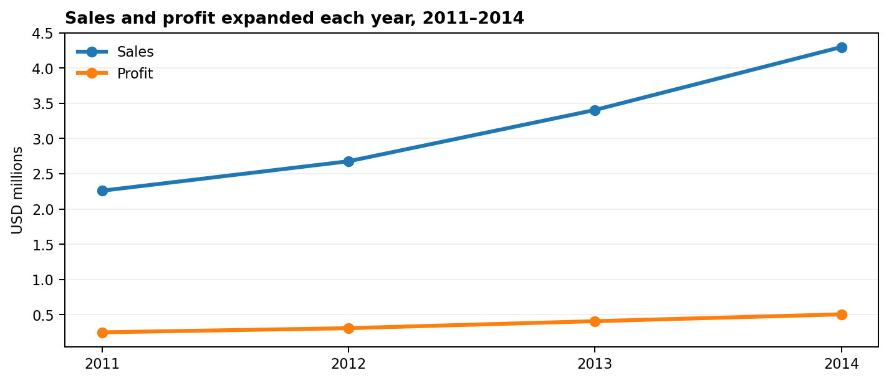
04 / TIME PERFORMANCE
Sales and profit increased in every year of the observed period
Annual totals and year-over-year change calculated from the CSV.
Year | Sales | Profit | Sales YoY
2011 | $2.26M | $249K | —
2012 | $2.68M | $307K | 18.5%
2013 | $3.41M | $407K | 27.2%
2014 | $4.30M | $504K | 26.3%
2014 closed at $4.30M sales and $504.2K profit. Sales growth moderated slightly in 2014 versus 2013, while profit growth also eased.
RETAIL SALES INTELLIGENCE • GLOBAL SUPERSTORE • 2011–2014
05

Slide 6
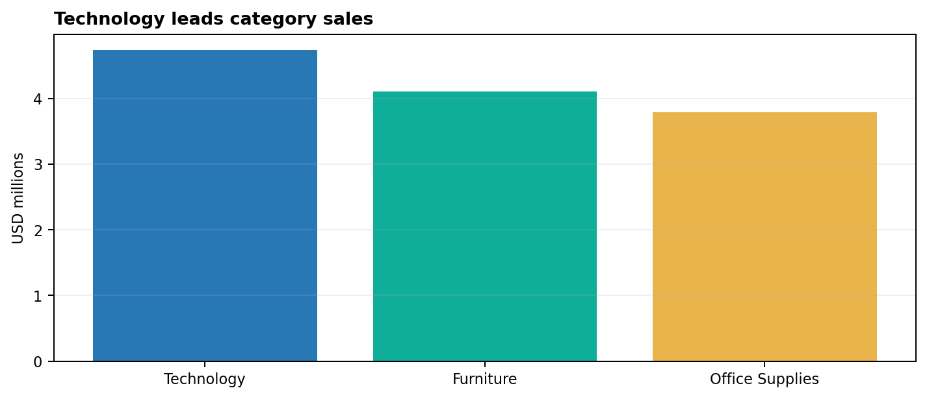
05 / PRODUCT ECONOMICS
Technology leads both revenue and profit; Furniture has the weakest category margin
Category totals aggregated from transaction lines.
Category | Sales | Profit | Margin
Technology | $4.74M | $664K | 13.99%
Furniture | $4.11M | $285K | 6.94%
Office Supplies | $3.79M | $518K | 13.69%
Technology margin: 13.99%. Furniture margin: 6.94%.
RETAIL SALES INTELLIGENCE • GLOBAL SUPERSTORE • 2011–2014
06

Slide 7
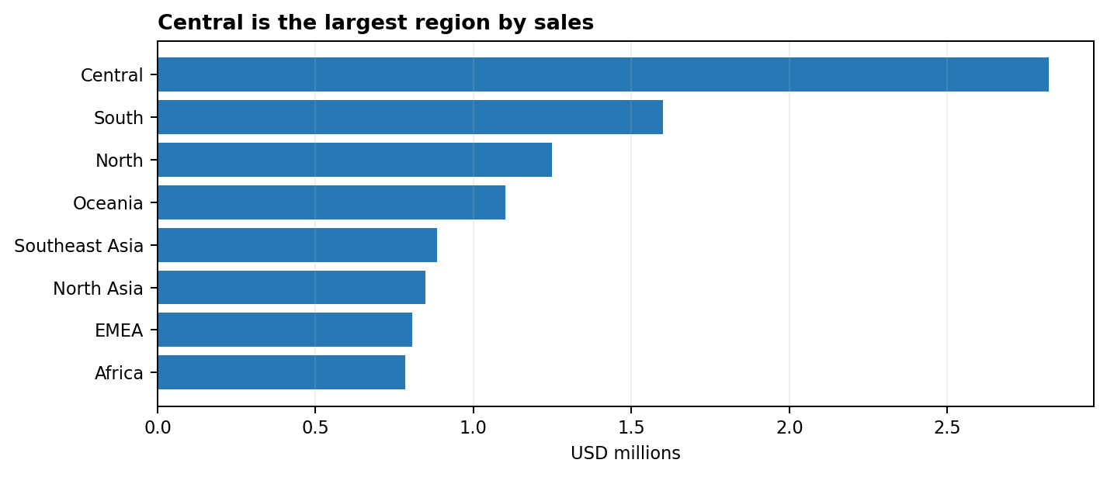
06 / GEOGRAPHIC PERFORMANCE
Central is the largest region by both sales and profit
Regional totals are descriptive and should be read alongside market and product mix.
Region | Sales | Profit | Margin
Central | $2.82M | $311K | 11.0%
South | $1.60M | $140K | 8.8%
North | $1.25M | $195K | 15.6%
Oceania | $1.10M | $120K | 10.9%
Southeast Asia | $0.88M | $18K | 2.0%
North Asia | $0.85M | $166K | 19.5%
EMEA | $0.81M | $44K | 5.4%
Southeast Asia generated $0.88M sales but only $17.9K profit (2.02% margin)—a clear investigation candidate.
RETAIL SALES INTELLIGENCE • GLOBAL SUPERSTORE • 2011–2014
07

Slide 8
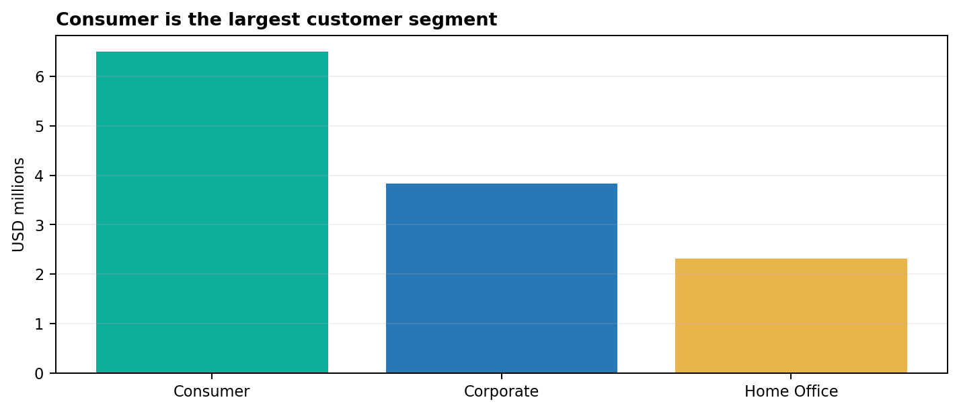
07 / CUSTOMER PERFORMANCE
Consumer contributes the largest segment; repeat rate is high under the stated definition
Repeat = more than one distinct Order_ID per Customer_ID across the full 2011–2014 file.
Repeat customers
Repeat rate
1,580
99.37%
Top sales customer | Sales | Orders
Tom Ashbrook | $35,668 | 25
Greg Tran | $34,472 | 30
Tamara Chand | $34,218 | 28
Sean Miller | $31,125 | 21
Bart Watters | $30,614 | 35
Full-period repeat rate is not a cohort retention metric; calculate it by acquisition/first-order cohort before using it to evaluate retention programs.
RETAIL SALES INTELLIGENCE • GLOBAL SUPERSTORE • 2011–2014
08

Slide 9
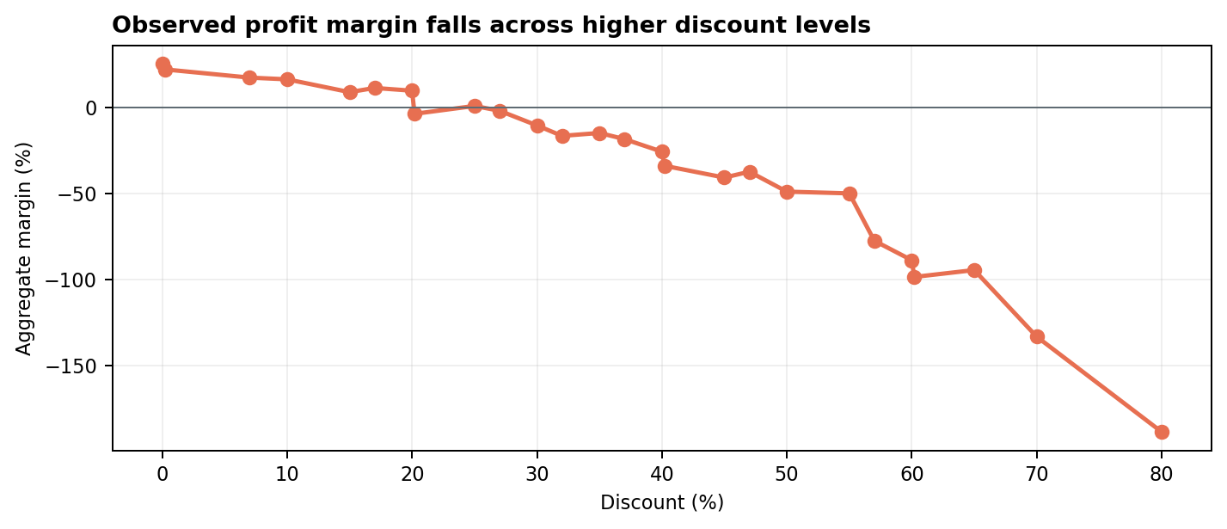
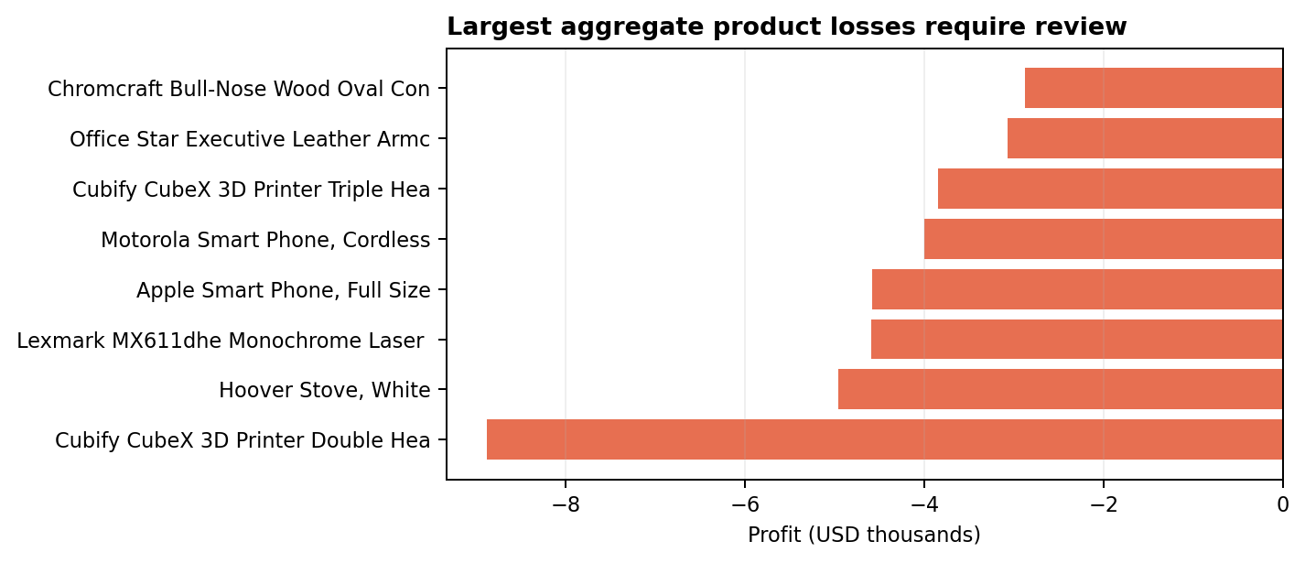
08 / MARGIN RISK
Higher discount bands show weaker aggregate margins; several products are net loss-making
These are associations in grouped data, not proof of discount causation.
Example: the 40% discount group recorded a -25.69% aggregate margin; the 70% group recorded -133.32%. Review sample sizes, product mix and transaction-level costs before setting discount rules.
RETAIL SALES INTELLIGENCE • GLOBAL SUPERSTORE • 2011–2014
09

Slide 10
09 / FULFILMENT
Shipping modes differ in order volume, elapsed days and shipping cost
Average elapsed calendar days = Ship_Date minus Order_Date.
Ship mode | Orders | Sales | Profit | Avg days | Shipping cost
First Class | 3,821 | $1.83M | $208K | 2.18 | $308K
Same Day | 1,347 | $0.67M | $76K | 0.04 | $116K
Second Class | 5,119 | $2.57M | $293K | 3.23 | $314K
Standard Class | 15,154 | $7.58M | $891K | 5.00 | $615K
Standard Class represents the largest order volume (15,154) and averages 5.00 elapsed days.
Same Day averages 0.04 elapsed calendar days; date-only fields cannot measure intraday service time.
Use mode-level comparisons for monitoring, not to infer service quality or cost causality.
RETAIL SALES INTELLIGENCE • GLOBAL SUPERSTORE • 2011–2014
10

Slide 11
10 / MANAGEMENT ACTION PLAN
Prioritize margin visibility and data reconciliation before intervention
Actions are proposed; no financial benefit is claimed.
Priority | Workstream | Monitor | Next step
1 • High | Discount guardrails | Margin by discount band; loss lines | Test thresholds by product/category and validate mix.
2 • High | Loss-product review | Product profit, margin, units | Review the 2,892 negative-profit products and top loss items.
3 • High | Category/region drill-down | Category × region margin | Investigate Furniture and low-margin regional combinations.
4 • High | Reconcile data model | Rows, sales, profit, orders, customers | Match Power BI and MySQL to the CSV baseline.
5 • Medium | Customer cohort view | Repeat rate by cohort; profit/customer | Move beyond full-period repeat rate to cohort retention.
6 • Medium | Shipping scorecard | Avg days; cost/order; profit | Monitor service and shipping economics by ship mode.
RETAIL SALES INTELLIGENCE • GLOBAL SUPERSTORE • 2011–2014
11

Slide 12
11 / CLOSE & VALIDATION GATE
A trusted performance baseline is the first deliverable.
CSV baseline has been recalculated and is internally consistent for the metrics reported.
MySQL remains unexecuted because the referenced table is not found; import/rename and rerun the SQL checks.
Power BI screenshots show rounded values and some measures that must be reconciled to the same CSV baseline.
The dataset supports descriptive analysis, not causal proof of why discounts, shipping or product outcomes occur.
RECOMMENDED NEXT STEP: reconcile the source table and Power BI model, then publish a single governed KPI baseline.
RETAIL SALES INTELLIGENCE • GLOBAL SUPERSTORE • 2011–2014
12

Slide 13
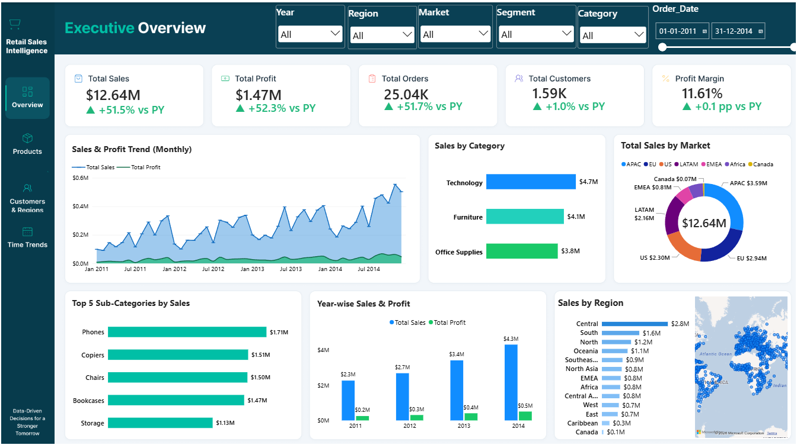
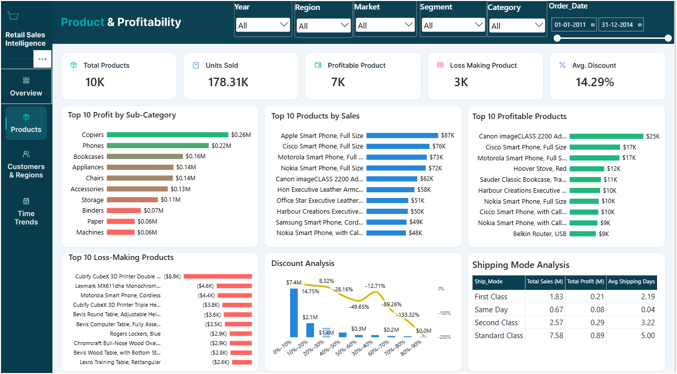
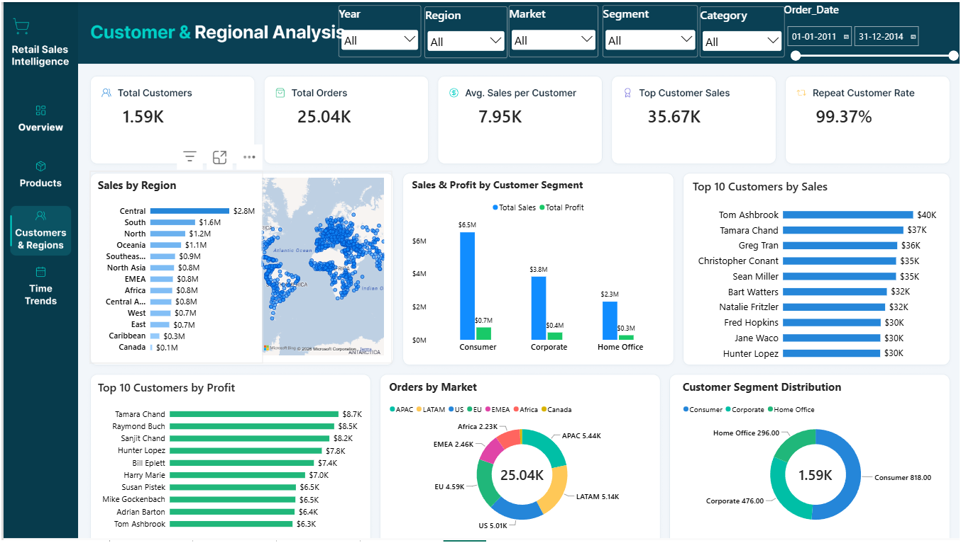
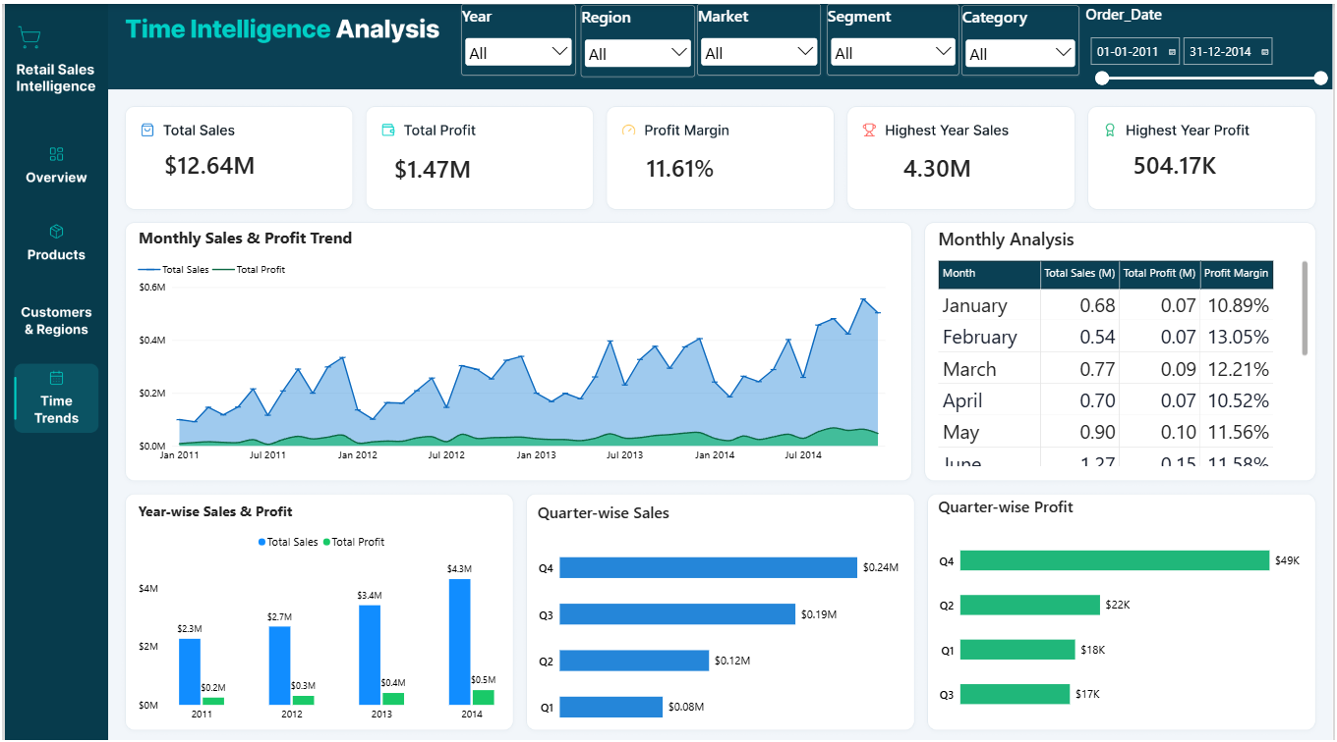
APPENDIX / POWER BI EVIDENCE
Four dashboard pages supplied for review
Screenshots are retained as supplied; visual values are not treated as independently validated unless reconciled to the CSV.
Retail Sales Intelligence • Global Superstore • 2011–2014
13

