Slide 1
OPERATIONS INTELLIGENCE / BUSINESS ANALYTICS
FROM SIGNAL TO ACTION
DELIVERY IS
THE CUSTOMER
EXPERIENCE.
A validated
operating baseline
Olist E-commerce Fulfilment & Delivery
Performance Analysis
A management-ready view of service reliability, review outcomes, regional exposure and freight economics.
9 cleaned tables • 25 purchase months
8.11%
OF ELIGIBLE DELIVERIES ARRIVED LATE
7,826 LATE ORDERS / 96,470 ELIGIBLE
OLIST BRAZILIAN E-COMMERCE | SOURCE WINDOW: SEP 2016 – OCT 2018
06 NOVEMBER 2026

Slide 2
01 / EXECUTIVE READOUT
The majority meet the promise — but 7,826 orders do not.
Validated from the nine cleaned CSVs; delivery cohort uses only eligible delivered orders.
96,470
7,826
12.56 d
1.73 pts
Eligible delivered orders
Late delivered orders
Average delivery time
Review score gap
96,478 delivered in source
8.11% of eligible
Purchase to customer receipt
4.29 on-time/early vs 2.57 late
WHAT THE EVIDENCE SAYS
MANAGEMENT PRIORITY
91.89% of eligible delivered orders arrived on or before the estimated date.
Investigate regional and carrier-level drivers before committing to process fixes or quantified benefits.
Late deliveries averaged 9.55 days beyond estimate and 31.52 days from purchase to receipt.
Late delivery is associated with lower order-level review scores; causality is not established.
Start with RJ and BA; retain order volume as context.
OLIST E-COMMERCE / FULFILMENT & DELIVERY PERFORMANCE
02

Slide 3
02 / BUSINESS PROBLEM
Where do delivery, freight and experience outcomes diverge?
The project is a diagnostic: it locates variation and creates a shortlist for operational investigation.
THE BUSINESS QUESTION
ANALYTICAL QUESTIONS
What factors are associated with late delivery, freight cost variation and customer review scores?
01
How many eligible delivered orders were late?
02
How does review score vary by delivery outcome and delay band?
03
Which customer states combine elevated late rates with meaningful volume?
A consistent view across customers, sellers, regions, product categories and order outcomes.
Where do freight cost and seller activity concentrate?
04
Observed pattern ≠ verified root cause.
OLIST E-COMMERCE / FULFILMENT & DELIVERY PERFORMANCE
03

Slide 4
03 / DATA & METHOD
Nine natural-grain tables; one controlled analytical workflow.
The SQL model aggregates one-to-many tables before order-level analysis and retains item grain for category / seller views.
ORDERS
CUSTOMERS
ORDER ITEMS
99,441
order grain
99,441
customer grain
112,650
order-line grain
PAYMENTS
REVIEWS
PRODUCTS
103,886
payment-sequence grain
99,224
review-record grain
32,951
product grain
SELLERS
GEOLOCATION
CATEGORY MAP
3,095
seller grain
19,015
ZIP-prefix lookup
71
category mapping
01
PROFILE
02
CLEAN + DERIVE
03
AGGREGATE SAFELY
04
EDA + SQL
05
POWER BI
569,774 total rows across all nine cleaned tables; row counts vary by table and must not be repeated as one grand total.
OLIST E-COMMERCE / FULFILMENT & DELIVERY PERFORMANCE
04

Slide 5
04 / DATA QUALITY
Core keys and joins pass; two audit visuals need repair.
Independent checks on uploaded tables; tested relationships only, not a blanket model certification.
0
0
99.99%
98.11%
99.72%
Candidate-key duplicates
Tested orphan rows
Delivery date coverage
Product category mapped
Customer ZIP match
Four primary-key candidates
Orders / items core joins
96,470 of 96,478 delivered
Product-row coverage
ZIP-prefix lookup
SOURCE TABLE COUNTS — CORRECT VALUES
POWER BI AUDIT FIXES
Orders
Order items
Payments
“Total Orders 113K” is order-item count. Unique orders = 99,441.
99,441
112,650
103,886
Reviews
Customers
Products
Row-count chart repeats the 569,774 grand total; use per-table row measures.
99,224
99,441
32,951
Sellers
Geolocation
Category map
Missing-value chart repeats one 0.15M aggregate; calculate nulls by table / column.
3,095
19,015
71
Optional review comments may be blank; review_score is complete.
OLIST E-COMMERCE / FULFILMENT & DELIVERY PERFORMANCE
05

Slide 6
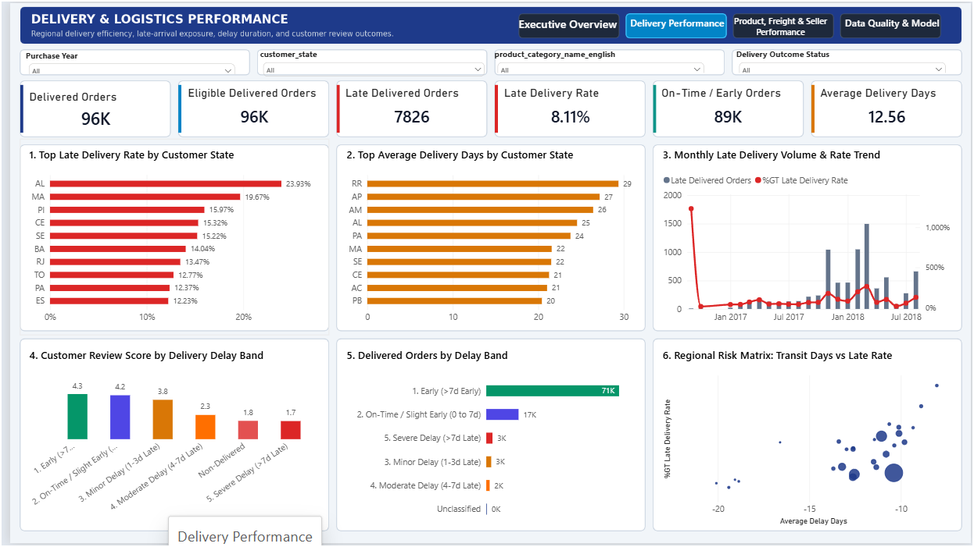
05 / DELIVERY RELIABILITY
8.11% of eligible deliveries were late; 91.89% met or beat the estimate.
Eligible = delivered orders with valid purchase, actual-delivery and estimated-delivery timestamps.
88,644 on time / early
7,826 late
12.56 d
-11.18 d
Avg delivery time
Avg delay vs. estimate
Negative = early on average
WHAT THE MEAN HIDES
Late orders averaged 9.55 days after the estimated delivery date.
The all-cohort mean delay is negative because the large on-time/early group was delivered ahead of estimate.
Screenshot supplied; headline KPI independently checked.
OLIST E-COMMERCE / FULFILMENT & DELIVERY PERFORMANCE
06

Slide 7
06 / CUSTOMER EXPERIENCE
Late orders score 1.73 points lower on average.
Order-level mean review score; cohorts include only eligible delivered orders with review data.
AVERAGE REVIEW SCORE / 5
INTERPRETATION
A large, consistent score gap makes delivery reliability a customer-experience KPI.
4.29
2.57
The data is observational. Reviews may also reflect product, seller, communication and other fulfilment factors.
ON TIME / EARLY
LATE
Do not describe the gap as a causal impact.
88,163 orders with reviews
7,661 orders with reviews
OLIST E-COMMERCE / FULFILMENT & DELIVERY PERFORMANCE
07

Slide 8
07 / REGIONAL EXPOSURE
Prioritise high-rate regions where the order base is material.
Rates below are calculated at customer-state / eligible-order grain; every comparison carries its sample count.
SCALE-AWARE PRIORITIES
AL
23.9% n=397
RJ
MA
19.7% n=717
13.47% late • 12,350 eligible
PI
16.0% n=476
CE
15.3% n=1,279
BA
14.04% late • 3,256 eligible
SE
15.2% n=335
BA
14.0% n=3,256
AL / MA
RJ
13.5% n=12,350
Highest displayed rates, but smaller samples: 397 and 717 eligible orders.
SP
5.9% n=40,494
Use volume + rate; do not rank on % alone.
OLIST E-COMMERCE / FULFILMENT & DELIVERY PERFORMANCE
08

Slide 9
08 / FREIGHT & SELLER NETWORK
Freight economics vary by category; seller item volume is concentrated.
Freight headline KPIs use all order items; category deep-dive uses delivered items with at least 100 item rows.
2.252M
19.99
16.57%
71.32%
48.57
Total freight
Average freight / item
Freight / item sales
SP seller item share
Top avg freight / item
All 112,650 order items
All order items
Total freight ÷ total item price
80,342 of 112,650 items
Computers; 199 delivered items
HIGHER AVERAGE FREIGHT / DELIVERED ITEM
SELLER-STATE ITEM VOLUME SHARE
Computers
48.6 n=199
SP
71.3% n=80,342
MG
7.8% n=8,827
Home appliances 2
44.4 n=231
PR
7.7% n=8,671
Office furniture
40.2 n=1,668
RJ
4.3% n=4,818
SC
3.6% n=4,075
Category average freight is not a profit/margin measure. Validate weight, dimensional weight, packaging, route and tariff before proposing pricing changes.
OLIST E-COMMERCE / FULFILMENT & DELIVERY PERFORMANCE
09

Slide 10
09 / ROOT-CAUSE BOUNDARY
The dataset shows where to look — not why delays happen.
Separate observed facts from hypotheses; instrument missing process events before attributing cause.
CONFIRMED SIGNALS
HYPOTHESES TO TEST
EVIDENCE STILL NEEDED
8.11% of eligible delivered orders were late.
Carrier transit performance or service mix.
Carrier ID, service level and route / distance.
Late orders averaged 9.55 days beyond estimate.
Seller dispatch / handover delays.
Pick-pack, dispatch and first-scan timestamps.
State, category and seller-side volumes differ.
Route distance, transfer nodes or ETA promise accuracy.
Delivery attempts, exceptions and returns.
Packaging or dimensional-weight complexity.
Stock availability and promise-date history.
Decision rule: do not report a root cause or savings estimate until the missing process data and a causal validation design exist.
OLIST E-COMMERCE / FULFILMENT & DELIVERY PERFORMANCE
10

Slide 11
10 / ACTION PLAN
A 90-day plan to turn insight into operational evidence.
Suggested functions are proposed owners; no individual owners were supplied in the source material.
0–30 DAYS
31–60 DAYS
61–90 DAYS
Baseline + data repair
Regional + carrier diagnostic
Intervention design
Lock late-rate denominator and review-score grain.
Start with RJ and BA; include SP as volume comparator.
Select a measurable route / carrier pilot.
Correct order vs item KPI label.
Add carrier, seller, route and dispatch segmentation.
Define alert point before promised delivery date.
Fix per-table row / null audit measures.
Validate AL / MA with sample sizes.
Establish comparison group and baseline.
Publish a weekly service scorecard.
Review category freight against weight and tariff.
Specify data needed for a future risk model.
PROPOSED OWNER
PROPOSED OWNER
PROPOSED OWNER
BI / Data Analytics + Fulfilment Ops
Logistics / Carrier Management + Ops Analytics
Operations + Data Science / BI
OLIST E-COMMERCE / FULFILMENT & DELIVERY PERFORMANCE
11

Slide 12
11 / CONCLUSION + MANAGEMENT DECISION
Make the baseline
consistent. Then find
the cause.
DECISION REQUEST
Approve a focused regional and carrier / dispatch diagnostic.
8.11%
validated late-delivery baseline
The evidence points to a specific late-delivery cohort, a clear review-score association and regional / seller / freight segments worth investigating.
No causal claim. No savings promise. A clear next diagnostic step backed by reproducible evidence.
OLIST BRAZILIAN E-COMMERCE / SEP 2016 – OCT 2018 / PYTHON + SQLITE + POWER BI
12

