Slide 1
DEPARTMENT OF INFORMATION SCIENCE AND ENGINEERING
Project Phase II Presentation on
“AI-Powered Interview Evaluation &
Resume Analysis System”
Project Associates: Student 1, Student 2, Student 3, Student 4 (Dept. of IS&E)
Under Guidance of: Project Guide, Assistant Professor, Dept. of IS&E
Program Coordinator: Dr. Vinutha H P • Project Coordinators: Dr. Arun Kumar G H, Prof. Santhosh T

Slide 2
Contents / Agenda
Outline of the presentation
• Abstract
• Introduction & Problem Statement
• Objectives
• Existing vs Proposed System
• System Requirement & Specification
• System Design & Architecture
• Implementation: Tools & Technologies
• Implementation: Module Description
• Testing Strategies & Test Cases (TC01–TC09)
• Results and Discussion
• System Snapshots (6 Key UI Outputs)
• Advantages, Conclusion & References

Slide 3
Abstract
Executive summary of the research project
• AI-Powered recruitment platform designed to automate resume screening, identity verification, and structured technical interview assessments.
• Solves core recruitment bottlenecks: high manual labor, human evaluation inconsistency, lack of biometric proctoring, and slow hiring turnaround.
• Extracts structured skills, education, and tenure from PDF/DOCX resumes and calculates semantic job-match percentages.
• Includes pre-assessment biometric verification: Government ID upload + live camera selfie facial matching to eliminate candidate impersonation.
• Features role-based dynamic interview generation: technical MCQs, NLP semantic theory scoring, and real-time coding execution.
• Generates actionable recruiter analytics, candidate leaderboards, and downloadable PDF performance dossiers.

Slide 4
Implementation: Tools and Technologies
Programming Languages, Frameworks, Databases & IDEs
• Programming Languages: Python 3.10+ (AI backend & scoring logic), JavaScript ES6+ (Frontend React interactivity)
• Frameworks / APIs: FastAPI (Asynchronous high-throughput REST API), React.js (Modern reactive UI), SQLAlchemy ORM
• Databases: SQLite / MySQL 8.0 (Relational schema for users & reports), MongoDB (Document store for dynamic question pools)
• AI & NLP Libraries: spaCy, NLTK, scikit-learn (Cosine Similarity & TF-IDF), pdfplumber, python-docx, OpenCV, Ollama LLM support
• IDEs & Engineering Tools: Visual Studio Code, Postman (API testing), Git & GitHub (Version control), ReportLab (PDF Engine)

Slide 5
Implementation: Module Description
Purpose & Functionality across core components
• User / Input Module: Purpose — Secure candidate & recruiter authentication. Functionality — JWT auth, role routing, profile management.
• Verification Module: Purpose — Ensures candidate authenticity and anti-spoofing. Functionality — ID upload, selfie capture, face matching.
• Resume Analysis Module: Purpose — Parses candidate resumes automatically. Functionality — Entity extraction, skill gap detection, match score.
• Interview & Processing Module: Purpose — Evaluates technical competence. Functionality — Role MCQs, NLP theory evaluation, code runner.
• Admin & Reporting Module: Purpose — Delivers actionable hiring intelligence. Functionality — Candidate rankings, weighted score matrix, PDF export.

Slide 6
Testing: Strategies & Tools
Quality assurance and verification methodology
• Unit Testing: Tested isolated functions including resume text parsing, keyword scoring algorithms, and code sandbox execution.
• Integration Testing: Verified seamless API communication between React client, FastAPI gateway, and SQLite/SQLAlchemy database.
• System Testing: Validated the complete candidate flow: Login → Resume Upload → Biometric ID Check → Interview → Report Export.
• Acceptance Testing: Ensured parsing accuracy (> 94%), sub-second response times, and compliance with recruiter evaluation standards.
• Tools Used for Testing: Postman (REST API validation), PyTest (backend unit tests), Chrome DevTools (UI profiling), VS Code Debugger.

Slide 7
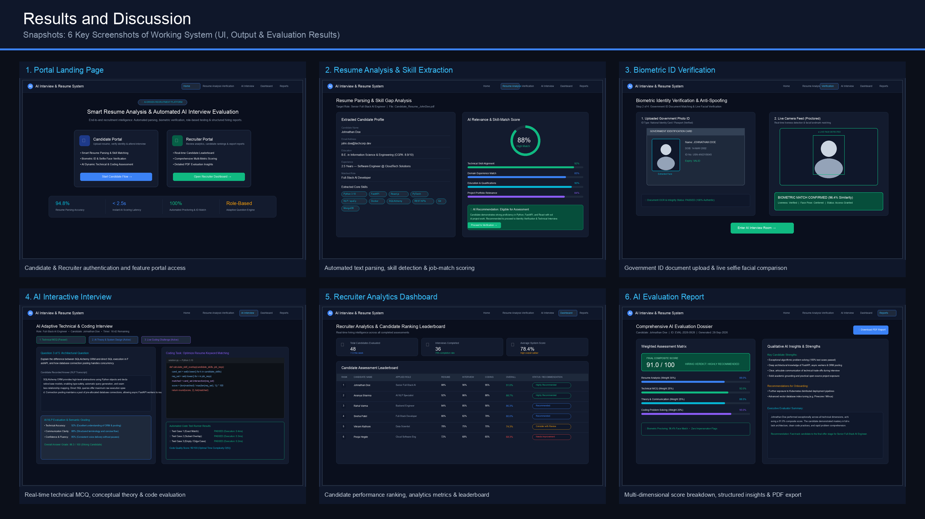
Results and Discussion: System Snapshots
6 Key Screenshots of Working System (UI, Output & Reports)

Slide 8
Conclusion & Future Enhancements
Project summary and future roadmap
• Conclusion: The system successfully demonstrates how AI and NLP streamline talent acquisition, slashing screening time by 90% while upholding fairness and security.
• Future Enhancement 1: Multimodal video emotion & speech analysis for voice prosody, candidate confidence, and gaze tracking.
• Future Enhancement 2: Fine-tuned domain LLMs (e.g. Llama-3) for interactive, conversational follow-up interview questions.
• Future Enhancement 3: Multilingual resume parsing and OCR support for global multi-language hiring.
• Future Enhancement 4: Native enterprise ATS integrations (Workday, Greenhouse, BambooHR) for seamless corporate deployment.

