Slide 1
AI-Powered Interview Evaluation & Resume Analysis System
Final Year Project Presentation

Slide 2
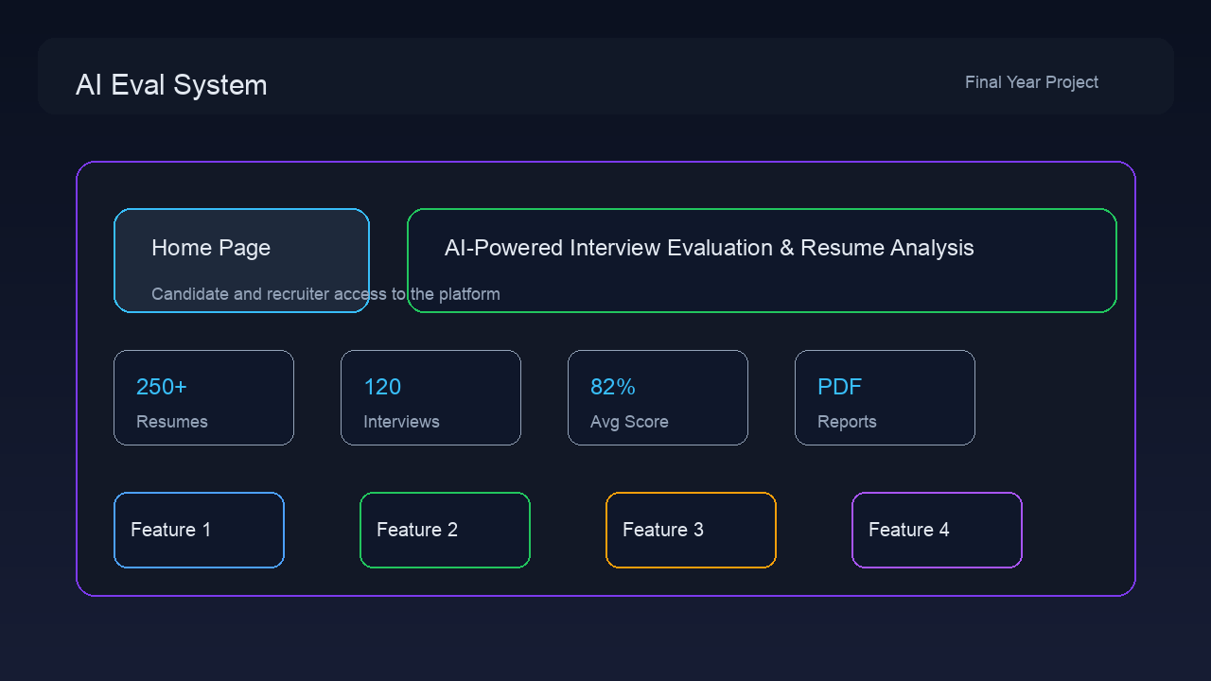
Abstract
Project overview and motivation
AI-Powered Interview Evaluation & Resume Analysis System

Slide 3
Introduction
Problem context and solution summary
AI-Powered Interview Evaluation & Resume Analysis System

Slide 4

Literature Survey
Related research and existing systems
AI-Powered Interview Evaluation & Resume Analysis System

Slide 5
Existing System & Proposed System
Manual process versus AI-driven system
AI-Powered Interview Evaluation & Resume Analysis System

Slide 6
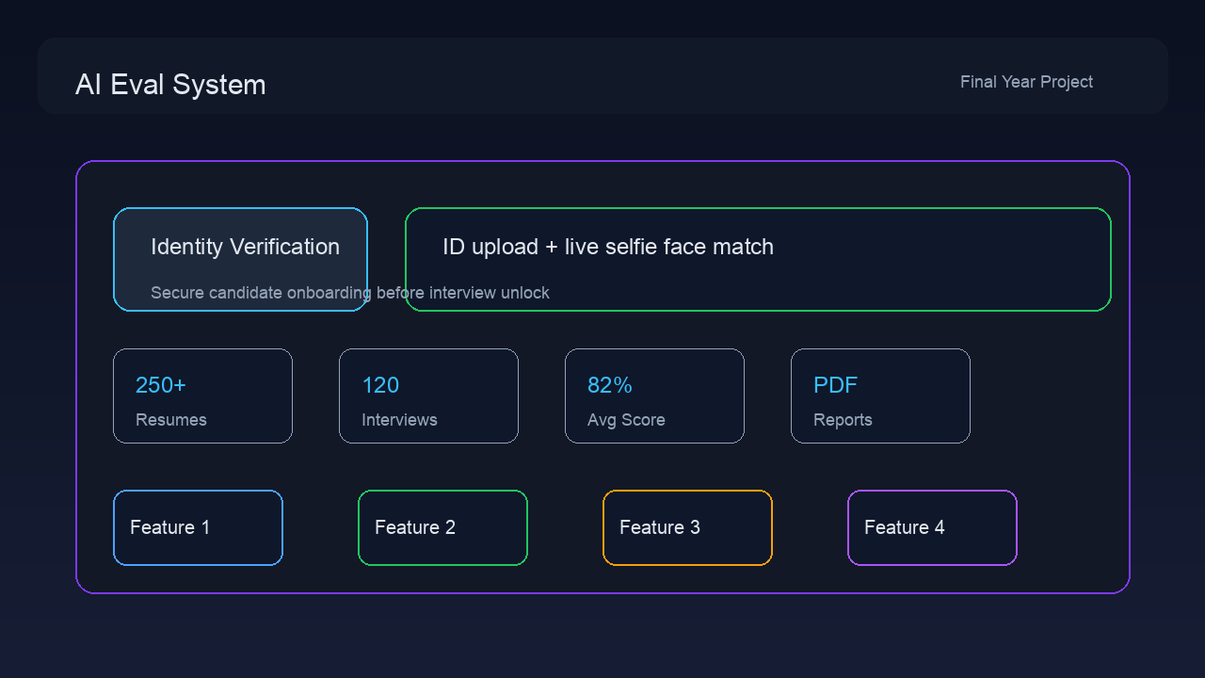
Problem Statement
Challenges in recruitment and evaluation
AI-Powered Interview Evaluation & Resume Analysis System

Slide 7
Objectives
Main goals of the project
AI-Powered Interview Evaluation & Resume Analysis System

Slide 8
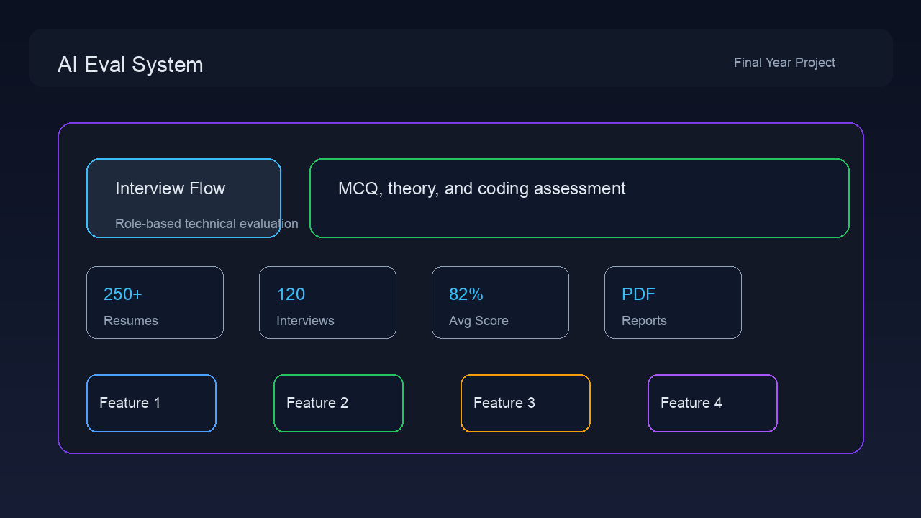
System Requirement & Specification
Functional and non-functional requirements
AI-Powered Interview Evaluation & Resume Analysis System

Slide 9
System Design
Architecture, diagrams, and application flow
AI-Powered Interview Evaluation & Resume Analysis System

Slide 10
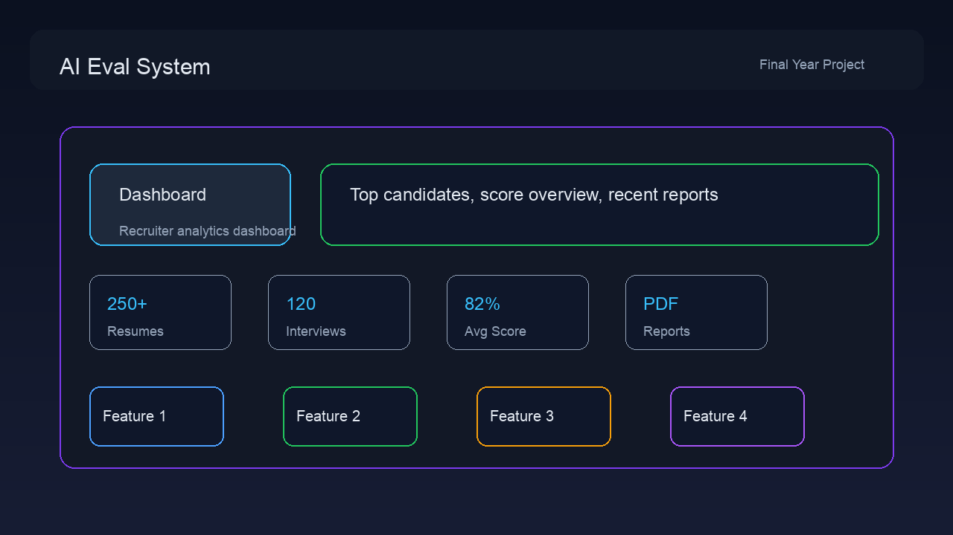
Implementation
Technology stack and project modules
AI-Powered Interview Evaluation & Resume Analysis System

Slide 11
Testing
Validation strategy and test cases
AI-Powered Interview Evaluation & Resume Analysis System

Slide 12

Results and Discussion
Working system results and findings
AI-Powered Interview Evaluation & Resume Analysis System

Slide 13
Advantages & Disadvantages
Strengths and limitations
AI-Powered Interview Evaluation & Resume Analysis System

Slide 14
Conclusion
Summary of project impact
AI-Powered Interview Evaluation & Resume Analysis System

Slide 15
Future Enhancements
Scalability and future improvements
AI-Powered Interview Evaluation & Resume Analysis System

Slide 16
References
Supporting sources and references
AI-Powered Interview Evaluation & Resume Analysis System

