Slide 1

WIPRO NGA Program – 25SUB4505_5 G Developer
Capstone Project Presentation – 13th Feb 2026
Project Title Here – SMF PDU Session Establishment
Presented by – Group (03)
www.rpsconsulting.in

Slide 2

Introduction to SMF
Session Management Function in 5G Core
2024 - RPS Consulting all rights reserved

Slide 3
What is the Session Management Function?
• Critical control plane network function in 5G Core (5GC)
• Manages complete lifecycle of PDU Sessions
• PDU Session = data connectivity tunnel between UE and Data Network
• Coordinates with AMF, UPF, PCF, and UDM
• Handles session establishment, modification, and release
• Controls user plane via PFCP protocol on N4 interface
2024 - RPS Consulting all rights reserved

Slide 4
SMF Key Responsibilities
• Session establishment, modification, and release
• UE IP address allocation (DHCPv4/v6)
• UPF selection based on DNN, S-NSSAI, location
• PFCP session management (PDR/FAR/QER/URR rules)
• QoS flow creation and mapping
• Session AMBR enforcement
• Downlink data notification handling
• Roaming support (V-SMF/H-SMF split)
• Lawful intercept control
• Policy enforcement from PCF
2024 - RPS Consulting all rights reserved

Slide 5
5G Core Architecture
Service-Based Architecture
2024 - RPS Consulting all rights reserved

Slide 6
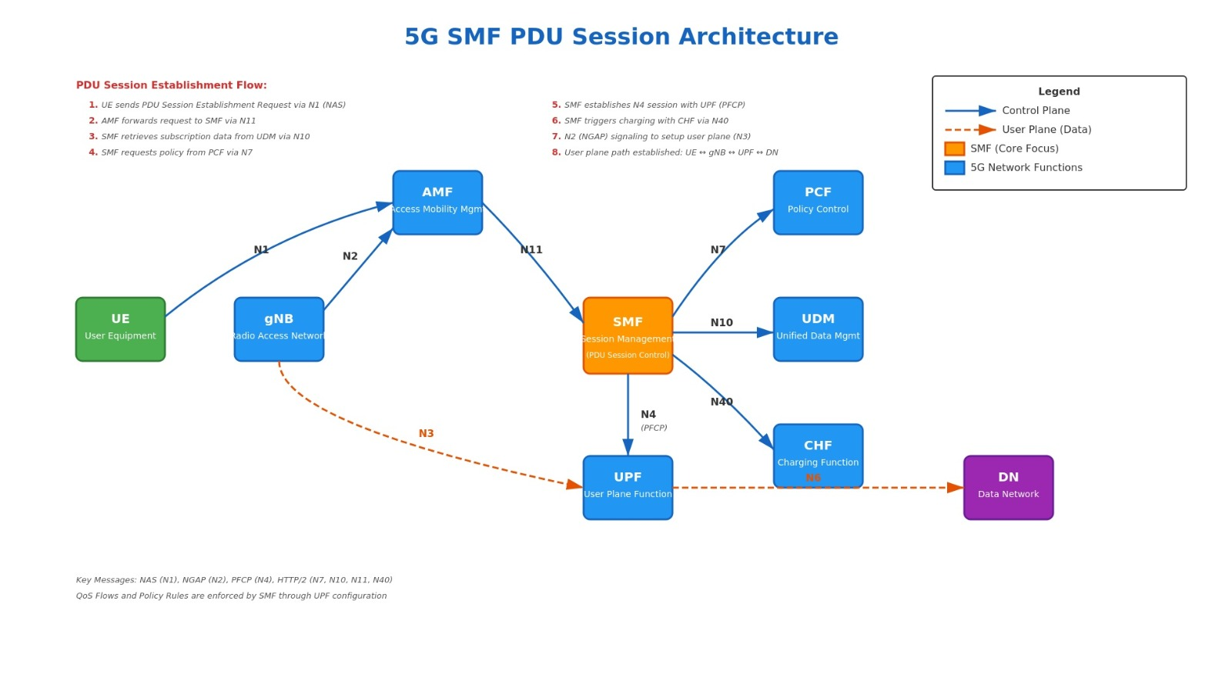
2024 - RPS Consulting all rights reserved

Slide 7
Key Interfaces & Network Functions
• N11 (AMF-SMF): NAS SM messages and session context
• N4 (SMF-UPF): PFCP protocol for packet processing rules
• N7 (SMF-PCF): Policy and charging control rules (PCC)
• N10 (SMF-UDM): Subscription data retrieval
• N3 (gNB-UPF): GTP-U user plane tunnel
• N6 (UPF-DN): Connection to external data network
2024 - RPS Consulting all rights reserved

Slide 8
PDU Session Establishment
12-Step Signalling Flow
2024 - RPS Consulting all rights reserved

Slide 9
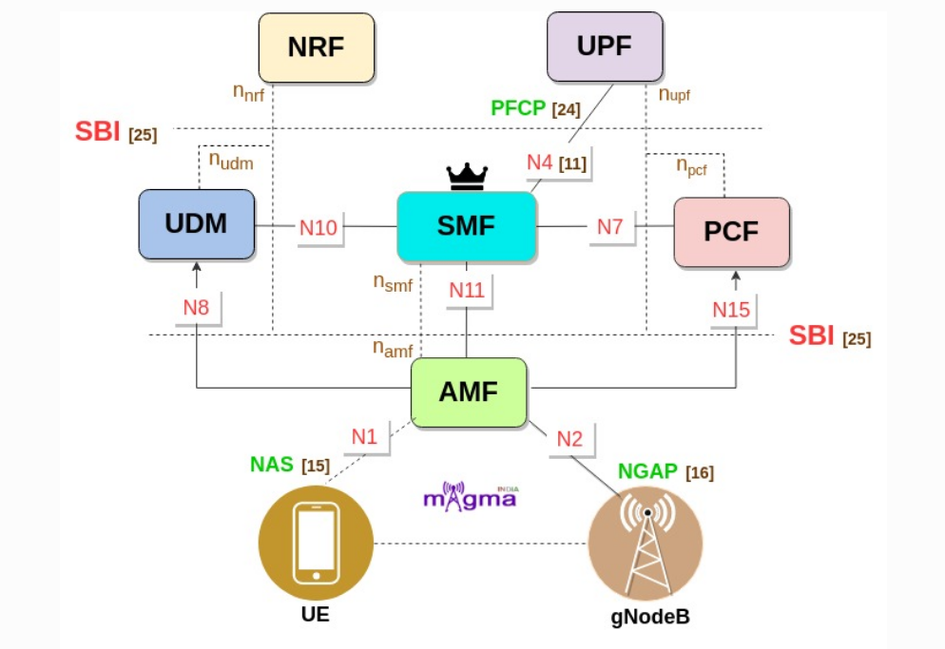
2024 - RPS Consulting all rights reserved

Slide 10
Signalling Flow: Steps 1-6
• Step 1: UE → AMF: NAS PDU Session Establishment Request
• Step 2: AMF → SMF: Nsmf_CreateSMContext
• Step 3: SMF → UDM: Get subscription data (DNN, AMBR, 5QI)
• Step 4: SMF → PCF: Request PCC rules (session AMBR, QoS)
• Step 5: SMF → UPF: PFCP Session Establishment (PDRs, FARs, QERs)
• Step 6: SMF → AMF: N1N2MessageTransfer (NAS Accept, NGAP Setup)
2024 - RPS Consulting all rights reserved

Slide 11
Signalling Flow: Steps 7-12
• Step 7: AMF → gNB: PDU Session Resource Setup Request
• Step 8: gNB → UE: RRC Reconfiguration (DRB setup + NAS)
• Step 9: UE → gNB: RRC Reconfiguration Complete
• Step 10: gNB → AMF: Resource Setup Response (gNB F-TEID)
• Step 11: AMF → SMF: Nsmf_UpdateSMContext (gNB tunnel info)
• Step 12: SMF → UPF: PFCP Session Modification (DL FAR: BUFFER → FORWARD)
2024 - RPS Consulting all rights reserved

Slide 12
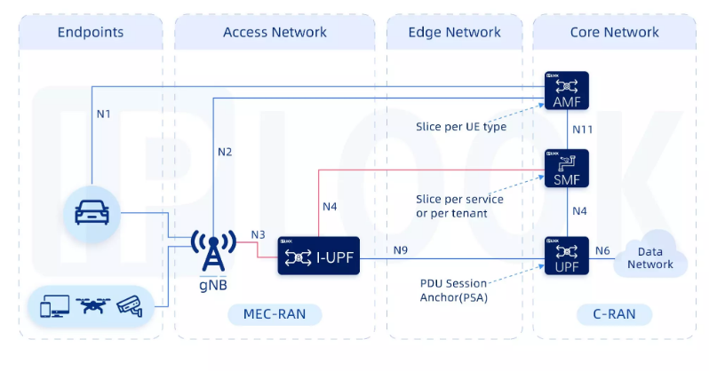
2024 - RPS Consulting all rights reserved

Slide 13
SMF PDU Session State Machine
IDLE
No PDU session exists
SM_CONTEXT_CREATING
Query UDM, PCF, allocate IP
N4_SESSION_SETUP
Create PFCP session on UPF
WAITING_AN_TUNNEL
Wait for gNB tunnel info
N4_SESSION_MODIFYING
Update DL FAR to FORWARD
ACTIVE
User plane data flowing
2024 - RPS Consulting all rights reserved

Slide 14
PDU Session Establishment
PFCP PROTOCOL
Packet Forwarding Control Protocol (TS 29.244)
2024 - RPS Consulting all rights reserved

Slide 15
PFCP Rules Explained
• PDR (Packet Detection Rule): Matches incoming packets
• FAR (Forwarding Action Rule): FORWARD, DROP, or BUFFER
• QER (QoS Enforcement Rule): Enforces MBR and GBR bit rates
• URR (Usage Reporting Rule): Tracks data usage for charging
• DL FAR initially set to BUFFER (gNB TEID unknown)
• After gNB setup: DL FAR updated to FORWARD with GTP-U encapsulation
2024 - RPS Consulting all rights reserved

Slide 16
GTP-U Tunnelling (N3 Interface)
• N3 interface uses GTP-U (GPRS Tunneling Protocol)
• Each PDU Session has a GTP-U tunnel
• F-TEID = TEID (32-bit Tunnel Endpoint ID) + IP address
• Uplink F-TEID: UPF side (from gNB to UPF)
• Downlink F-TEID: gNB side (from UPF to gNB)
• SMF coordinates tunnel endpoints via PFCP
2024 - RPS Consulting all rights reserved

Slide 17
5G QoS Model
• 5QI (5G QoS Identifier): Determines packet delay, error rate
• QoS Flow: End-to-end QoS treatment (QFI identifier)
• Session AMBR: Aggregate Maximum Bit Rate for session
• GBR flows: Guaranteed Bit Rate (voice, video)
• Non-GBR flows: Best effort (web, downloads)
• Example: 5QI=1 (VoNR), 5QI=9 (Internet), 5QI=80 (Low latency)
2024 - RPS Consulting all rights reserved

Slide 18
C++ Implementation
Complete SMF Simulation
2024 - RPS Consulting all rights reserved

Slide 19
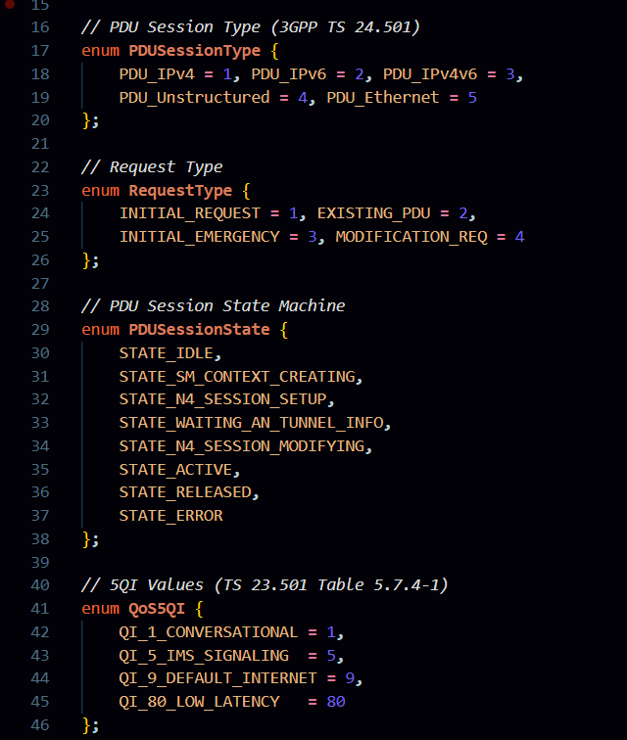
Sample Code
            PHASE : 01
This section defines important enumerations (Enums) used in the 5G PDU Session process. It includes PDU Session Types such as IPv4, IPv6, IPv4v6, Unstructured, and Ethernet.
It also defines Request Types like Initial Request and Modification Request, which indicate how the session is being created or updated. Additionally, the PDU Session State Machine is defined to represent different stages of a session such as Idle, Creating Context, Active, Released, and Error.
The code also defines standard 5QI (5G QoS Identifier) values based on 3GPP specifications. These values represent different service types like conversational traffic, signaling, default internet, and low latency communication. Using Enums improves readability, avoids hardcoding numbers, and ensures alignment with 3GPP standards
2024 - RPS Consulting all rights reserved

Slide 20
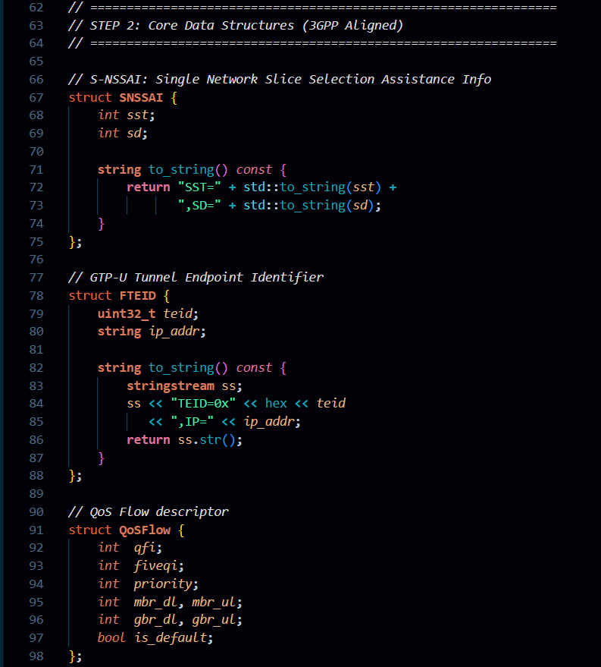
Sample Code
            PHASE : 02
This section defines core data structures required for 5G session management. The S-NSSAI structure represents network slicing information, including SST (Slice Service Type) and SD (Slice Differentiator).
The F-TEID structure represents the GTP-U tunnel endpoint identifier, which contains a TEID and IP address for user plane communication.
It also defines the QoS Flow structure, which stores quality-of-service parameters such as 5QI, priority, GBR (Guaranteed Bit Rate), and MBR (Maximum Bit Rate).
These structures organize network-related information in a structured way and are essential for handling session establishment and data flow management in the 5G Core.
2024 - RPS Consulting all rights reserved

Slide 21
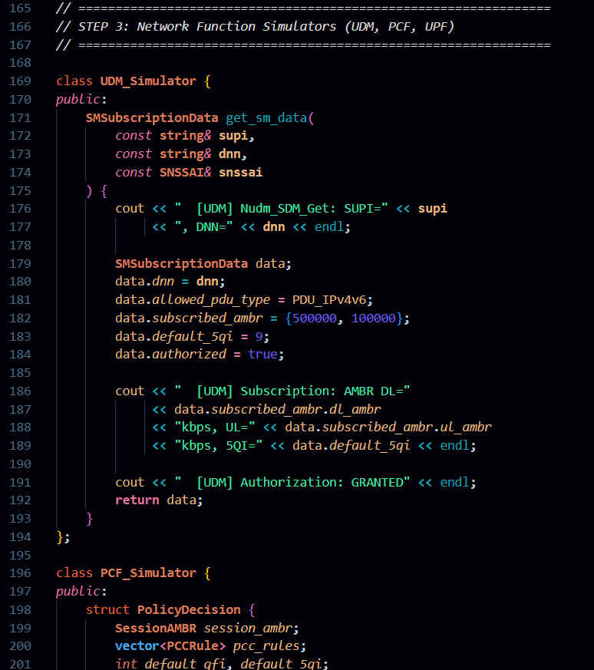
Sample Code
            PHASE : 03
This section implements simulators for core 5G network functions like UDM and PCF. The UDM simulator provides subscriber information such as allowed PDU type, AMBR (Aggregate Maximum Bit Rate), default 5QI, and authorization status.
It simulates how real subscription data is fetched in an actual 5G network.
The PCF simulator generates policy decisions for the session. It defines PCC rules and session AMBR values that control how traffic is managed. These simulated network functions help demonstrate how policy control and subscriber management work during PDU session establishment.
2024 - RPS Consulting all rights reserved

Slide 22
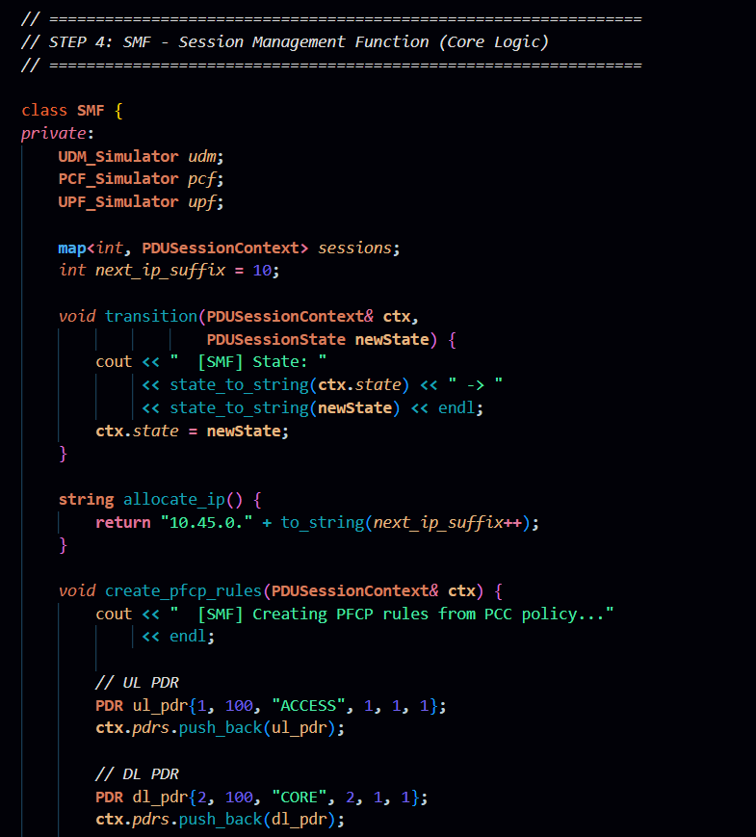
Sample Code
            PHASE : 04
This section defines the SMF class, which handles the main session management logic. It interacts with UDM, PCF, and UPF simulators to create and manage PDU sessions.
The SMF maintains session contexts, manages state transitions, and allocates IP addresses dynamically.
It also creates PFCP rules for uplink and downlink traffic by configuring PDRs (Packet Detection Rules).
The transition function ensures proper movement between session states. This part represents the brain of the PDU session establishment process.
2024 - RPS Consulting all rights reserved

Slide 23
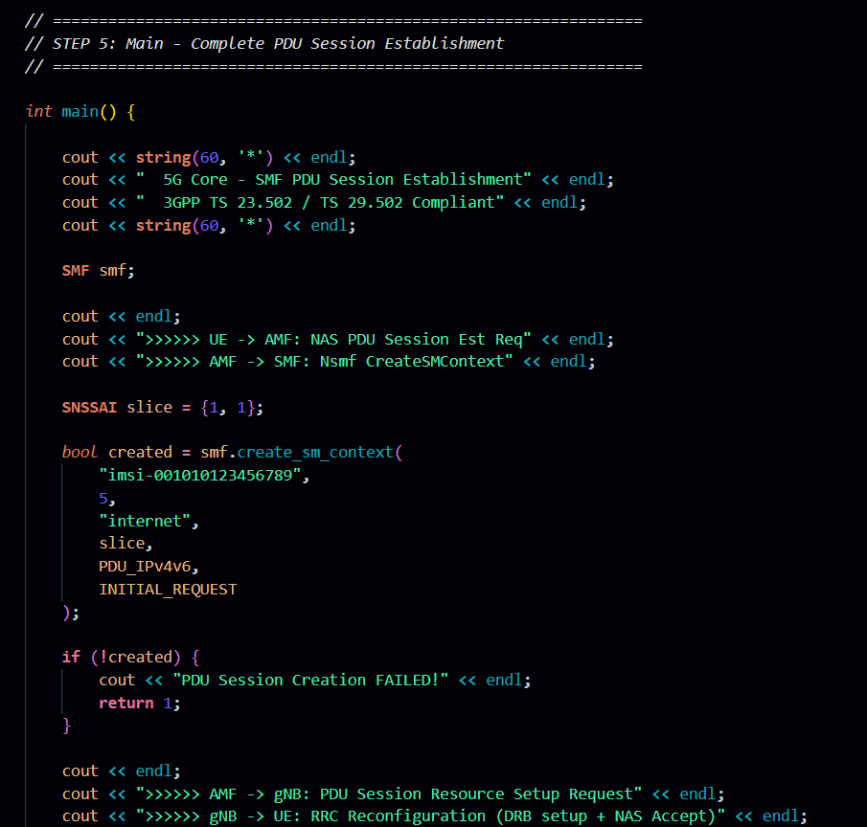
Sample Code
          PHASE : 05
This section contains the main function, which starts the complete PDU session simulation. It prints the session establishment steps and sends a PDU session request from UE to AMF and then to SMF.
It creates a session context with parameters like IMSI, DNN, slice information, and request type.
After successful session creation, the program simulates resource setup between AMF and gNB, followed by RRC reconfiguration. This demonstrates the full end-to-end PDU session establishment process in a simplified but structured way.
2024 - RPS Consulting all rights reserved

Slide 24
Output
***********************************************
5G Core - SMF PDU Session Establishment
3GPP TS 23.502 / TS 29.502 Compliant
***********************************************
>>>>>> UE -> AMF: NAS PDU Session Est Req
>>>>>> AMF -> SMF: Nsmf CreateSMContext
========================================
SMF: Nsmf_PDUSession_CreateSMContext
========================================
[SMF] New session: ID=5, SUPI=imsi-001010123456789
[SMF] DNN=internet, S-NSSAI=SST=1,SD=1
[SMF] State: IDLE -> SM_CONTEXT_CREATING
--- Phase A1: UDM Query ---
[UDM] Nudm_SDM_Get: SUPI=imsi-001010123456789, DNN=internet
[UDM] Subscription: AMBR DL=500000kbps, UL=100000kbps, 5QI=9
[UDM] Authorization: GRANTED
--- Phase A2: PCF Policy ---
[PCF] Npcf_SMPolicyControl_Create for DNN=internet
[PCF] Rules: 2 PCC rules installed
PCC_DEFAULT 5QI=9 Gate=OPEN
PCC_VIDEO 5QI=7 Gate=OPEN
--- Phase A3: IP Allocation ---
[SMF] Allocated UE IP: 10.45.0.10
[SMF] Default QoS Flow: QFI=1, 5QI=9
----------------------------------------------------------
Phase B: N4/PFCP Session Setup
----------------------------------------------------------
[SMF] State: SM_CONTEXT_CREATING -> N4_SESSION_SETUP
[SMF] Creating PFCP rules from PCC policy...
[SMF] Rules: 2 PDRs, 2 FARs, 1 QER created
[SMF] DL FAR initially set to BUFFER (gNB TEID unknown)
[UPF] N4: PFCP Session Est Request
[UPF] Installing: 2 PDRs, 2 FARs, 1 QERs
[UPF] PDR#1 ACCESS->FAR#1
[UPF] PDR#2 CORE->FAR#2
[UPF] N3 F-TEID: TEID=0x1000,IP=10.200.1.100
[UPF] Cause: Request Accepted
------------------------------------------------------------
Phase C: N1N2MessageTransfer to AMF
------------------------------------------------------------
[SMF] State: N4_SESSION_SETUP -> WAITING_AN_TUNNEL_INFO
[SMF] Sending to AMF:
N1 (NAS): PDU Session Est Accept
PDU Session ID: 5
PDU Type: IPv4v6
UE IP: 10.45.0.10
Session AMBR: DL=500000 UL=100000
QoS Flow: QFI=1 5QI=9
N2 (NGAP): PDU Session Resource Setup Request
UPF N3 TEID: TEID=0x1000,IP=10.200.1.100
QoS Flow List for DRB mapping
>>>>>> AMF -> gNB: PDU Session Resource Setup Request
>>>>>> gNB -> UE: RRC Reconfiguration (DRB setup + NAS Accept)
>>>>>> UE -> gNB: RRC Reconfig Complete
>>>>>> gNB -> AMF: Resource Setup Resp
>>>>>> AMF -> SMF: UpdateSMContext (gNB TEID)
=========================================
SMF: Nsmf_PDUSession_UpdateSMContext
=========================================
[SMF] Received gNB N3: TEID=0x2001,IP=192.168.1.50
=======================================
PDU SESSION SUMMARY
=======================================
Session ID : 5
SUPI : imsi-001010123456789
DNN : internet
S-NSSAI : SST=1,SD=1
State : ACTIVE
UE IP : 10.45.0.10
UPF N3 : TEID=0x1000,IP=10.200.1.100
gNB N3 : TEID=0x2001,IP=192.168.1.50
AMBR : DL=500000kbps, UL=100000kbps
QoS Flows : 1
QFI=1 5QI=9 [DEFAULT]
PFCP Rules : 2 PDRs, 2 FARs, 1 QERs
PCC Rules : 2
=======================================
Phase D: N4 Session Modification
------------------------------------------------------------
[SMF] State: WAITING_AN_TUNNEL_INFO -> N4_SESSION_MODIFYING
[SMF] Updating DL FAR#2: BUFFER -> FORWARD
[SMF] Adding outer header creation with gNB TEID
[UPF] N4: PFCP Session Mod Request
[UPF] Updating DL FAR with gNB: TEID=0x2001,IP=192.168.1.50
[UPF] DL path activated
[SMF] State: N4_SESSION_MODIFYING -> ACTIVE
* PDU SESSION ESTABLISHED SUCCESS *
* User Plane Data Active *
2024 - RPS Consulting all rights reserved

Slide 25
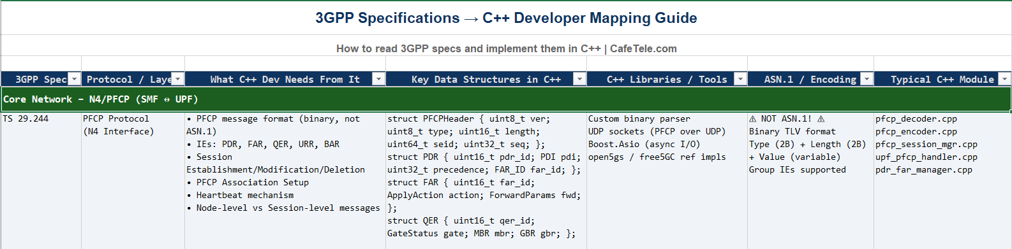
Reference
2024 - RPS Consulting all rights reserved

Slide 26
Key Concept Summary
• SMF orchestrates PDU Session lifecycle management
• PFCP protocol controls user plane (UPF) from control plane (SMF)
• State machine: IDLE → CREATING → N4_SETUP → WAITING → MODIFYING → ACTIVE
• DL FAR progression: BUFFER → FORWARD (after gNB tunnel known)
• QoS flows map to 5QI values for packet treatment
• 3GPP specs: TS 23.502 (procedures), TS 29.502 (APIs), TS 29.244 (PFCP)
2024 - RPS Consulting all rights reserved

Slide 27
Thank You
                Presented By Group : 03
                1. Jayavarshini G
                2. Harshinie M
                3. Yuvaraj P
                4. Shreyash Bhatt
                5. Vikas Srivastava
2024 - RPS Consulting all rights reserved

