Slide 1
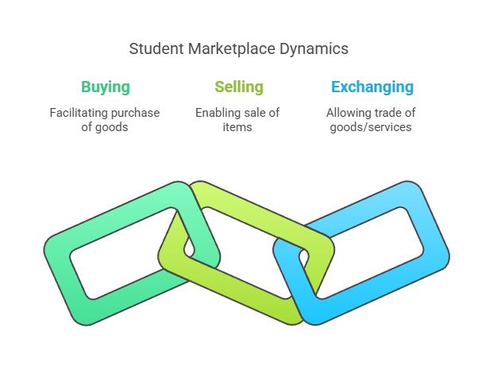
Student Market Place
A digital platform designed for students to buy, sell, and exchange goods and services within their college or university community

Slide 2
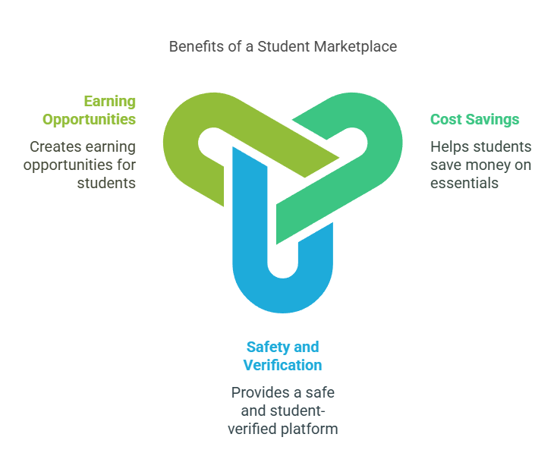
Why is it Important?
Helps students save money on essentials.
Provides a safe and student-verified platform.
Creates earning opportunities for students.

Slide 3
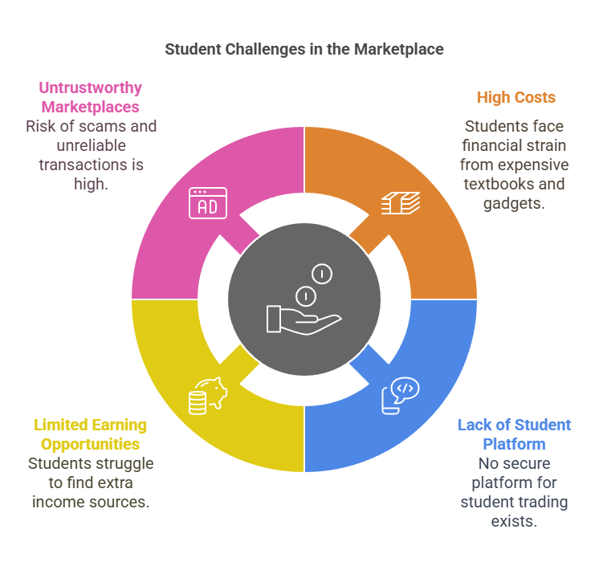
Challenges Faced by Students
High Costs – Textbooks, gadgets, and dorm essentials are expensive.
Lack of a Student-Specific Platform – No safe and reliable place for students to trade.
Limited Earning Opportunities – Students struggle to find ways to make extra money.
Untrustworthy Marketplaces – Risk of scams, unreliable buyers/sellers.

Slide 4
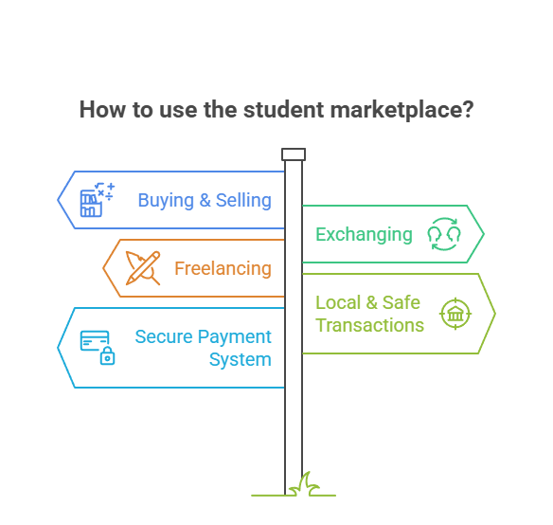
How It Works
A dedicated, secure, and student-verified platform that allows:
Buying & Selling: Textbooks, gadgets, furniture, and more.
Exchanging: Swap items with fellow students.
Freelancing: Offer services like tutoring, design, writing, and more.
Local & Safe Transactions: Meet up safely on campus.
Secure Payment System: Trusted payment and transaction security.

Slide 5
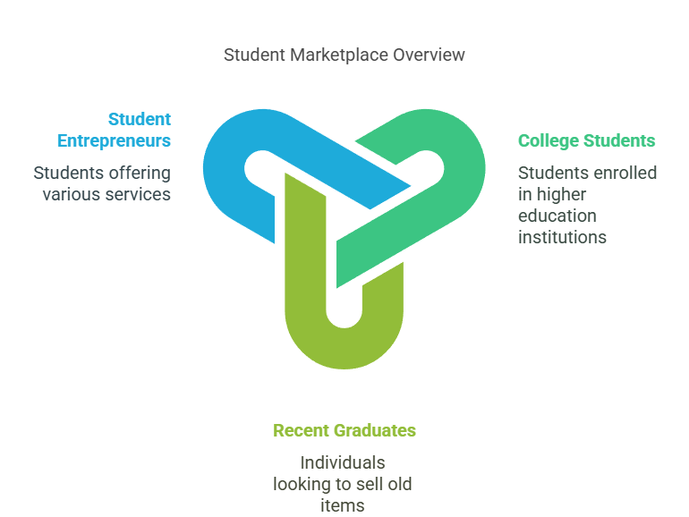
Target Audience
College and university students.
Recent graduates looking to sell old items.
Student entrepreneurs offering services.

Slide 6
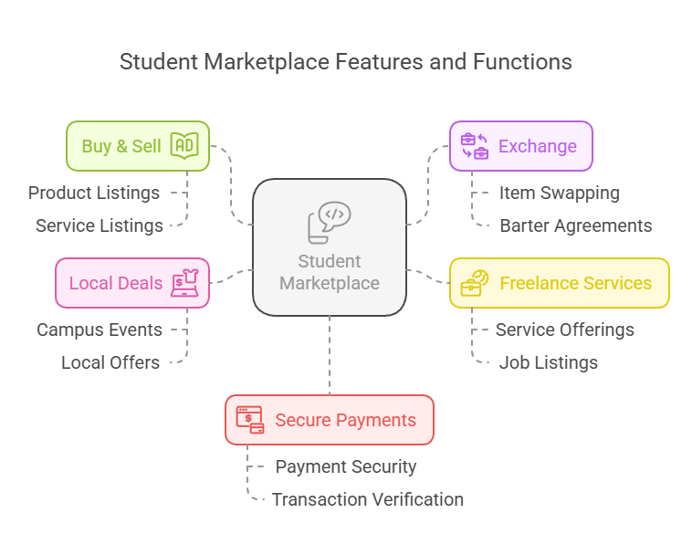
Key Points
📌 Buy & Sell: Easy listing of products and services.
🔄 Exchange: Barter system for swapping items.
💼 Freelance Services: Students can offer and find gigs.
📍 Local Deals: Campus-specific marketplace.
💰 Secure Payments: Safe and verified transactions.

Slide 7
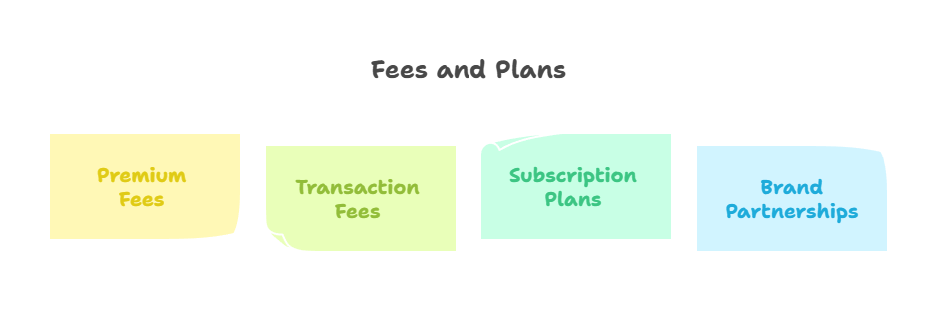
Business Model
Revenue Streams:
Premium Listing Fees – Sellers pay to promote their items.
Transaction Fees – Small commission on secure transactions.
Subscription Plans – For frequent sellers and businesses.
Brand Partnerships – Advertising and student discounts.

Slide 8
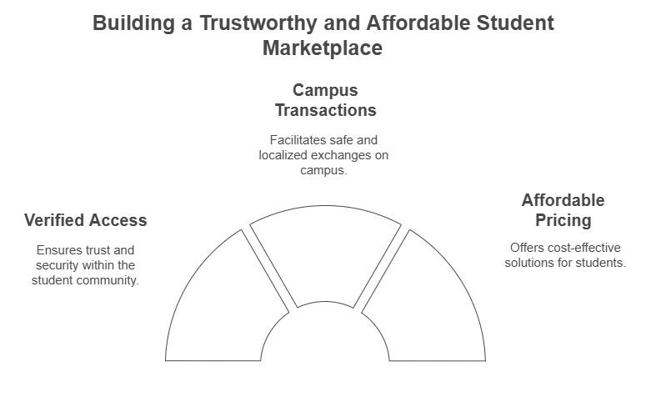
Competitive Advantage:
Student-Only Access – Verified users ensure trust.
Safe & Localized – Campus-based transactions.
Low Fees – More student-friendly pricing.

Slide 9
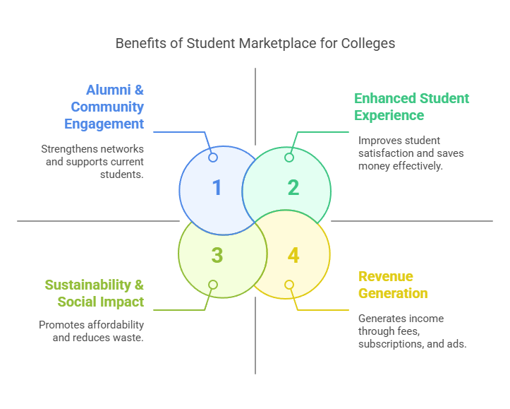
Profit for Colleges from a Student Marketplace:
Revenue Generation – Transaction fees, subscriptions, advertising.
Enhanced Student Experience – Saves money, improves satisfaction.
Alumni & Community Engagement – Strengthens networks, supports students.
Sustainability & Social Impact – Reduces waste, promotes affordability.
Branding & Competitive Advantage – Attracts students, showcases innovation.

Slide 10
THANKYOU

