Slide 1
NLP Nutshell
Vikas Kumbharkar

Slide 2
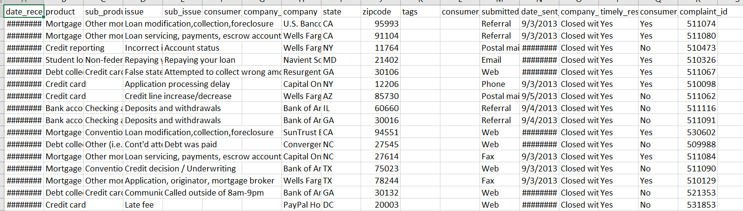
Reality comes with unstructured format
Expected
Reality
raw text
URLs, portal to extract data
Xml, pdf, image with text, etc.
Json,pickle

Slide 3



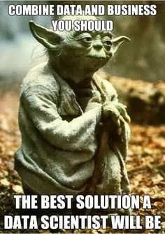
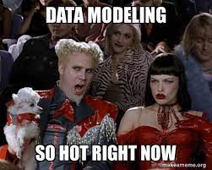
Data Modelling and Preparation

Slide 4







Libraries and Framework
NLTK

Slide 5
NLP Steps Before Release
Preprocessing and Cleaning
EDA
Feature Engineering
Data Modeling
Training Model
Evaluation
Monitoring

Slide 6
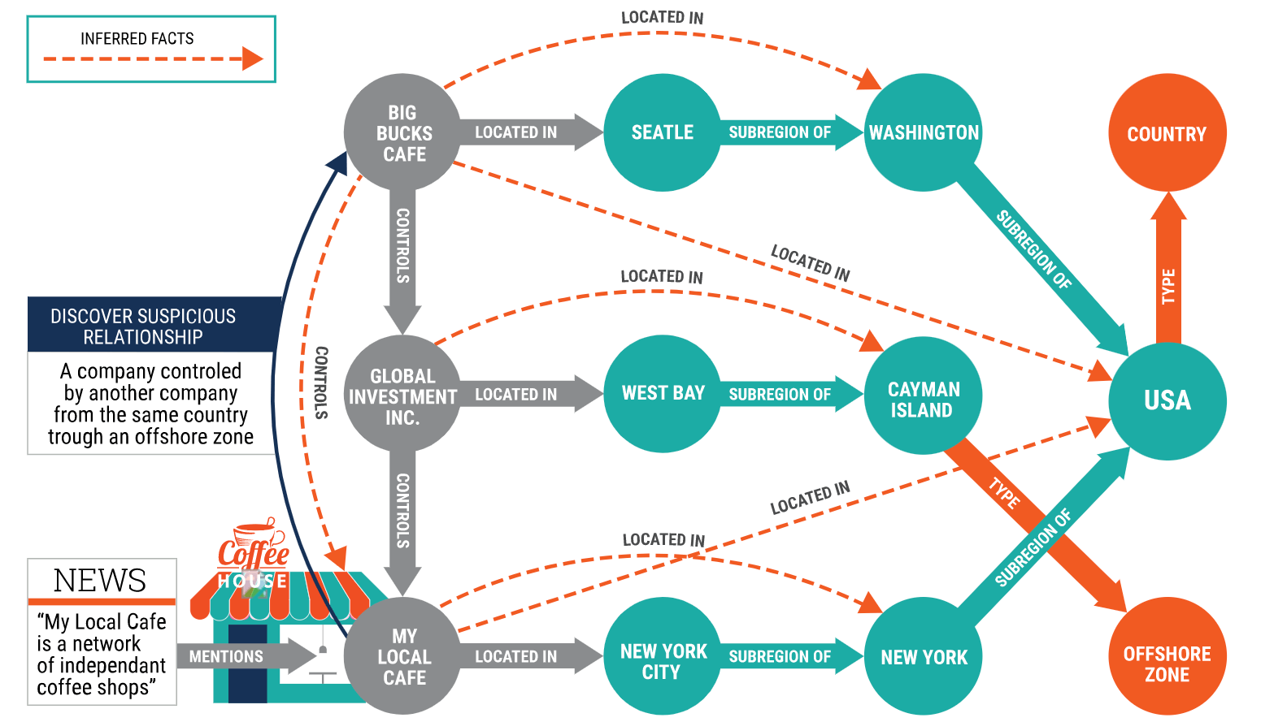
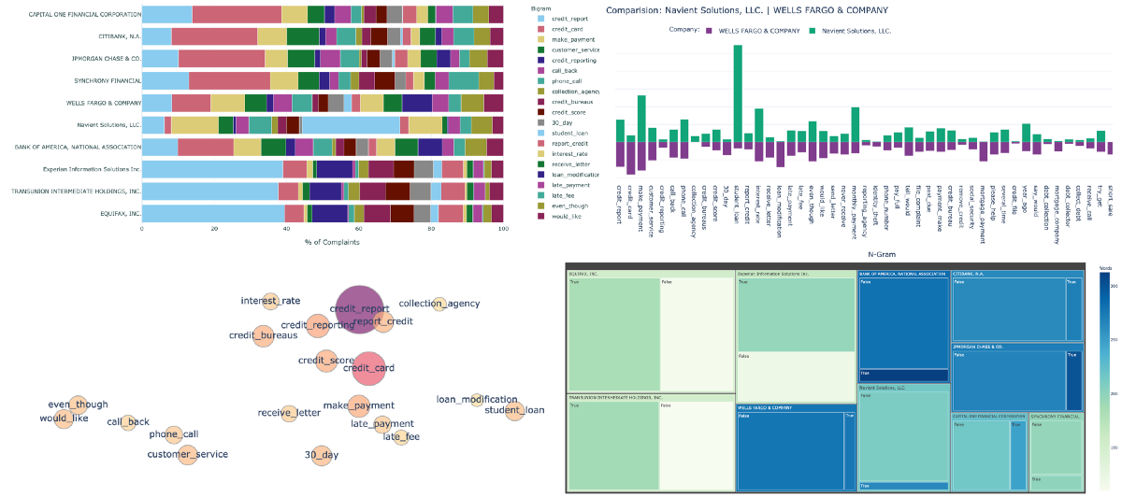
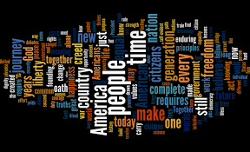
Visualizers

Slide 7


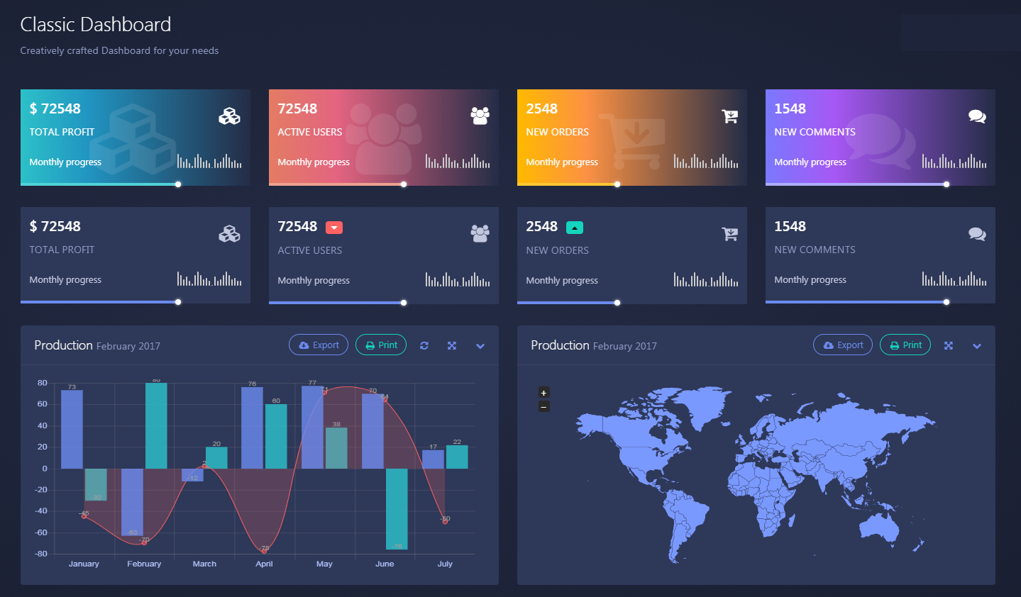
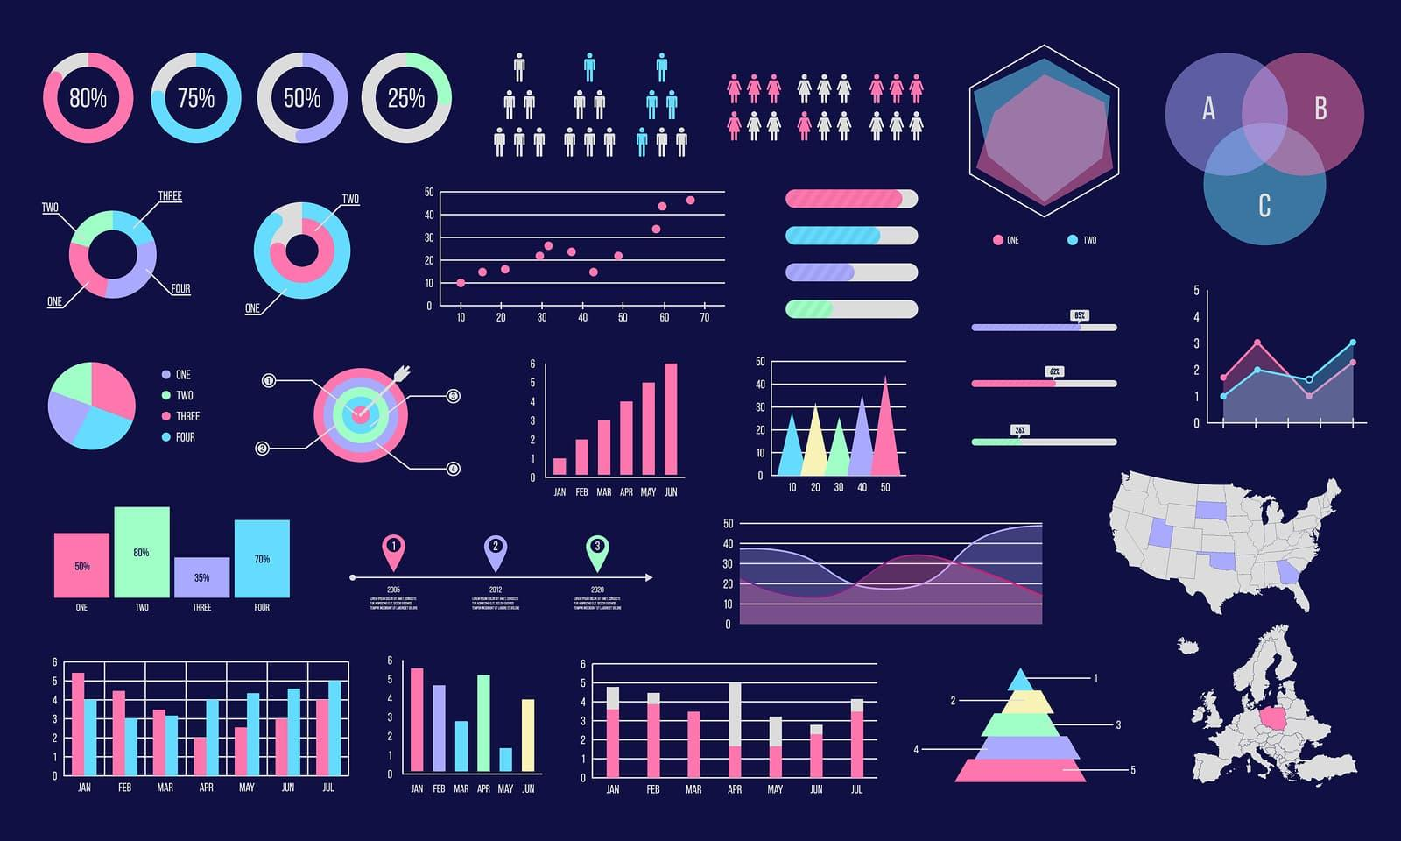
Web components

Slide 8
Advanced NLP
Word2vec
RNN
LSTM
Transformers
GPT
ELMO
T5

Slide 9
NLP connecting Big Data Challenges
Data pipelines for Extraction, Indexing.
Precision and Faster Unstructured Data processing with business requirements and Down streaming application.
User friendly interface with Breakdown complex problem.
Data segregation with respect to Business domain with overcoming technical hurdles.

Slide 10
Big Data with NLP Trends
Classifying / categorizing / organizing records
Clustering records
Extracting topics
Keyword / keyphrase extraction
Duplicate and near-duplicate detection
Semantic search
Trend Analysis with Keyword , Phrases, Topic, Term, context.

