Slide 1
LOCATOR
Group 2 Full Stack App

Slide 2
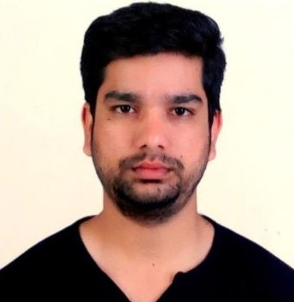

TEAM MEMBERS:
Vikas Basawapuram Deekshith Maram
Github: https://github.com/Vikas2004 Github: https://github.com/Dixith1196

Slide 3
Overview:
This app is a touch-based gaming app, where a user will be displayed two colors components on the home screen.
When the player touches/clicks the first color they request a valid (treasure) location from the list of the locations available and hear confirmation that a location has been selected so that they can start finding the location. The same is conveyed to the user/player through speech.
When the player touches/clicks the second color they check with the application if they are in the location or not by comparing their present location coordinates with the location coordinates. If not they will be instructed that they are not in the location yet with speech.(They can hear this.).
Finally, when user reaches the destination then the user will hear and see the confirmation of reaching the selected treasure location.

Slide 4
Stack:
The Stack used for this application development is MERN Stack.
Front End: REACT
Back End: EXPRESS
Database: MongoDB
Environment: Node

Slide 5
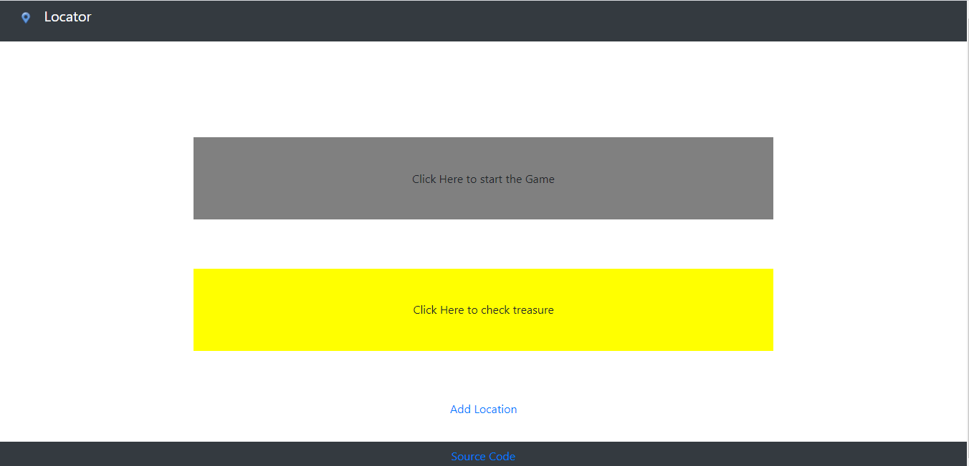
Hosted App Link: https://treasure-locator-frontend.herokuapp.com/ GitHub Repo Link: https://github.com/Vikas2004/locator
HOME PAGE:

Slide 6
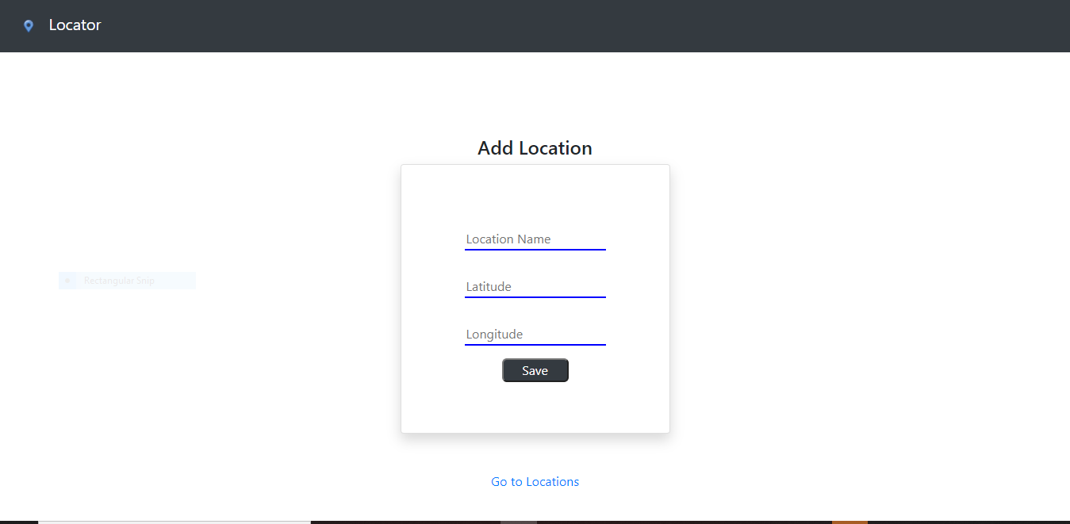
Adding a Location:
The user is provided with the option to add location of their choice on the home screen.
The user can also view the list of locations available while adding the locations.

Slide 7
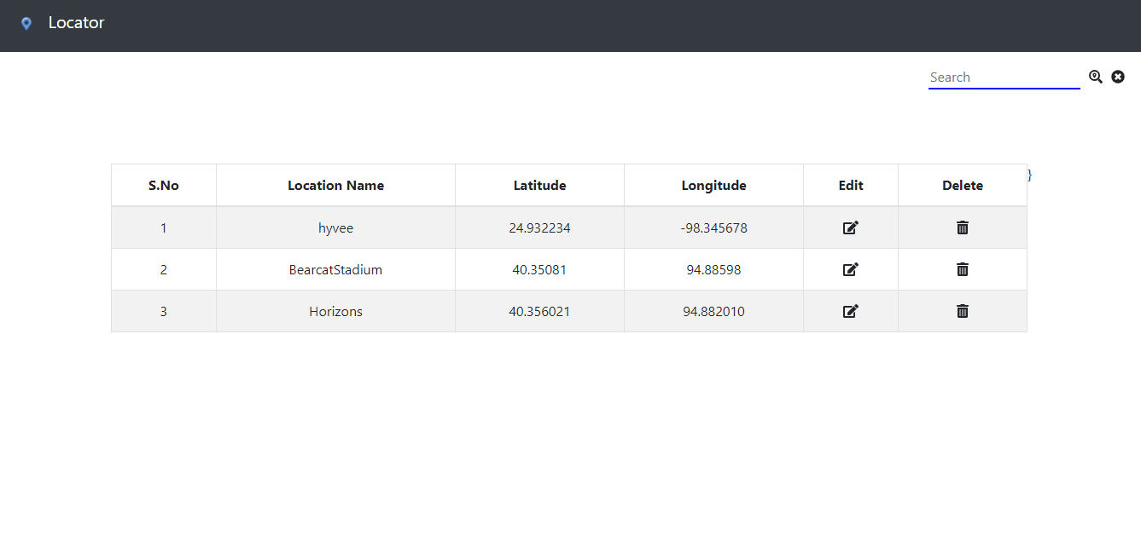
List of Locations:
The user can create, read, update and delete the locations from this page.

Slide 8
With the instructions provided on the home screen the user can start adding the locations or can directly play the game with the list of available locations.
If there are any issues we are happy to address them and can reach us out the following email addresses.
Vikas Baswapuram: S538336@nwmissouri.edu
Deekshith Maram: S538365@nwmissouri.edu

Slide 9


