Slide 1
Detail Project Report On To Predict Cost Of Zomato Restaurants ML PROJECT
BY VIKAS

Slide 2
1) Problem Statements 2) Benefit From The Project 3) Data Sharing Agreement And Data Description 4) Model Architecture 5) Code Explanation A) Data Validation And Transformation B) Data Insertion In Databases C) Model Training D) Predictions
Course Outline

Slide 3
The Main Goal Of This Project Is To Perform Extensive Exploratory Data Analysis(EDA) On The Zomato Dataset And Build An Appropriate Machine Learning Model That Will Help Various Zomato Restaurants To Predict The Cost Of Restaurant For Two People Based On The Given Indicators In The Training Data.
Problem Statement

Slide 4
1) Help For Predicate Amount to spend on food in Restaurant 2) Gives Better Idea About Rating Of Restaurant 3) Give Better Idea About Food Cost
Benefits From The Project

Slide 5
1) Name Of File (Ex :- zomato_15052019_170448.csv) 2) Length Of Date Stamp In File (Ex :- 8) 3) Length Of Time Stamp In File (Ex :- 6) 4) Numbers Of Columns 5) Name Of Columns 6) Datatypes Of Columns
Data Sharing Agreement

Slide 6
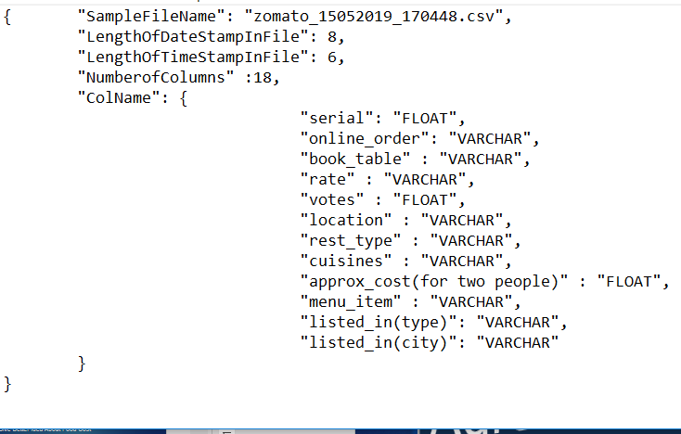
Data Sharing Agreement file for Training Data set.

Slide 7
Data Description
1. Serial : The Index/Serial Number
2. URL : The URL For The Restaurant
3. Address : The Address Of The Restaurant.
4. Name : The Name Of The Restaurant.
5. Online_order : Does The Restaurant Allow Online Order(yes/No)
6. Book_table : Does The Restaurant Allow Table Booking(yes/No)
7. Rate : Restaurant Rating Out Of 5.
8. Votes : The Number Of Votes For The Restaurant.
9. Phone : Restaurant Contact Number

Slide 8
10. Location : Location Of The Restaurant
11. Rest_type : Type Of The Restaurant(casual Dining, Café Etc.).
12. Dish_liked : The Most Liked Dishes In The Restaurant(pasta, Lunch Buffet, Masala Papad Etc.)
13. Cuisines : North Indian, Mughlai, Chinese Etc.
14. Approx_cost(for Two People) : In Rupees. (Target Column)
15. Reviews_list : The List Of Reviews
16. Menu_item : Open Dosa , 'Benne Set Dosa Etc.
17. Listed_in(type) : Buffet, Café Etc
18. Listed_in(city) : The Part Of City Where Restaurant Is Listed.

Slide 9
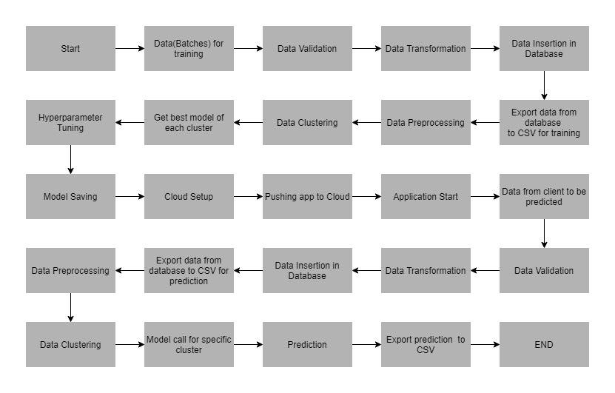
Model Architecture

Slide 10
Code Explanation
Data Validation And Transformation
Data Insertion In Databases
Model Training
Predictions
Deployment

Slide 11
Data Validation And Transformation
Step Involves In Data Validations Of Given Data :-
1) Name Validation - We Validate The Name Of The Files Based On Given Name In The Schema File .If All The Values Are As Per Requirement Then We Move Such Files To "Good_data_folder" Else We Move Such Files To "Bad_data_folder".
2) Number Of Columns - We Validate The Number Of Columns Present In The Files, And If It Doesn't Match With The Value Given In The Schema File, Then The File Is Moved To "Bad_data_folder".
3) Name Of Columns - The Name Of The Columns Is Validated And Should Be Same As Given In The Schema File. If Not Then The File Is Moved To "Bad_data_folder".
4) Datatype Of Columns - The Datatype Of Columns Is Given In The Schema File. This Is Validated When We Insert The Files Into Database. If The Datatype Is Incorrect, Then The File Is Moved To "Bad_data_folder".

Slide 12
Data Insertion In Database
Table Creation In The Database :- Table With Name "Good_data“ Is Created In The Database For Inserting The Files In The "Good_data_folder" .If The Table Is Already Present, Then The New Table Is Not Created, And New Files Are Inserted In The Already Present Table.
Insertion Of File In The Table :- All The Files In The "Good_data_folder" Are Inserted In The Table. If Any File Has Invalid Data Type In Any Of The Columns Then The File Is Not Loaded In The Table And Is Moved To "Bad_data_folder".

Slide 13
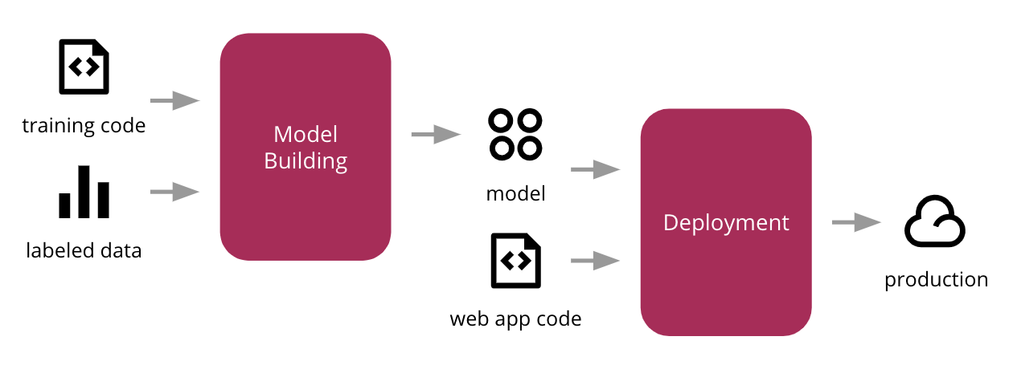
Model Training
Data Export From Db
Data Preprocessing
Clustering
Model Selection

Slide 14
Prediction
The Testing Files Are Shared In The Batches And We Perform The Same Validation Operations Then Data Transformation And Data Insertion On Them.
The Accumulated Data From Database Is Exported In Csv Format For Prediction.
We Perform Data Pre-processing Techniques On It.
Kmeans Model Created During Training Is Loaded And Clusters For The Preprocessed Data Is Predicted.
Based On The Cluster Number Respective Model Is Loaded And Is Used To Predict The Data For That Cluster.
Once The Prediction Is Done For All The Clusters. The Predictions Are Saved In Csv Format And Shared.

Slide 15
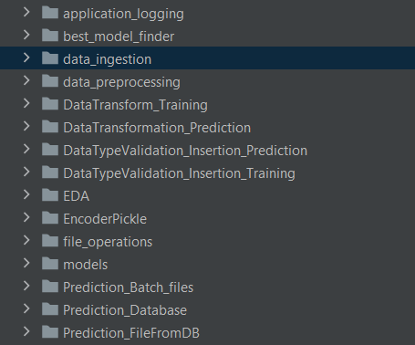
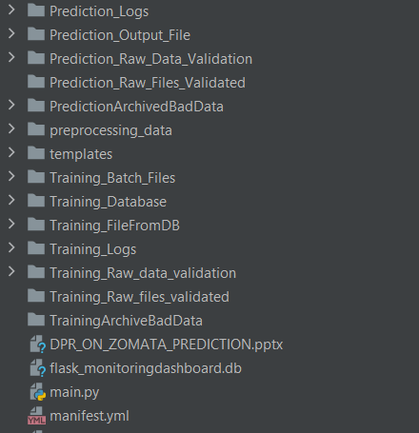
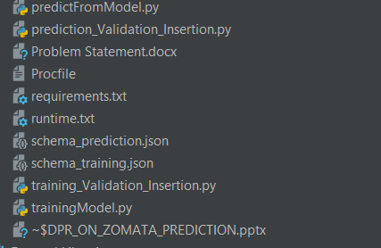
Structure Of Model Files

Slide 16
Question & Answers
Question 1 :- What Is The Source Of Data ?
Answer :- The Data For Training Is Provided By The Client In Multiple Batches And Each Batch Contain Multiple Files.
Question 2 :- What Is The Size Of Data ?
Answer :- The Data Contains 32561 Instances And 18 Rows .
Question 3 :- How Logs Are Managed?
Answer :- We Are Using Different Logs As Per The Steps That We Follow In Validation And Modeling Like File Validation Log , Data Insertion ,Model Training Log , Prediction Log Etc.
Question 4 :- What Is The Type Of Data?
Answer :- The Data Is The Combination Of Numerical And Categorical Values.

Slide 17
Question 5 :- What Techniques Were You Using For Data Pre-processing?
Answer :- a) Drop columns not useful for training the model. Such columns were selected while
doing the EDA.
b) Replace the invalid values with numpy “nan” so we can use imputer on such values.
c) Check for null values in the columns. If present, remove them.
d) Scale the training and test data separately
e) Encode the categorical values.
Question 6 :- How Prediction Was Done?
Answer :- The Testing Files Are Shared By The Client .We Perform The Same Life Cycle Till The Data Is Clustered. Then On The Basis Of Cluster Number Model Is Loaded And Perform Prediction. In The End We Get The Accumulated Data Of Predictions.

Slide 18
Question 7 :- How Training Was Done Or What Models Were Used?
Answer :- Before Diving The Data In Training And Validation Set We Performed Clustering Over Fit To Divide The Data Into Clusters. As Per Cluster The Training And Validation Data Were Divided. The Scaling Was Performed Over Training And Validation Data Algorithms Like Decision Tree Regressor , XG Boost Regressor Were Used Based On The Recall Final Model Was Used For Each Cluster And We Saved That Model .
Question 8 :- Which Clustering Technique U Will Used In Model Deployment ?
Answer :- Kmeans Clustering Algorithm Is Used To Create Clusters In The Preprocessed Data. The Optimum Number Of Clusters Is Selected By Plotting The Elbow Plot.
Question 9 :- Does Your Dataset Show Normally Distributed Or Not? If Not Then Which Techniques You Will Use To Make It Normal?
Answer :- No, These Data Set Does Not Show Normal Distribution Behavior. I Used Reciprocal, Square, Log, Exponential Techniques To Make It Normally Distributes.

Slide 19
Question 10 :- Which Tool You Are Used For Implementation This Model?
Answer :- 1) Ide : Pycharm
2) Cloud : GCP
3) Data Base : SQL Lite3
Question 11 :- How U Classify Your Project With Respect To Batch Learning And Online Learning?
Answer :- This Project Is The Type Of Batch Learning Then In This Project I Am Used Training Model In Offline And Once I Am Satisfied With The Performance Of The Model Then I Deployed It On Server For Serving The Prediction .
Question 12 :- Why Not On-line Learning U Used For Classify Your Model?
Answer :- The Main Problem In Online Learning Is Bad Data. If I Feed Bad Data In Online Learning Process And Train Our Model Then System Performance Is Gradually Decreases.

Slide 20
Question 13 :- What Type Of Storage You Have Used In Your Project?
Answer :- Initially All Training Files Are Kept In The Training_batch_files Folder Then I Perform Some Train Data Validation , Data Preprocessing Techniques On It Then I Stack All Good Data In Sql Lite3 Database.
Question 14 :- Why Data Validation Performed ?
Answer :- Machine Learning Is Continues Learning System Then I Need To Make Sure That The Data Type Of Columns , Number Of Column Etc. Are Same. Then It Is Necessary That Our Old Data And New Data Should Be Align Then So, That Our Training Will Happen Successfully.
Question 15 :- What Type Of Data Preprocessing Technique You Used In Project Development?
Answer :- Knn Imputer Used For Handling Missing Value And Standardscaler Technique Used For Feature Scaling.

Slide 21
Question 16 :- What are different type of missing value imputation techniques ?
Answer :- 1) Replacing it with mean , median , mode
2) KNN imputer
3) Imputation using for frequent
Question 17 :- What are the different types of outliers detection techniques?
Answer :- 1) Box plot
2) Using imperial techniques
3) IQR techniques
4) DBSCAN techniques

Slide 22
Question 18 :- What Are Different Task You Perform In Feature Engineering ?
Answer :- 1) Handling The Missing Value
2) Outliers Detection
3) Handling Categorical Data
4) Variable Transformation
Question 19 :- What Do You Mean By Curse Of Dimensionally?
Answer :- The Curse Of Dimensionality Basically Means That The Error Increases With The Increase In The Number Of Features. It Refers To The Fact That Algorithms Are Harder To Design In High Dimensions And Often Have A Running Time Exponential In The Dimensions.
Question 20 :- How You Are Handling Curse Of Dimensionality Problem ?
Answer :- To Overcome The Issue Of The Curse Of Dimensionality, Dimensionality Reduction(pca) Is Used To Reduce The Feature Space With Consideration By A Set Of Principal Features.

Slide 23
Question 21 :- Which Cross Validation Technique U Used In Your Project?
Answer :- In These Project I Am Used Grid Search Cv Cross Validation Techniques .
Question 22 :- What Kind Of Automation U Are Implemented ?
Answer :-1) Data Validation Pipeline
2) Data Preprocessing Pipeline
3) Database Insertions Pipeline
4) Clustering Pipeline
5) Model Training Pipeline
6) Model Selection Pipeline
7) Model Prediction Pipeline

Slide 24
Question 23 :- Tells About Various Type Of Feature Selection Techniques?
Answer :- 1) Chi-square Technique
2) Correlation
3) Variances Threshold Technique
4) Lasso Regression Techniques
5) Feature Importance Method (Tree Based)
Question 24 :- Why Is Normalization Required Before Apply Any Machine Learning Algorithm ?
Answer :- Normalization Is Not Always Not Required And Is Done To Prevent Variables That Are On Higher Scale From Affecting Outcomes That Are On Lower Levels . Normalization Is A Process That Is Required When An Algorithm Uses Something Like Distance Measure.

Slide 25
Question 25 :- What Is Different Between Feature Selection And Feature Extraction?
Answer :- Feature Selection Is Used To Filter A Subset Of Input Variables On Which The Attention Should Focus. Goal Of Feature Selection Is To Find Out An Optimal Feature Subset.
Feature Extraction Involves Transformations Of Feature So That We Can Extract Feature To Improve The Process Of Feature Selection .
Question 26 :- What Is R- Square ?
Answer :- R-squared (R²) Is A Statistical Measure That Represents The Proportion Of The Variance For A Dependent Variable That's Explained By An Independent Variable Or Variables In A Regression Model. It May Also Be Known As The Coefficient Of Determination.

Slide 26
Question 27 :- Differences Between SVR And Simple Regression Model?
Answer :- In Simple Regression Model We Try To Minimize The Error Rate But In Svr We Try To Fit The Error Within Certain Threshold.
Question 28 :- What Is Up Sampling And Down Sampling?
Answer :- Up Sampling Is The Process Of Randomly Duplicating Observation From The Minority Class To Reinforce Its Signal.
Down Sampling Is The Process Of Randomly Removing Observations From The Majority Class To Prevent Its Signal From Dominating The Learning Algorithm.
Question 29 :- Write Python Library Which Is Used For Up Sampling And Down Sampling?
Answer :- From Sklearn.Utils Import Resample

Slide 27
Question 30 :- What Do U Mean By Learning Rate?
Answer :- In Machine Learning And Statistics, The Learning Rate Is A Tuning Parameter In An Optimization Algorithm That Determines The Step Size At Each Iteration While Moving Toward A Minimum Of A Loss Function.

Slide 28


Thank You

