Slide 2
2. With reference to the burning of heavy residual fuel in the main engine:
State with reasons FOUR modifications which need to be made as compared with the same engine burning distillate fuels.
State with reasons SIX properties you would require to see in the specification for residual fuel indicating the effect EACH of these properties might have with respect to the storage and burning of the fuel.

Slide 3
1. Fuel Heating System (Preheaters & Tracing)
Modification:
1. fuel oil heaters before engine inlet & Steam tracing on pipes on fuel lines
Reason:
Heavy residual fuel has very high viscosity at ambient temperature
Fuel must be heated (typically to 120–150°C) to reach correct injection viscosity (~10–15 cSt).
Which will ensure
Proper atomization at injector
Stable combustion
Prevents pump overload and injector sticking

Slide 4
2. Fuel Treatment System (Separators, Settling & Service Tanks)
Modification: settling tanks ,Centrifugal purifiers
Since hfo contains Residual fuels contain ,Water
Catalytic fines
Ash and sediments
Purification Removes abrasive particles
Prevents excessive wear of pumps, injectors, liners, piston rings

Slide 5
3. Special Fuel Injection Equipment
Modification:
Larger injection pumps Hardened pump plungers and barrels
Fuel valves with cooling or circulation
Reason:
Residual fuel is ,More abrasive ,Higher temperature Higher injection pressure required
Which will prevent seizure and erosion ,Maintains correct injection pressure and spray pattern atomization

Slide 6
4. Exhaust Valve & Combustion Chamber Protection
Stellite-faced exhaust valves as
Residual fuel produces: More ash Vanadium and sodium compounds Higher corrosion and deposit formation
Which results in
Increases valve life Prevents burning and sticking
5. Use of high-BN cylinder oil for cylinder lubrication: Switch to high-alkalinity lube oil to neutralize acids from sulfur combustion; distillates produce fewer acids, allowing lower TBN oils

Slide 7
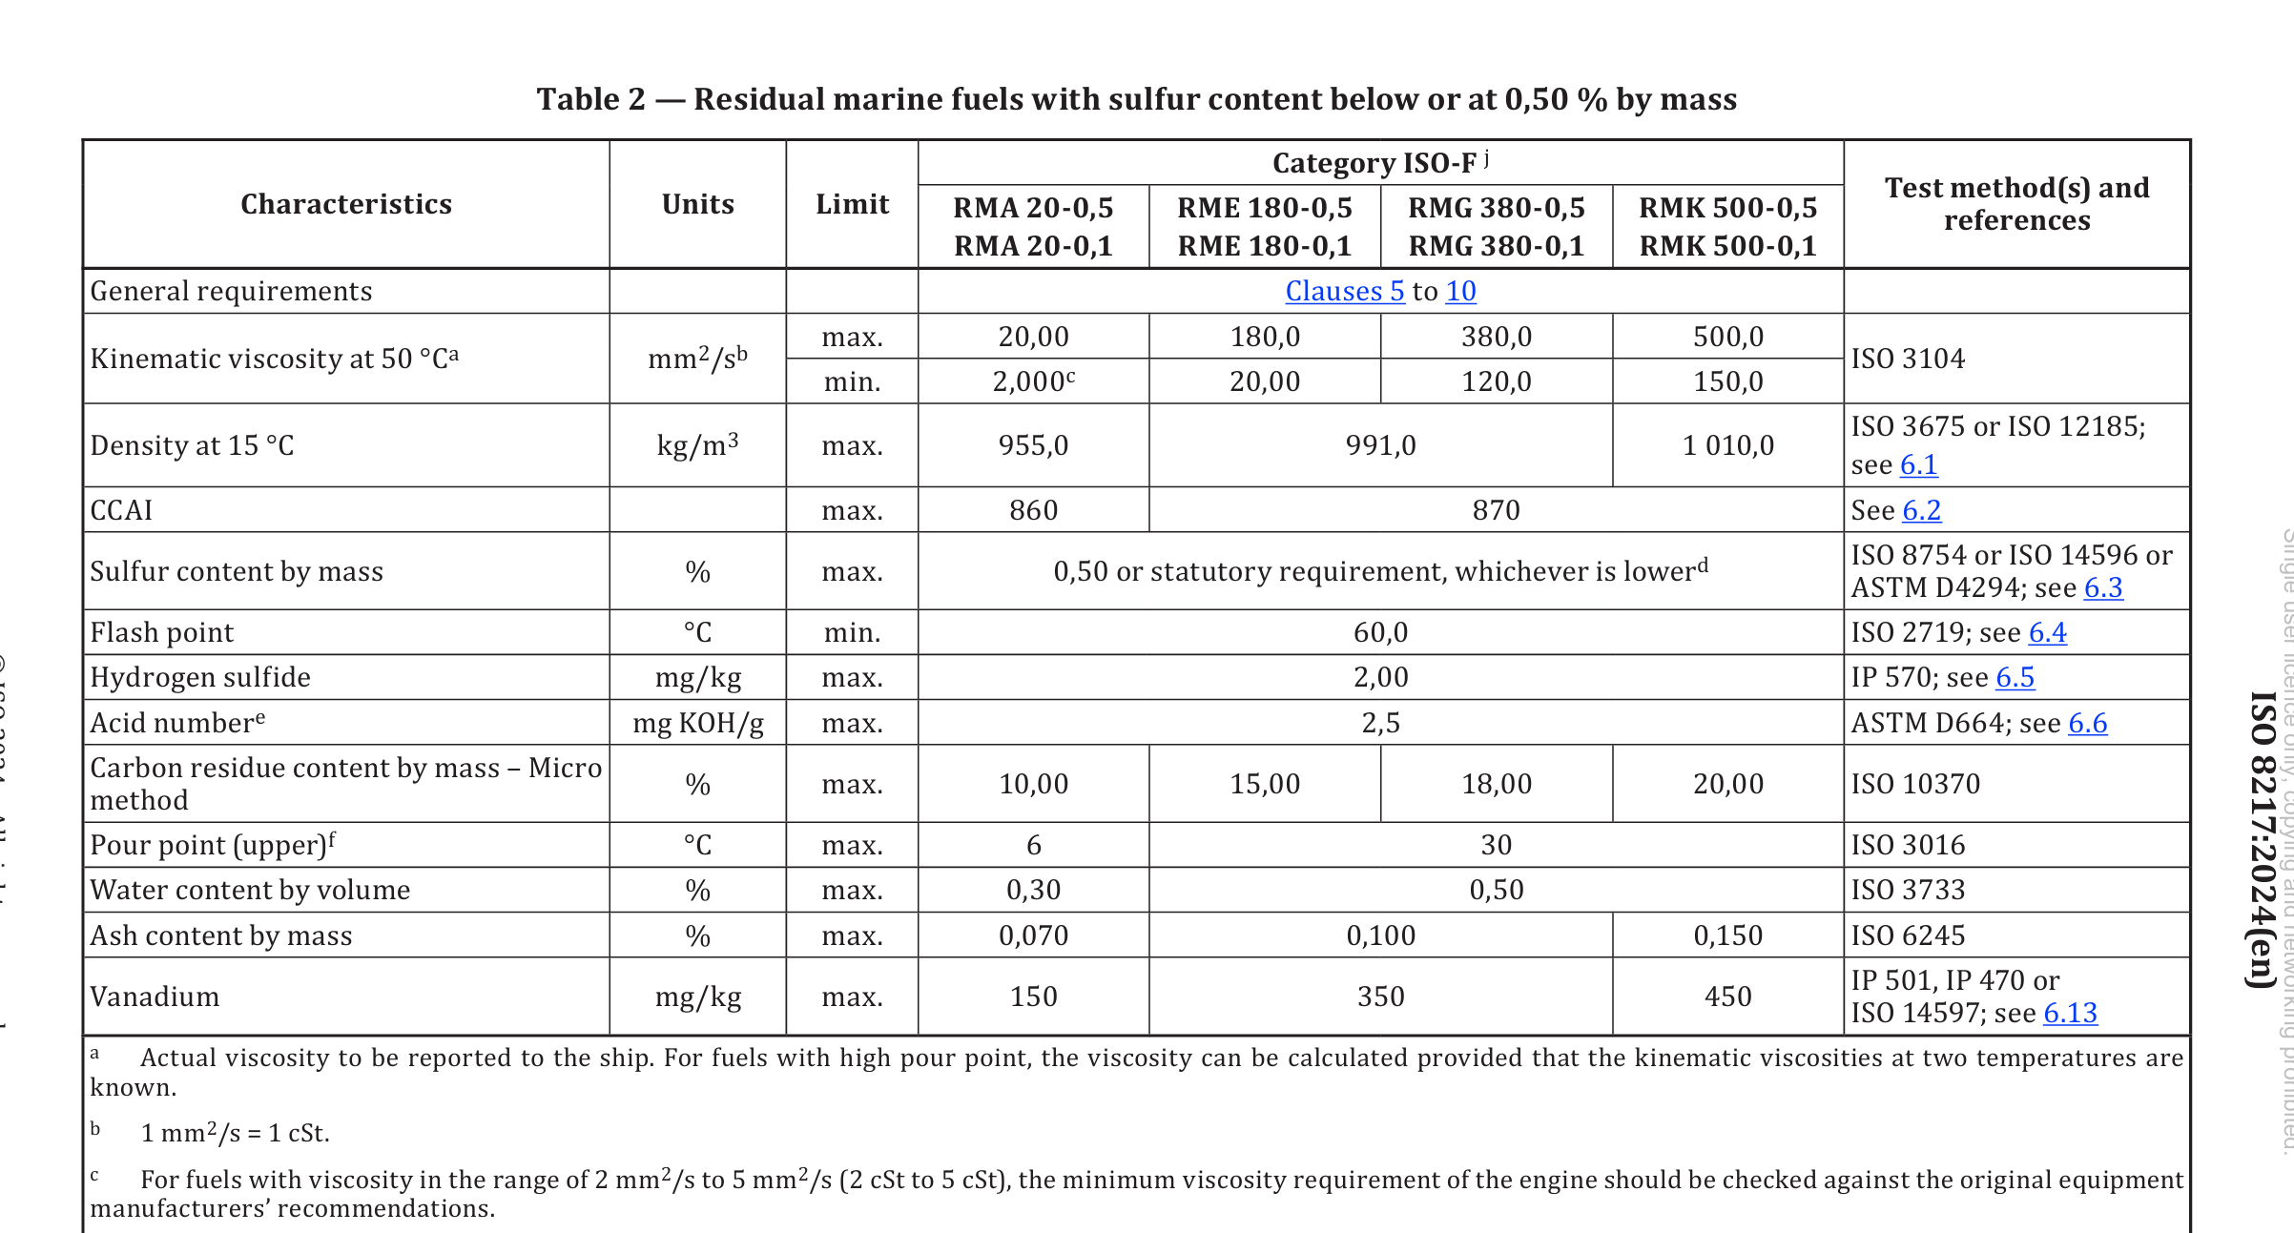
SIX properties required in residual fuel specification

Slide 8
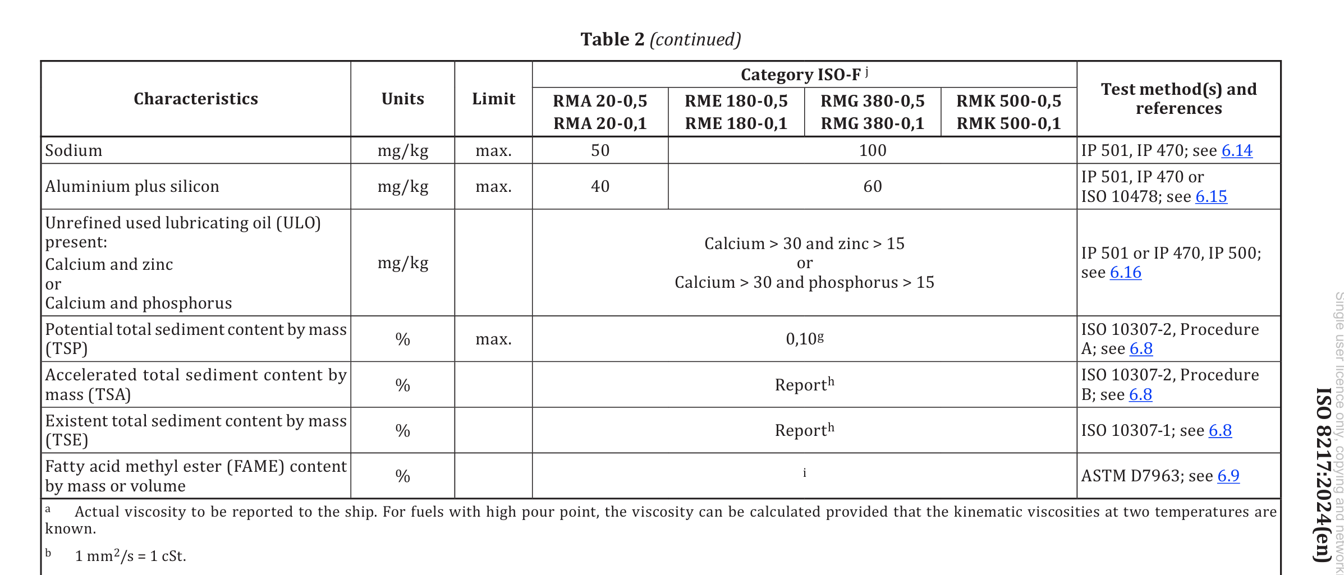

Slide 9
b) SIX properties required in residual fuel specification
(With effect on storage and burning)
1. Viscosity
Property: Resistance to flow
Effect on storage:
High viscosity requires heating in tanks and pipelines
Effect on burning:
Too high → poor atomization
Too low → leakage in pumps
Requirement: Must match heater capacity

Slide 10
2. Density
Property: Mass per unit volume
Effect on storage:
High density reduces effectiveness of centrifugal separation
Effect on burning:
Affects injection quantity and air–fuel ratio

Slide 11
3. Sulphur Content
Property: Percentage of sulphur in fuel
Effect on storage:
Promotes acidic sludge formation
Effect on burning:
Forms SO₂/SO₃ → sulphuric acid
Causes liner and exhaust valve corrosion
Must comply with MARPOL sulphur limits

Slide 12
4. Conradson Carbon Residue (CCR)
Property: Tendency to form carbon deposits
Effect on storage:
Higher sludge formation
Effect on burning:
Increases piston crown, ring groove, and exhaust deposits
Requirement: Low CCR preferred

Slide 13
5. Water Content
Property: Amount of water present
Effect on storage:
Promotes microbial growth
Corrosion in tanks
Effect on burning:
Poor combustion
Injector damage
Power loss
Requirement: As low as possible

Slide 14
6. Ash / Catalytic Fines (Aluminium & Silicon)
Property: Hard abrasive particles
Effect on storage:
Settle as sludge
Effect on burning:
Severe abrasive wear of:
Fuel pumps
Injectors
Cylinder liners and rings

