Slide 1
2. With respect to a 2-stroke main propulsion diesel engine draw and explain the following:
(16)
(a) How the various sections of exhaust manifold connected together for the main engine?
(b) What is the arrangement for thermal expansion of different sections of the manifold?
(c) What is the arrangement in the exhaust manifold to prevent broken pieces of piston
rings entering turbine of the T/C

Slide 2
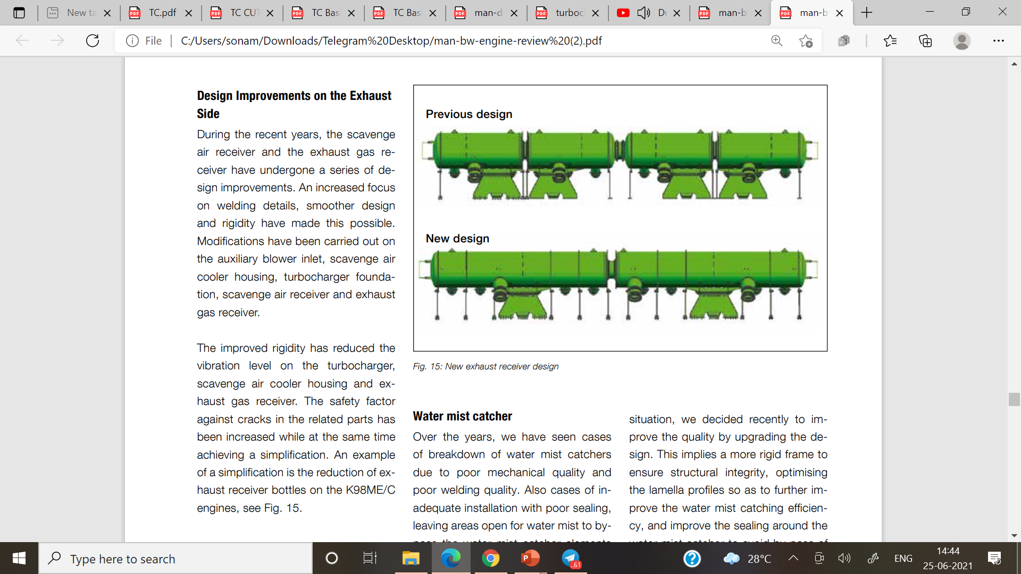
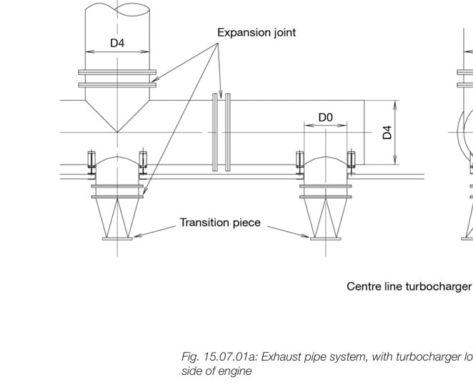
(a) How the various sections of exhaust manifold connected together for the main engine?
various sections of exhaust manifold are connected by expansion joint /compensators

Slide 3
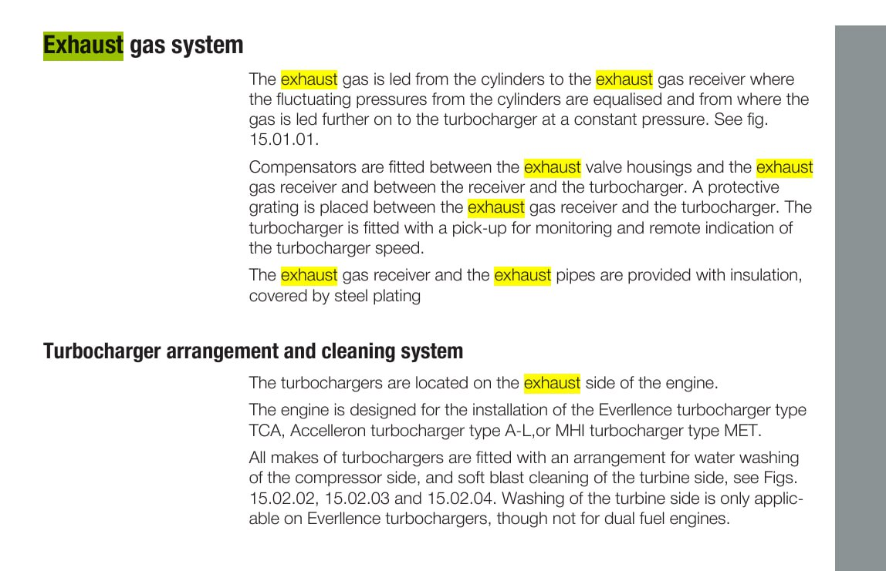

What is the arrangement for thermal expansion of different sections of the manifold?
Exhaust manifold is divided into two or more receiver portions .
Bellows /compensators are arranged to absorb the exhaust gas manifold dimensional changes that is caused by thermal expansion.
Whole exhaust gas manifold & it parts cover by the insulating material thereby the temperature that makes the exhaust gas manifold r outer surface is far below the exhaust gas temperature in the exhaust gas manifold
Manifold is also arranged with combination of fixed , sliding foot support to allow thermal expansion

Slide 4
What is the arrangement in the exhaust manifold to prevent broken pieces of piston
rings entering turbine of the T/C
the arrangement in the exhaust manifold to prevent broken pieces of piston
rings entering turbine of the T/C, the protective

