Slide 1

WELCOME TO FOLDER LOCK
Submitted by:
Vinay Sehrawat: 06210403112
Nikhil Dahiya: 09010403112
Hitesh Ahuja: 09910403112
Vikas: 10010403112

Slide 2

LANGUAGE USED

Slide 3

HISTORY OF JAVA
Developed by James Gosling.
His team- Mike Sheridan and Patrick Naughton.
Initially called OAK.
Later Renamed to GREEN.
First public implementation released by Sun Microsystems on May 20, 1995.
JDK Evolutions.
Different Versions(JAVA2): J2SE, J2EE,J2ME.

Slide 4
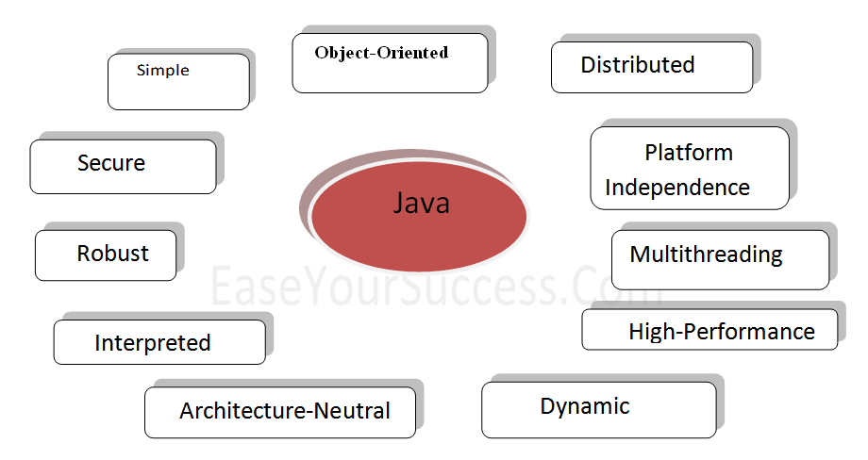
FEATURES OF JAVA

Slide 5
OBJECTIVE
The main objective is to lock a folder or a file from getting unauthorized access to sensitive files.
Protect folders with Folder lock a windows platform folder lock utility which protect folder and files from getting accessed without unlocking the folder first.
Folder lock allows you to lock the folder by hiding it. Locked folder/files cannot be accessed until path of the folder is provided to software.

Slide 6
ABOUT THE SOFTWARE
Folder Lock is a full suite solution for all your data security needs. It lets you keep your personal files protected from unauthorized access in both PC and portable drives.eep your personal files protected from unauthorized access in both PC and portable drives

Slide 7
HARDWARE REQUIREMENT
Ram: 512 M.B or more
Processor: Pentium-III or more.
Hard Disk: 10 GB or Above.
Display: Any Color CRT or flat panel display
Any windows compatible mouse-pointing device.

Slide 8
SOFTWARE REQUIREMENT
Eclipse:
Eclipse is an integrated development environment (IDE). Written mostly in Java, Eclipse can be used to develop applications.
Eclipse may also be used to develop applications in other programming languages Ada ,C ,C++, COBOL, Fortran, JavaScript, PHP, Python, Ruby(including Ruby on Rails framework)

Slide 9
SWING
Swing is the primary Java GUI widget toolkit.
Swing was developed to provide a more sophisticated set of GUI components than the earlier Abstract Window Toolkit (AWT).
Swing Features:
Light Weight
Rich Controls
Highly Customizable
Pluggable look and feel

Slide 10
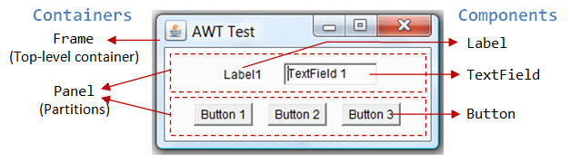
COMPONENTS OF SWING
JFrame
JPanel
JLabel
JTextField
JButton
JRadioButton
JCheckBox
JDialog
JList

Slide 11
Security Feature
For the purpose of security we provide the option
For the purpose of security the user must remember the path of that particular folder of file preventing unauthorized individuals from accessing them without your knowledge or consent.

Slide 12

STEPS OF IMPLEMENTATION:
Following are the Steps of Implementation:-

Slide 13
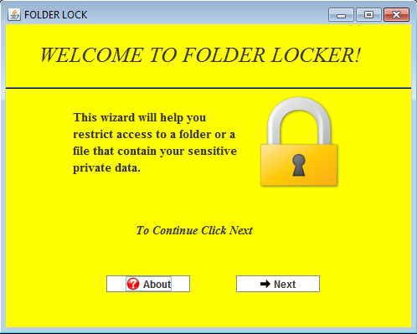
Step 1: The Home Page

Slide 14
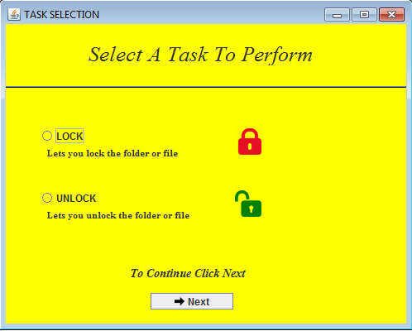
Step 2: Task Selection

Slide 15
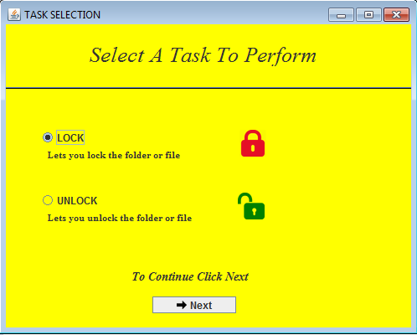
Step 3: Select Your Choice

Slide 16
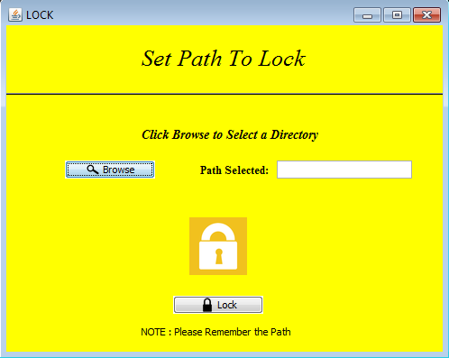
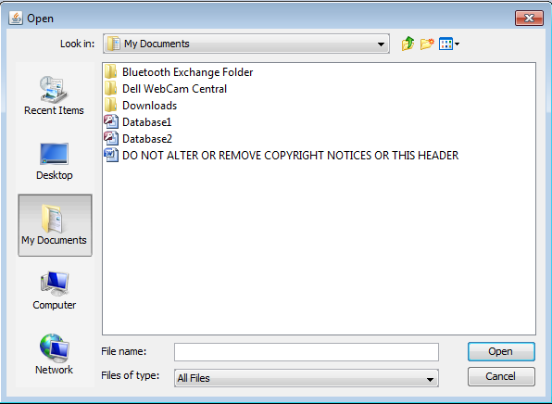
Step 4: Browse The Directory

Slide 17
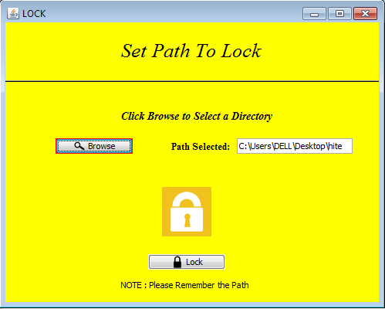
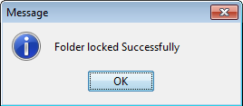
Step 5: Setting The Path

Slide 18
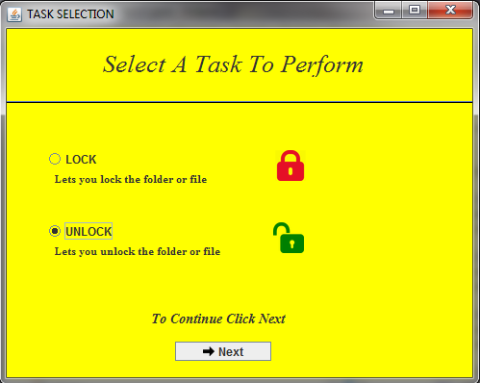
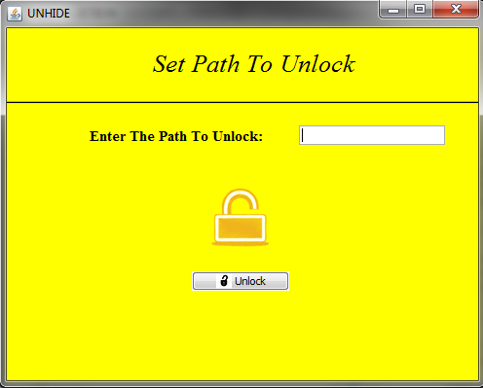
Step 6: How to Unlock

Slide 19
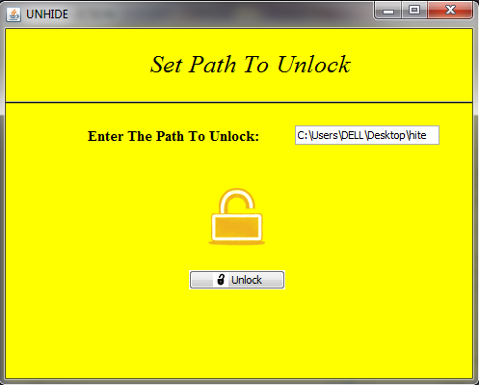
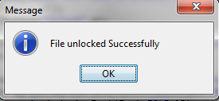
Step 7: Enter the Path

Slide 20
CONCLUSION
This Software can be useful to lock a folder or file against getting accessed by any unauthorized person to prevent sensitive and confidential data access.
The Folder is successfully locked by browsing it in any directory of the computing device or by giving its path which is remembered for unlocking.
The Folder is Successfully Unlocked by providing the path that is given at the time of locking it.

Slide 21
THANK YOU!

